Slide 1
Every Student Succeeds Act Update
California State Board of Education Meeting
February 24, 2021
Rachael Maves, Deputy Superintendent, Instruction and Measurement Branch
Mao Vang, Ed.D., Director, Assessment Development and Administration Division

Slide 2
Summary of Presentation
Federal and state requirements
Preparations for spring testing
Stakeholder feedback
Flexibilities offered by the US Department of Education

Slide 3
Flexibilities Offered From the US Department of Education (1)
On February 22, 2021, ED sent a letter to States indicating that they can Request a waiver to take advantage of full flexibilities offered by ED for the 2020–21 school year of the accountability and school identification requirements in the ESEA.
    States receiving this waiver would not be required to implement and report the results of its accountability system that includes:
      calculating progress toward long-term goals and measurements of interim progress or indicators
      annually meaningfully differentiate among its public schools using data from the 2020–21 school year

Slide 4
Flexibilities Offered From the US Department of Education (2)
In addition, the states who are granted the waiver
  Would also not be required to identify schools for
    Comprehensive support and improvement
    Targeted support and improvement, and
    Additional targeted support and improvement based on data from the 2020-2021 school year
Would be required to continue to support previously identified schools in the 2021–22 school year, resume school identification in the fall of 2022 and ensure transparency to parents and the public. As a condition of receiving the waiver, states will continue to publicly report disaggregated chronic absenteeism data for 2020–21.

Slide 5
Flexibilities Offered From the US Department of Education (3)
Implement assessment flexibility
  Administering a shortened version of its statewide assessments;
  Offering remote administration, where feasible; and/or
  Extending the testing window to the greatest extent practicable

Slide 6
Steps that California has already taken
  Administering a shortened version of Smarter Balanced ELA and mathematics, which the SBE approved for implementation at their November 2020 meeting.
  Offering remote administration, which is already available to California LEAs for all CAASPP and ELPAC.

Slide 7
Federal and State Requirements

Slide 8
Every Student Succeeds Act Requirements (1)
The federal Every Student Succeeds Act (ESSA), requires the following:
Assessment requirements in Section 1111(b)(2): the requirements that a state must administer annual statewide tests:
  Reading/language arts and mathematics—grades three through eight and once in high school
  Science—at least once in each of grades three through five, six through nine, and ten through twelve
  Primary language assessment
  English language proficiency assessments to eligible students in kindergarten through grade twelve

Slide 9
Every Student Succeeds Act Requirements (2)
Accountability and school identification requirements in section 1111(c)(4) and 1111(d)(2)(C)-(D): the requirements that a State annually meaningfully differentiate all public schools and the requirements to identify schools for comprehensive and targeted support and improvement and additional targeted support and improvement based on data from the current school year.
Report card provisions related to certain assessments and accountability in section 1111(h) based on data from the current school year:
Section 1111(h)(1)(C)(i) (accountability system description)
Section 1111(h)(1)(C)(ii) (assessment results)
Section 1111(h)(1)(C)(iii)(I) (other academic indicator results)
Section 1111(h)(1)(C)(iv) (English language proficiency assessment results)

Slide 10
Every Student Succeeds Act Requirements (3)
Additional report card provisions related to certain assessments and accountability in section 1111(h) based on data from the current school year:
Section 1111(h)(1)(C)(v) (school quality or student success indicator results)
Section 1111(h)(1)(C)(vi) (progress toward meeting long-terms goals and measurements of interim progress)
Section 1111(h)(1)(C)(vii) (percentage of students assessed and not assessed)
Section 1111(h)(1)(C)(xi) (number and percentage of students with the most significant cognitive disabilities taking an alternate assessment)
Section 1111(h)(2)(C) with respect to all waived requirements in section 1111(h)(1)(C) as well as 1111(h)(2)(C)(i)-(ii) (information showing how students in a local educational agency (LEA) and each school, respectively, achieved on the academic assessments compared to students in the State and LEA).

Slide 11
State Requirements (1)
California Assessment of Student Performance and Progress (CAASPP) as defined in California Education Code (EC) sections 60601 through 60649 include the following:
  Smarter Balanced Summative Assessments and the California Alternate Assessments (CAAs) for English language arts/literacy (ELA) and mathematics
  California Science Test (CAST) and CAA for Science
  California Spanish Assessment (CSA) for Spanish reading/language arts (optional)
English Language Proficiency Assessments for California (ELPAC) as defined in EC sections 313 and 60810:
  Initial ELPAC
  Summative ELPAC
  Alternate ELPAC (in development)

Slide 12
State Requirements (2)
California School Dashboard pursuant to EC Section 52064.5
Adoption and reporting of performance on state and local indicators on the California School Dashboard (Dashboard) for each local educational agency (LEA) and performance criteria for LEA assistance and intervention.

Slide 13
2020–2021 Initial and Summative Assessments Testing Windows
Statewide Testing Window | Availability of Assessments
July 1, 2020–June 30, 2021 | Initial ELPAC
September 8, 2020–July 15, 2021 | CAASPP: CAA for Science
January 12–July 15, 2021 | CAASPP: CAST, CAAs for ELA and mathematics, and CSA
February 1–May 31, 2021 | Summative ELPAC and locally-determined alternate assessment
February 22, 2021–July 15, 2021 | CAASPP: Smarter Balanced Summative Assessments for ELA and mathematics (Using adjusted blueprints approved by the SBE on November 5, 2020)

Slide 14
Key Events (1)
March 2020—US Department of Education (ED) approved waiver of spring 2020 testing, accountability, and reporting requirements.​
June 2020—Senate Bill (SB) 98
  Provided funds for an extension of the 2019–2020 Summative ELPAC as an optional test for the purpose of reclassification and COVID-related activities.​
  Required LEAs and schools to provide valid and reliable data for their improvement plans and the public to inform student progress.
  Prohibits the California Department of Education (CDE) from publishing state and local indicators in the 2020 California School Dashboard (Dashboard).
  Required CDE to report, in CALPADS, valid and reliable data collected in 2019–2020 that would have been included in the 2020 Dashboard.
Notes:
​

Slide 15
Key Events (2)
September 2020—SB 820 extended the Initial ELPAC testing window of 30 calendar days from enrollment by an additional 45 calendar days.
October 2020—ED issued guidance that states are expected to meet assessment, accountability, school identification, and reporting requirements in the 2020-2021 school year​
November 2020—California State Board of Education (SBE) approved adjusted blueprints for Smarter Balanced Summative Assessments for English language arts/literacy (ELA) and mathematics​
Notes:
​
​
​
​

Slide 16
Key Events (3)
December 2020 through January 2021—Spring test administration considerations
  In-person and remote computer-based ELA, math, science, and Summative ELPAC
  In-person administration only for the California Alternate Assessments in ELA, mathematics, science, and locally-determined English language proficiency assessments
  Postponed the Alternate ELPAC operational field test until the 2021–22 school year
February 2021—Guidance from ED
  Accountability and School Identification
  Transparency and Public Reporting
  Assessments

Slide 17
Preparations for Spring Testing

Slide 18
Implemented Adjusted Blueprints
November 2020: SBE approved the adjusted Smarter Balanced Summative ELA and mathematics blueprint
November–December 2020: ETS and Cambium removed original ELA and mathematics forms from the California Assessment System
January–February 2021: Conducted systems testing with adjusted blueprints
February 22, 2021: Released the adjusted Smarter Balanced ELA and mathematics assessments to LEAs

Slide 19
Estimated Testing Times for the Adjusted Smarter Balanced Blueprints
Content Area | Grades | Full Form Computer Adaptive Test Items hrs:mins | Short Form Computer Adaptive Test Items hrs:mins | Performance Task (PT) hrs:mins | Full Form Total hrs:mins | Short Form Total hrs:mins
ELA | 3–5 | 1:30 | 0:45 | 2:00 | 3:30 | 2:45
ELA | 6–8 | 1:30 | 0:45 | 2:00 | 3:30 | 2:45
ELA | 11 | 2:00 | 1:00 | 2:00 | 4:00 | 3:00
Mathematics | 3–5 | 1:30 | 0:45 | 1:00 | 2:30 | 1:45
Mathematics | 6–8 | 2:00 | 1:00 | 1:00 | 3:00 | 2:00
Mathematics | 11 | 2:00 | 1:00 | 1:30 | 3:30 | 2:30
Both | 3–5 | 3:00 | 1:30 | 3:00 | 6:00 | 4:30
Both | 6–8 | 3:30 | 1:45 | 3:00 | 6:30 | 4:45
Both | 11 | 4:00 | 2:00 | 3:30 | 7:30 | 5:30

Slide 20
Estimated Testing Times for Non-Smarter Balanced CAASPP Summative Assessments
Content Area | Grades | Estimated Testing Time | Total Testing Time
CAA for ELA | 3-8 and 11 | 1:00 to 1:40 | 1:00 to 1:40
CAA for Mathematics | 3-8 and 11 | 1:00 to 1:40 | 1:00 to 1:40
CAA for Science | 5, 8, and once in high school | 1:00 to 1:40 per PT, 4 PTs total | 4:00 to 6:40
CSA | 3–8 and 11 | 2:00 | 2:00
CAST | 5, 8, and once in high school | 1:00 to 2:00 | 1:00 to 2:00

Slide 21
Estimated Testing Times for Summative ELPAC
Content Area | Grades | Estimated Testing Time | Total Testing Time
Summative ELPAC | Kindergarten | :50 to 1:20 | :50 to 1:20
Summative ELPAC | 1 | 1:10 to 1:40 | 1:10 to 1:40
Summative ELPAC | 2 | 1:10 to 1:40 | 1:10 to 1:40
Summative ELPAC | 3 to 5 | 1:50 to 3:00 | 1:50 to 3:00
Summative ELPAC | 6 to 8 | 1:50 to 3:00 | 1:50 to 3:00
Summative ELPAC | 9 to 10 | 2:05 to 3:10 | 2:05 to 3:10
Summative ELPAC | 11 to 12 | 2:05 to 3:10 | 2:05 to 3:10

Slide 22
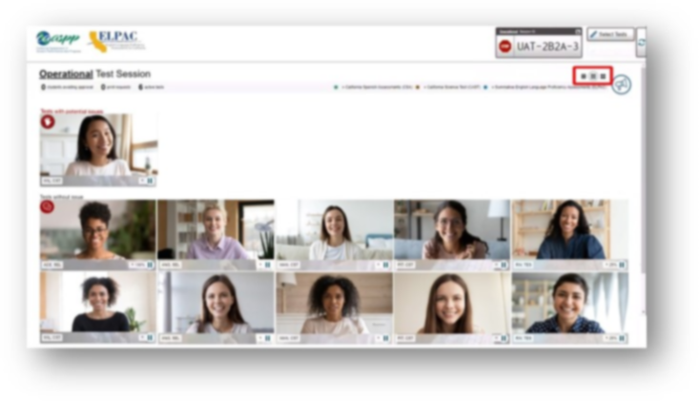
Developed Remote Administration Functionality (1)
Integrated into Test Delivery System
Direct engagement with key technology companies including Google, Apple, and Microsoft

Slide 23
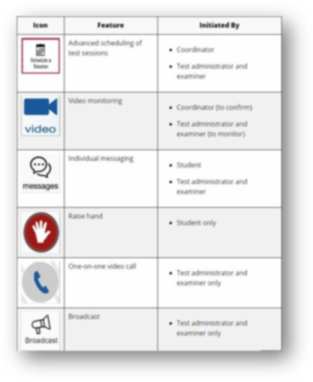
Developed Remote Administration Functionality (2)
Includes video monitoring, video calling, and messaging

Slide 24
Collected Input on Spring 2021 Plans
Monthly Assessment Stakeholder meetings
Participation and Presentations at Regional Assessment Network (RAN)
  Statewide meeting—January 2021
  13 regional meetings—January and February 2021
  5 training sessions
Surveys
  Technology readiness – January 2021
  Testing Window Options – February 2021
Feedback directly from stakeholders including:
  California Information Technology in Education (CITE)
  Association of California School Administrators (ACSA)
  California Parent Teacher Association (CA PTA)
  California Association for Bilingual Education (CABE)
  Californians Together
  California Small Schools Association (CSSA)

Slide 25
Summary of Input to Spring 2021 Plans
Process
Easier process to notify parents/guardians
More communications and support for students, parents/guardians, and educators
Reduce or eliminate handling of paper test materials
Keep the remote administration features like existing instructional tools
Testing
Waive testing or make it optional (i.e., eliminate accountability and participation requirements)
Resolve equity concerns for students to receive instruction (e.g., attendance, engagement, technology)

Slide 26
Learnings from the Fall 2020 Administration
Simplified the parent notification processes
Developed a solution for Summative ELPAC
K–2 Writing
Developed additional communication and training materials
Created spring administration web pages

Slide 27
Expanded Communication Opportunities
Pre-test workshops in December and January
  Six trainings each tailored to provide the most up-to-date information
CDE assessment update webinar
  Included updates and decisions since December pre-test
  Video recorded and released on January 11, 2021
Scheduled weekly office hours and coffee sessions
Continued support and training at local RAN meetings

Slide 28
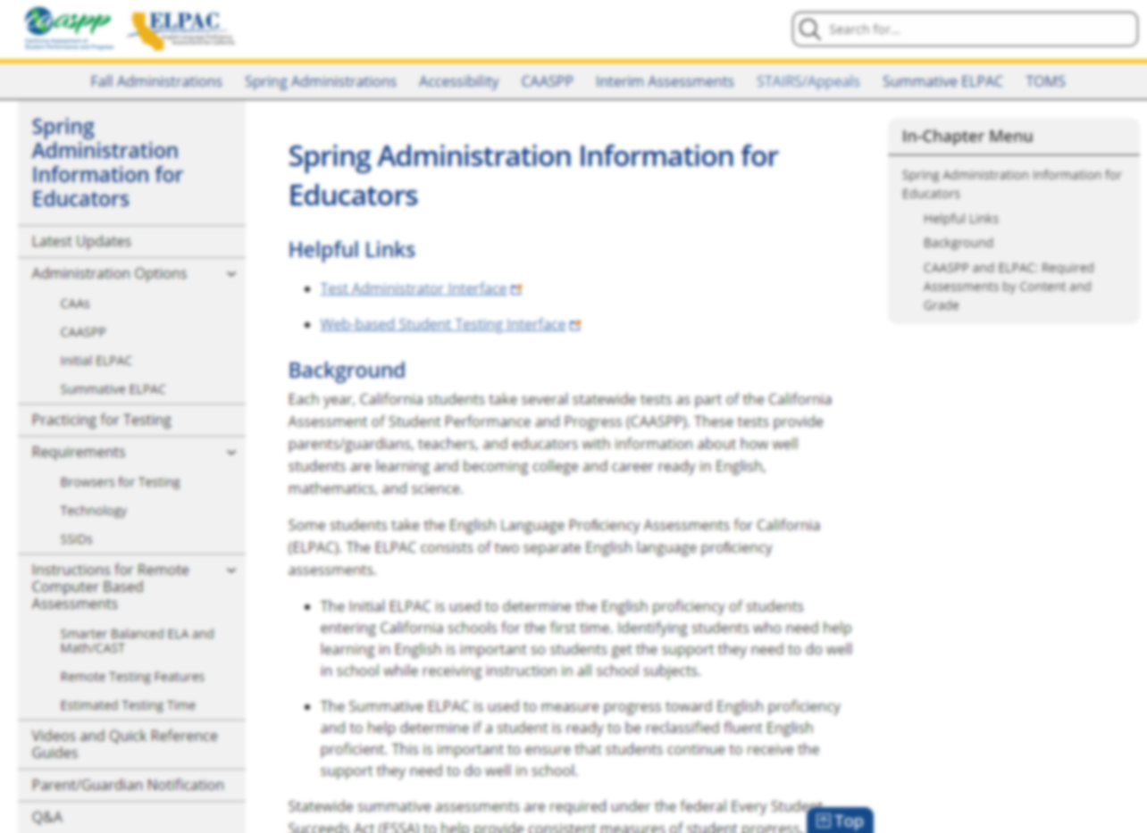
Spring Administration Website: Educators
All spring administration information in a centrally located place.
The website includes:
  Detailed browser and technology requirements
  Training videos
  Quick reference guides
  Parent/guardian notification letter available in eight languages
  Q&A from all Office Hours and Coffee Sessions

Slide 29
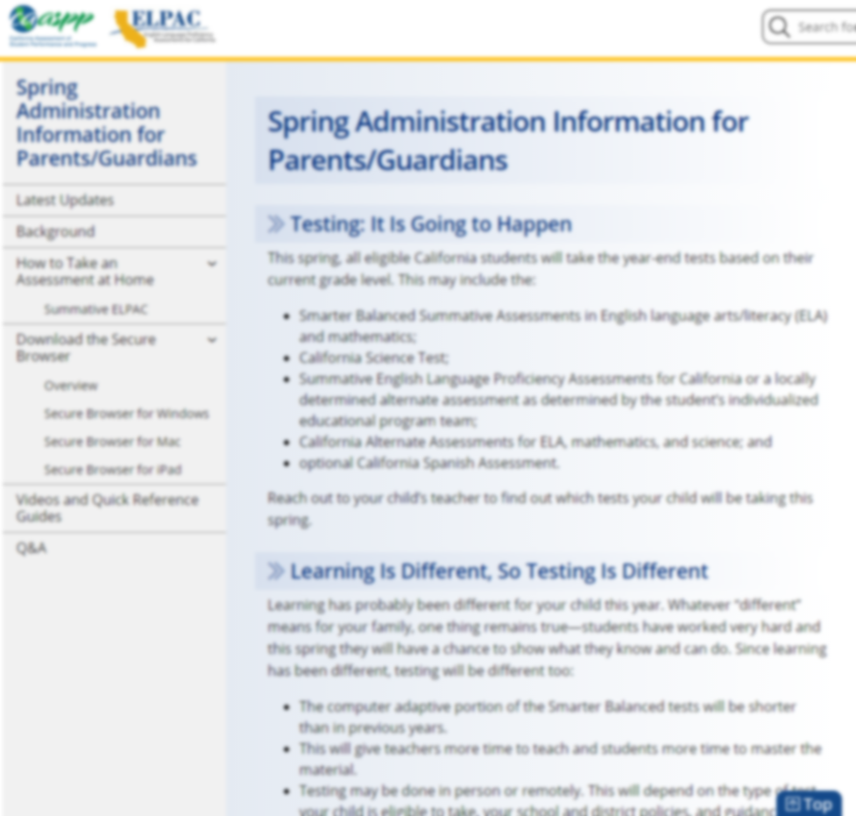
Spring Administration Website: Parents/Guardians/Students
Developed a site for parents, guardians, and students
The website Includes:
  Testing information flyer available in eight languages
  Instructions for secure browser
  Videos and quick reference guides in English and Spanish
  Questions and Answers

Slide 30
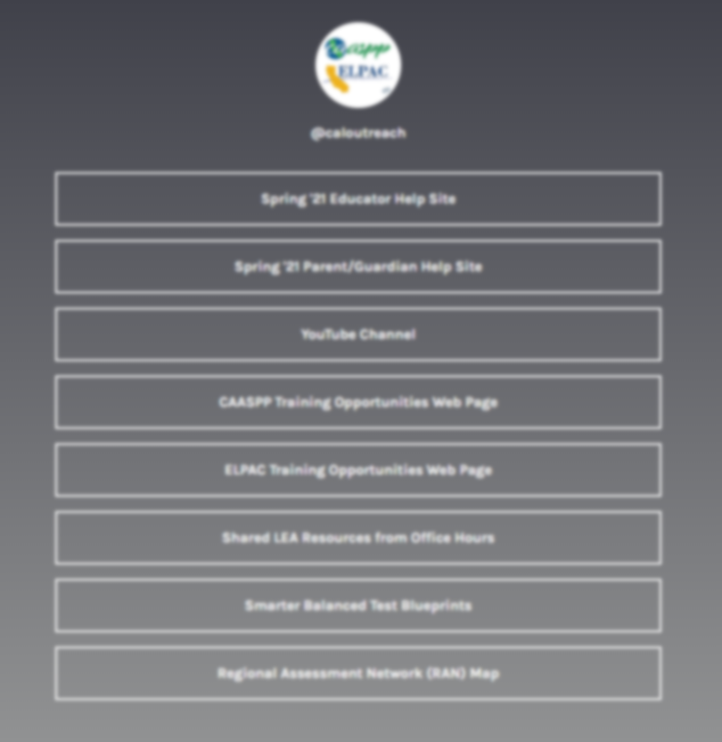
Links to Resources
Linktree list of resources: https://linktr.ee/caloutreach

Slide 31

Office Hours and Coffee Session Resources
Office hours resources: https://padlet.com/caaspp_elpac/OfficeHours

Slide 32
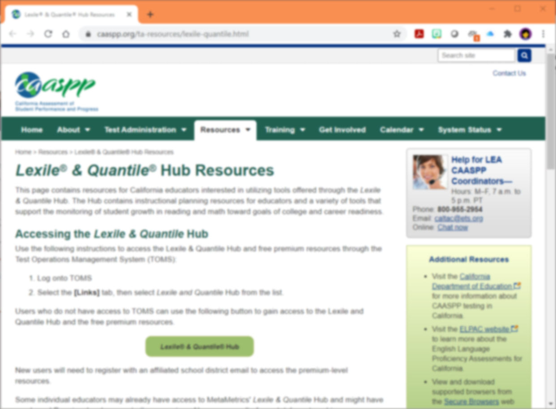
Lexile® & Quantile® Hub for CA Educators
  Free premium-access resource for California educators
  Use with locally available assessments and products that report Lexile and Quantile measures
  Resource page: https://www.caaspp.org/ta-resources/lexile-quantile.html

Slide 33
Stakeholder Feedback on Spring Assessments

Slide 34
Feedback Summary (1)
Overwhelming support for relief from assessment requirements
Varying degrees of student access to technology and the internet across the state
Varying degrees of home testing environments for students
Complying with the requirement that a secure browser must be used is difficult to implement
Some parents/guardians do not allow their children to have the camera on during the testing session

Slide 35
Feedback Summary (2)
Support for postponing for a fall administration rather than cancelling the summative assessments
Concerns over extended testing window as well as testing in fall 2021
  Each option would further reduce time with students for extended learning
Requests to submit for a waiver of assessment requirements
Concerns over the validity of assessment results

Slide 36
Feedback Summary (3)
Timing of data availability
Assessment data are greatly needed to best meet the needs of students
Majority of parents support assessments

Slide 37
Council of Chief State School Officers (1)
The Council of Chief State School Officers (CCSSO) did a survey in December 2020 of states to get a sense of what their plans are for this Spring. Responses were received from 39 states.
The CCSSO found that most states are planning to do some form of the state’s summative assessment.
The CCSSO also found that states are exploring different approaches
    19 states reporting they plan to extend their testing window
    8 states reporting they plan to shorten their assessments.
There are 23 states that have students who are remote and intend to try to bring students to a school site to take the summative assessment.

Slide 38
Council of Chief State School Officers (2)
There was indication that 31 states will try to bring English learners and students with disabilities to a school site for the assessment.
Five states are exploring the option of remote administration of the summative assessment.
At least 29 states responded that they will be pursuing the addendum that was offered by ED, seeking some relief from some of the accountability requirements.
As of February 19, we believe that 7 states have submitted a waiver to ED to waive assessment requirements.

Slide 39
Flexibilities Offered from US Department of Education

Slide 40
Flexibility 1: Accountability and School Identification and Transparency of Public Reporting
Request a waiver for the 2020–2021 school year of the accountability and school identification requirements in the ESEA.

Slide 41
Flexibility 2: Assessments
Implement assessment flexibility
  Administering a shortened version of Smarter Balanced Summative Assessments for ELA and mathematics, which the SBE approved for implementation at their November 2020 meeting.
  Offering remote administration, which is already available to California LEAs for all CAASPP and ELPAC.
  Consider extending CAASPP and ELPAC test administration windows beyond the testing windows as outlined in regulations.

Slide 42
Flexibility 2a: Administering a shortened version of statewide assessments
At the November 2020, the SBE approved the implementation of administering a shortened version of Smarter Balanced ELA and mathematics.
These shortened versions became available to LEAs on February 22, 2021.

Slide 43
Flexibility 2b: Offering remote administration
California has made remote administrations available to California LEAs for all CAASPP and ELPAC assessments.

Slide 44
Flexibility 2c: Extend the Testing Window
Extend the window to July 30 for the CAASPP and ELPAC
OR
End the testing windows per current assessment regulations and add a new fall Summative CAASPP and ELPAC testing window could be made available from August 15 through October 29, 2021

Slide 45
Flexibility 2c: Pros for Extending Assessment Window to July 30, 2021
Offers additional opportunities for instruction through summer extended year or expanded learning
Provides flexibility for schools and additional time to communicate with families and stakeholders
No delay for student level results
Allows for more adults to be vaccinated potentially increasing the opportunity for in person assessments
No added cost to extend the window to July 30, 2021

Slide 46
Flexibility 2c: Cons for Extending Assessment Window to July 30, 2021
Window extends beyond the traditional school year
Schools may not be able to provide students with transportation and infrastructure to support in-person assessments in the summer
High levels of COVID fatigue
Cause a delay in aggregated reporting to LEA-, state-, and federal-levels
Impact on CALPADS and LEA student information systems

Slide 47
Flexibility 2c: Pros for Fall Administration
Offers additional opportunities for instruction through summer extended year or expanded learning
Provides flexibility for schools and additional time to communicate with families and stakeholders
Allows for more adults to be vaccinated potentially increasing the opportunity for in person assessments

Slide 48
Flexibility 2c: Cons for Fall Administration
Significant delay in aggregate reporting to LEA-, state-, and federal-levels
Impact on CALPADS and LEA student information systems
Additional total cost of $73,695,000 to add the fall window

Slide 49
2020–21 Testing Window Extension Survey of LEA Assessment Coordinators
Question 1: Rank the following options:
  No changes to the current testing windows
  Extend both CAASPP and Summative ELPAC testing windows to July 30, 2021
  Provide an additional testing window in fall 2021 for both CAASPP and ELPAC
Question 2: Which benchmark assessments used that can be administered to all students in the same grade level?

Slide 50
Survey Results
As of Friday, 2/19/21, 5 p.m. PT, 1,226 out of 2,001 unique LEAs (61.3 percent) submitted responses.
For LEAs with multiple submissions, the responses from the LEA superintendent were included in the preliminary analysis.

Slide 51
Survey Results: Overall Rank Order of Testing Window Options
Summary by Option by Rank | No Change Count | No Change Percent | Extend to July 30 Count | Extend to July 30 Percent | Fall 2021 Admin Count | Fall 2021 Admin Percent
1st choice | 398 | 33% | 253 | 21% | 568 | 47%
2nd Choice | 290 | 24% | 614 | 51% | 274 | 23%
3rd Choice | 519 | 43% | 334 | 23% | 360 | 30%
Total Responses | 1207 | 100% | 1201 | 100% | 1202 | 100%
Weighted average rank | 1.90 | n/a | 1.93 | n/a | 2.17 | n/a
Average rank | 2.10 | n/a | 2.07 | n/a | 1.83 | n/a

Slide 52
Survey Results: Rank Order Testing Window Options for Largest LEAs and CORE Districts
Count of Largest LEAs by Option by Rank | No Change | Extend to July 30 | Fall 2021 Admin
1st choice | 10 | 3 | 10
2nd choice | 7 | 11 | 6
3rd choice | 7 | 10 | 8
Enrollment of Largest LEAs who selected as 1st choice | 534,692 | 163,004 | 1,008,803
Number of CORE members that selected as 1st choice (Note: 1 LEA declined to select a 1st choice) | 3 | 1 | 3

Slide 53
Survey Results: LEAs with Benchmark Assessments
1,235 LEAs indicated that they had at least one benchmark assessment that they could administer to all their students
The most frequently listed benchmark assessments available to LEAs, in order of most mentions:
  STARR / STAR—559 mentions
  I-Ready—337 mentions
  NWEA / MAP—304 mentions
  DIBELS—173 mentions
  Renaissance—131 mentions

Slide 54
Recommendations
The California Department of Education (CDE) requests the California State Board of Education (SBE) to take action as deemed necessary and appropriate.

Slide 55
Public Comment for Item 02
Conference dial-in number: (712) 770-4906
Participant access code: 1166083#​
The operator will inform you when it is your turn to speak​.
Please turn down the volume on your computer if you are following the live webcast to avoid an echo effect while providing public comment.

