Slide 1
Priority X: A Webinar Series Dedicated to the Local Control Funding Formula (LCFF) State Priorities
Today’s Topic: Priority 6
School Climate

Slide 2
Introductions
Jeff Breshears, Director, Local Agency Systems Support Office
Shanine Coats, Interim Division Director, Improvement and Accountability Division
Tom Herman, Education Administrator, Coordinated School Health and Safety Office
Brandi Jauregui, Information Technology Specialist, Educational Data Management Division
Kristen Brown, One System Whole Child Initiative Lead
Jacquelyn Ollison, Education Administrator, Office of the Chief Deputy
Jen Taylor, Education Programs Consultant, Expanded Learning Division
Special Guest – Dr. Susan Levine, Riverside County Office of Education
Special Guest – Spencer Lara, 12th grade student, Lakewood High School, Californians for Justice
Tom Torlakson, State Superintendent of Public Instruction

Slide 3
Goals for Today
The importance of school climate
School Climates connection to the system of support
Measuring school climate (State and Local Indicators)
Resources and supports for the implementation and improvement of school climate
Highlights of promising school climate practices from the field

Slide 4
What is Priority X?
Jacquelyn Ollison, Education Administrator
Office of the Chief Deputy
Jen Taylor,
Education Programs Consultant
Expanded Learning Division

Slide 5
School Conditions and Climate Work Group Scope
The California Department of Education (CDE) has convened a School Climate and Conditions Work Group (CCWG) to support further policy development in the area of school climate and in relation to the broader context of school conditions.
The role of the CCWG is advisory to the CDE and the State Superintendent of Public Instruction. The review of broader aspects of school climate will also inform the assessment of performance relevant to LCFF Priorities 1, 2, 3, 7, 8, 9, and 10.
The CDE will use the work of the CCWG to support the development of a set of recommendations regarding school conditions and climate metrics.

Slide 6
Results of the Work
Comprehensive set of recommendations for the state and local level that were split into three buckets for action
Bucket 1: Focus on Legislature
Bucket 2: Focus on the California School Dashboard
Bucket 3: Focus on including supports for capacity-building and implementation within the statewide system of support
Priority X is a product of Bucket 3

Slide 7
School Conditions and Climate Work Group Definition of School Climate
“School Conditions and Climate” refers to the character and quality of school life. This includes the values, expectations, interpersonal relationships, materials and resources, supports, physical environment, and practices that foster a welcoming, inclusive, and academically challenging environment. Positive school conditions and climate ensure people in the school community (students, staff, family, and community) feel socially, emotionally, and physically safe, supported, connected to the school, and engaged in learning and teaching.
View the School Conditions and Climate Work Group Recommendation Framework at https://www.cde.ca.gov/be/pn/im/documents/memo-ocd-oct17item01a1.pdf.

Slide 8
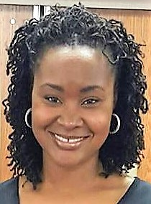
Overview of LCFF State Priorities and the Statewide System of Support
Shanine Coates
Interim Division Director
Improvement and Accountability Division

Slide 9
California’s Accountability and Continuous Improvement System
The Local Control Funding Formula (LCFF) significantly changed how California provides resources to public schools and holds local educational agencies (LEAs) accountable for improving student performance.
LCFF, which the Legislature and Governor passed in 2013, includes state priority areas that define a quality education more broadly than a single test score and requires that the accountability system consider all priorities.
The new accountability system is based on multiple measures that are based on factors that contribute to a quality education, including high school graduation rates, college/career readiness, student test scores, English learner (EL) progress, suspension rates, and parent engagement.
Central components of California’s Accountability and Continuous Improvement System include:
Local Control and Accountability Plan (LCAP)
California School Dashboard
California’s System of Support

Slide 10
Shifts in California’s Approach to Improvement
Education Improvement Before LCFF | Education Improvement After LCFF
Top-down transactional exchanges focused on schools in isolation | Support providers’ work alongside LEAs and their schools to identify key challenges and opportunities
Packaged approaches for interventions | Systemic approach tailored to locally identified needs and strengths
Isolated team decision making | Engaging with local educators and communities as part of decision making
Redundancy and contradictions across state and federal programs | Streamlined and coherent expectations for LEAs across state and federal programs
Assistance disconnected from local priorities and focus | Assistance supports LEAs in aligning, prioritizing, and using resources to meet student needs identified in the LCAP

Slide 11
California’s System of Support
The overarching goal of California’s System of Support is:
To help LEAs and their schools meet the needs of each student they serve, with a focus on building local capacity to sustain improvement and to effectively address disparities in opportunities and outcomes.
The characteristics within the Statewide System of Support are:
Reduce redundancy across state and federal programs
Integrate guidance and resources across state and federal programs
Support LEAs to meet identified student needs through the LCAP process

Slide 12
Levels of Support
Level of Support | Description of Supports Available
Support for All LEAs and Schools (Level 1) | Various state and local agencies provide an array of support resources, tools, and voluntary technical assistance that all LEAs may use to improve student performance at the LEA and school level and narrow disparities among student groups across the LCFF priorities, including recognition for success and the ability to share promising practices.
Differentiated Assistance (Level 2) | County superintendents, the California Department of Education, and the California Collaborative for Educational Excellence provide differentiated assistance for LEAs and schools, in the form of individually designed assistance, to address identified performance issues, including significant disparities in performance among student groups.
Intensive Intervention (Level 3) | The Superintendent of Public Instruction may require more intensive interventions for LEAs and/or schools with persistent performance issues and a lack of improvement over a specified time period.

Slide 13
Eligibility Criteria for Support
Basics (LCFF Priority 1)
Not Met for Two or More Years on Local Performance Indicator
Implementation of State Academic Standards (LCFF Priority 2)
Not Met for Two or More Years on Local Indicator
Parent Engagement (LCFF Priority 3)
Not Met for Two or More Years on Local Indicator
Pupil Achievement (LCFF Priority 4)
Red on both English Language Arts (ELA) and Math tests or
Red on ELA or Math tests AND orange on the other test or
Red on the English Learner Progress Indicator (English learner student group only)
Pupil Engagement (LCFF Priority 5)
Red on Graduation Rate Indicator or
Red on Chronic Absence Indicator
School Climate (LCFF Priority 6)
Red on Suspension Rate Indicator or
Not Met for Two or More Years on Local Indicator
Access to and Outcomes in a Broad Course of Study (LCFF Priorities 7 & 8)
Red on College/Career Indicator

Slide 14
Priority 6: How it is Measured
Jen Taylor,
Education Programs Consultant
Expanded Learning Division
Jacquelyn Ollison,
Education Administrator
Office of the Chief Deputy

Slide 15
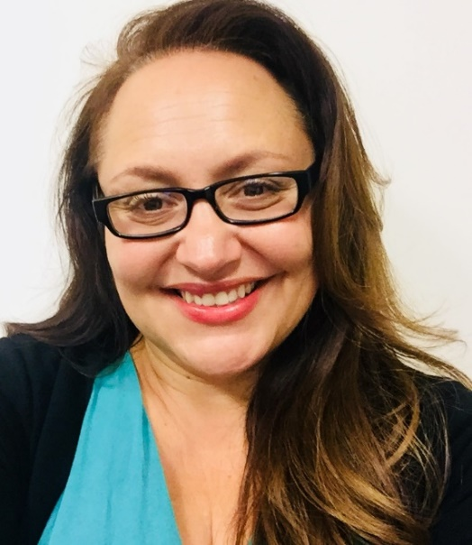
State Indicator: Understanding the California Longitudinal Pupil Achievement Data System (CALPADS) Data Behind School Climate
Brandi Jauregui
Information Technology Specialist
Educational Data Management Division

Slide 16
CALPADS Data Related to School Climate (1 of 2)
Pupil suspension and expulsion rates are equal to:
Count of students suspended or expelled (unduplicated)
Divided By
Cumulative enrollment count

Slide 17
CALPADS Data Related to School Climate (2 of 2)
Student offenses committed outlined in Education Code sections 48900 and 48915 that result in:
In- or out-of-school suspensions
Expulsions
Minimum of a full-day removals for general education students
Any increment of a day for students with disabilities

Slide 18
Where Can These Rates be Found? (1 of 2)
California School Dashboard – https://www.caschooldashboard.org
Suspension rates only

Slide 19
Where Can These Rates be Found? (2 of 2)
DataQuest - https://dq.cde.ca.gov/dataquest
Suspension and Expulsion Rates

Slide 20
How are the Data Collected?
Collected and stored throughout the school year in local student information systems (SIS)
Data from the SIS are reported in the California Longitudinal Pupil Achievement Data System (CALPADS) annually and represent offenses committed and the resulting disciplinary actions that occurred between July 1 and June 30 annually

Slide 21
When are the Data Collected?
Collected in the End-of-Year 3 submission in CALPADS (Student Discipline)
Data review and certification window opens in May and closes in mid-August annually
LEAs may submit discipline data year-round

Slide 22
Which Data are Collected?
Data collected include (but are not limited to):
Specific student offense(s) within an incident
Incident date
Disciplinary action (suspension, expulsion)
Duration of the disciplinary action
Any modifications made to the disciplinary action
A complete list of required data elements can be found in the CALPADS File Specifications (Student Discipline section) on the CALPADS Systems Documentation web page at https://www.cde.ca.gov/ds/sp/cl/systemdocs.asp.

Slide 23
How to Ensure Accuracy of the Data (1 of 3)
Local educational agencies (LEAs) should have a documented local process that ensures:
Accurate documentation of the incident
Which student(s) were involved in the incident?
What specific offense(s) did each student commit?
Accurate documentation of the outcome (disciplinary action)
What was the final disciplinary action for the student?
What was the duration of the disciplinary action?

Slide 24
How to Ensure Accuracy of the Data (2 of 3)
Site administrators should be responsible for:
Determining the appropriate offense code
Determining the appropriate disciplinary action
Ensuring staff responsible for data entry are appropriately trained
Reviewing data prior to certification in CALPADS

Slide 25
How to Ensure Accuracy of the Data (3 of 3)
Allow all stakeholders ample time to review and update data prior to certifying reports in CALPADS
Establish a reporting calendar that incorporates
Data submission deadlines
Data review and certification deadlines
Staff responsible for review, submission, and certification

Slide 26
Other Reminders
State statute (Education Code Section 48900(k)(2)) prohibits
Students in grades kindergarten through 3 to be suspended solely for defiance and disruption
Students in grades kindergarten through 12 cannot be expelled solely for defiance or disruption.

Slide 27
Using the Data to Address School Climate Issues
State-level data systems and reporting sites are not intended to be early warning systems but can provide information on trends in schools and districts annually
LEAs should use data stored in the local SIS to perform analysis on a more frequent basis
E.g., provide monthly reports to site administrators on suspension and expulsion rates by subgroup
Requires timely data entry and an emphasis on data quality and validation
Many student information systems provide data analysis tools

Slide 28
Training and Resources (1 of 2)
End of Year (EOY) 2-3 - Reporting and Certification Self-Paced Training
http://csis.fcmat.org//Pages/EOY-1-4-SP.aspx
End of Year 3 Data Mapping Guides
http://csis.fcmat.org/Documents/TrainingResources/Job-Aides/Data-Mapping-Guides/End-Of-Year-3/EOY_3_Mapping_Guides.pdf

Slide 29
Training and Resources (2 of 2)
How CALPADS Data are Used and Consequences
http://csis.fcmat.org/Documents/OtherResource/How_Certified_CALPADS_Data_are_Used_and_Consequences.pdf

Slide 30
Contact Information
CALPADS Service Desk
CALPADS-support@cde.ca.gov
Or
CALPADS/CBEDS/CDS Office
CALPADS@cde.ca.gov
916-324-1414

Slide 31
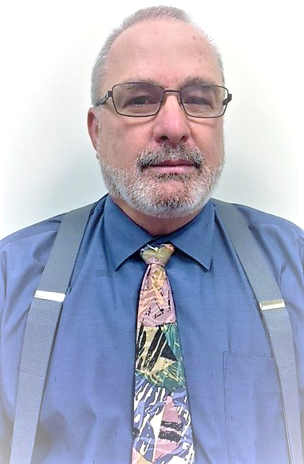
Local Indicators
Jeff Breshears
Division Director
Local Agency Systems Support Office

Slide 32
Definition: Local Indicator
For Local Control Funding Formula (LCFF) priorities where data is not collected at the state level, an LEA will measure its progress with locally collected data, and report that progress through the Dashboard.

Slide 33
Why Local Indicators?
Reflects the emphasis on ‘local control’
LEAs measure priorities that are oriented more to implementation measurement rather than summative outcome
Important for the local community to understand the holistic picture of an LEAs progress

Slide 34
The Dashboard Informs the Development of the LCAP (1)
The Dashboard
Identifies an LEA’s areas of strength and areas of need
Local Data
Provides an LEA with additional data to inform decision-making and planning
The LCAP
The vehicle for an LEA to review its progress, articulate their plans to address the areas of identified need, and communicate its plan to educational stakeholders

Slide 35
Applicability of Local Indicators
Local indicators apply only to LEAs, which are defined by LCFF statute as:
School districts
County offices of education
Charter schools
Indicators, including local indicators, apply to charter schools for state accountability purposes only if the underlying charter petition includes goals for each of the related state priorities that apply to the grade levels served and the nature of the charter school program.
Note: Local indicators do not apply to individual schools.

Slide 36
School Climate
Local Indicator - Priority 6

Slide 37
Performance Standard - School Climate
LEA administers a local climate survey at least every other year that provides a valid measure of perceptions of school safety and connectedness, such as the California Healthy Kids Survey (CHKS)
Administers the survey to students in at least one grade within the grade span(s) that the LEA serves (e.g., K-5, 6-8, 9-12)
Reports the results to its local governing board at a regularly scheduled meeting and to stakeholders and the public by using a self-reflection tool shared through the Dashboard.

Slide 38
Target Population
Students
at least one grade within the grade span (e.g., K-5, 6-8, 9-12)
Staff
all staff, both certificated and classified
Parents
Reach out to all parents, ensure that families from all student groups are represented

Slide 39
What to Measure
Survey students, staff, and parents regarding:
Safety
Perceived safety
Physical and emotional safety
Harassment and bullying
Substance use
School Connectedness
5-question scale in the CHKS
Student-staff caring relationships
Student peer relationships

Slide 40
Reporting to the Governing Board
Prior to finalizing this information in the Dashboard, the information must be reported at an LEA’s regularly scheduled governing board meeting.
Using the Dashboard Interface, LEAs can provide the results for the governing board to review.
View the Quick Reference Guide for California’s New Accountability System on the California Accountability Model & School Dashboard web page (Data Files and Guide section) at https://www.cde.ca.gov/ta/ac/cm/.

Slide 41
Reporting on the Dashboard (1 of 2)
In the text box provided in the California School Dashboard, provide a narrative summary of the local administration and analysis of a local climate survey:
student perceptions of school safety and connectedness,
parents and teachers on the sense of safety and school connectedness.
include differences among student groups, and
for surveys that provide an overall score, report the overall score for all students and student groups.

Slide 42
Reporting on the Dashboard (2 of 2)
As a recommended best practice, LEAs should report the results of their school conditions and climate tools on the Dashboard by including a URL to a district website that shows the school conditions and climate survey results, disaggregated by student groups, with a minimum n-size, for each school site, if applicable.

Slide 43
Narrative Summary – Guiding Questions
Suggested guiding questions for the narrative summary:
Reflect on the key learnings from your results, and share what you learned.
Review student group differences
Compare student and staff responses
Look at trend data
Review parent responses
What do the disaggregated results (if applicable) of the survey and other data collection methods reveal about schools in the LEA, such as areas of strength or growth, challenges, and barriers?

Slide 44
Informing LCAP Development
Using Local Indicator Data to Inform Planning

Slide 45
Beyond Surveys
Dig deeper into the survey results by conducting interviews or focus groups to understand the ‘why’ behind survey responses
Review additional Dashboard data such as suspension and chronic absenteeism rates, by subgroup
Use both quantitative and/or qualitative data to drive action-planning and decision making

Slide 46
Responding to Results – Guiding Question
What revisions, decisions, or actions has, or will, the LEA implement in response to the results for continuous improvement purposes? Why? If you have already implemented actions, did you see the results you were seeking?

Slide 47
The Dashboard Informs the Development of the LCAP (2)
The Dashboard
Identifies an LEA’s areas of strength and areas of need
Local Data
Provides an LEA with additional data to inform decision-making and planning
The LCAP
The vehicle for an LEA to review its progress, articulate their plans to address the areas of identified need, and communicate its plan to educational stakeholders

Slide 48
Questions or Comments?
Please contact
Local Agency Systems Support Office
LCFF@cde.ca.gov
916-319-0809

Slide 49
Coming Soon
Tuesdays at 2:00

Slide 50
Tuesdays at 2:00 – A Webinar Series
A series of 6 webinars:
Local Indicators – What, How, and Why?
Begins Tuesday, August 28, at 2 p.m.
More information to come via the LCFF listserv
To subscribe to the LCFF listserv, send a "blank" message to join-LCFF-list@mlist.cde.ca.gov

Slide 51
Reflection Question (1)
Please respond to the following by typing in the chat:
Based on the information shared, what stood out to you?

Slide 52
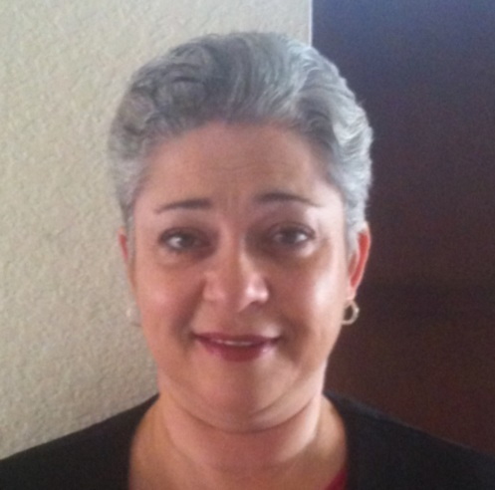
Exemplar 1: Practitioner Perspective Riverside County Office of Education
Susan Levine, Ed.D., Director II
Pupil and Administrative Services
Division of Educational Services

Slide 53
California’s Multi-tiered System of Support (MTSS): Continuum of Support
Riverside County subscribes to the alignment of systems necessary for all students’ academic, behavioral, and social success.
The Pupil and Administrative Services (PAS) unit targets the school climate indicator in its training for Child Welfare & Attendance (CWA) and school site staff and administrators.
http://www.ocde.us/MTSS/Pages/Continuum-of-Support.aspx

Slide 54
Our Journey
Districts were dissatisfied with their data….graduation rate, dropout data, suspension/expulsion, School Attendance Review Boards (SARB) cases, absenteeism, truancy, CHKS.
DataQuest data, in conjunction with their California Dashboard data, sparked the districts’ requests for more targeted training in the area of school climate. Disproportionality among student groups was a great concern.
The CWA Directors’ Network, in a Gallery Walk exercise, identified types of trainings that they believed their staff would benefit from in these areas.
The PAS administrators pulled from their networks and their colleagues’ networks to plan a year’s worth of targeted school climate training.

Slide 55
School Climate/Social-Emotional Learning Trainings (1 of 3)
Multi-tiered System Of Support (MTSS)/ Positive Behavioral Interventions and Supports (PBIS)
Tier I,II,III
Capturing Kids’ Hearts
CWA Topics Boot Camp
Trauma Informed Care
Youth Mental Health First Aid
Teen Self-Injury Suicide Prevention
Drugs and Vaping
Restorative Processes
Investigations, Searches and Due Process
Universal Design for Learning
Olweus Bullying Prevention

Slide 56
School Climate/Social-Emotional Learning Trainings (2 of 3)
MTSS/Attendance
How to Conduct a Great SARB Meeting
SARB Certification
Restorative Practices in the Attendance Process
Model SARB App
Records Training
Individualized Training at Your District

Slide 57
School Climate/Social-Emotional Learning Trainings (3 of 3)
Implicit Bias/Cultural Competency
Navigating Difference (Washington State University)
Network Meetings For CWAs
Two CBO Presentations
Leg Update
Hot Topics
Agency Updates
Burning Questions in a Hat

Slide 58
RESOURCES
WestEd will provide your school with a “school climate index report” if you give the Healthy Kids Survey.
Check out the toolkit on the “California Safe and Supportive Schools” website. http://californias3.wested.org/tools/
Check out the “National School Climate Center” website. https://www.schoolclimate.org/
Consider adding a book club school climate activity to your professional learning community. (i.e., School Climate: Leading with Collective Efficacy, DeWitt, Peter)
Check out the “Alliance for the Study of School Climate” at California State University, Los Angeles. http://web.calstatela.edu/centers/schoolclimate/
Research trainings at the “International Institute of Restorative Practices”. https://www.iirp.edu/

Slide 59
Exemplar 2: Student Perspective
Spencer Lara, 12th grade student
Lakewood High School (Long Beach)
Californians for Justice

Slide 60
School Climate
School Climate impacts the way students show up in their classroom and on campus
Students are experts
School climate surveys are a good start, but can’t be the only thing
We need to focus on racial bias, supporting teachers and staff, student and adult teams to lead together

Slide 61
Californians for Justice student leaders with Assembly Member Kevin McCarty lobbying at the state capitol for investment in community engagement and school climate

Slide 62
Relationship Centered Schools
What is it?
A Relationship Centered School breaks down the cycles of racial bias and inequity in our schools by supporting educators and students to build relationships that embrace and empower all students to pursue their dreams. They are schools that invest in school staff, value student voice, and create space for relationship building.
Cabrillo Case study
Key outcomes: Shared student-teacher-admin decision making space
3 practices in the next year:
Wellness center
Streamlining social emotional learning practices through school climate and restorative justice plans
Qualitative data to supplement school climate surveys

Slide 63
What is Coming Up Next at Californians for Justice?
Supporting Lakewood High School (LBUSD) and 10 other schools across 4 districts
Growing the Relationship Centered Schools movement statewide
Advocating for local and state policies like teacher retention, increased funding

Slide 64
Californians for Justice Resources
Californians for Justice website: caljustice.org/believeinme
Social media
Instagram: https://www.instagram.com/cal4justice/?hl=en
Twitter: https://twitter.com/cal4justice?lang=en
Contact Norma Rodriguez: norma@caljustice.org

Slide 65
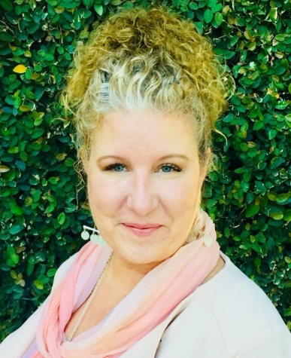
Resources for Implementation – Part 1
Kristen Brown, Ph.D.
One System Whole Child Initiative Lead
California Department of Education

Slide 66
One System of Connected Resources & Supports

Slide 67
One System Initiative Purpose
Support capacity of the CDE and local educational agencies (LEAs) to better achieve the goals of the LCFF Priorities.
Prioritize supports for CDE-led aligned initiatives, and resources to support the field.

Slide 68
Background
LCFF Implementation
One System Serving the Whole Child

Slide 69
Local Control Funding Formula/ Whole Child Resource Map
Each ray represents one Local Control Accountability Plan (LCAP) priority.
One star represents one child who is surrounded by those who want to ensure the child’s daily safety and health, and ensure that every child is engaged, challenged, and uniquely supported.
From cradle to career, the CDE has resources that support the work of LEAs and make the goals of each priority attainable.

Slide 70
LCFF Priorities/Whole Child Resource Map (1 of 2)
Local Control Funding Formula Priorities/Whole Child Resource Map https://www.cde.ca.gov/eo/in/lcff1sys-resources.asp
Collaboration in Common https://collaborationincommon.org

Slide 71
LCFF Priorities/Whole Child Resource Map (2 of 2)

Slide 72
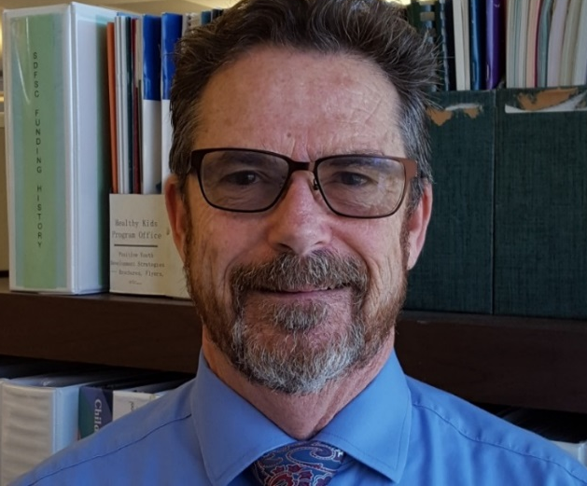
Resources for Implementation – Part 2
Tom Herman
Education Administrator
Coordinated School Health and Safety Office

Slide 73
Resources: Safe Schools (1 of 2)
Safe schools:
Provides training, resources, and technical assistance to establish a school/community environment which is physically and emotionally safe, well disciplined, and conducive to learning.
View the Safe Schools web page at https://www.cde.ca.gov/ls/ss/.

Slide 74
Resources: Safe Schools (2 of 2)

Slide 75
Resources: Safe and Supportive Schools (1 of 2)
Safe and Supportive Schools:
Supports statewide measurement of conditions for learning (school climate) and targeted programmatic interventions to improve those conditions.
View the Safe and Supportive Schools web page at https://www.cde.ca.gov/ls/ss/se/safesupportive.asp.

Slide 76
Resources: Safe and Supportive Schools (2 of 2)

Slide 77
Resources: School Environment (1 of 2)
School Environment:
Provides training, resources, and technical assistance in the establishment of a school/community environment that is physically and emotionally safe, well disciplined, and conducive to learning.
View the School Environment web page at https://www.cde.ca.gov/ls/ss/se/.

Slide 78
Resources: School Environment (2 of 2)

Slide 79
Resources: Positive School Climate (1 of 2)
Positive School Climate:
Information regarding the importance of positive school climate and resources to improve school climate.
View the CDE’s web page on Positive School Climate at https://www.cde.ca.gov/ls/ss/se/schoolclimate.asp.

Slide 80
Resources: Positive School Climate (2 of 2)

Slide 81
Resources: Social Emotional Learning (1 of 2)
Social Emotional Learning:
Provides resources on Social and Emotional Learning to help students develop a range of skills they need for school and life.
View the Social and Emotional Learning web page at https://www.cde.ca.gov/eo/in/socialemotionallearning.asp.

Slide 82
Resources: Social Emotional Learning (2 of 2)

Slide 83
Continuous Improvement: Resource Map Feedback Survey

Slide 84
Continuous Improvement: Professional Development Survey

Slide 85
Next Steps

Slide 86
Mapping Bright Spots
Purpose: To identify and map Bright Spots to promote continuous improvement activities that are grounded in outstanding field experience.
Bright Spot exemplars will be used to support peer-to-peer learning between districts, schools, and educators.
Potential Bright Spots could include programs, practices, instructional models, platforms, or tools.

Slide 87
Connecting
Tom Herman, Administrator Coordinated School Health & Safety
therman@cde.ca.gov
Kristen Brown, One System Whole Child Initiative
One System Website
http://www.cde.ca.gov/eo/in/onesystem.asp
Email
OneSystem@cde.ca.gov

Slide 88
Reflection Question (2)
Please respond to the following by typing in the chat:
Based on the information shared, what resonates with you?

Slide 89
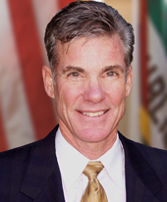
Thoughts from the State Superintendent of Public Instruction on School Climate
Tom Torlakson

Slide 90
Coming Soon: CDE EdTalks a Podcast
A new podcast featuring conversations about education related topics that is produced, edited, and published by the CDE’s Communications Department
* Logo subject to change

Slide 91
Reminders
Look out for the Tuesdays at 2:00 webinar and the next Priority X webinar
CDE EdTalks Podcast coming soon
Sign-up for the following mailing lists to receive more information about the topics shared today:
LCFF: https://www.cde.ca.gov/fg/aa/lc/index.asp
One System/Whole Child: OneSystem@cde.ca.gov
SBE: join-sbe-full-agenda-subscribers@mlist.cde.ca.gov

Slide 92
Priority X: A Webinar Series Dedicated to the Local Control Funding Formula (LCFF) State Priorities Today’s Topic: Priority 6—School Climate
Thank you!

