Slide 1
Webinar on COVID-19 Guidance for Early Learning and Care Contractors
California Department of Education
Early Learning and Care Division and Fiscal and Administrative Services Division
Date: August 28, 2020​
Time: 10:00 AM–11:00 AM​
Photo Credit: (right) Kidango Inc., (left) Amador Tuolumne CA State Preschool

Slide 2
Welcome and Introduction

Slide 3
Meeting Agenda
Introduction and Director's Welcome
Ongoing CDE Guidance Work – What's New and What's Ahead
Child Development Management Information System (CDMIS) and Fiscal Reporting Updates
Fiscal Updates
Questions

Slide 4
Ongoing CDE Guidance Work
Recently Released Guidance
Requirements for Reopening and Reimbursement for Direct Service Contactors – sent email on August 21, 2020.
Pending Guidance
Family Fees
Distance Learning
Emergency Closures for Reasons Other Than COVID-19
COVID-19 Guidance to California Resource and Referral Programs and Local Planning Councils
Webinar on Procurement Guidance: September 2 at 1pm

Slide 5
Budget Trailer Bill (Senate Bill [SB] 820)
Requirements for Reopening and Reimbursement for Direct Service Contractors
Supports for Voucher Providers
Family Fees
Parent Signatures
Addressing Priorities for In-Person Services

Slide 6
Differences Between Reporting Attendance In CDMIS and Fiscal Reporting (1)
Scenarios | CDMIS: 801A Reporting | CDNFS: 8501/9500 Attendance Reporting
Child is receiving in-person services | No changes to reporting guidelines | Report the days of attendance (including excused absences) for any child that was expected to physically attend the program.

Slide 7
Differences Between Reporting Attendance In CDMIS and Fiscal Reporting (2)
Scenarios | CDMIS: 801A Reporting | CDNFS: 8501/9500 Attendance Reporting
Child is participating in distance learning activities | Report the enrolled families on the CDD-801A who received distance learning services | Do not report the days of attendance for any children participating in distance-learning activities

Slide 8
Alternative Payment Contract Amendment Update
Budget Act Amendments are on schedule to be processed early September
The following allocations have been or will be shared by next week:
Emergency Child Care (extension of care and enrolling children into ongoing care) per SB 98
Paying providers at the maximum certificate until funds are exhausted per SB 98 and MB 20-15
Reduction in Proposition 64 funds per SB 74 and SB 820
July and August 2020 Family Fee Waiver per SB 820

Slide 9
Alternative Payment Provider Stipends Update
Funding provided for stipends in SB 98 was reduced in SB 820 from $62.5 million to $31.25 million
Anticipate allocations to be completed next week, in collaboration with Department of Social Services (DSS), if the CDE received all the necessary data from contractors
AP contractors will be notified of their allocation from their CDNFS Fiscal Analyst

Slide 10
Questions
Photo Credit: Martinez Unified School District

Slide 11
Resources
The slides for this webinar, along with MBs and FAQs, can be found on the ELCD COVID-19 Guidance web page at:​
https://www.cde.ca.gov/sp/cd/re/elcdcovid19.asp
If you have additional questions you can submit them to the ELCD Emergency email inbox at:​
ELCDEmergency@cde.ca.gov
If you have questions regarding this Webinar, please contact your assigned ELC Program Quality Implementation Office Regional Consultant. A list of consultants can be found on the ELCD Consultant Regional Assignments web page at:
https://www.cde.ca.gov/sp/cd/ci/assignments.asp
or by phone at 916-322-6233

Slide 12
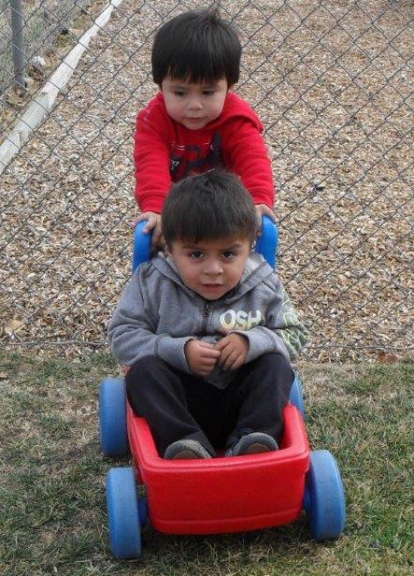
Closing
Photo Credit: CAPE, Inc.- Alameda County

