Slide 1
Information Item Related to California’s State and Federal Accountability System: 2024 Accountability Workplan
California Practitioners Advisory Group
June 14, 2024

Slide 2
Topics
2024 Accountability Workplan
  Science Metric for the Dashboard
  Long-Term English Learners (LTELs)
  Local Control Funding Formula (LCFF) Differentiated Assistance (DA) Criteria
  Every Student Succeeds Act Eligibility
    Targeted Support and Improvement (TSI) Criteria
2025 Accountability Workplan

Slide 3
2024 Accountability Workplan

Slide 4
California School Dashboard 2024
The California Department of Education (CDE) is committed to continuous improvement within the accountability system and Dashboard.
CDE's annual workplan reviews the state and local indicators and performance standards and addresses suggested revisions or updates in the workplan each March.
  This workplan was presented at the March 2024 State Board of Education (SBE) Meeting.

Slide 5
Update to Dashboard Schedules
SB 114 (Chapter 48, Statutes of 2023) moves up the publication date of the 2024 Dashboard to December 1, 2024.
The SBE annual adoption of items from the Workplan has moved up from September to July.

Slide 6
Consolidated 2024 Accountability Workplan
Incorporate Science Assessment Results onto the Dashboard: Phase I
New Student Populations: Transitional Kindergarteners (TK) and Long-Term English Learners (LTEL)
College/Career Indicator (CCI) Reflection
Student-Level Growth Model Data Release
Priority 1: State-Level Data

Slide 7
Incorporate Science Assessment Results onto the Dashboard

Slide 8
Background on Science (1 of 3)
2018
  First operational California Science Test (CAST) was administered to student in grades five, eight, and once in high school.
2020
  At the March SBE meeting, CDE discussed the timeline for potential incorporation of the Science test results into the California School Dashboard (Dashboard).

Slide 9
Background on Science (2 of 3)
March 2022 SBE Meeting
  The CDE provided an update on the feasibility of when the science results could be incorporated into the Dashboard considering the revised blueprints.
September 2022 SBE Meeting
  SBE approved the insertion of a link on the Dashboard Additional Reports to the California Science Test results on the California Assessment of Performance and Progress (CAASPP) website.

Slide 10
Background on Science (3 of 3)
December 2022
  2022 Dashboard Additional Reports links to the CAST results on the CAASPP website.
December 2023
  2023 Dashboard Additional Reports links to the CAST results on the CAASPP website.
February/March 2024
  California Practitioners Advisory Group (CPAG) and SBE provided feedback and support of the CDE’s two-year workplan for adding Science to the Dashboard.

Slide 11
Science Workplan and Dashboard Principles
Principle 5: Values high performance and growth equally.
Principle 8: Reflects technical quality through measures that are valid and reliable.
Principle 11: Is subject to continuous revision and improvement.

Slide 12
SBE Decision Points for Science Workplan
The SBE is being asked to act on the following six individual decision points:
Phase I
Approval of a Metric to Measure Science Assessment Performance for Use on the Dashboard
Phase II
Approval of Status Cut Points
Approval of Change Cut Points
Approval of a Color Scheme for the Five-by-Five Color Grid
Inclusion of the Indicator within the state accountability system through DA criteria
Inclusion of the Indicator within the federal accountability system through ESSA Eligibility Identification

Slide 13
Decision Point 1: Approval of a Metric
Approval of a Metric to Measure Science Assessment Performance for Use on the Dashboard
  CDE Work Timeframe: February – May 2024
  California Practitioners Advisory Group: June 2024
  State Board of Education Meeting: July 2024
Posting Science metric on the 2024 Dashboard

Slide 14
Decision 1: Approval of a Metric to Measure Science Assessment Performance for Use on the Dashboard (July 2024)
Adding Science to the Dashboard required a full technical evaluation of the results from the 2021–22 and 2022–23 CAST and CAA-Science administrations to ensure the creation of a new Accountability Indicator is valid and reliable.
  While the science assessments have similar characteristics to both the English Language Arts (EL) and Mathematics assessments, they have many unique features that must be evaluated to ensure fair and valid results for Accountability determinations.

Slide 15
Science:
Metric

Slide 16
Methodologies Evaluated
CDE evaluated the reliability/validity of:
  Distance from Standard (DFS)
  Percent Met/Exceeded Standard

Slide 17
Dashboard Metrics and Measurements
State Indicator | Dashboard Metric | Unit of Measurement
Academic - ELA | Distance from Standard | Points
Academic - Mathematics | Distance from Standard | Points
Science DFS | Distance from Standard | Points
Science [Percent] | Percent Met/Exceeded Standard | Percentage Rate
Suspension Rate | Percent Suspended | Percentage Rate
Chronic Absenteeism | Percent Chronically Absent | Percentage Rate
Graduation Rate | Percent Graduated | Percentage Rate
College/Career | Percent Prepared (School/LEA) | Percentage Rate
English Learner Progress | Percent Progressed | Percentage Rate

Slide 18
Science Is Unique!
ELA/Mathematics Assessments | Science Assessments
Administered every year from Grades 3-8 and in Grade 11 | Administered in Grade 5 and Grade 8 and once in either Grade 10, 11 or 12
Continuous scale from Grade 3-11 that increases across grade levels | Non-continuous scale
Scale differs in every grade (467 to 617 point range) | 100 point scale for every grade
Proficient is at the 55th percentile of the scale | Proficient is at the 65th percentile of the scale

Slide 19
Technical Evaluation of Science Scores: Distance from Standard
Calculate Percent Met or Exceeded
  Numerator: aggregate of all individual DFS scores
  Denominator: all students meeting Accountability rules
2021–22 CAST & 2022–23 CAST
  CAA-Science were not included
Apply Accountability Rules
Limited to continuously enrolled students
Evaluate Aggregated Scores
  School, District and Student Group Levels

Slide 20
Technical Feedback on DFS
The CDE technical advisory group, the Technical Design Group (TDG), evaluated aggregated values (state/LEA/school/student group levels) for validity and reliability within the Accountability system and found DFS not valid for use for Science for the following reasons:
  Scores were clustered together and not spread across the full range of 100 possible scores, which would cause issues in setting cut scores in the future
  DFS would likely create confusion among wide ELA/Math scale expectations and narrow Science scale expectations
    A 10-point DFS increase in ELA/Math is not comparable with a 10-point DFS increase in Science.

Slide 21
Technical Evaluation of Science Scores: Percent Met/Exceeded Standard
Calculate Percent Met/Exceeded
  Numerator: students scoring Level 3 and Level 4
  Denominator: all students meeting Accountability rules
Apply Accountability Rules
  Limited to continuously enrolled students
Evaluate Aggregated Scores
  School, District and Student Group Levels
2021–22 CAST & 2022–23 CAST
  CAA-Science were not included

Slide 22
Technical Feedback on
Percent Met/Exceeded Standard
The TDG provided feedback on the aggregated percentages (state/LEA/school/student group levels) for validity and reliability within the Accountability system
  Found Percent Met/Exceed to be valid and reliable for use for Science
    Parents, teachers, schools would likely be familiar with the measurement since it is used in student score reports
    This will allow for a wide range of results for aggregate scores across schools, local educational agencies (LEAs) and student groups at all levels

Slide 23
Feedback from Educational Partners on Concerns Using Percent Met/Exceeded
Educational partners expressed concerns that Science would be seen as “less important” than ELA/Mathematics if it used a different metric on the Dashboard

Slide 24
Preferred Methodology
Percent Met/Exceeded Standard
  Technically sound
  Valid and accessible on the Dashboard due to familiarity with the metric on Student Score Reports and the CAST/CAA-Science public reports
  Allows for Science to clearly demonstrate its unique outcomes for its distinct grades tested

Slide 25
CPAG Feedback on Science Methodology
Does CPAG have any feedback or questions about:
  Using “Percent Met/Exceeded” for the Science metric for the Dashboard?

Slide 26
Science
Metric
Methodology:
Incorporation of the Participation Rate for Science

Slide 27
Science Participation Rate Not Required
The U.S. Department of Education (ED) requires that states annually assess 95 percent of all students at the school/district/student group levels on the ELA and Mathematics assessments.
  There is no such requirement for any additional assessments/subject areas

Slide 28
2023 District Participation Rate Distribution
There is a lower participation rate in Science than in ELA and Math assessments
Assessment | 95-100% | 90-94.9% | 85-89.9% | Less Than 85%
Science (Current Year) | 70.6% | 19.3% | 4.1% | 6.0%
Science (Cumulative) | 77.2% | 15.9% | 2.8% | 4.1%
Math | 89.1% | 8.1% | 0.9% | 1.8%
ELA | 90.9% | 6.4% | 1.0% | 1.7%

Slide 29
2023 School Participation Rate Distribution
There is a lower participation rate in Science than in ELA and Math assessments
Assessment | 95-100% | 90-94.9% | 85-89.9% | Less Than 85%
Science (Current Year) | 82.8% | 8.4% | 2.9% | 5.9%
Science (Cumulative) | 85.6% | 7.7% | 2.3% | 4.4%
Math | 89.8% | 5.5% | 1.4% | 3.2%
ELA | 91.0% | 4.8% | 1.3% | 2.9%

Slide 30
2023 5th/8th Grade School
Participation Rate Distribution
Science has a similar participation rate to ELA and Math in grades 5th/8th grade
Assessment | 95-100% | 90-94.9% | 85-89.9% | Less Than 85%
Science (5th & 8th Grade) | 89.4% | 6.40% | 1.5% | 2.8%
Math (3rd-8th Grade) | 93.8% | 3.40% | 0.8% | 2.1%
ELA (3rd-8th Grade) | 94.5% | 2.80% | 0.7% | 2.0%

Slide 31
2023 High School
Participation Rate Distribution
There is a lower participation rate in Science for high schools compared to ELA and Math
Assessment | 95-100% | 90-94.9% | 85-89.9% | Less Than 85%
Science (Current Year) | 50.9% | 18.2% | 9.8% | 21.0%
Science (Cumulative) | 63.2% | 15.4% | 6.1% | 15.3%
Math (11th Grade) | 68.7% | 17.1% | 5.0% | 9.1%
ELA (11th Grade) | 72.7% | 15.2% | 4.4% | 7.7%

Slide 32
What Does the Incorporation of the Participation Rate Look Like for ELA/Mathematics?
Academic Indicator adds the Lowest Obtainable Scale Score (LOSS) into the average distance from standard for the number of students needed to bring the participation rate to 95 percent
  This penalty can only be applied to an average Distance from Standard
    The LOSS is a numeric value intended to affect the overall average

Slide 33
What Would a Participation Rate Look Like for Science?
English Learner Progress Indicator (ELPI) uses the number of students needed to bring the participation rate to 95 percent and counts them as not making progress.
  A participation rate for Science and “Percent Met/Exceeded” could be included in the same way
    i.e., Add the number of students needed to bring the science participation up to 95 percent to the denominator as not earning standard met/exceeded

Slide 34
Technical Feedback on Inclusion of Participation Rate
The TDG provided feedback or questions on including a participation rate within the Science metrics
  Science metric would remain valid either with or without the inclusion of a participation rate
    Found that the ELPI participation rate inclusion methodology would be valid for the Science metric

Slide 35
Feedback from Educational Partners on Incorporating a Participation Rate in the Science Metric
There was overwhelming support for alignment between the expectations for participation for ELA/Mathematics and Science and holding schools/districts/student groups accountable for participation rates below 95 percent

Slide 36
Feedback from CPAG on the Science Participation Rate
Does CPAG have feedback or questions on:
  Incorporating participation rates at the school/district/student group level below 95 percent into the Science metric for the Dashboard?

Slide 37
Science
Metric
Methodology:
Aggregating High School

Slide 38
CAST and CAA-Science in High School
High School assessment is given once in grade 10, grade 11, or grade 12
For purposes of measuring Science performance, we need to determine how we would like to group high school assessment results

Slide 39
High School Denominator Options
Current Year Scores
  All high schoolers who tested in 2023–24
    10th graders in 2023–24
    11th graders in 2023–24
    12th graders in 2023–24
Cumulative Scores
  All 12th graders who tested in either:
    10th grade (2021–22)
    11th grade (2022–23)
    12th grade (2023–24)
    For this option, the 10th and 11th grade testers would not be reported until their 12th grade year

Slide 40
Technical Feedback: Aggregating High Schools
The TDG supported the use of the Current Year methodology to aggregate high school science scores
  This option would alleviate any issues that may arise in combining scores across years
  If used for support determinations in the future, the results would all be from the most recent year

Slide 41
Feedback from Educational Partners: Aggregating High Schools
Overwhelmingly favored Current Year method
Comments included
  Closest to ‘real time’ data
  Shows results for students that ‘completed’ science
  Would still like access to the cohort data
    Available through CAST reporting website

Slide 42
Preferred Option: Aggregating High Schools
Current Year
  Resounding support from educational partners
  Technically valid and reliable
  Allows for high school results to reflect the most recent test administration

Slide 43
Feedback from CPAG on Aggregating High School Science Results
Does CPAG have any feedback or questions on:
  Using the Current Year method to group high school Science results?

Slide 44
Science: Dashboard Card

Slide 45
2024 Science Dashboard Card
The Science metric will be published with the release of the 2024 Dashboard
A Dashboard card will be displayed on main page, as well as student group results on the secondary page
Data that can be included:
  Status (number/value): i.e. 35% met/exceeded standard
  Change (number/value): i.e. -1.5%
Data that cannot be included:
  Performance Level (Color)
  Status Level
  Change Level
  Equity Report

Slide 46
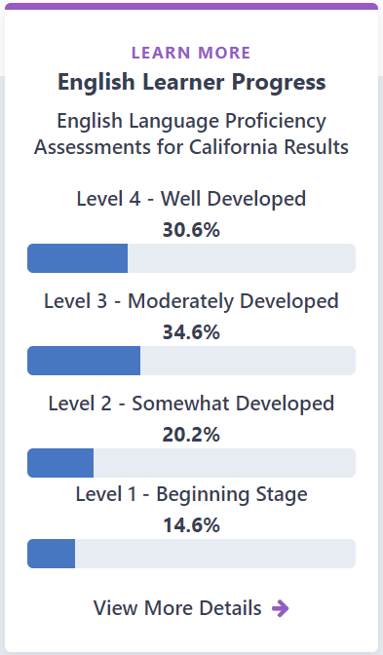
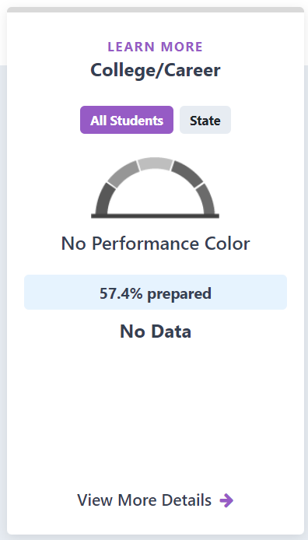
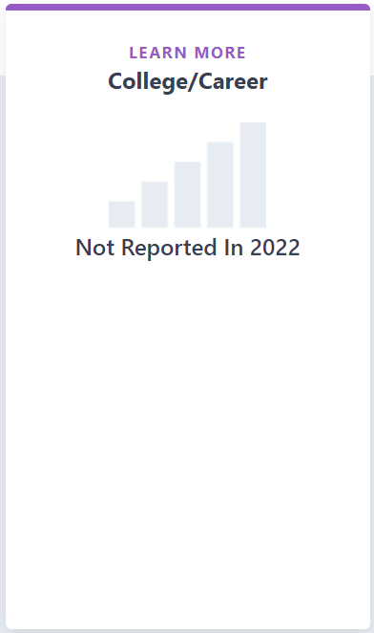
What We Have Done in the Past for Incomplete Indicators on the Dashboard

Slide 47
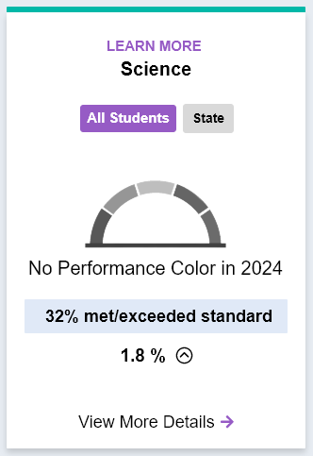
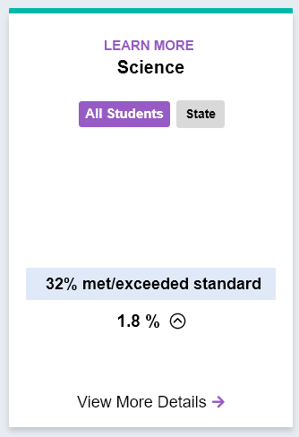
Mockups of Dashboard Card

Slide 48
Feedback from CPAG on the Science Dashboard Card
Does CPAG have any feedback or questions about how Science data should be displayed on the 2024 Dashboard?

Slide 49
Into the Future
2025 Accountability Workplan for Science

Slide 50
2025 Science Assessment Workplan: Science Indicator with a Color
Phase II: Decision Points 2, 3, and 4
Approval of Status Cut Points, Change Cut Points, and Color Scheme for the Five-by-Five Color Grid
  CDE Work Timeframe: January – May 2025
  California Practitioners Advisory Group: June 2025
  State Board of Education Meeting: July 2025
Posting of Science Indicator with a full color on the 2025 Dashboard

Slide 51
2025 Science Assessment Workplan:
State and Federal Eligibility
Phase II: Decision Points 5 and 6
Decision on the inclusion of the Indicator within the state accountability system through Differentiated Assistance Criteria and Federal Accountability System through ESSA Eligibility Identification
  CDE Work Timeframe: January – May 2025
  California Practitioners Advisory Group: June 2025
  State Board of Education Meeting: July 2025
(If Approved) Inclusion of Science in LCFF Determinations based on 2025 Dashboard
(If Approved) Revisions submitted to ESSA State Plan for Inclusion of Science in ESSA Determinations beginning with 2026 Dashboard

Slide 52
New Student Group:
Long-Term English Learners

Slide 53
LTEL Workplan and Dashboard Principles
The work on this state indicator aligns with the following Dashboard Principles:
  Principle 5: Values high performance and growth equally.
  Principle 8: Reflects technical quality through measures that are valid and reliable.
  Principle 11: Is subject to continuous revision and improvement.

Slide 54
Background on LTELs and the Dashboard
Senate Bill 141 (Chapter 194, Statues of 2023) added LTELs to the Dashboard
  Definition: “A pupil who has not attained English language proficiency within 7 years of initial classification as an English learner”
This is the first of its’ kind student group nationally and becomes the 14th student group on the Dashboard

Slide 55
LTELs and 2024 Dashboard Indicators
Beginning with the 2024 Dashboard, the LTEL student group will be added to all state Indicators:
    Suspension Rate Indicator
    Graduation Rate Indicator
    College/Career Indicator
    Chronic Absenteeism Indicator
    Academic Indicators
    English Learner Progress Indicator
      This indicator will now have an overall performance for English Learners and a single student group: LTELs

Slide 56
LTELs Dashboard Workplan
CDE will conduct technical work to operationalize the inclusion of the LTEL student group on the Dashboard within:
  Cumulative Enrollment,
  Cohort Calculations, and
  Assessment demographics.
The CDE will engage with educational partners obtain feedback on resources to advertise the addition of the new student group on the Dashboard.

Slide 57
Operationalize Definition:
When would a student be considered an LTEL?

Slide 58
When are EL/LTELs Counted as EL/LTELs on the Dashboard?
Student Population | Applicable Indicators | English Learner | Long-Term English Learner
Cumulative Enrollment | Chronic Absenteeism, Suspension Rate | EL at any point during the year | LTEL at any point during the year
Cohort | Graduation Rate, College/Career Readiness | EL at any point during the cohort | LTEL at any point during the cohort
Academic Demographics | Academic – ELA, Academic – Mathematics, English Learner Progress Indicator (ELPI) | EL at any point during the year | LTEL at any point during the year

Slide 59
English Learner Progress Indicator and Student Groups

Slide 60
English Learner Progress Indicator Student Groups: EL and LTEL
The English Learner Progress Indicator (ELPI) has been a unique indicator on the Dashboard because:
  The overall performance level is also the performance level for the EL student group
    There is no Equity Report on the Dashboard for the Indicator
  Adding LTELs to the Dashboard adds another student group to the ELPI

Slide 61
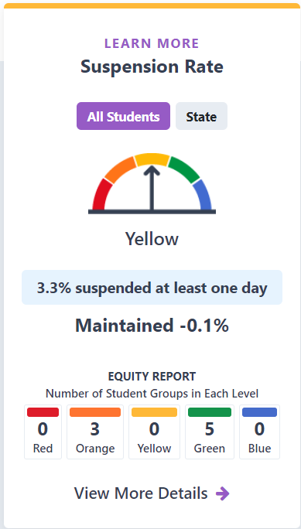
Example of a Dashboard Card with an Equity Report:
2023 Suspension Rate Dashboard Card

Slide 62
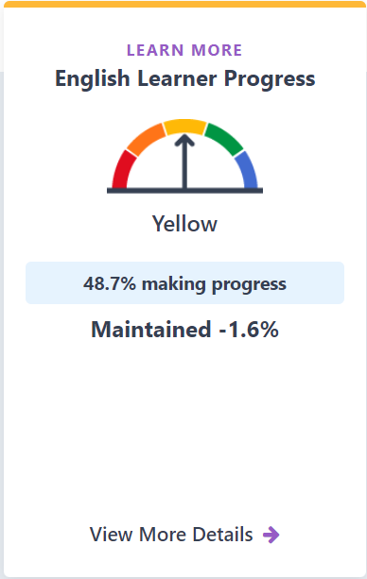
ELPI on the 2023
Dashboard

Slide 63
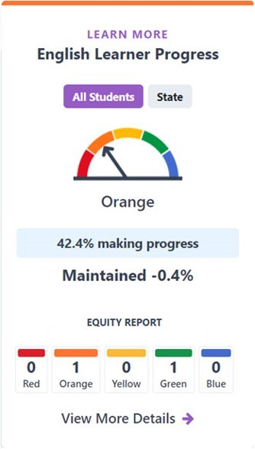
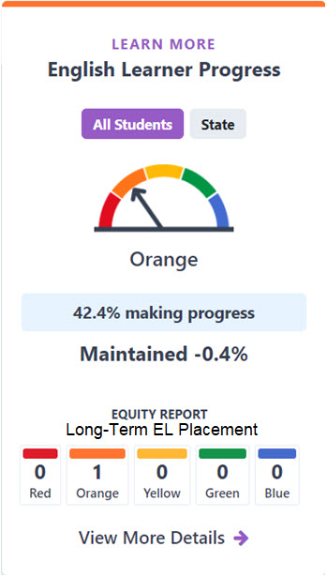
What Should the ELPI Equity Report Look Like?
Equity Report that includes:
  Performance EL (same as overall) and LTEL student groups
  Performance of only LTEL student group

Slide 64
Feedback from CPAG on the ELPI Dashboard Card
Does CPAG have any feedback or questions about how the LTEL student group should be displayed on the Dashboard?

Slide 65
LCFF
Differentiated Assistance
Criteria for the
2024 Dashboard

Slide 66
Levels of Assistance
Level 1 – Support for All:
  All districts, charter schools, and County Offices of Education (COEs) are eligible for general assistance.
Level 2 – Differentiated Assistance:
  All districts, charter schools, and COEs are eligible for differentiated assistance based on performance in each Local Control Funding Formula (LCFF) state priority area.
Level 3 - DA with Additional Geographic Lead Support
Level 4 - Eligibility for Support from CCEE

Slide 67
Differentiated Assistance:
Timeline for Eligibility
Differentiated assistance eligibility determinations are made annually following the release of the Dashboard.
  Differentiated assistance is not a status. Therefore, districts, COEs, and charter schools do not exit from assistance.

Slide 68
Differentiated Assistance Eligibility Criteria
State and local indicator results, for each priority area reported on the Dashboard, are used to determine eligibility of districts and COEs for differentiated assistance.
In 2024, the Dashboard will have all Indicators available. Therefore, there will be no modifications to the standard eligibility criteria.
  Update will be made to incorporate the LTEL student group to the criteria

Slide 69
Differentiated Assistance Eligibility Criteria for Priorities 1-3
Priority Number | Priority Area | Criteria
1 | Basics | Not Met for Two or More Years on Local Performance
2 | Implementation of State Academic Standards | Not Met for Two or More Years on Local Performance
3 | Parent and Family Engagement | Not Met for Two or More Years on Local Performance

Slide 70
Eligibility Criteria for Priorities 4-5 (Cont.)
Priority Number | Priority Area | Criteria
4 | Pupil Achievement | Red on both English language arts and math tests, or Red on English language arts or math test and Orange on the other test, or Red on the English Learner Progress Indicator (ELPI) (English Learner student group or Long-Term English Learner student group)
5 | Pupil Engagement | Red on Graduation Rate Indicator, or Red on Chronic Absence Indicator

Slide 71
Differentiated Assistance Eligibility Criteria for Priorities 6-10
Priority Number | Priority Area | Criteria
6 | School Climate | Red on Suspension Rate Indicator, or Not Met for Two or More Years on Local Performance
7 | Access to a Broad Course of Study | Not Met for Two or More Years on Local Performance
8 | Outcomes in a Broad Course of Study | Red on College/Career Indicator (CCI)
9 | Coordination of Services for Expelled Pupils – COEs ONLY | Not Met for Two or More Years on Local Performance
10 | Coordination of Services for Foster Youth – COEs Only | Not Met for Two or More Years on Local Performance

Slide 72
Districts and COEs May be Eligible for Differentiated Assistance Based on...
State Indicators Only (Method 1):
  One student group meets the criteria in at least two priority areas (e.g., Hispanic student group is Red for Chronic Absenteeism and Suspension—priority areas 5 and 6).
Local Indicators Only (Method 2):
  “Not Met for Two or More Years” in at least two priority areas (e.g., priority areas 1 and 2).
A Combination of State and Local Indicators (Method 3):
  One or more student group(s) meets(s) the criteria in one priority area (e.g., Students with disabilities receives Red for graduation rate—5), and the LEA or COE meets the “Not Met for Two or More Years” on only one local indicator in a different priority area (e.g., Parent Engagement—3)

Slide 73
Charter Schools May be Eligible for Differentiated Assistance Based on...
The eligibility criteria for charters is identical to districts/COEs eligibility criteria, except for charter schools are required to meet the criteria in two or more years.
State Indicators Only (Method 1):
  See previous slide for example.
Local Indicators Only (Method 2):
  See previous slide for example.
A Combination of State and Local Indicators (Method 3):
  See previous slide for example.

Slide 74
Every Student Succeeds Act (ESSA) Identification

Slide 75
Federal Support Programs
Comprehensive Support and Improvement (CSI)
  CSI – Low Graduation Rate – applies to all schools (non-Title I funded and Title I funded) with a three-year graduation rate average below 68 percent.
  CSI – Low Performing – limited to Title I funded schools with low performance on the Dashboard.
Additional Targeted Support and Improvement (ATSI)
  Focuses on schools with low performing student groups.
Targeted Support and Improvement
  Focuses on schools with low performing student groups. This the first year that schools in California will be eligible for TSI.

Slide 76
Timeline of Federal Support Identification
2023 Dashboard
CSI
ATSI
2024 Dashboard
TSI
2025 Dashboard
TSI
2026 Dashboard
CSI
ATSI

Slide 77
CSI/ATSI Three-Year Cycle
The 2023 Dashboard marked the start of a three-year cycle for CSI/ATSI entry determinations.
  The next entry cycle begins with the 2026 Dashboard (2026–27 ESSA Assistance).
  CSI/ATSI exits are determined annually.

Slide 78
Targeted Support and Improvement
During the CSI/ATSI non-entry years, TSI determinations are made.
  All schools that are not in CSI/ATSI, even those schools that exit CSI/ATSI based on the results of the 2024 Dashboard, are in the eligibility pool for TSI determinations.

Slide 79
TSI Eligibility Criteria
All schools with a student group (other than LTELs) that meets the criteria below are eligible for TSI.
Criteria | 2024 TSI Criteria Based on the 2023 Dashboard | 2024 TSI Criteria Based on the 2024 Dashboard
Criterion 1 | All Red indicators | All Red indicators
Criterion 2 | All Red indicators except for one indicator of another performance color | All Red indicators except for one indicator of another performance color
Criterion 3 | Five or more indicators where the majority are Red | Five or more indicators where the majority are Red

Slide 80
2025
Accountability Workplan

Slide 81

Dashboard Publication Deadlines
Deadlines for future Dashboard years (per SB 114):
  2025—November 15, 2025
  2026—October 15, 2026

Slide 82
2025 Workplan Schedule
Beginning in 2025, CDE will adjust its annual workplan review and approval to the following months:
  December: CPAG reviews and provides feedback on workplan
  January: SBE reviews and adopts workplan
  June: CPAG review and provide feedback on workplan progress
  July: SBE reviews and adopts workplan components

Slide 83
Public Comment

Slide 84
Public Comment Call-in Number
Phone number: 717-908-1926
Participant Access Code: 1166083#
Notes: Turn down the volume of your computer or live webcast to avoid background echoes.
When it is your turn, an operator will announce, “Please say your name and affiliation and begin public comment. Your time begins now.”

