Slide 1
Social and Emotional Distance Learning Webinar Series
Supporting Social and Emotional Development Outside of School
Session 3: Families
September 23, 2020
Notes:
Erika:
Hello and welcome to the Social and Emotional Distance Learning Webinar Series. My name is Erika St. Andre from the California Department of Education (CDE). I work in the Educator Excellence and Equity Division in the Professional Learning Innovations office.
As participants continue to join, please feel free to introduce yourselves in the chat. Include your name and how to pronounce it, as well as your role.

Slide 2
Housekeeping: Using Zoom
Please keep your microphone muted unless otherwise directed.
Click the ^ next to the microphone icon to start or change your audio connection.
The chat will open a chat window on the right side of the screen.
Post questions in the chat window and the speaker will address them when possible.
Notes:
Erika:
There are a few housekeeping items we need to review.
All participants will be muted during the webinar, so please keep your microphone muted unless otherwise directed. Click the small arrow next to the microphone to start or change your audio connection. Post questions in the chat and the speaker will address them when possible.

Slide 3
Welcome
Notes:
Erika:
Welcome everyone, and thank you for taking the time to be with us this afternoon for the third in our four-part series on Social and Emotional Learning (SEL). We know that your time is important, and we hope to share some valuable information with you that can transfer directly to your home as you support your kids in school this year.

Slide 4
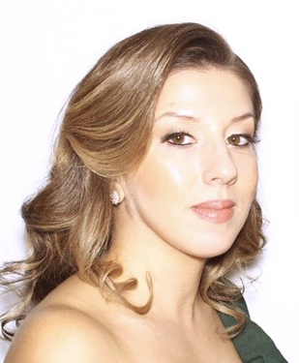
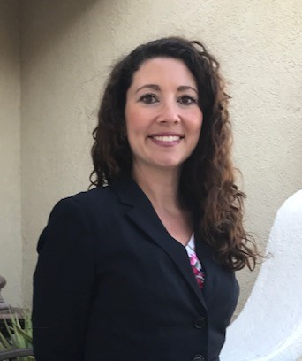
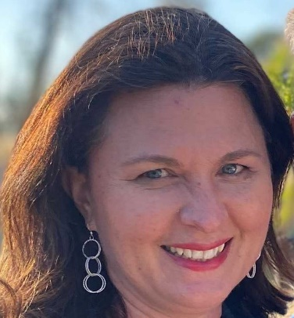
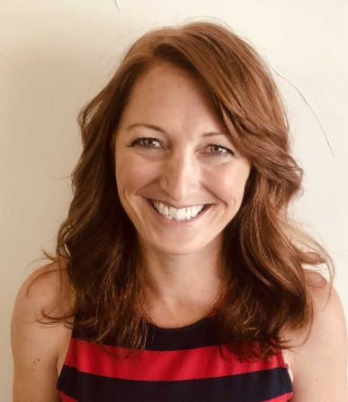
Introductions
Lorena Magallanes
Julia Agostinelli
Erika St. Andre
Sarah Smith
Notes:
Erika:
Today’s webinar is hosted by the CDE. My name is Erika St. Andre and I am joined today by three of my colleagues from the Professional Learning Innovations Office, Julia Agostinelli, Sarah Smith, and Erika St. Andre. They will be assisting me in facilitating the webinar as well as overseeing the chat.
We also have a very special guest speaker, Lorena Magallanes, an expert in the field of SEL. Lorena Magallanes is a licensed marriage and family therapist providing support to families, children, youth, and couples. She earned her bachelors in Psychology and masters in Marriage and Family Therapy from the University of La Verne. She recently also earned her master’s in School Counseling with Pupil Personnel Services credential at the University of La Verne. She has been providing therapeutic services since 2011. She currently works at Bonita Unified School District as a therapist providing therapy to children, teens, and families. She is also currently part of the CDE SEL Learning Work Group, The School Counselor Academy Advisory Committee, and The Los Angeles County Post-Covid19 Lesson Development. Her interests include SEL, cognitive behavioral therapy, restorative practices, mindfulness, and wellness.

Slide 5
Agenda
Welcoming Ritual
Self-Care Activity
Engaging Practice
Optimistic Closure
Questions and Answers
Upcoming Webinar
Notes:
Erika:
In today’s webinar, we will begin with a Welcoming Ritual. Next we will learn about SEL. Then, we will engage in what is called an optimistic closure. Finally, we will open up for questions and provide answers, and take a look at our final upcoming webinar.

Slide 6
Today’s Outcomes
Today, we will:
Introduce/review what is meant by "social and emotional learning" (SEL)
Provide skills and strategies to practice SEL at home
Share ideas for promoting SEL for children
Notes:
Erika:
[Read from slide.]
We want to start by acknowledging that parents and caretakers are already doing this work with their children, you just may be using different language or terminology when you talk with your children about it. It may be helpful to learn the terms and language your child's school is using around SEL in order to build more consistency for your children.
I will now turn it over to Lorena Magallanes.

Slide 7
Welcoming Ritual
Breathe In, Breathe Out
Notes:
Lorena:
I will be reading a mindfulness script.
Before we get started with our content, we would like to check in with you to see how you are doing. Mindfulness activities like these at the start of the day or at mealtimes can be a quick but effective way to check in with yourself and your family.
We are going to begin with what is called a welcoming ritual. [Play video of Breathe In, Breathe Out.]
One of the important points we are going to hear about today is that we can teach our kids to think about their thoughts, what is called metacognition, and to learn techniques for acknowledging thoughts they are having and then move forward with the task at hand. As parents and caregivers, we must practice these skills in order to effectively teach them to our kids.

Slide 8
Social and Emotional Learning Background (1)
Many Parents and Families are wondering what SEL is and how they can assist their child with it. (Hint: You are probably already providing SEL skills to support your child!)
SEL is how children and adults process and manage emotions, set and achieve positive goals, feel and show empathy for others, establish and maintain positive relationships, and make responsible decisions.
SEL has become even more important now due to the COVID-19 Pandemic.
Notes:
Lorena:
[Read from slide.]
Resources to consider adding to the slide:
https://www.sanfordharmony.org/harmony-at-home/?track=em_eloqua_toolkit-launch&utm_campaign=at-home-toolkit&utm_source=eloqua&utm_medium=email&utm_content=toolkit (Sanford Harmony at Home toolkit)
https://www.marcbrackett.com/emotions-at-home-how-do-we-want-to-feel/ (Dr. Marc Brackett family charter)

Slide 9
Social and Emotional Learning Background (2)
SEL is something that is taught intentionally or unintentionally in different settings. Students receive SEL at school by their teacher(s), school counselors, staff, and even their peers.
The home can be an extension of SEL. With distance learning, it is very important to also maintain the SEL being taught at school in the home. Parents are partners!
SEL also helps prevent bullying, promotes kindness, and helps students develop positive social skills.
Notes:
Lorena:
[Read from slide.]
Resources to consider adding to the slide:
https://www.sanfordharmony.org/harmony-at-home/?track=em_eloqua_toolkit-launch&utm_campaign=at-home-toolkit&utm_source=eloqua&utm_medium=email&utm_content=toolkit (Sanford Harmony at Home toolkit)
https://www.marcbrackett.com/emotions-at-home-how-do-we-want-to-feel/ (Dr. Marc Brackett family charter)

Slide 10
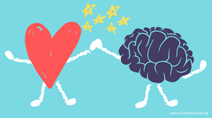
Social and Emotional Learning Video t.ly/plUb
https://www.youtube.com/watch?v=ikehX9o1JbI&feature=emb_logo
Notes:
Lorena:
[Read from slide.]
Resources to consider adding to the slide:
https://www.sanfordharmony.org/harmony-at-home/?track=em_eloqua_toolkit-launch&utm_campaign=at-home-toolkit&utm_source=eloqua&utm_medium=email&utm_content=toolkit (Sanford Harmony at Home toolkit)
https://www.marcbrackett.com/emotions-at-home-how-do-we-want-to-feel/ (Dr. Marc Brackett family charter)

Slide 11
Social and Emotional Learning Resources
SEL is very easy to teach and maintain in the home.
SEL skills are needed and used from early childhood through adulthood. There is not a time or place where they are not needed.
As a parent we want to share two ways to support social-emotional development at home through SEL books and creating an SEL passport at https://www.cfchildren.org/blog/2018/05/sel-passport-challenge/.
For parents of teenagers, look into ParenTeenConnect for resources at https://www.parenteenconnect.org/.
Notes:
Lorena:
[Read from slide.]
SEL Passport: https://www.cfchildren.org/blog/2018/05/sel-passport-challenge/
Parent Teen Connect: https://www.parenteenconnect.org/

Slide 12
Engaging Practice
Notes:
Lorena:
An Engaging Practice is simply a topic or strategy we engage in to learn more.

Slide 13
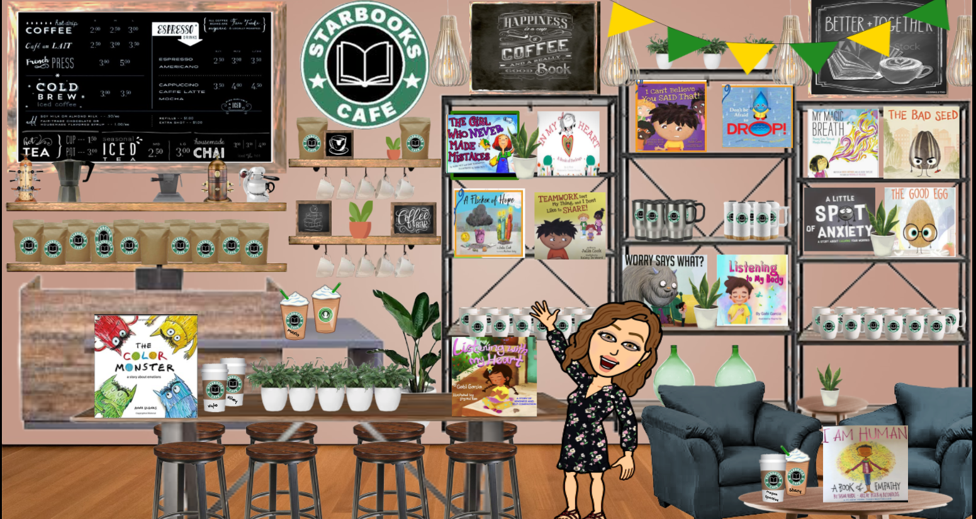
Virtual Coffee Shop
https://www.youtube.com/watch?v=W6wIEp-M4tg
Notes:
Lorena:
Describe virtual coffee shop and Bitmoji as a part of Distance Learning.

Slide 14
Circle of Control (1)
There are some things in your life that are in your control, which means you can change them or make choices about them.
Things in your control are like Play-Doh, you can mold and shape them how you want.
Notes:
Lorena:
[Read from slide.]

Slide 15
Circle of Control (2)
There are things out of your control. These are things you can’t make changes or choices about.
Things out of your control are like rocks. You can’t change them. You just have to accept them for how they are!
Notes:
Lorena:

Slide 16
Breakout Room Activity (1)
In vs. Out of Control
Read each of the things below. Check boxes to show if they are IN or OUT of your control.
What Are You in Control Of | IN Your Control | OUT of Your Control
What I Say
What I Do
My Family
Things that Already Happened
My Thoughts and Attitude
What Other People Say
Other Peoples’ Choices
How Hard I Try
Notes:
Lorena:

Slide 17
Breakout Room Activity (2)
In vs. Out of Control
Read each of the things below. Check boxes to show if they are IN or OUT of your control.
What Are You in Control Of | IN Your Control | OUT of Your Control
Who I’m Friends With
Having Money to Pay the Bills
What I Do with My Feelings
Keeping Other People Happy
How I Spend My Time
Things Happening in the News
Notes:
Lorena:

Slide 18
Breakout Room Activity (3)
In vs. Out of Control Practice
Write in two things from your week that were IN your control and two things that were OUT of your control.
Write IN your control things inside the circle, write OUT of your control things outside of the circle.
Notes:
Lorena:
Each breakout group will have a Jamboard they will use to record their ideas. The link to the Jamboard is being put into the chat right now. https://jamboard.google.com/d/1ioRj1xaAwg11fjq_qvj6zl5PLiHGdRR7wuFgnYMD5XA/edit?usp=sharing

Slide 19
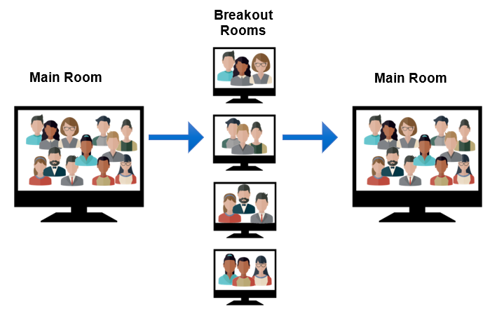
Breakout Activity: Interaction Flow
The host of the webinar will invite you to join a Breakout Room. When the Breakout Room session is over, you will return to the Main Room.
Notes:
Erika:
We are now going to discuss what we just learned about with small groups in breakout rooms.

Slide 20
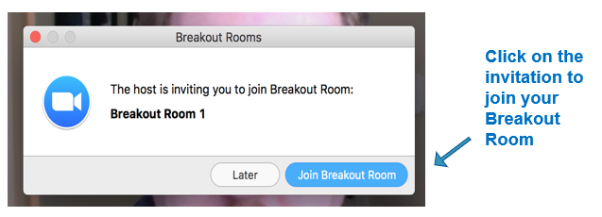
Breakout Room Assignment
The host of the webinar will invite you to join a Breakout Room. Click on the Join Breakout Room button to join.
Notes:
Erika:
Once we set up the breakout rooms, click on the invitation to join your Breakout Room.

Slide 21
Breakout Room Navigation
Once you have joined a Breakout Room, you can click on the ? Ask for Help button if you need assistance, or click on the Leave Breakout Room if you want to leave.
Notes:
Erika:
Once in your Breakout Room, your bottom navigation will change slightly, providing you with a new Ask for Help button, which will invite the host to your breakout room, and a Leave Breakout Room button, which will return you to the Main Room.

Slide 22
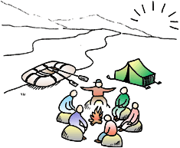
Whole Group Share
What are you taking away from your group discussion?
Notes:
Lorena:
Great job everyone and thank you for coming back to the whole group. We would like to hear from a few of you about your reflections on the Circle of Control activity.
[Participants share out]

Slide 23
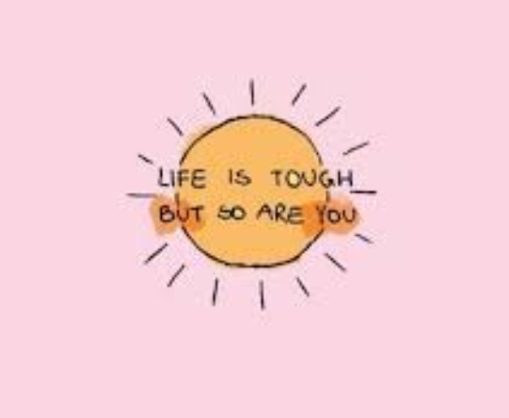
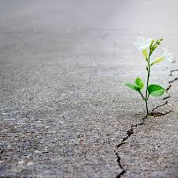
Optimistic Closure
Notes:
Lorena:
To wrap up, we will do what is called an Optimistic Closure.
I will be reading a gratitude mindfulness script:
This is a great meditation to do at the beginning of the day, or very end. Turn off your phone and free yourself of interruptions. Please don’t listen to this recording while you are driving. Either sit or lie down, whatever is most comfortable. Now close your eyes. Take a long slow, deep breath in and slowly exhale. Feel any tension melting away as you gradually relax deeper with each breath. Take another long slow, deep breath in and exhale. Feel yourself drifting into a state of deep relaxation. Continue to breathe slowly and gently as you bring your awareness to the top of your head. Picture a warm, loving golden light spreading from the top of your head down to your toes. Feel your muscles relax as the light washes over you, surrounding and protecting you. Take a few more deep breaths and relax deeply. In this safe, relaxed state reflect on all the things you’re grateful for: loved ones, breath in your lungs, sunshine, fresh air, the tasty dinner you had that evening, a nice compliment from a coworker—whatever comes to mind. As each gratitude appears, visualize yourself saying the words thank you to each. Picture the person you’re grateful for standing in front of you tell them how grateful you are for them and why. Try to make the image and feeling as real as you can. Taste the delicious apple you ate for lunch and say thank you to it. If you’re having a difficult time coming up with gratitudes, ask God, a higher power, or the highest part of yourself to reveal them to you. Now, allow the feeling of deep gratitude to come into your body. Notice where in your body the feeling is. Take a few deep breaths and allow this feeling to expand. Enjoy the pleasant feeling gratitude gives you, and feel it washing away your tension and negativity. You can remain in this relaxed state as long as you like. When you’re ready, end your gratitude meditation with the following affirmation: Thank you for the many blessings I have been bestowed with. May these blessings multiply as I continue to notice and give thanks for them. Thank you universe. Amen. Now, wiggle your toes and fingers, open your eyes and give yourself a few moments to adjust. Bring that feeling of gratitude with you as you go through your day, or drift off to sleep.
Now I will hand it back over to Diane.

Slide 24
Questions and Answers
Notes:
Erika:
If time, ask: Are there any questions or comments? Please share in the chat.

Slide 25
Social and Emotional Distance Learning Web Page
http://www.cde.ca.gov/ci/se/seldistance.asp
Resources for teachers, school leaders, parents, and students
Notes:
Erika:
You can find the CDE’s SEL Distance Learning web page at [read URL]. The web page has four distinct areas: teachers, school leaders, parents, and students.

Slide 26
Upcoming Webinar
Engaging Youth and Building Life Skills—Monday, October 5, 2020, 4:00 PM
Notes:
Erika:
Our final webinar will be titled Engaging Youth and Building Life Skills and will be held on Monday, October 5, 2020, at 4:00 PM.

Slide 27
Thank You For Joining Us!
Notes:
Diane:
Thank you to Julia, Sarah, and Erika for their support today. I also want to extend a special thank you to Lorena Magallanes for sharing her expertise. Stay safe and be well.

Slide 28
Follow us on Social Media!
Facebook
California Department of Education
SEL Twitter @CDE_SEL
Notes:
Erika:
Our division shares ongoing information about SEL. We hope you will follow us on Facebook at CDE and on Twitter @CDE_SEL.

