Slide 1
Budget Overview for Parents
California Department of Education
September 8, 2020

Slide 2
Background
California Education Code (EC) Section 52064.1 requires each school district, county office of education (COE), and charter school (LEA) to develop the Local Control Funding Formula (LCFF) Budget Overview for Parents in conjunction with the Local Control and Accountability Plan (LCAP) by July 1 of each year.
The current template and instructions for the Budget Overview for Parents is posted on the Local Control and Accountability Plan (LCAP) web page at https://www.cde.ca.gov/re/lc/.
Notes:
First interim report, not the adopted budget

Slide 3
Impact of Senate Bill 98
SB 98 added EC Section 43509 which changed the adoption date for the Budget Overview for Parents for the 2020–21 school year.
Local governing boards or governing bodies are now required to adopt and submit the Budget Overview for Parents on or before December 15, 2020, in conjunction with the LEA’s first interim budget report.
Notes:
First interim report, not the adopted budget

Slide 4
Impact of SB 820
SB 820 proposes to add subsection (g) to EC Section 43509, which requires the Superintendent, subject to the approval of the Executive Director of the State Board of Education (SBE), to make specific updates to the template and instructions for the Budget Overview for Parents by September 15, 2020.
The purpose of this webinar is to solicit stakeholder feedback related to proposed updates to the Budget Overview for Parents template and instructions for 2020–21.
Notes:
First interim report, not the adopted budget

Slide 5
Required Updates (1)
SB 820 proposes to require the template and instructions to be updated to include the following:
Replace references to the LCAP with references to the Learning Continuity and Attendance Plan (Learning Continuity Plan), where applicable.
Include the specific amount of federal funds allocated to the LEA under the Coronavirus Aid, Relief, and Economic Security (CARES) Act.
Notes:
First interim report, not the adopted budget

Slide 6
Required Updates (2)
SB 820 proposes to require the template and instructions to be updated to include the following:
Replace “Total Budgeted Expenditures in LCAP” and “Total Budgeted Expenditures for High Needs Students in LCAP” with “Total Budgeted Expenditures in the Learning Continuity Plan” and “Total Budgeted Expenditures that Contribute to Increasing or Improving Services for Unduplicated Pupils in the Learning Continuity Plan.”
Notes:
First interim report, not the adopted budget

Slide 7
Proposed Revisions to Data Entry

Slide 8
Current Data Entry (1)
Local Educational Agency (LEA) name: | Sample Unified School District
CDS code: | 12345678910111
LEA contact information: | Administrator, 555-555-5555, Admin@sampleusd.org
Coming LCAP Year: | 2020-2021
Current LCAP Year: | 2019-2020
*NOTE: The "High Needs Students" referred to in the tables below are Unduplicated Students for LCFF funding purposes.

Slide 9
Proposed Data Entry (1)
Local Educational Agency (LEA) name: | Sample Unified School District
CDS code: | 12345678910111
LEA contact information: | Administrator, 555-555-5555, Admin@sampleusd.org
Current School Year: | 2020-2021
Prior School Year | 2019-2020
*NOTE: The "High Needs Students" referred to in the tables below are Unduplicated Students for LCFF funding purposes.

Slide 10
Proposed Updates (1)
“Current School Year” instead of “Coming LCAP Year”
This field will be prepopulated with “2020–21”
“Prior School Year” instead of “Current LCAP Year”
This field will be prepopulated with “2019–2020”

Slide 11
Current Data Entry (2)
Projected General Fund Revenue for the [Coming LCAP Year] LCAP Year | Amount
Total LCFF funds | $ 1,041,226,850
LCFF supplemental & concentration grants | $ 126,215,370
All other state funds | $ 194,543,729
All local funds | $ 31,690,641
All federal funds | $ 278,343,283
Total Projected Revenue | $ 11,545,804,503

Slide 12
Proposed Data Entry (2)
Projected General Fund Revenue for the 2020-2021 School Year | Amount
Total LCFF funds | $ 1,041,226,850
LCFF supplemental & concentration grants | $ 126,215,370
All other state funds | $ 194,543,729
All local funds | $ 31,690,641
Total federal funds | $ 278,343,283
Federal CARES funds | $ 22,487,241
Total Projected Revenue | $ 1,545,804,503

Slide 13
Proposed Updates (2)
Addition of Federal CARES funds
This amount is the total amount of federal funds allocated to the LEA under the federal CARES Act (Public Law 116-136)

Slide 14
Current Data Entry (3)
Total Budgeted Expenditures for the [Coming LCAP Year] LCAP Year | Amount
Total Budgeted General Fund Expenditures | $ 1,420,819,370
Total Budgeted Expenditures in LCAP | $ 355,204,843
Total Budgeted Expenditures for High Needs Students in LCAP | $ 163,532,887
Expenditures not in the LCAP | $ 1,065,614,527

Slide 15
Proposed Data Entry (3)
Total Budgeted Expenditures for the 2020-2021 School Year | Amount
Total Budgeted General Fund Expenditures | $ 1,420,819,370
Total Budgeted Expenditures in the Learning Continuity Plan | $ 355,204,843
Total Budgeted Expenditures for High Needs Students in the Learning Continuity Plan | $ 163,532,887
Expenditures not in the Learning Continuity Plan | $ 1,065,614,527

Slide 16
Proposed Updates (3)
References to the Learning Continuity Plan instead of the LCAP
References to the current 2020–21 school year

Slide 17
Current Data Entry (4)
Expenditures for High Needs Students in the [Current LCAP Year] LCAP Year | Amount
Total Budgeted Expenditures for High Needs Students in the LCAP | $ 153,538,219
Estimated Actual Expenditures for High Needs Students in LCAP | $ 167,493,028

Slide 18
Proposed Data Entry (4)
Expenditures for High Needs Students in the 2019-2020 School Year | Amount
Total Budgeted Expenditures for High Needs Students in the LCAP | $ 153,538,219
Actual Expenditures for High Needs Students in the LCAP | $ 167,493,028

Slide 19
Proposed Updates (4)
Propose removing the word “estimated” from Estimated Actual Expenditures for High Needs Students in LCAP
Revised prompt would read: Actual Expenditures for High Needs Students in LCAP

Slide 20
Requirement to Revise the Annual Update
SB 820 proposes requiring the State Superintendent of Public Instruction, in consultation with the executive director of the SBE, to revise the template for the annual update to the LCAP on or before January 31, 2021 to include the following:
The 2019–2020 LCAP
The Learning Continuity and Attendance Plan

Slide 21
Proposed Revisions to Narrative Responses

Slide 22
General Fund Expenditures
Current prompt: Briefly describe any of the General Fund Budget Expenditures for the LCAP year that are not included in the LCAP
Proposed prompt: Briefly describe any of the General Fund Budget Expenditures for the 2020-21 school year that are not included in the Learning Continuity Plan

Slide 23
High Needs Students
If the amount of “LCFF supplemental & concentration grants” is less than the amount of “Total Budgeted Expenditures for High Needs Students in the [Plan]” the LEA must respond to the following prompt:
Current prompt: Provide a brief description of how the actions and services in the LCAP will meet the requirement to improve services for high needs students
Proposed prompt: Provide a brief description of the additional actions [the LEA] is taking to meet its requirement to increase or improve services for high needs students

Slide 24
Actual Expenditures for High Needs Students
If the amount of “Total Budgeted Expenditures for High Needs Students in the LCAP” is greater than the amount of “Actual Expenditures for High Needs Students in LCAP” the LEA must respond to the following prompt:
Current prompt: Provide a brief description of how the difference impacted the actions and services and overall increased or improved services for high needs students in the current fiscal year pursuant to EC Section 42238.07
Proposed prompt: Provide a brief description of how the difference impacted the actions and services and overall increased or improved services for high needs students in the 2019–20 fiscal year pursuant to EC Section 42238.07

Slide 25
Proposed Revisions to the Template

Slide 26
Proposed Updates (5)
Addition of a second pie chart that provides a breakout of CARES Act funding as opposed to All Other Federal Funds received by the LEA
Revising the Budgeted Expenditures bar graph
The current template compares the total budgeted expenditures to the total budgeted for actions and services in the LCAP
The proposed revision compares the total budgeted for actions in the Learning Continuity Plan to the total budgeted for actions in the Learning Continuity Plan that contribute to meeting the requirement to increase or improve services for students who are low income, English learners, and foster youth

Slide 27
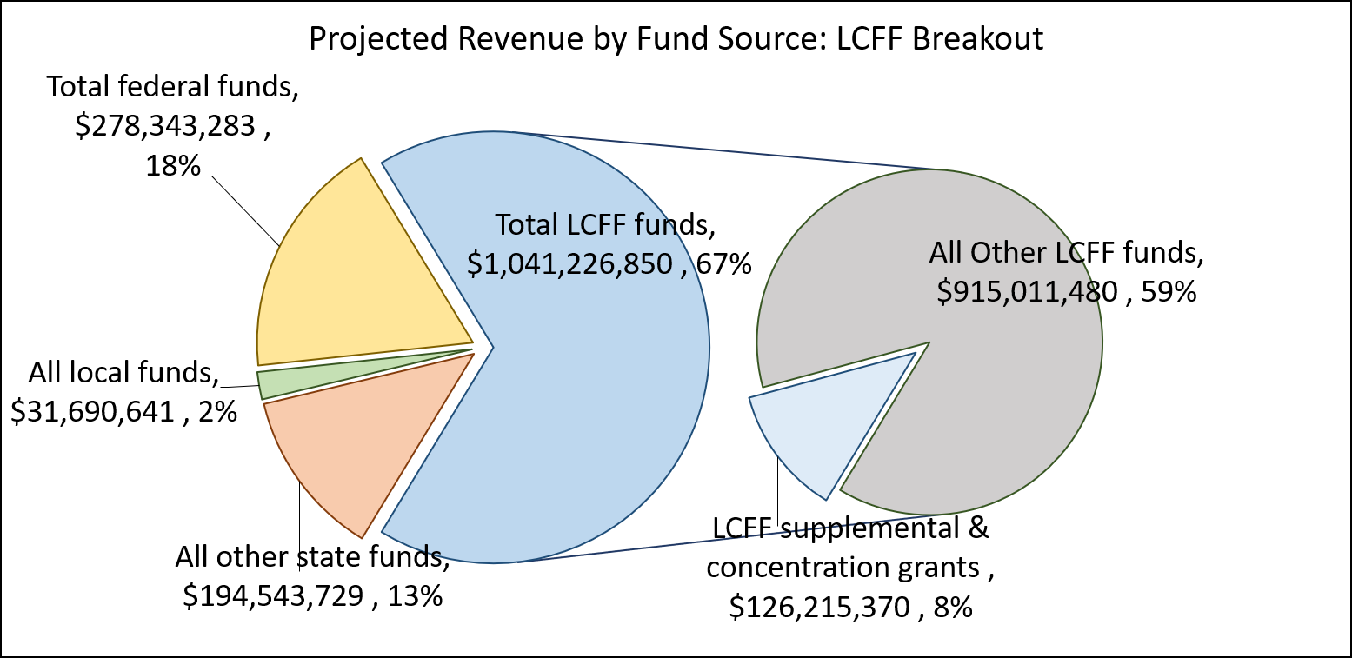
Current Pie Chart

Slide 28
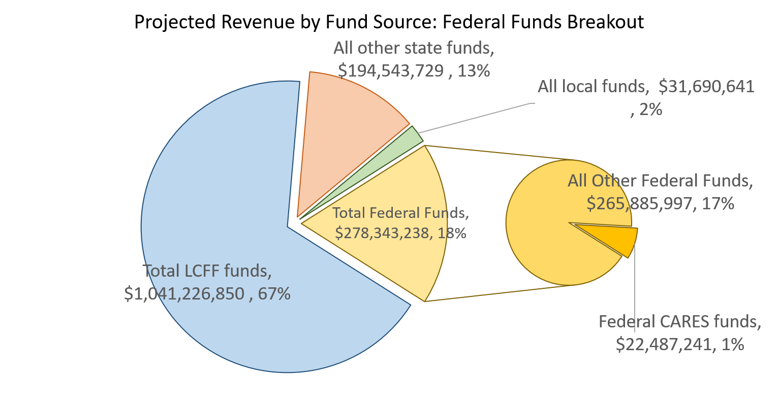
Proposed Second Pie Chart

Slide 29
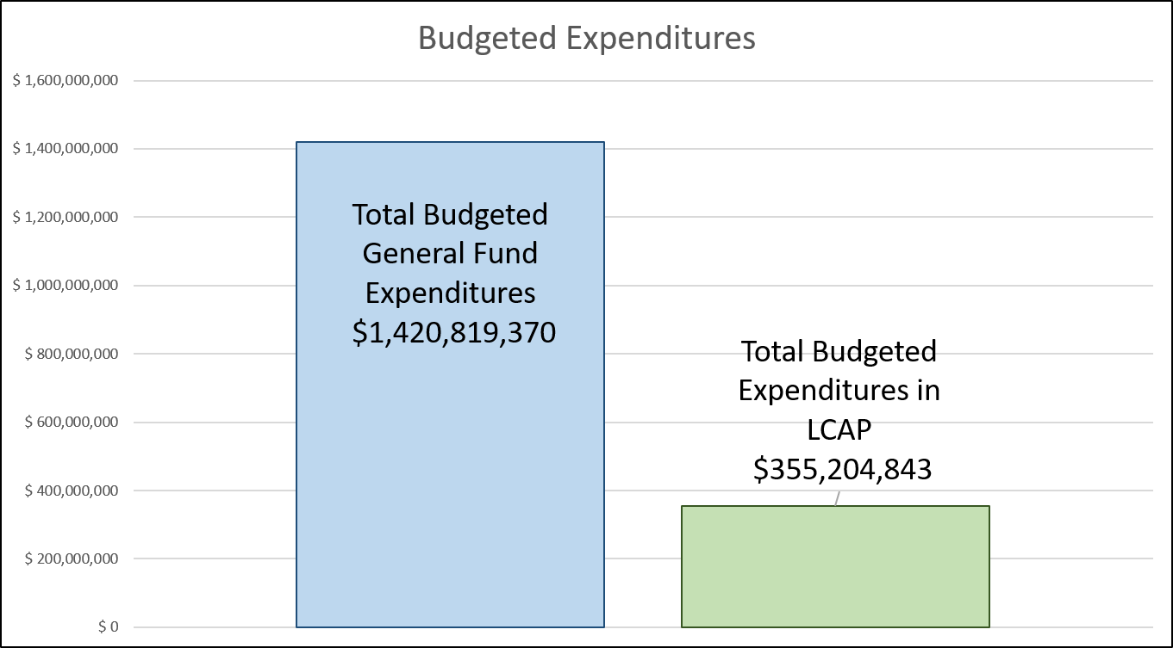
Current Budgeted Expenditures Graph

Slide 30
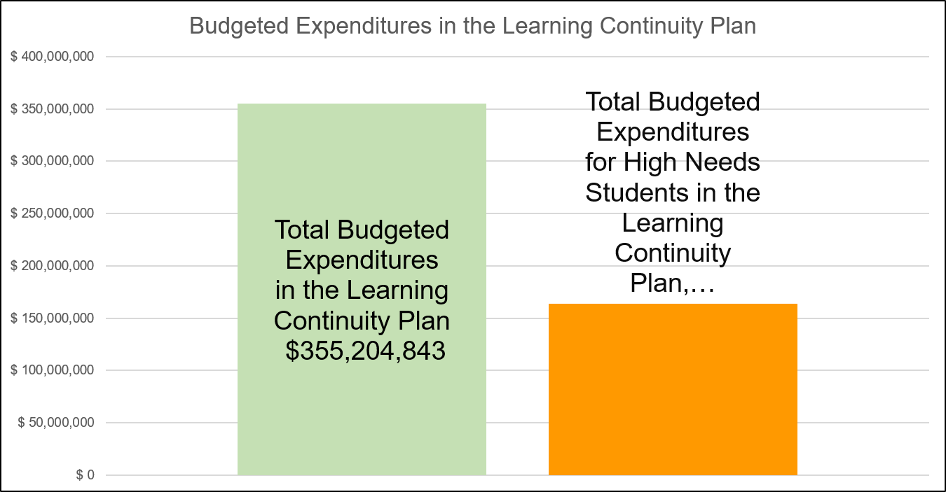
Proposed Budgeted Expenditures Graph

Slide 31
Questions
Questions or feedback related to the proposed template and instructions for the 2020–21 Budget Overview for Parents may be submitted via email to LCFF@cde.ca.gov.

Slide 32
Description of Pie Chart in Slide 27
Screenshot of a fictitious LEA with values for the “Projected Revenue by Fund Source: LCFF Breakout” pie chart. There are 2 pies, side by side. The left pie has the following items: Total LCFF funds ($1,041,226,850, 67%), All Other State Funds ($194,543,729, 13%), All Local Funds ($31,690,641, 2%), and Total Federal Funds ($278,343,283, 18%). The right pie is a breakout of the Total LCFF funds into LCFF Supplemental and Concentration Grant Funds ($126,215,370, 8%) and All Other LCFF Funds ($915,011,480, 59%).

Slide 33
Description of Pie Chart in Slide 28
Screenshot of a fictitious LEA with values for the “Projected Revenue by Fund Source: Federal Funds Breakout” pie chart. There are 2 pies, side by side. The left pie has the following items: Total LCFF funds ($1,041,226,850, 67%), All Other State Funds ($194,543,729, 13%), All Local Funds ($31,690,641, 2%), and Total Federal Funds ($278,343,238, 18%). The right pie is a breakout of the Total Federal Funds into Federal CARES Funds ($22,487,241, 1%) and All Other Federal Funds ($265,885,997, 17%).

Slide 34
Description of Bar Chart in Slide 29
Screenshot of bar graph of values of a fictitious LEA with 2 vertical bars, one labeled "Total Budgeted General Fund Expenditures" ($1,420,819,370) and the other "Total Budgeted Expenditures in LCAP" ($355,204,843).

Slide 35
Description of Bar Chart in Slide 30
Screenshot of a bar graph of values of a fictitious LEA with 2 vertical bars, one labeled "Total Budgeted Expenditures in the Learning Continuity Plan" ($355,204,843) and the other "Total Budgeted Expenditures for High Needs Students in the Learning Continuity Plan".

