Slide 1
Stakeholders and the 2021–22 LCAP
California Department of Education
January 26, 2021

Slide 2
Webinar Series
Tuesdays @ 2
Thursdays @ 3
1/26: Stakeholders and the LCAP
2/2: LCAP and Annual Update Templates and Instructions for the 2021–22 School Year
2/9: Developing Focus Goals and Maintenance Goals for the LCAP
1/28: Data and the LCAP
2/4: Developing Broad Goals for the LCAP
2/11: The CA School Dashboard Local Indicator Process for 2021–22

Slide 3
Session Goals
Background
Stakeholder Engagement Requirements
Stakeholder Engagement Section in the Local Control and Accountability Plan (LCAP)
Considerations for meaningful stakeholder engagement

Slide 4
Background
Foundational Principles and Framing

Slide 5
Foundational Principles of LCFF
Subsidiarity
A principle of social organization that holds that social and political issues should be dealt with at the most immediate level
Necessitates transparency and collaboration with the community
Equity
Additional funding to address specific identified needs of students who are low income, English learners, and/or foster youth
Requirement to Increase or Improve Services in proportion to the increase in funding
Continuous Improvement

Slide 6
Flexibility to Ensure Student Success
LCFF provides for an increased level of local flexibility to determine which programs and/or services have the greatest likelihood of ensuring that each student will succeed in relation to each of the eight LCFF state priorities.
In exchange for this flexibility, the LCFF model requires greater local responsibility for selecting appropriate and effective programs.
This necessitates transparency and engaging stakeholders in analysis and decision-making.

Slide 7
Framing the LCAP
The LCAP development process serves three distinct, but related functions:
Comprehensive Strategic Planning
Meaningful Stakeholder Engagement
Accountability and Compliance

Slide 8
Meaningful Stakeholder Engagement
The LCAP development process should result in an LCAP that reflects decisions made through meaningful stakeholder engagement.
Local stakeholders possess valuable perspectives and insights about an LEA's programs and services.
Effective strategic planning will incorporate these perspectives and insights in order to identify potential goals and actions to be included in the LCAP.

Slide 9
Requirements
Requirements for Stakeholder Engagement in Developing the Plan

Slide 10
Reminders
The prompts in the LCAP Template are required to be written in a way that is understandable and accessible to parents.
The Instructions provide technical information for local educational agencies (LEAs) to complete the template properly.
Instructions have the full force of the law and supersede the prompts.
LCAP approval criteria include adherence to the template
Instructions are part of the template and must be included when posting the LCAP

Slide 11
Statute defines the floor, not the ceiling.

Slide 12
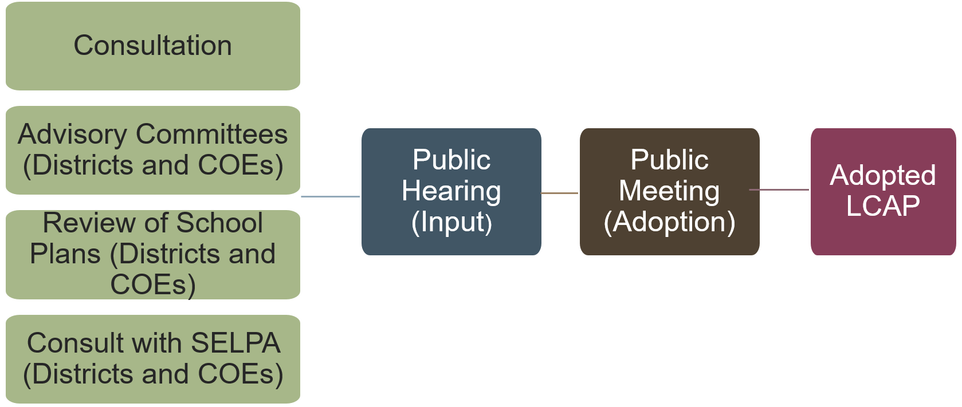
Stakeholder Engagement Process
*See Addendum 1 for descriptive text

Slide 13
Consultation
School Districts and COEs
Charter schools
teachers,
principals,
administrators,
other school personnel,
local bargaining units,
parents, and
pupils
teachers,
principals,
administrators,
other school personnel,
parents, and
pupils

Slide 14
Student Consultation
To consult with pupils means a process to enable pupils, including unduplicated pupils and other numerically significant pupil subgroups, to review and comment on the development of the LCAP.
This process may include surveys of pupils, forums with pupils, pupil advisory committees, or meetings with pupil government bodies or other groups representing pupils

Slide 15
Advisory Committees
The governing board of the school district or county office of education (COE) must establish a parent advisory committee
The committee is a committee of parents, including parents of low income, English learner, or foster youth students
If the if the enrollment of the school district or COE includes at least 15% English learners and the school district or COE enrolls at least 50 pupils who are English learners the school district or COE must establish an English learner parent advisory committee.

Slide 16
Input From Advisory Committees
Before the governing board of a school district or county office of education considers the adoption of the LCAP the superintendent of the district or county superintendent of schools must:
Present the LCAP or annual update to the LCAP to the parent advisory committee and the English learner parent advisory committee, as applicable, for review and comment; and
Respond, in writing, to comments received from the advisory committees.

Slide 17
Presenting the LCAP to Advisory Committees During the Pandemic
The method of LCAP presentation to Advisory Committees is a local decision made in consultation with the LEA’s stakeholders.
LEA’s may present the LCAP and invite stakeholders to provide feedback in a non-meeting setting (e.g. surveys, mailed letters, emails, etc.).
If an LEA chooses to present the LCAP in a meeting, Executive Order N-29-20 allows for meetings to take place virtually while the state is under restrictions for in-person gatherings.
Notes:
Greene Act?

Slide 18
Public Opportunity to Submit Written Comment
School districts and COEs are required to provide members of the public with the opportunity to submit written comments regarding the actions and expenditures proposed in the LCAP.
Notifications should be made using the most efficient method of notification possible.
School districts and COEs are required to ensure that written notifications are translated into the primary language of any student population that make up 15% or more of the LEA’s students who speak a primary language other than English.

Slide 19
Review of School Plans
A school district or COE shall review all School Plans for Student Achievement (SPSA) for schools within the district or COE to ensure that the specific actions included in the LCAP are consistent with strategies included in the schools’ SPSAs.

Slide 20
Consultation With SELPA
A school district or COE is required to consult with its Special Education Local Plan Area (SELPA) administrator(s) to:
Determine that specific actions for individuals with exceptional needs (i.e. Students with Disabilities) are included in the LCAP; and
Are consistent with strategies included in the annual assurances support plan for the education of individuals with exceptional needs.

Slide 21
Public Hearing (Prior to Adoption)
Before the LEA considers adoption of the LCAP or an annual update to the LCAP, the LEA shall:
Hold at least one public hearing to solicit the recommendations and comments of members of the public regarding the specific actions and expenditures proposed to be included in the LCAP or annual update to the LCAP.
The agenda for the public hearing must be posted at least 72 hours in advance and must include the location where the LCAP will be available for public inspection

Slide 22
Public Meeting (i.e. Adoption)
A governing board of an LEA must adopt the LCAP or an annual update to the LCAP in a public meeting.
This meeting shall be held after, but not on the same day as, the public hearing (discussed in the previous slide).
This meeting must be the same meeting as that during which the governing board of the school district/COE adopts a budget.
This is also the same meeting at which an LEA reports the California School Dashboard local indicators

Slide 23
The Plan Summary

Slide 24
Purpose
A well-developed Plan Summary section provides a meaningful context for the LCAP.
This section provides information about an LEA’s community as well as relevant information about student needs and performance.
In order to provide a meaningful context for the rest of the LCAP, the content of this section should be clearly and meaningfully related to the content included in the subsequent sections of the LCAP.

Slide 25
Reflections: Successes and Identified Needs for the 2021–2022 LCAP
For the 2021–22 LCAP reflections on successes and identification of needs should based on a review of available state and local data, including input from stakeholders (teachers, principals, administrators, other school personnel, local bargaining units*, parents, and pupils).
Data should demonstrate both what the successes were and what the identified needs were.
*Note: Charter schools are not required to consult with local bargaining units
Notes:
How did unduplicated pupils and their families fair during the pandemic? What worked well?

Slide 26
Reflections: Identified Needs for the 2021–22 LCAP
Based on stakeholder input and analysis of available data, the LEA reports on its areas of opportunity and explains how it plans to address identified needs of its pupil populations.
This includes identifying specific needs of the LEA’s foster youth, English learners, and low-income students, and how the LEA plans to address these areas of need.
Notes:
How did unduplicated pupils and their families fair during the pandemic? What needed improvement?
From LCAP Template
Reflections: Successes – Based on a review of performance on the state indicators and local performance indicators included in the Dashboard, progress toward LCAP goals, local self-assessment tools, stakeholder input, and any other information, what progress is the LEA most proud of and how does the LEA plan to maintain or build upon that success? This may include identifying specific examples of how past increases or improvements in services for foster youth, English learners, and low-income students have led to improved performance for these students.
Reflections: Identified Need – Referring to the Dashboard, identify: (a) any state indicator for which overall performance was in the “Red” or “Orange” performance category or any local indicator where the LEA received a “Not Met” or “Not Met for Two or More Years” rating AND (b) any state indicator for which performance for any student group was two or more performance levels below the “all student” performance. What steps is the LEA planning to take to address these areas of low performance and performance gaps? Other needs may be identified using locally collected data including data collected to inform the self-reflection tools and reporting local indicators on the Dashboard.

Slide 27
Reflections: Identified Need (1)
Referring to the Dashboard, an LEA will identify:
any state indicator for which overall performance was in the “Red” or “Orange” performance category or any local indicator where the LEA received a “Not Met” or “Not Met for Two or More Years” rating AND
any state indicator for which performance for any student group was two or more performance levels below the “all student” performance.

Slide 28
Reflections: Identified Need (2)
LEA identifies the steps that are being planned to take to address these areas of low performance and performance gaps.
Other needs may be identified using locally collected data including data collected to inform the self-reflection tools and reporting local indicators on the Dashboard.

Slide 29
The LCAP
Stakeholder Engagement Section

Slide 30
Purpose (1)
Significant and purposeful engagement of parents, students, educators, and other stakeholders, including those representing the student groups identified by LCFF, is critical to the development of the LCAP and the budget process.
Consistent with statute, such stakeholder engagement should support comprehensive strategic planning, accountability, and improvement across the state priorities and locally identified priorities (EC 52064(e)(1)).
Stakeholder engagement is an ongoing, annual process.

Slide 31
Purpose (2)
This section is designed to reflect how stakeholder engagement influenced the decisions reflected in the adopted LCAP.
The goal is to allow stakeholders that participated in the LCAP development process and the broader public understand how the LEA engaged stakeholders and the impact of that engagement.
LEAs are encouraged to keep this goal in the forefront when completing this section.

Slide 32
Summary of Stakeholder Process
Prompt 1
A summary of the stakeholder process and how the stakeholder engagement was considered before finalizing the LCAP
Instructions
Describe the stakeholder engagement process used by the LEA to involve stakeholders in the development of the LCAP, including, at a minimum, describing how the LEA met its obligation to consult with all statutorily required stakeholder groups as applicable to the type of LEA.
A sufficient response must include general information about the timeline of the process and meetings or other engagement strategies with stakeholders. A response may also include information about an LEA’s philosophical approach to stakeholder engagement.

Slide 33
Summary of Feedback
Prompt 2
A summary of the feedback provided by specific stakeholder groups
Instructions
Describe and summarize the stakeholder feedback provided by specific stakeholders.
A sufficient response to this prompt will indicate ideas, trends, or inputs that emerged from an analysis of the feedback received from stakeholders.

Slide 34
Description of Aspects (1)
Instructions:
A sufficient response to this prompt will provide stakeholders and the public clear, specific information about how the stakeholder engagement process influenced the development of the LCAP.
The response must describe aspects of the LCAP that were influenced by or developed in response to the stakeholder feedback described in response to Prompt 2. This may include a description of how the LEA prioritized stakeholder requests within the context of the budgetary resources available or otherwise prioritized areas of focus within the LCAP.
Prompt 3:
A description of the aspects of the LCAP that were influenced by specific stakeholder input

Slide 35
Description of Aspects (2)
Inclusion of a goal or decision to pursue a Focus Goal
Inclusion of metrics other than the statutorily required metrics
Determination of the desired outcome on one or more metrics
Inclusion of performance by one or more student groups in the Measuring and Reporting Results subsection
Inclusion of action(s) or a group of actions
Elimination of action(s) or group of actions
Changes to the level of proposed expenditures for one or more actions
For the purposes of this prompt, “aspects” of an LCAP that may have been influenced by stakeholder input can include, but are not necessarily limited to:

Slide 36
Description of Aspects (3)
Inclusion of action(s) as contributing to increased or improved services for unduplicated services
Determination of effectiveness of the specific actions to achieve the goal
Determination of material differences in expenditures
Determination of changes made to a goal for the ensuing LCAP year based on the annual update process
Determination of challenges or successes in the implementation of actions
For the purposes of this prompt, “aspects” of an LCAP that may have been influenced by stakeholder input can include, but are not necessarily limited to:

Slide 37
Stakeholder Engagement
Considerations

Slide 38
Benefits of Engaging Stakeholders
Why?
Many Potential Benefits
Engaging stakeholders is not only a requirement; research has identified it as a key practice of effective LEAs.
Better understanding of current needs and possible solutions
More informed decision-making
Greater likelihood of positive outcome given access to broader input and information
Greater trust
Stronger and longer lasting partnerships

Slide 39
The Dual Capacity-Building Framework, for Family-School Partnerships, Version 2
Visit the Dual Capacity-Building Framework for Family School Partnerships (Version 2) Web page at https://www.dualcapacity.org/

Slide 40
Planning (1)
As LEAs plan for future stakeholder engagement activities, they may consider various strategies for telling their local stakeholder engagement story.
Please note that it is important to know the needs of the local stakeholder engagement community in designing the approach that will work best for each LEA.

Slide 41
Planning (2)
In general, LEAs are encouraged to consider developing approaches that will promote:
Inclusiveness, Accessibility and Equity
Strong stakeholder relationships (focus on building respectful, collaborative and trusting relationships)
Partnerships to support improved student outcomes
Dual capacity building for meaningful stakeholder engagement
Transparency
Meaningful engagement in the LCAP development process
Notes:
Prior slides

Slide 42
Strategies: Continuous Improvement
Reflect upon prior stakeholder engagement approaches and practices.
Understand needs and interests of each stakeholder group.
Ask for feedback to improve engagement efforts/outcomes over time.
Identify strategies that have worked well and areas for possible improvement.
Update stakeholder engagement plans/practices based on requirements, data, information, reflection, needs, resources, etc.

Slide 43
Strategies: Systems/Structures
Dedicate resources and staff to support stakeholder engagement.
Dedicate time for collaboration.
Develop practices to embed stakeholder engagement into the “fabric” of the LEA vs “one-time engagement events.”
Establish partnerships with community based organizations to support student learning/development.

Slide 44
Strategies: Conditions and Climate
Communicate early, often using multiple formats/strategies
Create and maintain welcoming environments where all stakeholders are valued.
Understand the languages and cultures of student groups.
Build trust, relationships, and collaboration.
Promote understanding of content to be discussed.
Clearly reflect how the stakeholder engagement process influenced the development of the LCAP.

Slide 45
Strategies: Knowledge and Capacity
Support staff capacity for stakeholder engagement
Implement strategies to build staff capacity (e.g. stakeholder engagement, facilitation, cultural competency, facilitating data conversations, etc.).
Provide training to administrators and staff in planning and facilitating stakeholder engagement sessions.
Support the development of stakeholder capacity so that stakeholders may take a more active role in the stakeholder engagement process.

Slide 46
Strategies: Participation and Representation
Consider potential barriers to stakeholder engagement and possible options for addressing those barriers:
Hold meetings at varying times during the day.
Holding multiple meetings in various places, rather than only in the LEA headquarters.
Hold meetings in multiple formats
Implement a communication strategy that uses multiple methods, avenues and opportunities to reach stakeholders, including those who may be difficult to reach and underrepresented.
Notes:
Facilitating broad participation beyond the representatives that will be attending the meetings or hearings in person (for example, by working with trusted stakeholders to gather input from other stakeholders who may not be able or inclined to attend a hearing);

Slide 47
Strategies: Meaningful Engagement
Provide stakeholders with information regarding data and concepts/content in a clear, understandable manner.
Allow time for information to be reviewed, translated and made accessible.
Provide accommodations and supports to ensure meetings or hearings are accessible (e.g. materials in alternative formats for use by persons with disabilities).
Allow all stakeholders who are participating in meetings or hearings to provide substantive input.

Slide 48
Closing Thoughts

Slide 49
Trusting Relationships Are Key
Subsidiarity will not work without trusting relationships
Trusting relationships must be developed and maintained
Respect
Honesty
Openness
Being responsive

Slide 50
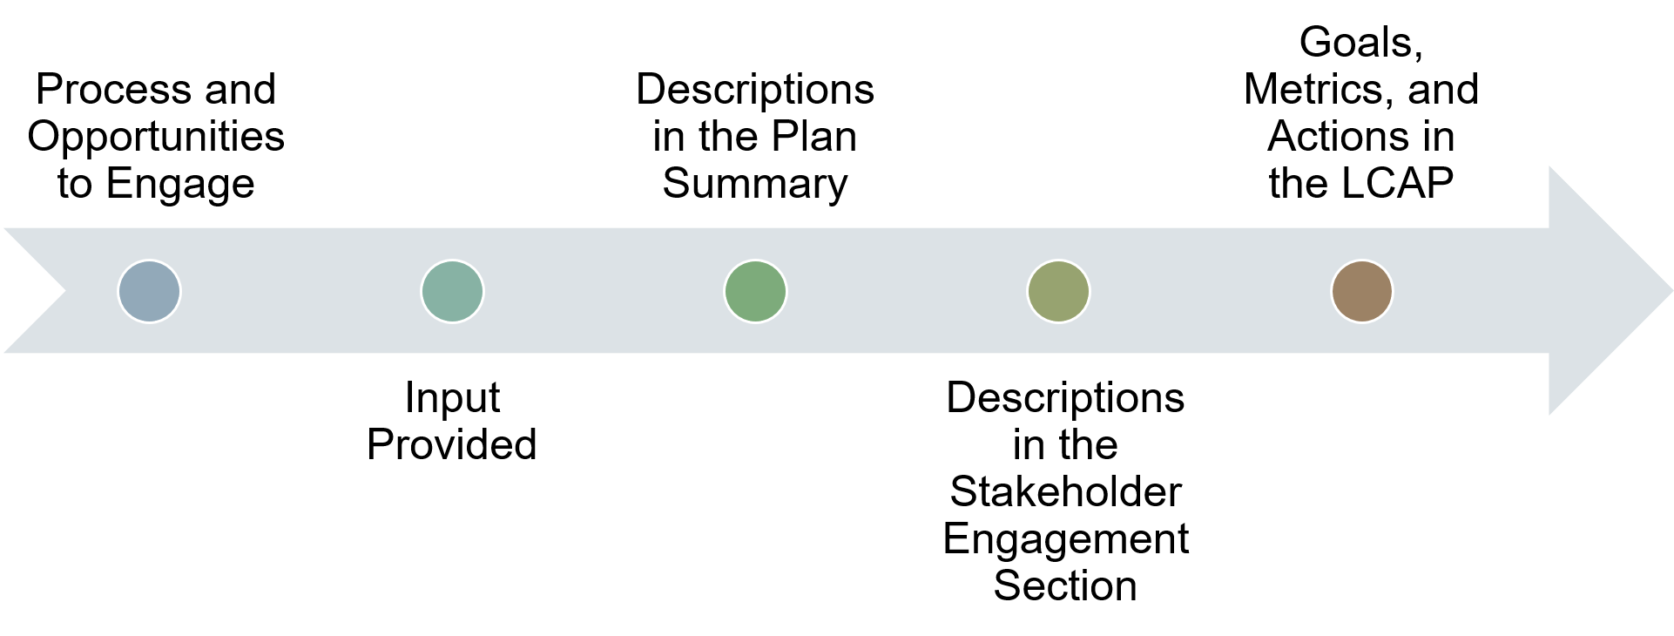
The Through-line
*See Addendum 2 for descriptive text

Slide 51
Resources (1)
The following list provides selected resources that LEAs may find useful or informative in engaging stakeholders or when considering their stakeholder engagement strategy.
A District Guide to ESSA and the Importance of Stakeholder Engagement: Participation, Preparation and What Comes Next. Partners for Each and Every Child. Retrieved from http://partnersforeachandeverychild.org/wp-content/uploads/2017/01/P4_District-Guide_12.11.16.pdf
Moving Toward Equity: Stakeholder Engagement Guide, Planning for Engagement with Stakeholders in Designing Educator Equity Plans. December 2014. Retrieved from https://gtlcenter.org/sites/default/files/GTL_Moving_Toward_Equity.pdf

Slide 52
Resources (2)
ESSA Stakeholder Engagement Sessions: Free (or “Freemium”) Technology Options to Enhance Engagement. Retrieved from https://ccsso.org/resource-library/essa-stakeholder-engagement-sessions-free-or-freemium-technology-options-enhance
Partners for Each and Every Child and the Council of Chief State School Officers (CCSSO). 2017. Meaningful Local Engagement Under ESSA: A Handbook for LEA and School Leaders. Retrieved from https://partnersforeachandeverychild.org/wp-content/uploads/2017/08/LEA-and-SL-Handbook_8.10.17.pdf

Slide 53
Resources (3)
California School Boards Association (CSBA). May 2019. Six Essential School Board Roles in LCAP Implementation and Development. Retrieved from https://www.csba.org/-/media/CSBA/Files/GovernanceResources/GovernanceBriefs/2019052019_CSBA-Brief_School-Board-Roles-in-LCAP-Implementation-and-Development.ashx?la=en&rev=5de030cfa072450fa3f30559d2a6fdea
Oregon Department of Education. May 2019. Unlocking Potential: A Tool to Support Ongoing Meaningful Engagement with Stakeholders. Retrieved from https://www.oregon.gov/ode/schools-and-districts/grants/ESEA/IA/Documents/RoadmapforEngagement.pdf

Slide 54
Resources (4)
National Indian Education Association. 2016. Building Relationships with Tribes: A Native Process for ESSA Consultation. Retrieved from https://www.niea.org/s/NIEA-BuildingRelationships-FINAL.pdf
Albert Shanker Institute. 2017. How Relationships Drive School Improvement–And Actionable Data Foster Strong Relationships. Retrieved from http://www.shankerinstitute.org/blog/how-relationships-drive-school-improvement%E2%80%94and-actionable-data-foster-strong-relationships

Slide 55
Resources (5)
Reform Support Network. March 2014. Strategies for Community Engagement in School Turnaround. Retrieved from https://www2.ed.gov/about/inits/ed/implementation-support-unit/tech-assist/strategies-for-community-engagement-in-school-turnaround.pdf
Wood, Lacy and Bauman, Emily. 2017. How Family, School and Community Engagement Can Improve Student Achievement and Influence School Reform, Literature Review. Nellie Mae Education Foundation. Retrieved from https://www.nmefoundation.org/wp-content/uploads/2020/05/Final-Report-Family-Engagement-AIR.pdf

Slide 56
Resources (6)
California Department of Education’s Connecting with Stakeholders web page available at https://www.cde.ca.gov/qs/vi/stakeholders.asp
Berg, Amy, C. Blank, Martin, J and Melaville, Atelia. Community and Family Engagement, Principals Share What Works. Coalition for Community Schools. Retrieved from https://files.eric.ed.gov/fulltext/ED494521.pdf
Culturally and Linguistically Responsive Teaching. Retrieved from https://www.cde.ca.gov/pd/ee/responsiveteaching.asp

Slide 57
Resources (7)
How Stakeholder Engagement Fuels Improvement Efforts in Three California School Districts. Retrieved from https://edpolicyinca.org/sites/default/files/LCFF_RC_engagement%20cases.pdf
CCSSO Principles of Effective School Improvement Systems. Retrieved from https://ccsso.org/sites/default/files/2017-10/CCSSOPrinciplesofEffectiveSchoolImprovementSystems06212017_0.pdf

Slide 58
Resources (8)
Connecting Commitments, Principles, and Practices to Strategically Address Equity and Improvement. Retrieved from https://ccsso.org/sites/default/files/2019-12/Connecting%20Commitments%20Principles%20and%20Practices%20to%20Strategically%20Address%20Equity%20and%20Improvement%202019.pdf

Slide 59
Upcoming Webinars
Tuesdays @ 2
Thursdays @ 3
2/2: LCAP and Annual Update Templates and Instructions for the 2021-22 School Year
2/9: Developing Focus Goals and Maintenance Goals for the LCAP
1/28: Data and the LCAP
2/4: Developing Broad Goals for the LCAP
2/11: The CA School Dashboard Local Indicator Process for 2021-22

Slide 60
Questions
If you have any questions, please contact the Local Agency Systems Support Office at LCFF@cde.ca.gov
Tuesdays @ 2 webpage: https://www.cde.ca.gov/fg/aa/lc/tuesdaysat2.asp

Slide 61
Addendum 1
Process diagram of 4 light green rectangles stacked vertically labeled with Consultation, Advisory Committees (Districts and COEs), Review of School Plans (Districts and COEs), and Consult with SELPA (Districts and COEs). Then 3 rectangles (colored dark blue, dark brown, and fuchsia) linked vertically to the right of the initial 4 rectangles, are labeled as follows: Public Hearing (Input), Public Meeting (Adoption), and Adopted LCAP.

Slide 62
Addendum 2
A large arrow pointing from left to right with 5 colored circles (blue, aqua green, green, olive green, and brown) in the middle that illustrates how the process should be implemented in chronological order. First is “Process and Opportunities to Engage”. Second dot is “Input Provided”. Third dot is “Descriptions in the Plan Summary”. Fourth dot is “Descriptions in the Stakeholder Engagement Section”. Fifth dot is “Goals, Metrics, and Actions in the LCAP”.

