Slide 1
Local Food for Schools (LFS) Funding Overview
March 15, 2023
California Department of Education
Nutrition Services Division

Slide 2
Webinar Overview
Purpose of Funds
Eligible School Food Authorities (SFA)
Funding Overview
Requirements for Accepting Funds
Commonly Asked Questions
Attestation / Opt-In Process Overview
Funding Timeline

Slide 3
Purpose of Funds
Assist SFAs in accessing nutritious foods for lunch and breakfast meals
Enhance efforts to strengthen local and regional food supply chains
Purchase from socially disadvantaged farmers and ranchers and small businesses

Slide 4
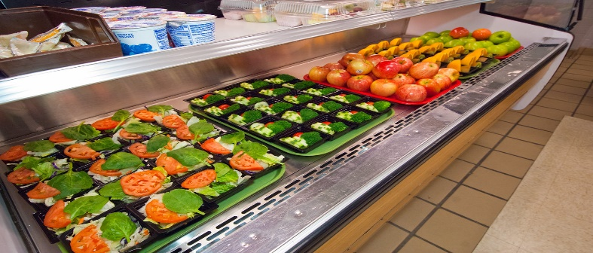
Eligible SFAs
SFAs that currently operate the National School Lunch Program (NSLP) or School Breakfast Program (SBP)
All sponsor types are eligible

Slide 5
Funding Overview (1)
Can only use funds to purchase unprocessed or minimally processed, local, regional, or California grown and produced food products
Funds are voluntary; you can accept or opt out

Slide 6
Funding Overview (2)
California received $23,071,364
Allocations based on a predetermined formula:
-Base payment of $5,000
-Proportional amount based on each SFA’s share of statewide student enrollment
Enrollment data from October 2021 will be used

Slide 7
Calculation Example
Total funds: $23,071,364
SFA Payments = base payment ($5k) + enrollment-based payment
Enrollment-based payment: SFA share of statewide enrollment

Slide 8
Disbursement of Funds
80 percent of funds as advance payment
20 percent of funds as a reimbursement

Slide 9
Examples of Allowable Expenses (1)
Fluid milk
Yogurt
Cheese
Eggs
Fruits
Vegetables
Pastas
Rice
Meats and Poultry
Beans and legumes

Slide 10
Examples of Allowable Expenses (2)
Allowable Processing States:
Whole, cut, pureed
Fresh, frozen, canned, dried

Slide 11
Examples of Unallowable Expenses
Breads
Muffins
Crackers
Pre-packaged sandwiches
Pre-packaged meals
Prepared/pre-cooked items
Nondomestic items
Labor
Supplies
Administrative costs
Past expenditures
Food items for meals outside of the NSLP/SBP

Slide 12
Opt-In Process
Two Part Opt-In Process
Part One: Attestation Statement
Part Two: Procurement Documentation

Slide 13
Attestation Statement Overview (1)
Must complete the online Attestation Statement to receive funding no later than March 31, 2023
Attestation statement is now available at: https://surveys3.cde.ca.gov/go/lfsattestationform.asp
Nonresponses or un-submitted surveys will be considered an opt out
Attestations will not be accepted past the posted deadline.

Slide 14
Attestation Statement Overview (2)
You understand and commit to using these funds as intended­
You will not use the funds for any labor, indirect, or other administrative expenses
You will comply with all existing recordkeeping and review requirements
You will comply with all applicable federal procurement and financial management requirements
You will report all purchasing data to the California Department of Education (CDE) when requested

Slide 15
Attestation Statement Overview (3)
Provide current purchasing data for unprocessed or minimally processed foods
local, small, and/or socially disadvantaged vendors
Indicate if assistance is needed to connect with local, small, and/or socially disadvantaged vendors
State if additional LFS funds could be utilized, if available

Slide 16
Opt-In Process – Part Two: Procurement Documentation
Procurement documents
Established purchasing schedule

Slide 17
Farm to School Connections
California Department of Food and Agriculture (CDFA) Farm to School Network has new regional staff to support local food procurement
Create connections with local farmers, ranchers, and vendors, especially small farms and socially disadvantaged food producers
Help local farms meet school food standards and requirements
Organize additional educational opportunities
Contact cafarmtoschool@cdfa.ca.gov

Slide 18
Reporting
Name of vendors, dollar value awarded to vendors and type of food purchased
Number of small businesses, dollar value of purchases, and type of food purchased
Number of socially disadvantaged farmers/producers, dollar value of purchases, and type of food purchased

Slide 19
Commonly Asked Questions (1)
Where should the LFS funds be deposited?
Nonprofit school food service account
What are the LFS funds tracking requirements?
Documentation to support purchases, consistent with record-keeping requirements
What is the standardized account code structure Resource Code?
– Resource Code 5467

Slide 20
Commonly Asked Questions (2)
How will the CDE monitor SFA use of the LFS funds?
Submission of procurement documents
Established purchasing schedule
Quarterly progress reports
Food purchased
Value of food purchases
Type of vendor

Slide 21
Commonly Asked Questions (3)
What programs can we support with LFS funds?
Only the NSLP and SBP can be supported by LFS funds
Do SFAs have to accept the LFS funds?
No. SFAs can decline the funds.

Slide 22
Commonly Asked Questions (4)
When will SFAs be notified about their calculated payments?
Award amounts will be calculated after the attestation statement deadline passes
The CDE anticipates sending notifications in April

Slide 23
Commonly Asked Questions (5)
When will SFAs receive the funds?
Our goal is to distribute the advance payment of LFS funds in August 2023.
Our goal is to distribute the reimbursement payment of LFS funds in April 2024.

Slide 24
Commonly Asked Questions (6)
Can SFAs use LFS funds for existing contracts with suppliers?
–Yes, if the SFA amends the existing purchasing agreement to increase planned purchases to supplement rather than supplant existing food procurement activities.

Slide 25
Commonly Asked Questions (7)
Can SFAs use LFS funds if they utilize contracts to procure vended meals and/or the services of a Food Service Management Company?
–Yes, the SFA may use LFS funds toward the payment of invoices associated with those agreements. The SFA must ensure that such payments include charges for minimally processed domestic foods at least equal to the amount of LFS award.

Slide 26
Commonly Asked Questions (8)
How can I find local vendors and suppliers?
California Department of Food and Agriculture Office of Farm to Fork’s Farm to School Program
https://cafarmtofork.cdfa.ca.gov/CaFarmtoSchoolProgram.htm

Slide 27
Commonly Asked Questions (9)
Who should I contact for procurement related questions?
For general procurement related questions, please visit the CDE Procurement in School Nutrition Programs web page at https://www.cde.ca.gov/ls/nu/sn/fsmcproc.asp
Contact the CDE Procurement Resources Unit by email at SFSCONTRACTS@cde.ca.gov

Slide 28
Funding Timeline
Date | Activity
March 1, 2023 | Attestation statement available
March 31, 2023 | Attestation statement due
April 30, 2023 | SFA notifications of award amount
May 30, 2023 | Procurement documentation due
August 2023 | Advance payments to be released
April 2024 | Reimbursement payments to be released

Slide 29
Questions
Email LFSGrant@cde.ca.gov

Slide 30
Transforming Schools

Slide 31
Thank you!
This institution is an equal opportunity provider.

