Slide 1

Tuesday @ 2
School Nutrition Town Hall
February 27, 2024
California Department of Education
Nutrition Services Division

Slide 2

Town Hall At-A-Glance
Celebrations
District Spotlights
State and Federal Updates
Operational Reminders
Funding Updates
Important Dates
Resources & Other Announcements

Slide 3

Celebrate National Nutrition Month 2024
Theme: Beyond the Table
Resources: National Nutrition Month web page at eatright.org

Slide 4

National School Breakfast Week (NSBW)
NSBW: March 4-8, 2024
Theme: Surf’s Up with School Breakfast
Resources: School Nutrition Association’s Nation School Breakfast Week web page
Social Media: #NSBW24

Slide 5
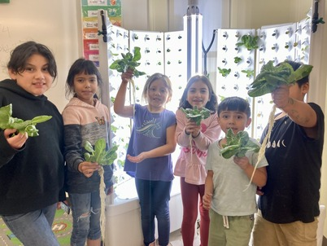
In the News: Farm to School
Heaven's Windows in San Diego is serving up local foods at after-school and summer meal sites.
The agency serves summer and after-school meals at apartments, recreation clubs, the library, and for the Campo Band of Mission Indians.
Features all three elements of Farm to School: Local Foods, Education, and Gardening.

Slide 6
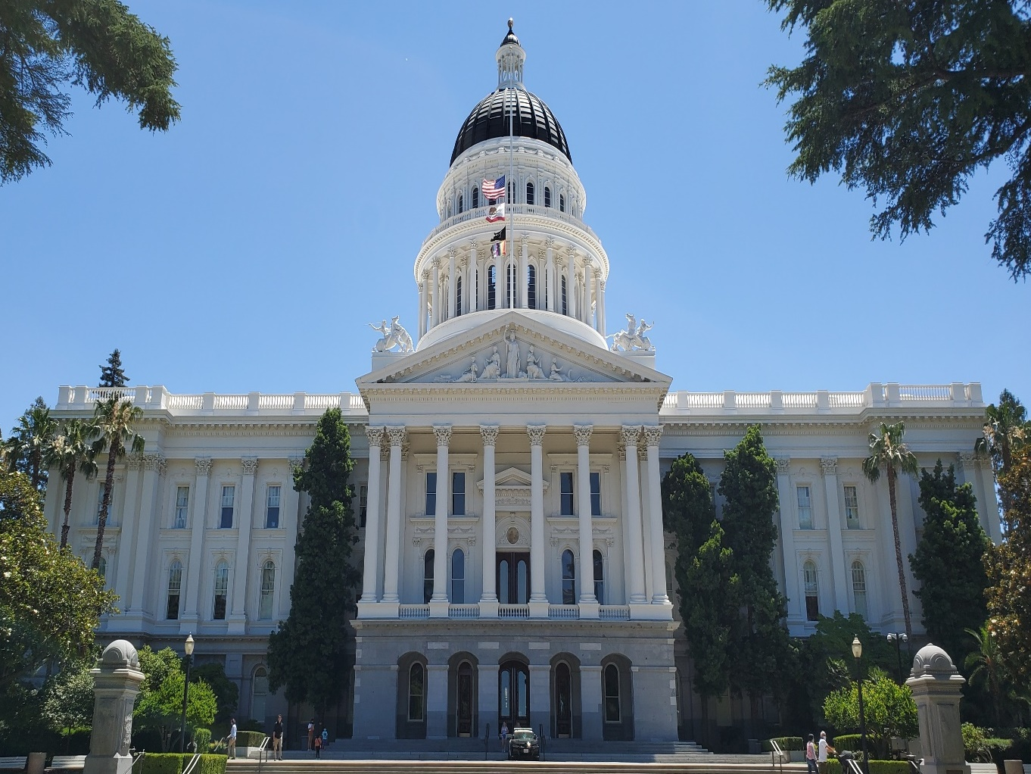
State Updates

Slide 7
Kitchen Infrastructure and Training (KIT) Freshly Prepared Onsite Meals
Preferred approach: fresh raw whole ingredients are integrated with the ready-made product at the point of service.
Accommodations for short staffing: fresh, raw, whole ingredients can be served alongside the ready-made product (pre-cupped, etc.) and made available in the service area (such as on a salad bar or self-serve line) and promoted at the point of service through signage and verbal cues.

Slide 8
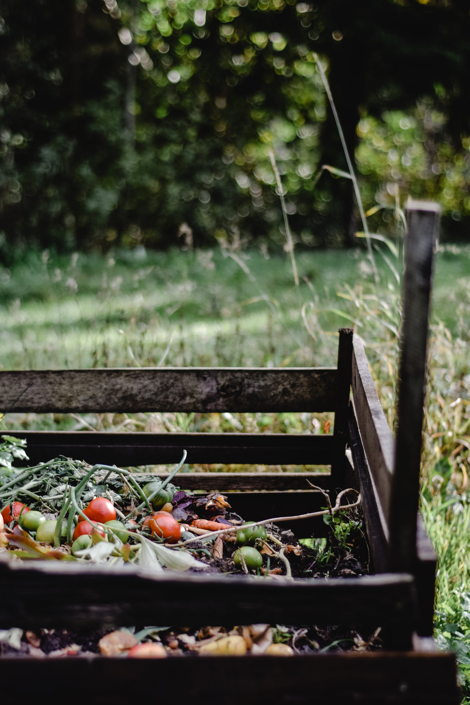
Senate Bill (SB) 1383 Short-Lived Climate Pollutants: Organic Waste Methane Emissions Reduction Requirements
Kindergarten through Grade 12 (K-12) public school districts, charter schools, and county offices of education are required to recycle organic waste either by subscribing to service or self-haul/back-haul, and
K-12 public school district sites with an on-site food facility are required to recover edible food.

Slide 9
In Review: SB 1383
Implementation FAQ–Vended Meals
If our sites use vended meals and generates very minimal waste, are we still required to donate the excess edible food to a food recovery organization or can we just compost the remaining daily meals?
Answer:
All excess food must be recovered for human consumption.
If waste is minimal, be sure to document as proof for any facility inspections related to this California law.
In the event excess food is available to donate, be sure to establish a relationship with a food recovery organization.

Slide 10
In Review: SB 1383 Implementation
FAQ–Saturday School
Does this law extend to Saturday School as well?
Answer:
Yes, waste recovery requirements apply to organic waste and recyclables generated at an onsite food facility on all operating days.

Slide 11
In Review: SB 1383 Implementation FAQ–
Food Donation
Where can excess edible food be donated?
Answer:
Excess edible food and meals may be donated to another Child Nutrition Program (CNP) or a charitable nonprofit organization, such as a food bank.
Food may not be directly sent home with children or families.
Share tables may be used to redistribute excess edible food to children during meal service.

Slide 12
In Review: SB 1383 Implementation FAQ–
Food Donation Resources
Guidance on the Food Donation Program in CNPs, U.S. Department of Agriculture (USDA) web page https://www.fns.usda.gov/cn/guidance-food-donation-program-child-nutrition-programs
Leftover Food Donation in the School Nutrition Programs (SNP), California Department of Education (CDE) web page https://www.cde.ca.gov/ls/nu/leftoverfooddonationsnp.asp

Slide 13
In Review: SB 1383 Implementation FAQ–
Funding (1)
Can we use KIT Funds to help with organic waste and other specific requirements of this law?
Answer:
Yes, KIT funds can be used to purchase a composter to support increased use of fresh foods in school meals. This composter may also assist with management of organic waste.

Slide 14
In Review: SB 1383 Implementation Questions–
Funding (2)
Can cafeteria funds be used to purchase trash cans and/or composting bins for this purpose?
Answer:
Yes, trash cans and composting bins are an allowable cost for cafeteria funds in support of school nutrition only.
Waste and composting disposal service expenses are not allowable. Such expenses, are usually paid for with indirect costs and are subject to consistent treatment across programs.

Slide 15
CalRecycle Local Educational Agency Resources
Access CalRecycle's SB 1383 Local Educational Agency (LEA) presentation and other resources on the CalRecycle Resources for LEA: K-12 Public Schools and School District web page at https://calrecycle.ca.gov/organics/slcp/schools/.
Contact CalRecycle staff at Schools@calrecycle.ca.gov.

Slide 16
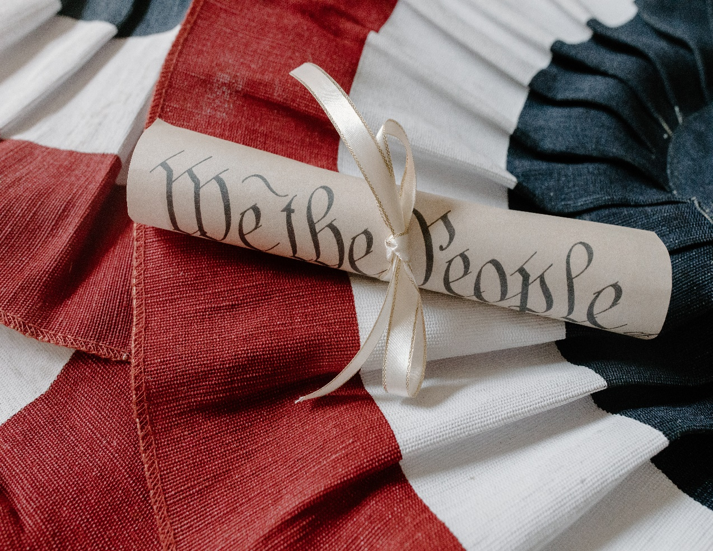
Federal Updates

Slide 17
Summer Interim Final Rule
The Consolidated Appropriations Act, 2023 amended the National School Lunch Act to establish:
Permanent, rural non-congregate meal service through the Summer Food Service Program (SFSP) and Seamless Summer Option (SSO).
Permanent, new program, Summer Electronic Benefits Transfer (EBT).
Comments accepted through April 29, 2024.

Slide 18
Rural Non-congregate
The definition of rural is expanded to include multiple datasets.
Operators provide non-congregate meals in areas that meet the USDA’s definition of rural.
Additional USDA Policy Memos are expected and then a CDE Management Bulletin will follow.

Slide 19
Summer Meal Applications
SFSP Application window planned to open on April 2, 2024.
HOLD SSO Site Applications.

Slide 20
Summer EBT
Pending USDA approval for Summer 2024.
Benefits: New Summer EBT card with $120.
Benefit Distribution:
  Children eligible during the school year will receive benefits between June 3rd and June 30th.
  Newly eligible students will receive benefits over the summer period.
  All benefits will be distributed by October 15th.

Slide 21
Summer EBT–Individual Student Determination (1)
Automatic determination for children:
Approach #1
Age 6–18 and enrolled in CalFresh, CalWORKs, or income eligible through Medi-Cal.

Slide 22
Summer EBT–Individual Student Determination (2)
Automatic determination for children:
Approach #2
Up to age 22, and enrolled in a school participating in the National School Lunch Program and/or the School Breakfast Program (SBP)
AND
Determined eligible during the 2023–24 school year (SY) or 2024 summer period for free or reduced-price meals through a meal application, alternative income form, local direct certification, or designation as homeless, migrant, or foster.

Slide 23
Summer EBT–Provision Schools
Note: 2024 Summer EBT has different eligibility requirements for Provision schools than Pandemic EBT
Children attending Community Eligibility Provision (CEP) or Provision schools:
Will not all be issued benefits (different from P-EBT)
Must have individual eligibility through direct certification or alternative income form

Slide 24
Summer EBT–School Food Authority Support (1)
School food authorities (SFA) are encouraged to assist with the following:
Support Summer EBT access to homeless children by distributing cards that are mailed to school or school district addresses.
Request that households update their address.
  Address updates should be completed in the California Longitudinal Pupil Achievement Data System (CALPADS) no later than March 29, 2024, for June issuance.

Slide 25
Summer EBT–SFA Support (2)
SFAs are encouraged to assist with:
Making meal applications or alternative income forms available during Summer
Routinely updating CALPADS. CALPADS administrators will be sent a CALPADS flash communication about how regular updates can support household access to Summer EBT
Notify households about Summer EBT
  Notification resources and listserv forthcoming

Slide 26
Summer EBT–Questions
The California Department of Social Services will have a customer service helpline and website to assist households with questions (coming soon).
We will share this information when available.
For SFA questions, please reach out to SummerEBT@cde.ca.gov.
  NOTE: This email address is not for household inquiries.

Slide 27
Sample Procurement Procedures: Updated
Updates include recent policy changes:
Buy American
California grown foods
Micropurchase threshold
Termination
Final rule
Other certifications
Child Nutrition Information and Payment System (CNIPS) Download Forms, Form ID: PRU-08b
Please update your procedures to ensure they align with current regulations and state laws

Slide 28
Federal Micropurchase and Small Purchase Threshold CNP 01-2024 (1)
Micropurchases:
Should distribute equitably among qualified suppliers
May award without soliciting competitive price or rate quotations, if:
  The price is determined to be reasonable based on research, experience, purchase history, or other information
  Purchases are documented

Slide 29
Federal Micropurchase and Small Purchase Threshold CNP 01-2024 (2)
Micropurchase threshold increased from $10,000 to $50,000 if the SFA meets the following:
  Annual, documented self-certification, including threshold, and justification
  Determined a low-risk auditee
  Performs an annual risk assessment to identify, mitigate, and manage financial risks
  Higher threshold is consistent with state law

Slide 30
Updated: Unpaid Meal Charge Policy and Excess Account Balance
Revised Management Bulletin SNP-04-2023
Aligns with amendments to California Education Code 49557.5
Prohibits disciplinary measures against students that result in the denial or delay of a breakfast or lunch
SFAs may not take actions if a student reaches a negative balance
Reminder: for all Universal Meals Program, Provision 2, or CEP sites, unpaid meal charge policy requirements do not apply. No meal charge policy is required.

Slide 31
Nonprogram Food–Consolidated Guidance
Updated Management Bulletin SNP-03-2024
  Nonprogram food and revenue requirements
  SFA compliance monitoring
  Unique situations
  Catering and vending requirements
  State agency monitoring
Establishes an SFA monitoring reference period of no less than ten (10) consecutive days

Slide 32
USDA Foods SY 2024–25 Estimated Entitlement
The estimated per meal rate for SY 2024–25 is $0.45 cents.
Entitlement is based on actual SY 2022–23 lunches.
The effective rate will be updated in July when the actual per meal rate is published in the Federal Register.

Slide 33
USDA Foods Ordering and Timelines for SY 2024–25
Preplanner and Surveys are due March 1, 2024.
The Food Distribution Program (FDP) uses your orders to compile truckload quantities and finalize orders to the USDA.
Questions can be emailed to FoodDistribution@cde.ca.gov.

Slide 34
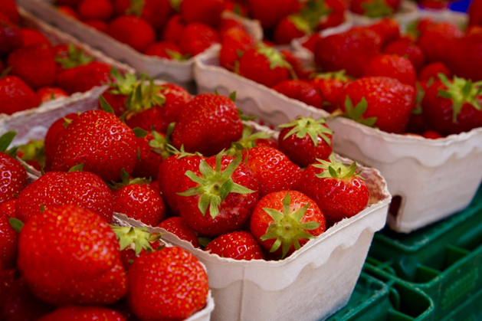
Department of Defense Fresh Entitlement
Reminder to use your entitlement in Fresh Fruit and Vegetables Order Receipt System (FFAVORS) by May 1st

Slide 35
Important Operational Dates:
Next 30 to 60 days
Action | Date
USDA Foods Pre-Planner Survey | March 1, 2024
Second Review of Meal Applications Report due in CNIPS–only SFAs who received the listserv | March 1, 2024
Deadline to update mailing addresses in CALPADS for Summer EBT benefits | March 29, 2024 (revised)

Slide 36
Meal Reimbursement
Claim Deadlines
Claim Month | Submission Deadline
December 2023 | Thursday, February 29, 2024
January 2024 | Monday, April 1, 2024
February 2024 | Monday, April 29, 2024

Slide 37

Funding Updates

Slide 38

Local Food for Schools
Expected Allocation Release: March 2024
Expenditure Deadline: June 30, 2024
Allowable Expenditures beginning March 31, 2023, may be applied to Local Food for Schools (LFS) funds once received

Slide 39
Commercial Dishwasher Competitive Grant–Tentative Timeline
Expected Release: March 2024
Deadline: Four weeks from release
Per site award up to $40,000
Maximum five (5) sites per SFA for $200,000
Questions: cdg@cde.ca.gov

Slide 40

2024 SBP and Summer Meal Programs Start-up and Expansion Grants
Applications open now
$1.017 Million available
$15,000 per school site
Applications due no later than 4 p.m. on March 1, 2024

Slide 41
Grant Funds Overview (1)
Grant | Timeline
LFS funding disbursed | March 2024 (revised date)
2024–25 Fresh Fruit and Vegetable Program (FFVP) Request for Application (RFA) released | March 1, 2024 (revised date)
Supply Chain Assistance funds disbursed (round four) | March 2024 (revised date)

Slide 42
Grant Funds Overview (2)
Grant | Timeline
SBP and Summer Meal Programs Startup and Expansion Grant application due | March 1, 2024
CDG RFA tentative release | March 2024
FFVP RFA application due | April 1, 2024

Slide 43
Grant Opportunity: Serving Rural Communities by Providing
Non-Congregate Feeding Models
No Kid Hungry (NKH) California is offering grants to schools and community organizations providing non-congregate feeding models in rural communities as part of the SFSP or SSO.
Grant award: $10,000 to 15,000.
Prioritization is provided for certain communities in California.
Inquiry forms are open until March 1, 2024.
Contact NKH California with questions by email at NoKidHungryCA@strength.org.

Slide 44
Farm to School Incubator Grants for 2023–24
The California Department of Food and Agriculture is accepting applications for its Incubator Grants.
Funding tracks: Schools, Early Care and Education, Technical Assistance for Schools and Producers.
Applications Due: April 4, 2024.
Total Funding: $52 million.
Focus: cultivating equity, nurturing students, building climate resilience, and creating scalable and sustainable change.

Slide 45

Resources & Other Announcements

Slide 46
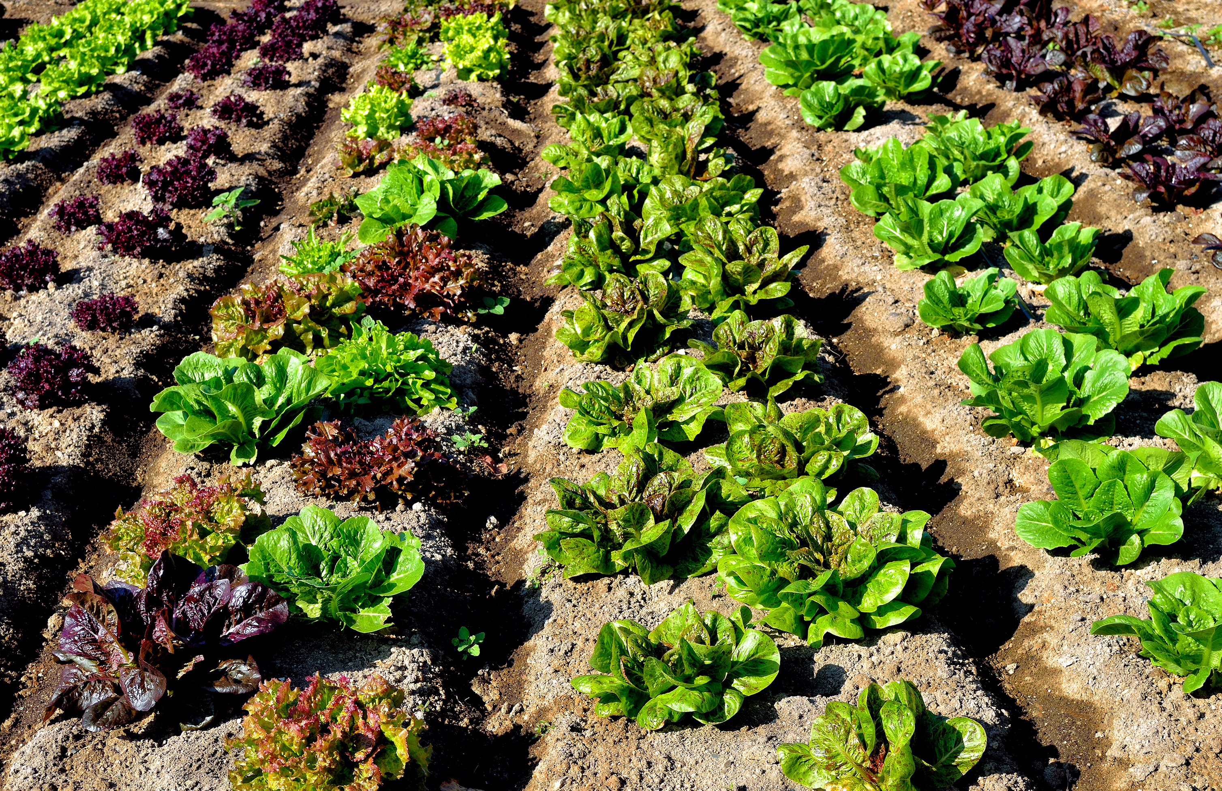
Verifying Farm Food Safety
The USDA has a new webpage for CNP Operators on how to verify a farm's food safety practices, includes:
  Tips for farm visits.
  Explains good agricultural practices, the Food Safety Modernization Act, the Produce Safety Rule, and more.

Slide 47
School Nutrition Department Vacancy Survey
Chef Ann Foundation, Food Insight Group and Urban Institute creating a survey partnership
The survey will help assess school nutrition department:
  Wages, benefits, and staffing models across California
The unique survey link will be sent from Beth Katz to each SFA
Survey begins: Friday, March 1, 2024
Survey ends: Thursday, March 29, 2024
Questions contact: Beth Katz at beth@foodinsightgroup.com

Slide 48
Save the Date
Introduction to School Nutrition Program Administration Training (ISNPA)
Date: July 29-31, 2024
Location: California Endowment, Sacramento
Audience: New Food Service Directors in their positions less than two (2) years

Slide 49

Quick Reference Guides: Updated
Resource to help orient LEAs to the SNPs.
Updated February 2024.
Accessible in CNIPS Download Forms.

Slide 50
Healthy Meals Incentive Overview Webinar
Date: March 6, 2024
Time: 12:30 p.m. - 1:30 p.m.
Overview information about eligibility, application, technical assistance support, and more

Slide 51
Tuesday @ 2pm Town Hall Schedule
Held on the fourth Tuesday of the month
Month | Format | Date
March | State Update | 3/26/24
April | State Update and Guest Speaker | 4/23/24
May | State Update | 5/28/24

Slide 52
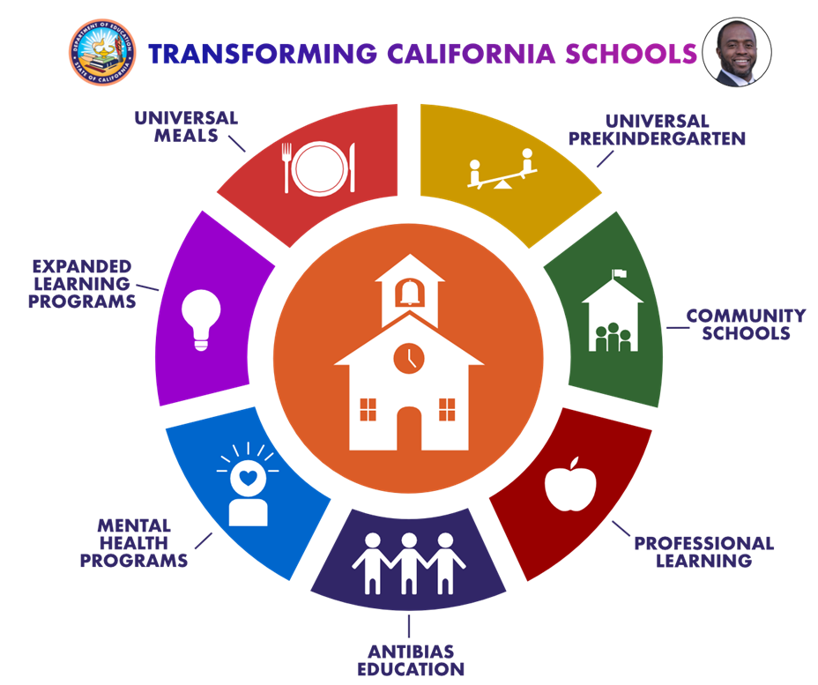
Thank you!
Next Town Hall:
March 26, 2024
This institution is an equal opportunity provider.

