Slide 1

Tuesday @ 2
School Nutrition Town Hall
January 23, 2024
California Department of Education
Nutrition Services Division

Slide 2

Town Hall At-A-Glance
District Spotlights
State and Federal Updates
Guest Speaker
Operational Reminders
Funding Updates
Important Dates
Resources & Other Announcements

Slide 3

The Great Kindness Challenge (GKC)
The GKC week is January 22–26, 2024.
The theme for the 13th Annual GKC Week is Create Kindness.
Sign up for free resources on the GKC website.
Become a Kindness Certified School and receive a GKC certificate and digital GKC badge!

Slide 4
District Spotlight: Sacramento City Unified School District (USD) and the Food Literacy Center
KVIE Public TV Series Inside California Education.
Student field trips to the 1-acre farm; cooking school; fruit and vegetable tastings.
Goal: Get kids to eat their fruits and vegetables.
Students exposed to the program were more likely to pick healthy options!

Slide 5
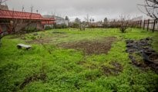

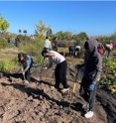
In the News: Farm to School
Piner High School received a School Garden Network grant for garden revitalization.
Over 250 students are now involved in the garden.
Vegetables from the garden are used to support the Harvest of the Month program.

Slide 6
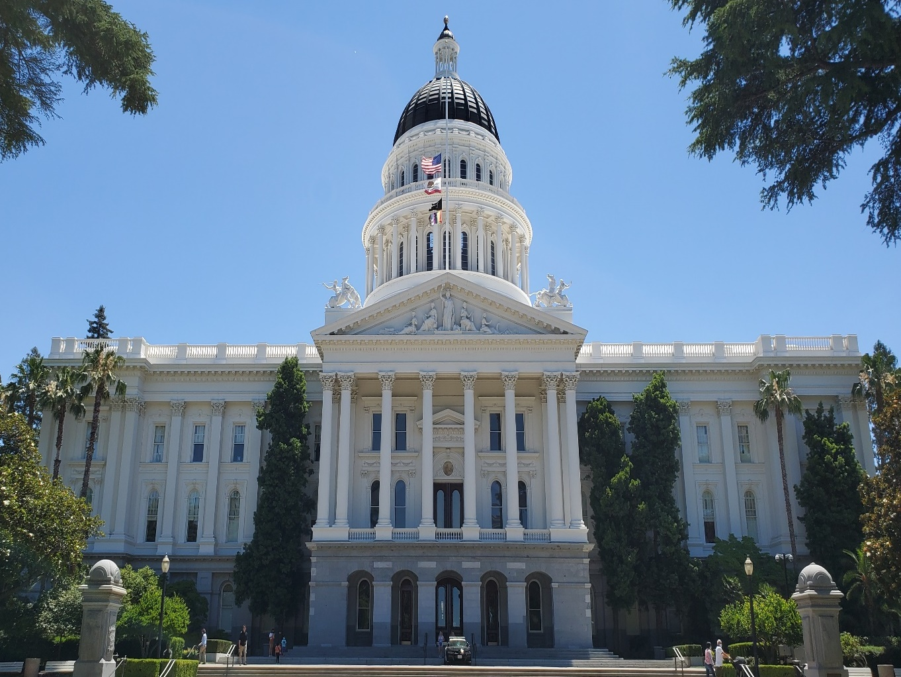
State Updates

Slide 7
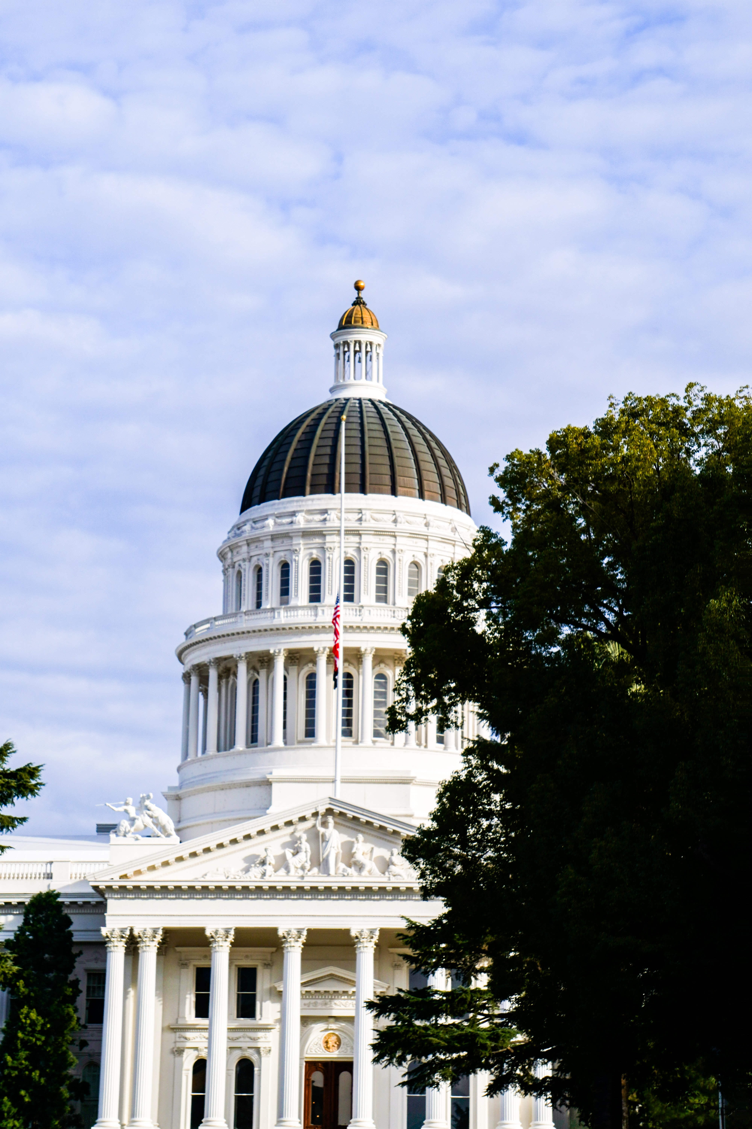
Governor's Proposed Budget
Proposed budget continues a strong commitment to Universal Meals.
The budget allows $1.5 billion to fund Universal Meals.

Slide 8
Buy American Provision
Senate Bill (SB) 490 (1)
Effective January 1, 2024, through January 1, 2029
Applies to local educational agencies (LEA) who receive over $1,000,000 in federal meal reimbursement annually
Requires LEAs to only purchase agricultural food products grown, packaged and processed domestically unless the LEA can document that the domestic:
  Bid or price is 25 percent higher than the non-domestic price
  Quality is inferior
  Product is available in insufficient quantities
Does not apply to contracts already in place on January 1, 2024

Slide 9
Buy American Provision
SB 490 (2)
Process for reporting price gouging
Email NSDBuyAmericanProvision@cde.ca.gov
Including the following information:
  Contractor/Vendor
  Agriculture food produce
  Original/Current Price
  New/Proposed Price (increase must be 25 percent or more)
  Supporting documentation (may include, but is not limited to invoices, receipts, or bill of sale)

Slide 10
Senate Bill 348: Pupil Meals
(Universal Meals)
Education Code 49501.5 requires two meals (one breakfast and one lunch) be made available on site for all school days, including shortened/minimum days.
The California Department of Education (CDE) is required to submit a waiver request for non-congregate meals for shortened school days.
CDE submitted the request for School Year (SY) 2023–24 to U.S. Department of Agriculture (USDA) and it was denied.

Slide 11
Senate Bill 1383 Short-Lived Climate Pollutants: Organic Waste Methane Emissions Reduction (1)
Current:
Effective January 1, 2022, Kindergarten through Grade 12 (K-12) public school districts, charter schools, and county offices of education are required to recycle organic waste either by subscribing to service or self-haul/back-haul.
As of January 1, 2024:
K-12 public school district sites with an on-site food facility are required to recover edible food.

Slide 12
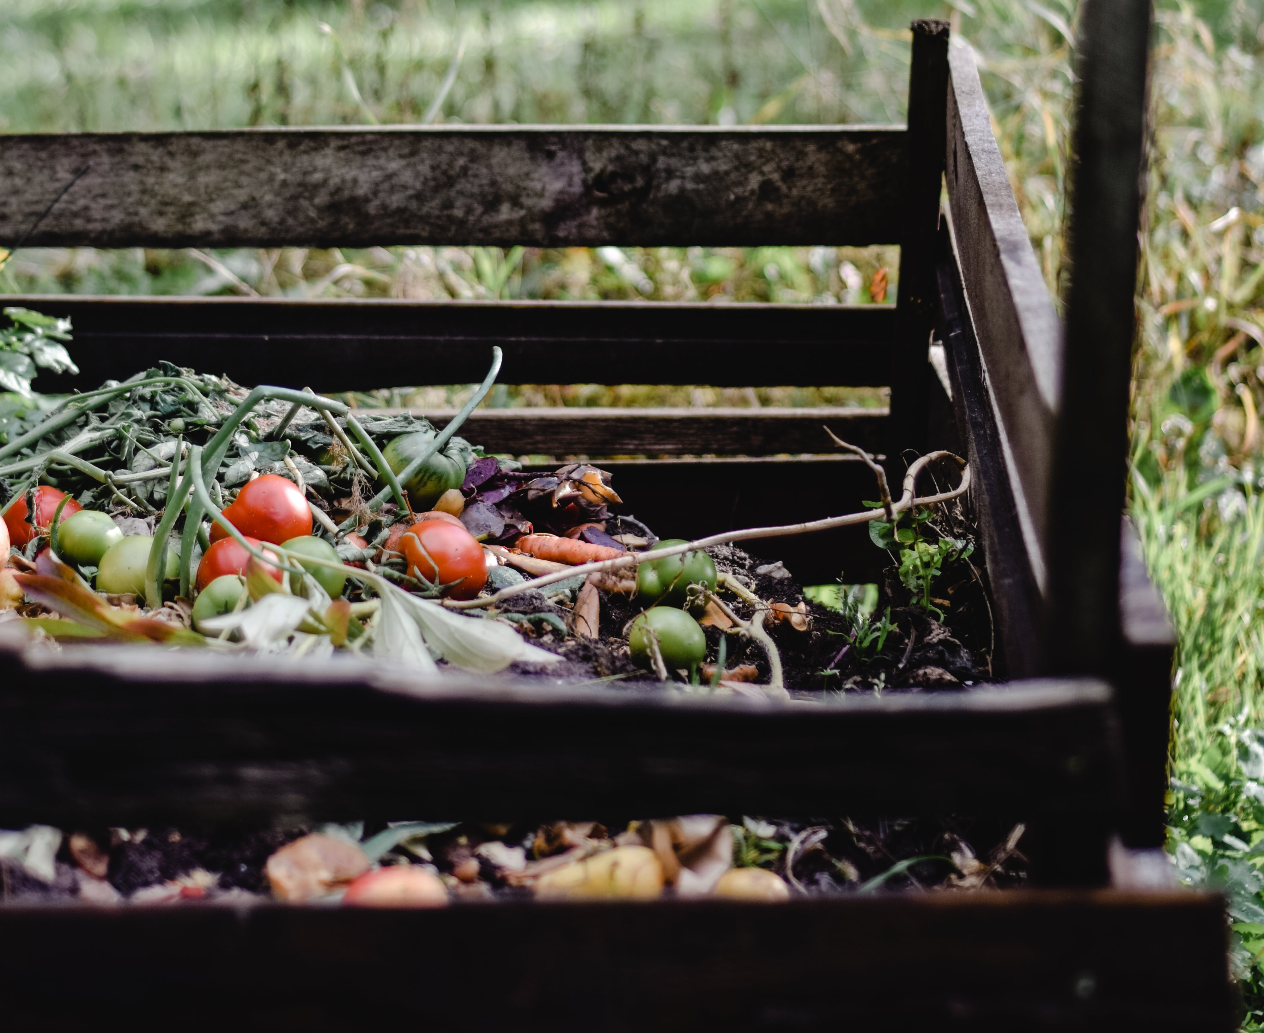
Senate Bill 1383 Short-Lived Climate Pollutants: Organic Waste Methane Emissions Reduction (2)
Michelle Cevallos
Senior Environmental Scientist
Local Assistance and Market Development Team
CalRecycle
Contact: Schools@calrecycle.ca.gov

Slide 13
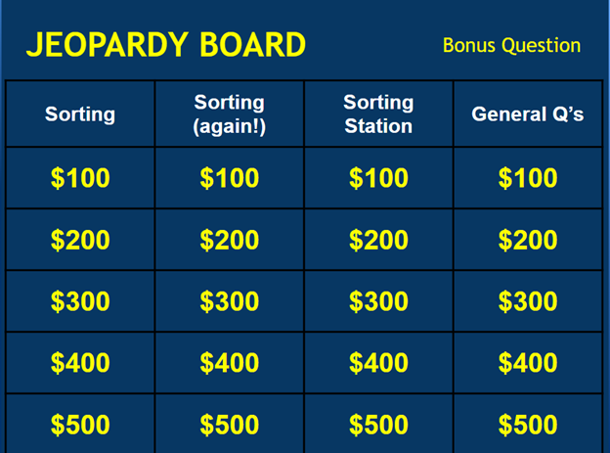
Oakland Unified School District (OUSD)
Waste Sorting Resources
Check out OUSD's Waste Sorting Resources, available at https://www.ousd.org/facilities-planning-management-department/about/sustainability/what-we-do/waste-reduction
OUSD Waste Sorting Video
Waste Sorting Jeopardy

Slide 14

Federal Updates

Slide 15
Summer Interim Final Rule (IFR)
The Consolidated Appropriations Act, 2023 amended the National School Lunch Act to establish:
Permanent, rural non-congregate meal service through the Summer Food Service Program (SFSP) and Seamless Summer Option (SSO).
Permanent, new program, Summer Electronic Benefits Transfer (EBT)
Comments accepted through April 29, 2024

Slide 16
Rural Non-congregate
The definition of rural is expanded to include multiple datasets.
Operators with plans may provide non-congregate meals in areas that meet the USDA definition of rural.
Additional USDA Policy Memos are expected and then a CDE Management Bulletin will follow.

Slide 17
Summer Food Service Program Rate Increase
Average 5.3 percent increase from 2023
Rates applicable 1/1/24 - 12/31/24
Meal Type | Rural or Self Prep | All other site types
Breakfast | $2.9775 | $2.9225
Lunch or Supper | $5.2125 | $5.1300
Snacks | $1.2350 | $1.2050

Slide 18
Summer EBT
Administered in partnership with the California Department of Social Services
Purpose: to provide benefits to purchase groceries to reduce hunger and nutrition insecurity during the Summer
Timeline: Beginning Summer 2024
Benefits: $120 per eligible child
Benefit Distribution: Majority of eligible children will receive benefits by June 1st

Slide 19
Summer EBT – 2024
Automatic Eligibility
Age 6–18 and enrolled in CalFresh, CalWORKS, or Medi-Cal
OR
2. Enrolled in a school participating in National School Lunch Program (NSLP)/School Breakfast Program (SBP)
AND
  Determined eligible during preceding school year or summer period for free or reduced-price meals through meal application, alternative income form, local direct certification, or designation as homeless, migrant, or foster

Slide 20
Summer EBT – Issuance
Summer 2024: No separate EBT application
  Benefits will be sent automatically to children enrolled in CalFresh, Medi-Cal, CalWORKS, or have a free and reduced-price designation in the CDE California Longitudinal Pupil Achievement Data System (CALPADS)
Determined newly eligible during Summer period June 1–August 31
Additional communications forthcoming

Slide 21
2024 Summer EBT – Challenges
Current mailing addresses are required for families.
Provision and Community Eligibility Provision (CEP) school children are NOT automatically eligible - these students must have eligibility through alternative income form or other designation.
Summer EBT may change in the future.

Slide 22
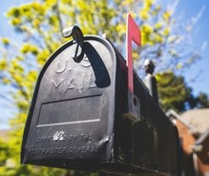
Summer EBT –
School Food Authority (SFA) Support
  Request updated mailing addresses from families
  Contact information is pulled from CALPADS on March 15th and routinely thereafter
  Make meal applications and/or alternative income forms available during Summer and routinely update CALPADS

Slide 23
USDA Policy Memo SP 03-2024,
Child Nutrition Program Integrity Final Rule: Administrative Review (AR) and
Food Service Management Company (FSMC) Review Cycles (1)
Released 12/1/23
AR Cycle: CDE is currently operating under a 5-year AR cycle waiver through SY 2027–28

Slide 24
USDA Policy Memo SP 03-2024,
Child Nutrition Program Integrity Final Rule: AR FSMC Review Cycles (2)
FSMC Reviews:
    CDE is conducting annual reviews
    Will be requesting contract invoices and review before approving annual extensions

Slide 25
USDA Policy Memo SP 04-2024,
Child Nutrition Program (CNP) IFR: State Agency Discretion for Repeat Meal Pattern Violations Fiscal Action
State Agency Discretion for Repeat Violations of: | Fiscal Action Required:
Food quantities Whole grain-rich foods Milk types Vegetable subgroups Dietary specifications (calories, saturated fat, and trans-fat) | Missing food components Missing production records

Slide 26

2023 Farm to School (F2S) Census
The 2023 F2S Census is now completed!
Thank you to the 699 (53.1 percent) SFAs who completed the F2S Census!
USDA is providing badges for SFAs to use who completed and submitted their 2023 F2S Census.

Slide 27
Survey: 2024 Supply Chain Disruption and Student Participation
USDA survey link will be distributed to SFAs on January 29, 2024
For SY 2023–24: Key challenges related to program administration, finances, and procurement
From noreply@qemailserver.com
Please add the above email address to your approved senders.

Slide 28

Food Ordering and Timelines for SY 2024–25
Preplanner and Surveys
  Distribution date: February 1, 2024
  Due date: March 1, 2024
Forecast and Plan
  What to purchase commercially and how to use USDA Foods Entitlement

Slide 29

Balances at Processors
Check balances at current processors
Review prior year diversions
Determine if excess pounds were
recently swept

Slide 30
USDA Foods Available List (1)
Item Removed
  100443 – Oil, Vegetable – Bulk
  Items Temporarily Removed
  100277 – Orange Juice (70 count/4 oz cartons)
  110651 – Orange Juice (96 count/4 oz cups)
USDA Available Food List for SY 2025
https://www.fns.usda.gov/usda-fis/usda-foods-available

Slide 31
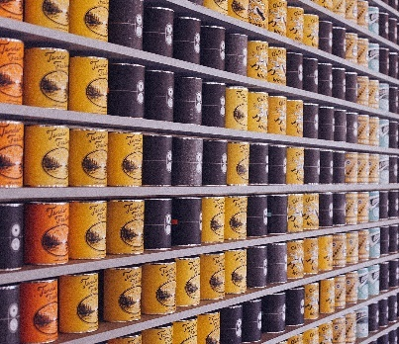
USDA Foods Available List (2)
Items with Specification Changes
  110921 – Chicken, Grilled Fillets
  Truckload Weights & Item Code Changes
  Egg Patties 110931 → Now 111751
  Yogurt Vanilla, 6/32 oz tub 110398 → Now 111750

Slide 32
Important Operational Dates:
Next 30 to 60 days
Action | Date
USDA Foods Pre-Planner Survey | March 1, 2024
Second Review of Meal Applications Report in Child Nutrition Information and Payment System (CNIPS)* – only SFAs who received the listserv | March 1, 2024
Deadline to update mailing addresses in CALPADS for Summer EBT benefits | March 15, 2024

Slide 33

Funding Updates

Slide 34
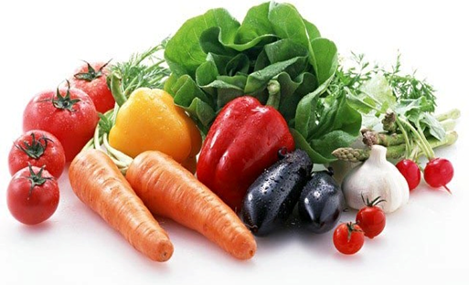
Local Food for Schools (LFS) (1)
Expected Allocation Release: February 2024.
Expenditure Deadline: June 30, 2024.
Allowable Expenditures beginning on March 31, 2023, may be applied to LFS funds once received.

Slide 35
Local Food for Schools (2)
First report of expenditures due: February 14, 2024
Supplier information reported online includes
  Total dollar amount of all purchases, purchases from socially disadvantaged suppliers, and purchases from small businesses
  Number of suppliers and distance to each supplier
Invoice copies for reported purchases must be sent to LFSGrant@cde.ca.gov

Slide 36
Kitchen Infrastructure and Training (KIT) and Composting
Allowable Expense | Unallowable Expense
Composters Training on use of kitchen equipment that supports increased fresh foods in school meals such as a composter | Stand-alone training on composting and recycling

Slide 37
2021 KIT Final Report
The link to access the final report was emailed from surveys@cde.ca.gov on January 9, 2024.
The due date is June 30, 2024.
If you have expended or obligated your full award, you can complete this final report at any time.
Spend down: Review the KIT 2021 web page for allowable cost information prior to emailing the inbox.

Slide 38
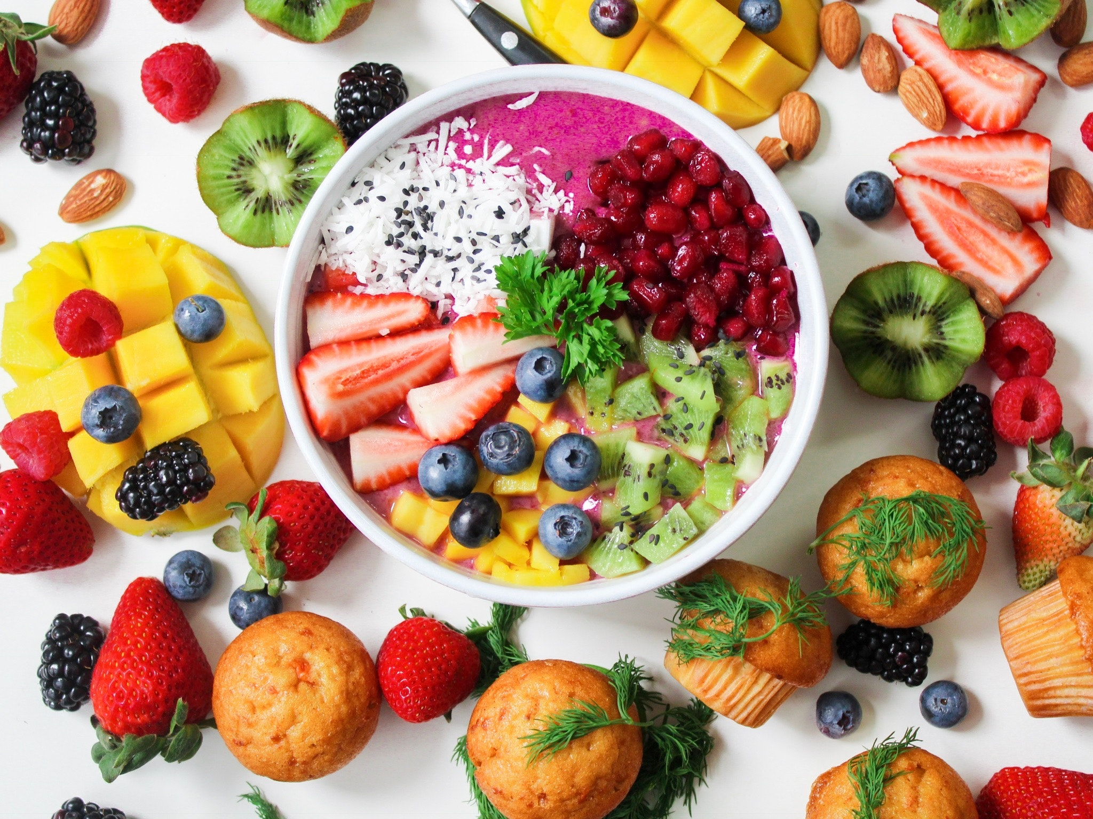
2024 SBP and Summer Meal Programs Start-up and Expansion Grants
Applications open now
$1.017 Million available
$15,000 per school site
Applications due no later than March 1, 2024

Slide 39
Supporting the Use of Traditional
Indigenous Foods in
Child Nutrition Programs (CNP)
Funding: $2 million and up to four organizations
Purpose: Request for Application (RFA) to provide regional training and technical assistance for procuring, preparing, and crediting traditional indigenous foods
Informational webinars: February 8, 2024, 10 am PT and February 13, 2024, 12 pm PT
Letter of intent due: February 19, 2024
Application deadline: March 18, 2024

Slide 40
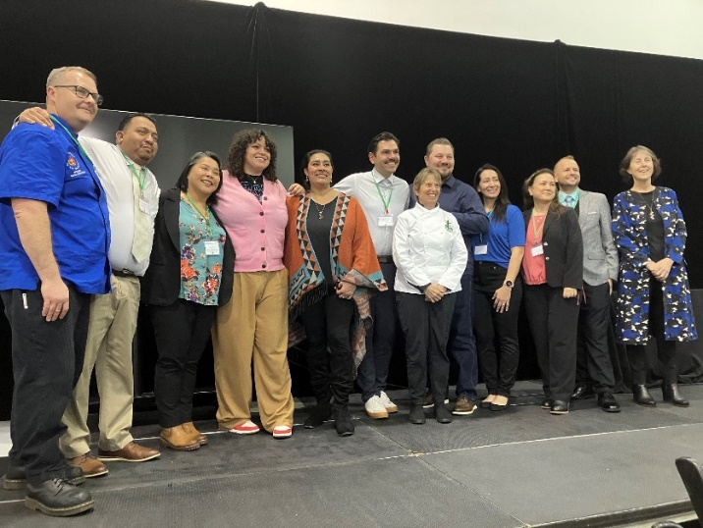
Healthy School Food Pathways
Pre-Apprenticeship
Applications open now
Deadline: February 12, 2024
Seven-week work-based paid learning program emphasizing scratch cooking
Email: pathway@chefannfoundation.org

Slide 41
Grant Funds Overview
Grant | Timeline
LFS funding disbursed | February 2024 (revised date)
2024–25 Fresh Fruit and Vegetable Program RFA released | February 2024 (revised date)
Supply Chain Assistance funds disbursed (round four) | February 2024
LFS Expenditure Report due | February 14, 2024
School Breakfast Startup Grant application due | March 1, 2024

Slide 42

Resources & Other Announcements

Slide 43
Webinar: Safe Practices, Safe Meals, Safe Children: Food Safety Tips for Safe Summer Meals
Date: January 31, 2024
Time: 12 pm – 1:30 pm Pacific Time
Webinar information available on the Safe Practices, Safe Meals, Safe Children: Food Safety Tips for Safe Summer Meals listserv at https://www.cde.ca.gov/ls/nu/smrmlsfoodsafetytips.asp
Registration is not required

Slide 44

National Nutrition Month (NNM) 2024
NNM: The entire month of March
Theme: Beyond the Table
Resources: National Nutrition Month web page at eatright.org

Slide 45

National School Breakfast Week (NSBW)
NSBW: March 4-8, 2024
Theme: Surf’s Up with School Breakfast
Resources: School Nutrition Association’s National School Breakfast Week web page
Social Media: #NSBW24

Slide 46
Child Nutrition Advisory Council (CNAC)
Recruitment (1)
Mission: To advise the SSPI in areas of health, wellness, and nutrition for all students in California’s K-12 public schools.
Positions under recruitment:
  Child Care Food Program Sponsor
  Classroom Teacher
  Curriculum Coordinator
  Food Service Director
  Food Service Supervisor/Manager
  Lay Person
  Nutrition Education Specialist
  Parent–Teacher Association (PTA) or Organization (PTO) Representative

Slide 47
CNAC Recruitment (2)
Three-year term (3-years): January 1, 2024, through December 31, 2026.
Recruitment application is now available on the CNAC web page under Member Application Information at https://www.cde.ca.gov/ls/nu/he/cnac.asp.
Application deadline extended to January 26, 2024.

Slide 48
Tuesday @ 2pm Town Hall Schedule
Held on the fourth Tuesday of the month
Month | Format | Date
February | State Update and Guest Speaker | 2/27/24
March | State Update | 3/26/24
April | State Update and Guest Speaker | 4/23/24

Slide 49
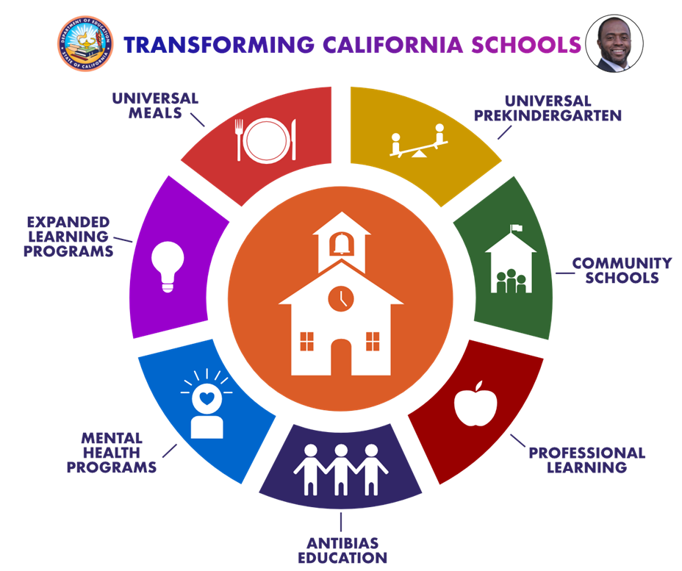
Thank you!
Next Town Hall:
February 27, 2024
This institution is an equal opportunity provider

