Slide 1

Tuesday @ 2
School Nutrition Town Hall
September 24, 2024
California Department of Education
Nutrition Services Division

Slide 2
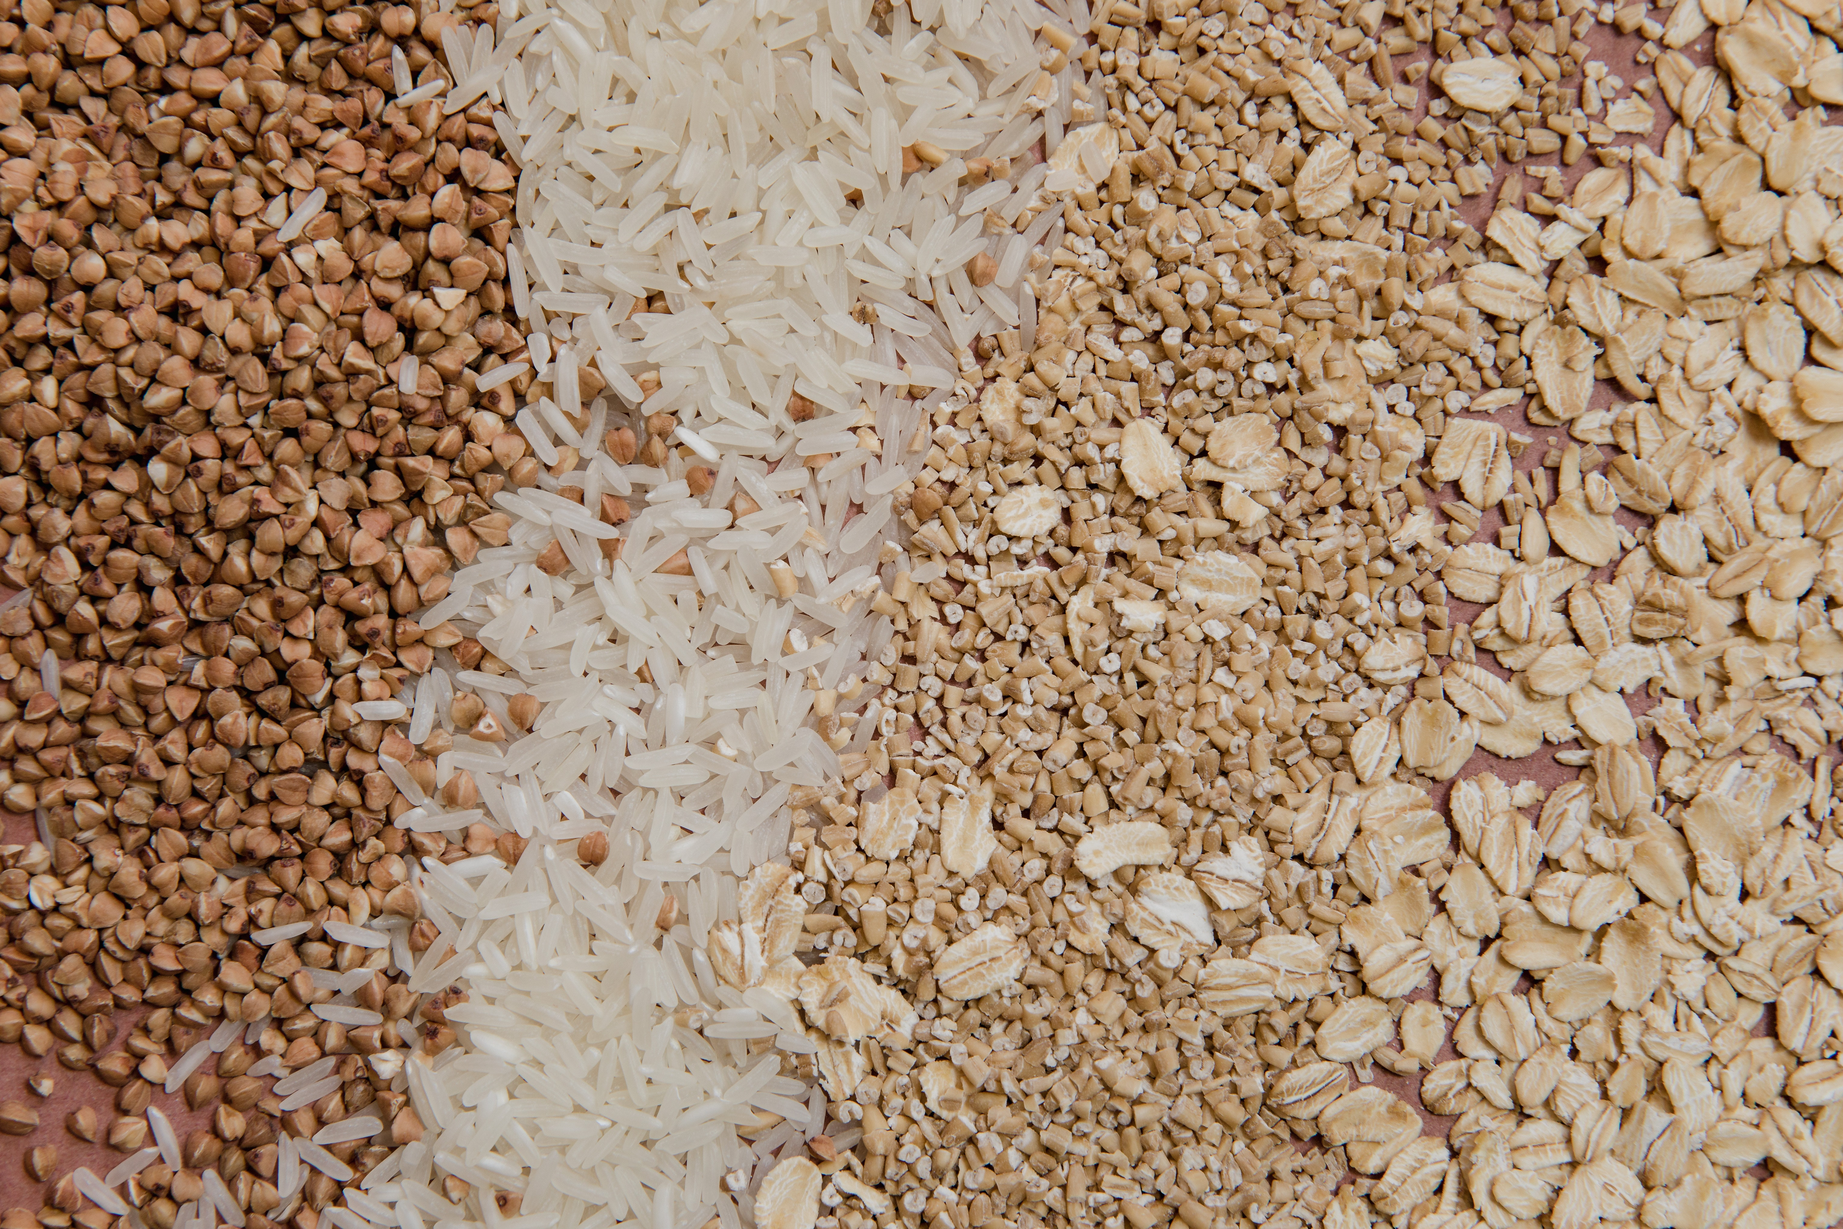
Town Hall at a Glance
District Spotlights & Award Recognition
Federal Updates
State Updates
Reminders
Funding Updates
Other Announcements

Slide 3

District Spotlight: Newman-Crows Landing Unified School District (USD)
Newman-Crows Landing USD is a recipient of the U.S. Department of Agriculture (USDA) Healthy Meals Incentives Breakfast Trailblazer Award; the district successfully reduced added sugars in items at breakfast.
Learn how Newman-Crows USD reduced added sugars at on Team Nutrition's Meal Talk Webinar series web page at https://www.fns.usda.gov/tn/meal-talk-webinar-series.

Slide 4
District Spotlight: Needles USD
The Associated Student Body has started the "Four Guy Review" where four students review new lunch items and post their review on Instagram.
“The Four Guy Review” is one of several ways the district is trying to increase lunch participation.
Check out the Four Guys Review on Instagram at https://www.instagram.com/reel/C_OVtZBxSL9/?igsh=MXY5MXQ1enB4cjZxMg==.

Slide 5
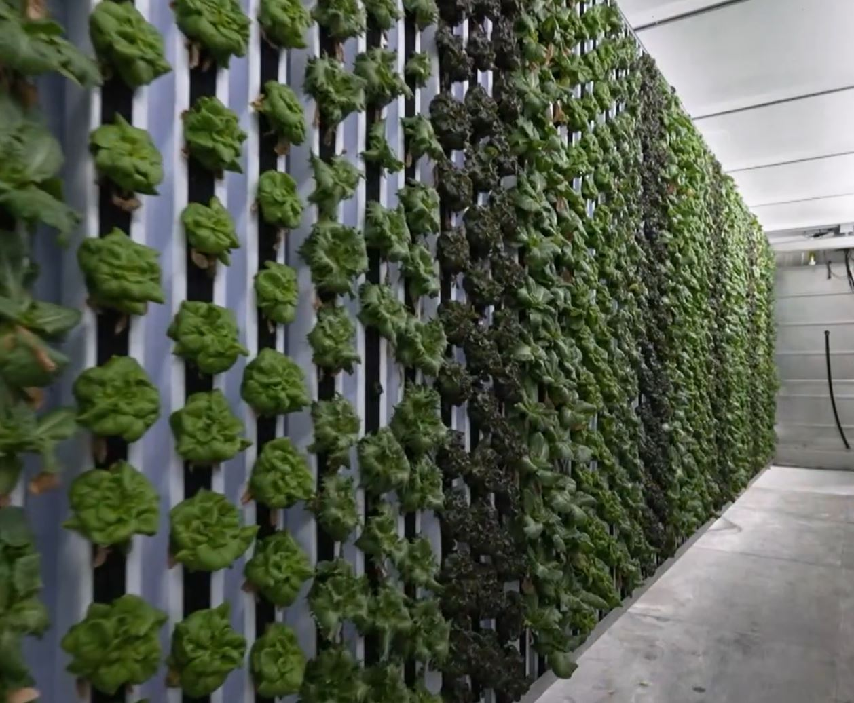
District Spotlight: Morgan Hill USD
Morgan USD is using hydroponics technology to grow five types of lettuce in shipping containers called Freight Farms.
The lettuce is being used in the school's nutrition program.
Watch the episode of America's Heartland featuring Morgan Hill USD at www.video.kqed.org/video/freight-farms-2hkfzd

Slide 6
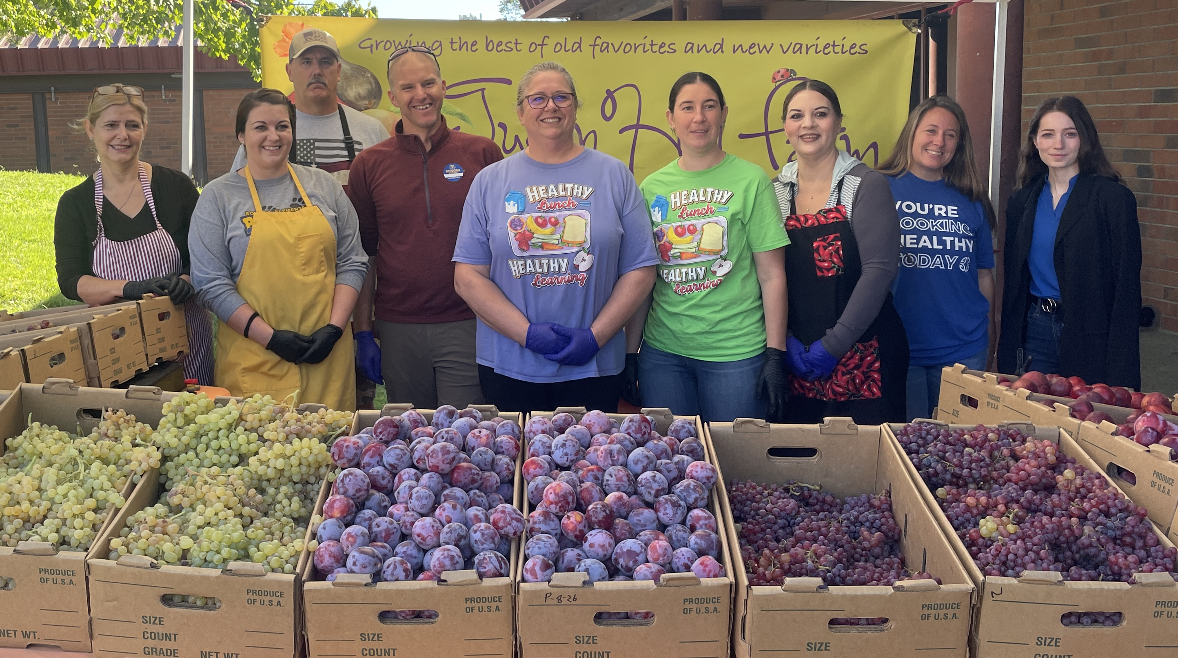
District Spotlight: Sonora Elementary School District
Sonora Elementary introduces students to produce from a local farm.
To read more about the event, look here: https://www.uniondemocrat.com/news/article_f4a377a8-754a-11ef-b73e-c7baa2706d39.html

Slide 7
Upcoming Celebrations
Dates | Celebrations
September 15-October 15, 2024 | Hispanic Heritage Month
The Month of October | National Farm to School (F2S) Month and National Filipino American History Month
October 10, 2024 | California Crunch Day
October 12, 2024 | National Farmer's Day
October 14, 2024 | Indigenous People's Day
October 14-18, 2024 | National School Lunch Week

Slide 8
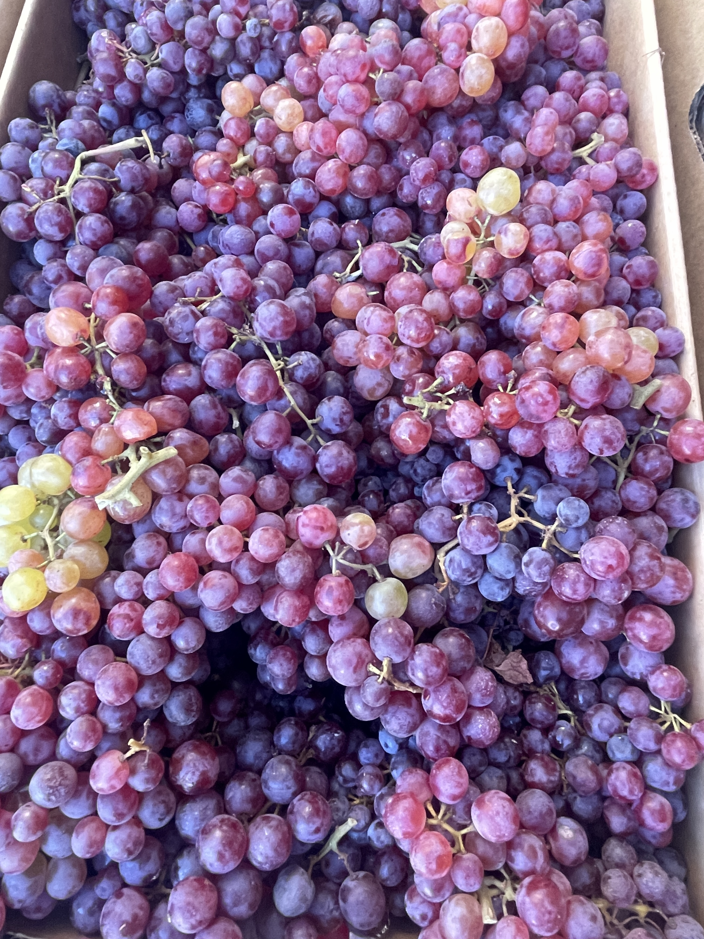
National Farm to School Month
Host a mini-Farmers Market at your school.
Add local items to a salad bar.
Provide taste-tests of local, new, or unusual produce items.

Slide 9
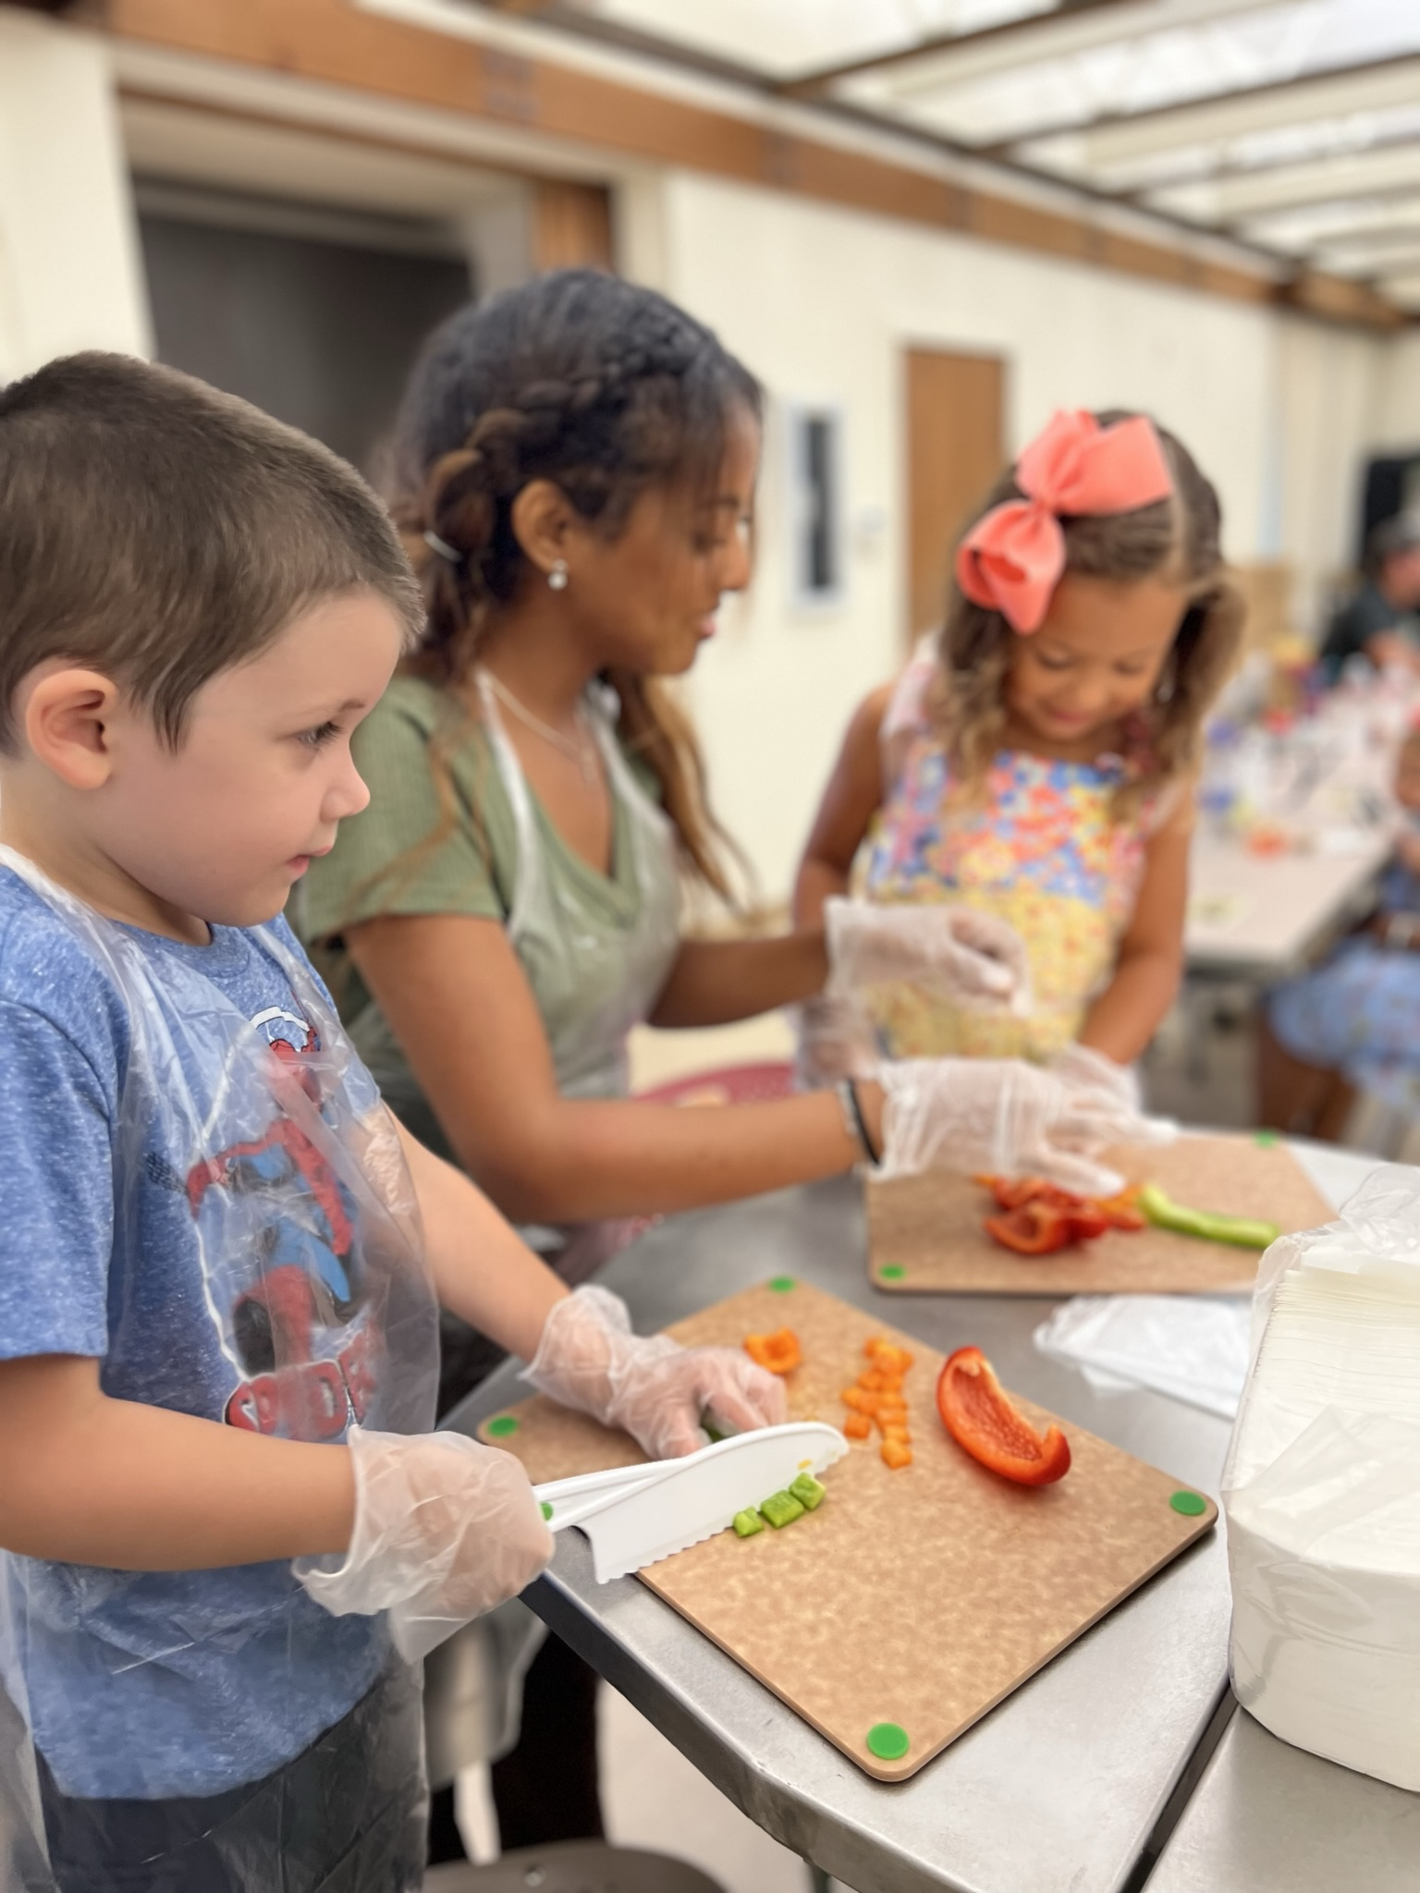
Needs Assessment:
What do you need for F2S?
We would like your input on our F2S services and materials!
Access the Farm to School Needs Assessment survey at https://surveys3.cde.ca.gov/go/f2sneedsassessment2024.asp
Input appreciated by December 31, 2024.

Slide 10

California Green Ribbon Schools
(CA-GRS) Recognition Program
Applications are due Monday, November 4, 2024.
CA-GRS recognition honors excellence in whole-school sustainability.
Awardees receive California Department of Education (CDE) recognition and an award plaque.
For CA-GRS information or to request an application visit the CDE CA-GRS web page at https://www.cde.ca.gov/ls/fa/sf/greenribbonprog.asp.

Slide 11

Federal Updates

Slide 12
Uniform Guidance (1)
Updated Title 2, Code of Federal Regulations (2 CFR), Part 200
Effective October 1, 2024
Applies to all Federal Child Nutrition Programs:
  Financial Management
  Resource Management
  Procurement

Slide 13
Uniform Guidance (2)
Title 2, Code of Federal Regulations, Part 200 update:
The USDA provided crosswalk documents from the Council on Federal Financial Assistance.
For many of the updates, the USDA must issue new or revised regulations, policy, and guidance to state agencies before the CDE will release updated management bulletins, webpages, and resources.

Slide 14
Uniform Guidance
Financial Management
Defined the terms “recipient” (state agency) and “subrecipient” (program operator) [2 CFR, 200.302].
Added that internal controls must be documented and include cybersecurity to safeguard information [2 CFR, 200.303].
Effective October 1, 2024, the single audit threshold will be increased from $750,000 to $1,000,000 [2 CFR, 200.501].

Slide 15
Uniform Guidance
Resource Management (1)
Effective October 1, 2024, equipment definition increased to $10,000 per unit cost and supplies less than $10,000 [2 CFR, 200.1].
  Seek approval from state agency if items have a per unit cost of $10,000 or more unless school food authority (SFA) has established a lower capitalization threshold.
  No approval required if on capital expenditure approved list.
  Action: Evaluate the local capitalization threshold.
  USDA guidance may issue new or revised regulations/policy.

Slide 16
Uniform Guidance
Resource Management (2)
Loss, theft, or damage to equipment that impacts Child Nutrition Programs should be reported to the state agency [2 CFR, 200.313].
  Pending clarification and guidance from USDA
  Significant program disruption such as information system problems (ransomware or disaster), or refrigeration malfunction that affects food safety
  Report to Resource Management Unit at snpcafefundquestions@cde.ca.gov

Slide 17

Uniform Guidance
Resource Management (3)
  Prizes and challenges (i.e., contests and incentives) [2 CFR, 200.438]:
  Pending USDA guidance
  Must be included in federal award and have direct program purpose

Slide 18
Uniform Guidance
Resource Management (4)
Memberships, subscriptions, and professional activity costs no longer require state agency approval according to 2 CFR, 200.454.
  Must be reasonable and necessary
  No country club or dining clubs allowed
  Note: USDA federal regulations do not allow for program funds to pay for college courses to meet professional standards

Slide 19
Uniform Guidance
Resource Management (5)
Marketing costs: State agency approval is no longer required according to 2 CFR 200.467.
  Not a significant change as advertising and promotion has been allowed without state agency approval.
  Pending further USDA guidance for examples of allowable marketing costs.

Slide 20
Uniform Guidance
Resource Management (6)
The cost of land and buildings changed from not allowable to allowable if not otherwise prohibited according to Title 2 Code of Federal Regulations 200.439.
  The cost of land and buildings is still prohibited in CA under Title 7, Code of Federal Regulations 210.14 and California Education Code 38100.
  USDA regulations and state law change is needed to allow cafeteria funds to be used for the cost of land and buildings.

Slide 21
Uniform Guidance Procurement (1)
Written Procurement Procedures:
  Include oversight of contractors, avoidance of unnecessary or duplicative items, and use of surplus when possible [2 CFR 200.318].
CDE will send a notification when updated sample procurement procedures are available.

Slide 22
Uniform Guidance Procurement (2)
Written Code of Conduct [2 CFR 200.318]:
  Includes board members
  Individuals with real or apparent conflicts of interest shall exclude themselves from the selection, award, or administration of contracts.
  SFAs should consult with administration and legal to determine if board approval is required.

Slide 23
Uniform Guidance Procurement (3)
Procurement
  Terminology changes [2 CFR 200.1]
    Micropurchase now specified as individual procurement transaction
    Small purchase = simplified acquisition
    Simplified acquisitions and micropurchases = both informal methods of procurement
  Addition of labor related goals (e.g., small, minority, women owned, and veteran owned business) [2 CFR 200.321]

Slide 24
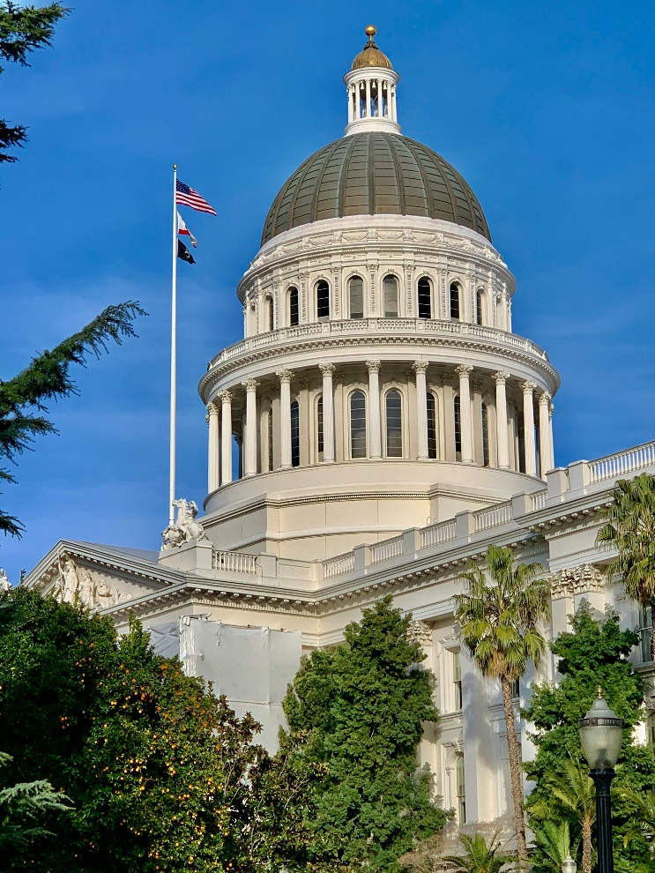
State Updates

Slide 25
Resource Management
Excess Net Cash Resources (1)
Excess net cash resources of six or more months requires a budget agreement to spend excess net cash over a specified time period to achieve compliance.
  Monitor through form SNP-57 in Child Nutrition Information and Payment System (CNIPS).
  Note: Supply chain assistance funds should be included in your calculation. However, Kitchen Infrastructure and Training (KIT) funds and other special purpose grant funds (equipment grant, dishwashers, and local foods for schools) do not need to be included.
  Reach out to SNPBA@cde.ca.gov.

Slide 26

Resource Management
Excess Net Cash Resources (2)
Long-term noncompliance (prior to 2020–21)
  Receive technical assistance to decrease excess
  CDE may exercise payment hold or reimbursement rate reduction as a last resort

Slide 27
Back to School Reminders (1)
Submit 2024–25 Annual Updates in CNIPS.
CNIPS must accurately reflect current program operations (e.g., meal service times, adult meal prices, etc.).
School Nutrition Programs (SNP) application packets must be approved prior to submitting claims for School Year (SY) 2024–25.
Claiming deadlines:
  July claims are due September 29th.
  August claims are due October 30th.

Slide 28
Back to School Reminders (2)
Direct certification matching through the California Longitudinal Pupil Achievement Data System (CALPADS) is now required monthly for all public schools, county offices of education and charter schools.
This requirement applies to standard counting and claiming sites and sites operating a federal provision such as the Community Eligibility Provision (CEP) or Provision 2 (P2).

Slide 29
Back to School Reminders (3)
Complete the Food Safety Inspection Survey (FSIS) for SY 2023–24 in CNIPS.
Collecting data on mandatory FSIS conducted at school sites in SY 2023–24
FSIS reporting in the 2024–25 CNIPS program year
Due date September 27, 2024

Slide 30
Verification Process for
SY 2024–25 (1)
SFAs with standard counting and claiming sites, or P2 sites in a base year must complete verification process.
Schools on CEP or schools on P2 during non-base years are exempt from conducting verification.
There are no exemptions from Verification Reporting all SFAs must complete verification reporting in CNIPS.

Slide 31
Verification Process for
SY 2024–25 (2)
Timeline:
  October 1: Determine sample size and begin verification process
  November 15: Complete verification process
  November 15, 2024 - January 15, 2025: Submit verification report in CNIPS

Slide 32
Disaster and Unanticipated School Closure Guidance
USDA approved waiver to allow for non-congregate meal service, parent/guardian pickup, meal-time and offer vs. serve flexibilities during unanticipated school closures (e.g., disasters, labor disputes, unscheduled building repairs, etc.):
School closed; virtual learning: National School Lunch Program (NSLP), School Breakfast Program (SBP)
School closed; no virtual learning: Seamless Summer Option (SSO), Summer Food Service Program (SFSP)
SFAs must apply to CDE prior to using flexibilities

Slide 33
Meal Service During School Breaks (1)
SFAs may be eligible to serve meals during school breaks, if the following applies:
Sites meet area eligibility requirements
School break period meets the required number of days
Child Nutrition Program | *Minimum School Break Period:
Seamless Summer Option | More than 10 school days
Summer Food Service Program | 15 or more school days
*Holidays and weekends are not counted towards the school break period.

Slide 34
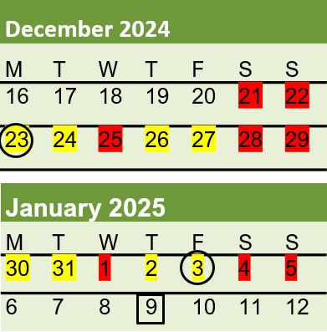
Meal Service During School Breaks (2)
Winter break for XYZ USD is December 23rd through January 3rd, with students returning to school on January 6th:
XYZ USD is not eligible to operate SSO or SFSP as school break is 8 operating days.
If XYZ USD returned on January 9th, for a 10-day break, they could be eligible to operate SSO.
Questions? Contact the SSO Team by email at SSFO@cde.ca.gov.

Slide 35
Important Operational Dates:
Next 30 to 90 days (1)
Action | Date
Complete FSIS in CNIPS | September 27, 2024
Complete annual updates | July-October 2024
Use all carryover pounds for USDA Foods | October 31, 2024

Slide 36
Important Operational Dates:
Next 30 to 90 days (2)
Action | Date
Complete the verification process | October 1 – November 15, 2024
Submit the verification report in CNIPS | November 15 – January 15, 2025

Slide 37
Food Distribution Program (FDP) Advisory Committee
The FDP Advisory committee is looking for 12 to 15 FDP leaders to contribute to FDP-related discussions.
Committee members serve a two-year term and attend virtual meetings.
Complete an FDP Advisory Committee Application and submit by the deadline.
For questions, please contact Sherry Tam by email at stam@cde.ca.gov.

Slide 38

Funding Updates

Slide 39
Local Food for Schools (LFS) Reminders
Spending Deadline:
  Expend all LFS funds no later than Friday, November 29, 2024
Mandatory Quarterly Report #4:
  Report LFS expenditures made July 1, 2024, through September 30, 2024
  Report due October 11, 2024
View final funding allocations at https://www.cde.ca.gov/fg/fo/r9/lfsfundresults22.asp
Send your LFS questions to the LFS team by email at LFSGrant@cde.ca.gov

Slide 40
Grant Funds Overview (1)
Grant | Timeline
2024 Equipment Assistance Grant deadline to apply | October 10, 2024
LFS Mandatory Quarterly Report #4 | October 11, 2024
LFS deadline to expend any unused funds | November 29, 2024

Slide 41

Resources & Other Announcements

Slide 42
California School Nutrition Association (CSNA) Annual Conference
Join us at the CSNA 72nd Annual Conference in Sacramento.
Date: November 13-16, 2024
CSNA Conference registration is available on the CSNA website at https://calsna.org/events/annualConference2024.php

Slide 43

Resource Update:
USDA Whole Grain Resource
The Whole Grain Resource for the National School Lunch and School Breakfast Program is now updated!
The resource offers guidance on how to meet the whole grain-rich criteria for NSLP and SBP.
The resource includes updates from the new final rule.
This resource is available on the USDA website at https://www.fns.usda.gov/tn/whole-grain-resource.

Slide 44
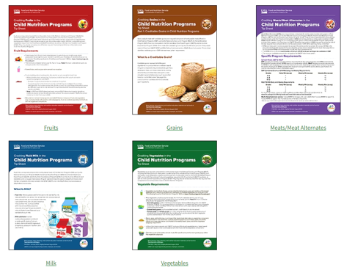
Resource Update:
Crediting Tip Sheets
Resources include Final Rule updates for all meal components.
Each tip sheet includes knowledge checks.
Available in English and Spanish soon!
Access these resources on the USDA website at https://www.fns.usda.gov/tn/cn/crediting-tipsheets.

Slide 45
Training Opportunity: Get Schools Cooking Applications are Open
Applications due: September 30, 2024
Three-year assessment and strategic planning program to transition K-12 public schools to a scratch-cooking operational model.
Learn more about the Get School Cooking opportunity on the Chef Ann Foundation website at https://www.thelunchbox.org/apply-for-a-grant/get-schools-cooking/.

Slide 46
Tuesday @ 2pm Town Hall Schedule
Held on the fourth Tuesday of the month
Month | Format | Date
October | State Update | 10/22/24
November | No Town Hall | N/A
December | State Update | 12/17/24

Slide 47
Thank you!
Professional Standards Crediting Information
  Key Area: Administration (3000)
  Training Topic: Program Management (3200)
  Learning Objective: Manage Staff Work Including Scheduling (3210)
  Instructional Hours 1.5 hours
This institution is an equal opportunity provider.

