Slide 1

Tuesday @ 2
School Nutrition Town Hall
October 22, 2024
California Department of Education
Nutrition Services Division

Slide 2
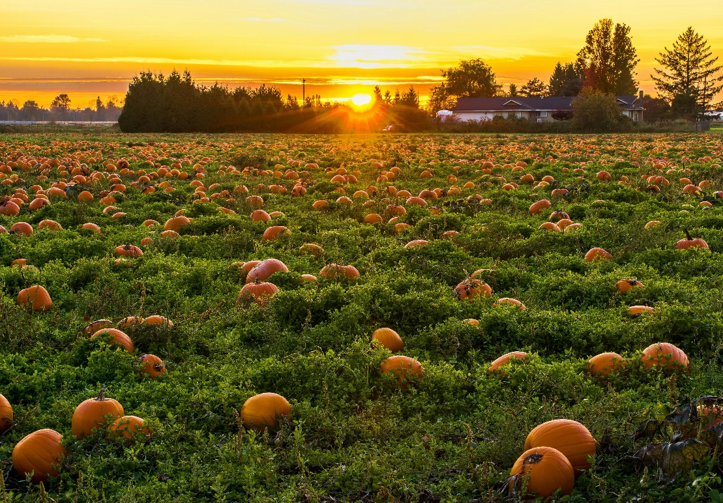
Town Hall at a Glance
District Spotlights & Award Recognition
Federal Updates
State Updates
Reminders
Funding Updates
Resources & Other Announcements

Slide 3
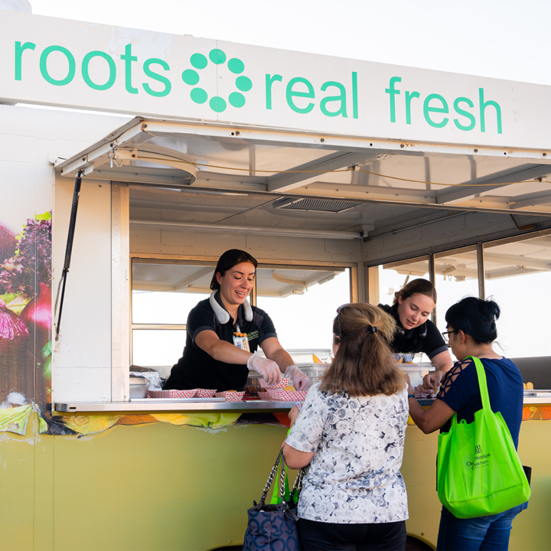
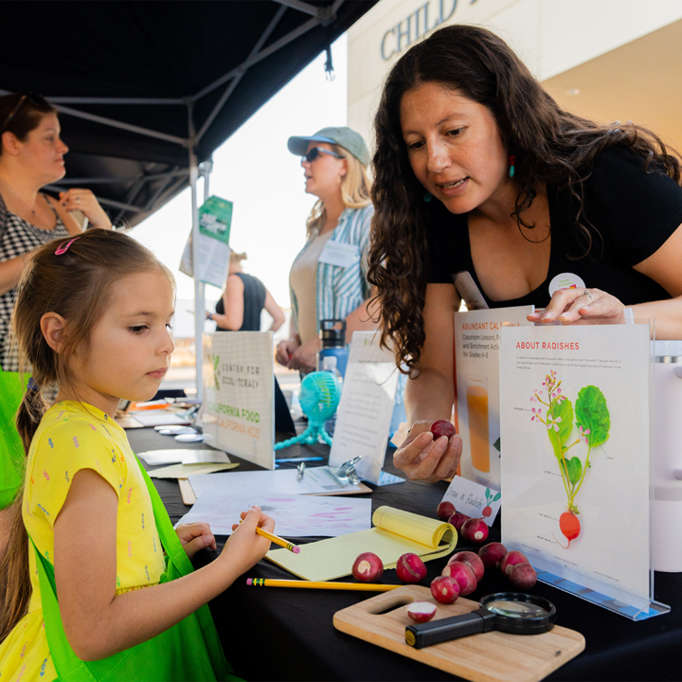
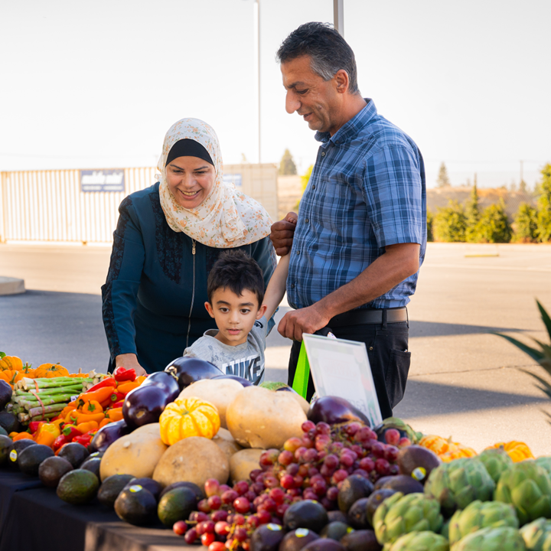
District Spotlight: Turlock Unified School District (USD)
Farm to School Month event photos by Center for Ecoliteracy.

Slide 4
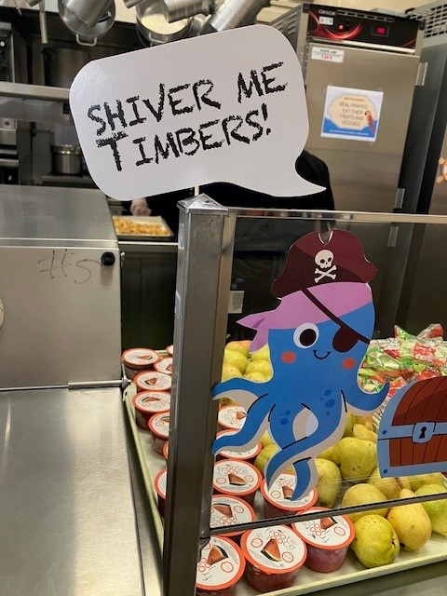
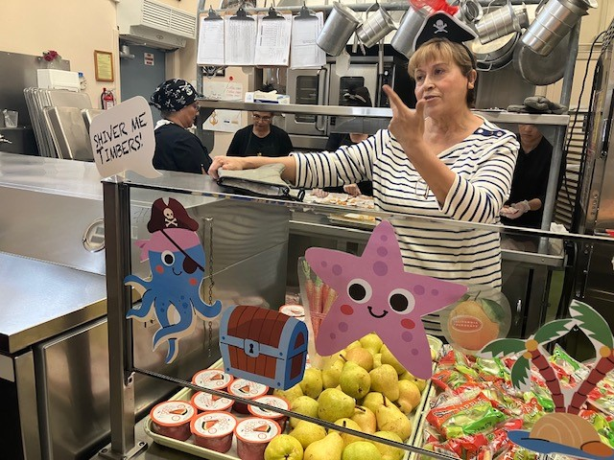
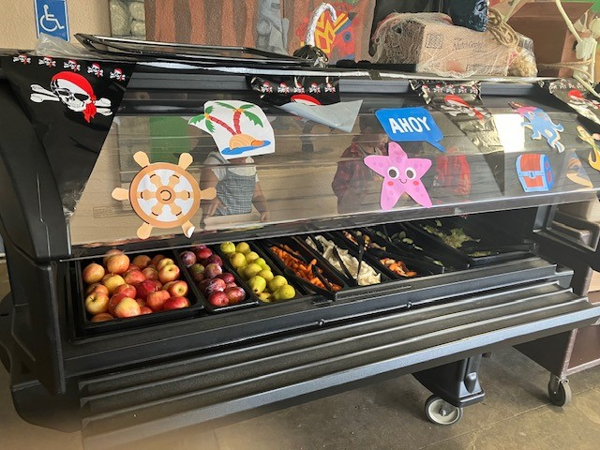
Los Angeles USD Celebrates National School Lunch Week

Slide 5
CA Healthy Meals Incentives (HMI) Initiative: Recognition Awardees
Congratulations CA awardees:
  Western Placer USD, Rialto USD, Borrego USD, Huntington Beach Union High School District, and Fallbrook Union High School District
HMI applications are accepted on a rolling basis through June 30, 2025.
Send your request for your HMI letter of support from California Department of Education (CDE) at HMILetterOfSupport@cde.ca.gov.

Slide 6
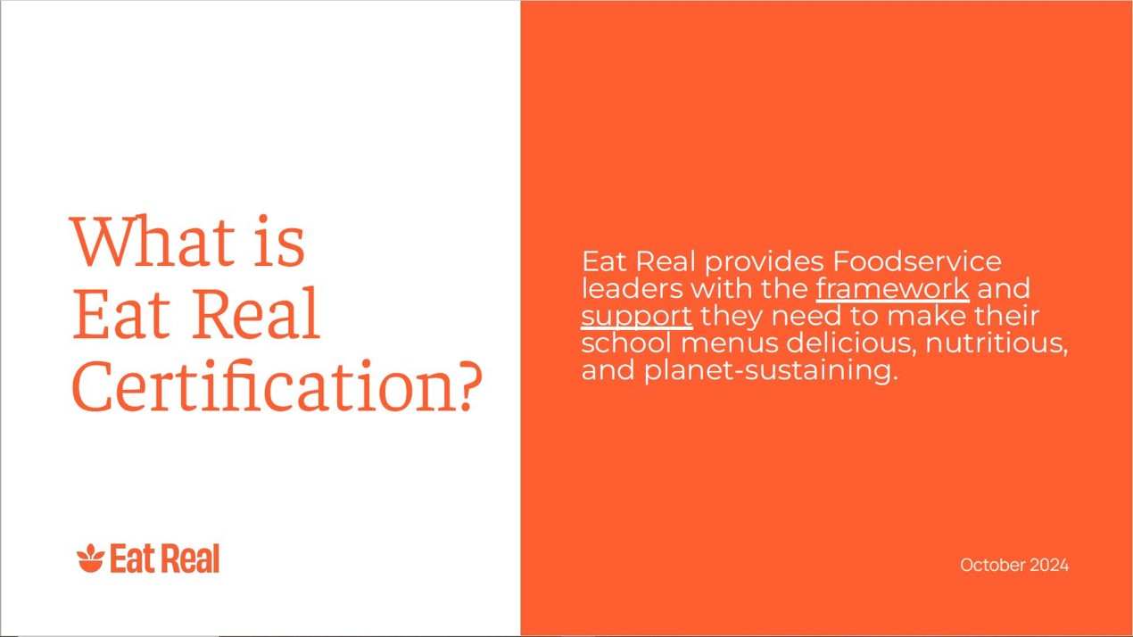
What is Eat Real Certification?

Slide 7
Eat Real Elements
Program Support: Get data, action and community connections to achieve nutrition and environmental goals.
Elevated Standards: Ten standards exceed federal and state requirements.
Be a Changemaker: Break the status quo and prove what school food can and should be.
*Slide content adjusted slightly for web posting.

Slide 8
10 Eat Real Standards
Eat Real’s 10 standards emphasize nutrition, sustainability, and overall transparency and include the following standards which go above federal nutrition requirements:
  Reduced sugar, whole carbohydrates, fresh produce, healthy fats, minimal processing, sustainable sourcing, responsible proteins, menu variety, minimized food waste, and real food education.
*Slide content adjusted slightly for web posting.

Slide 9

Four Tiers: Green to Platinum
For more information on the Eat Real Certification process on Eat Real’s website at https://eatreal.org/.

Slide 10

California Green Ribbon Schools
(CA-GRS) Recognition Program
Applications due Monday, November 4, 2024.
Honors excellence in whole-school sustainability.
Awardees receive CDE recognition and an award plaque.
For CA-GRS information or to request an application visit the CDE CA-GRS web page.

Slide 11

Federal Updates

Slide 12

2023 Farm to School Census
More than three quarters of the school food authorities (SFA) completed the 2023 Farm to School Census!
Among all of the SFAs in California, at least:
  67% serve local foods.
  53% provide food, nutrition or agricultural education.
  23% have an edible garden.
  55% serve local fruits or vegetables weekly.

Slide 13
SP 01-2025 Fluid Milk Requirements for Schools
This memorandum updates and clarifies current guidance for fluid milk requirements in school meal programs
  The 2024 final rule maintains existing requirements for fluid milk and nondairy fluid milk substitutes
  Additionally, milk options from the Section 5 of the Food Buying Guide continue to meet the meal pattern requirements
Beginning July 1, 2025, flavored milk offered must contain no more than 10 grams of added sugar per 8 fluid ounces

Slide 14
SP 02-2025 Substitution of Vegetables for Fruit Flexibility in the School Breakfast Program: Question & Answer
Allows flexibility to substitute vegetables for fruits at breakfast.
  Substitution one day per week may offer vegetables from any vegetable subgroup.
  Substitutions on two or more days per week must offer vegetables from at least two different vegetable subgroups over the course of the week.
For School Year (SY) 2024–25 only, schools do not have to meet vegetable variety requirements when substituting vegetables for fruit at breakfast.

Slide 15
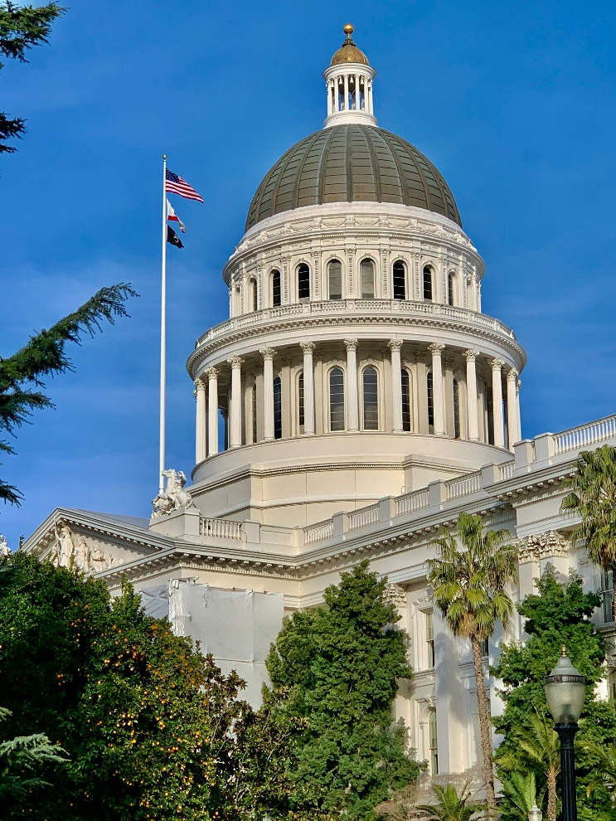
State Updates

Slide 16
Assembly Bill (AB) 2316-Pupil nutrition: substances: prohibition
Prohibits the following substances in School Meals & Competitive Foods:
  Blue 1 and 2; Green 3; Red 40; Yellow 5 and 6
Impacts: Public non-charter schools, County Offices of Education (COE)
Implementation Date: December 31, 2027
Meals not in compliance with state regulations are ineligible for state reimbursement

Slide 17
Modifications to Accommodate Disabilities in the School Nutrition Programs (SNP)
Management Bulletin SNP-07-2024
  Supersedes management bulletin SNP-02-2017 to reflect changes resulting from the U.S. Department of Agriculture (USDA) Final Rule.
  Beginning July 1, 2025, registered dietitians are permitted to complete and sign a written medical statement for a school meal modification due to a disability.
  For questions, please contact the SNP Team at SNPInfo@cde.ca.gov.

Slide 18
Satellite Food Service Operations
Satellite food service is defined as:
  A remotely located food service operation that is conducted on the same property as, in reasonable proximity to, and in conjunction with and by, a fully enclosed permanent food facility.
Facilities operating satellite food service must provide their local environmental health department (LEHD) with a written standard operating procedures.
For any additional questions, reach out to your LEHD.

Slide 19
Food Safety Certification vs.
Food Handler Cards
CA Health and Safety Code Section 113947.1 requires at least one food safety employee at each food facility to pass an examination from an accredited food protection manager certification organization.
Some counties have their own food handlers program, but this is not a state-wide requirement for schools.
Questions on whether or not your staff are required to have food handler cards should be directed to the LEHD.

Slide 20
Last Call - SNP Reminders (1)
Submit 2024–25 Annual Updates in Child Nutrition Information and Payment System (CNIPS).
CNIPS must accurately reflect current program operations (e.g., meal service times, adult meal prices, etc.).
SNP application packets must be approved prior to submitting claims for SY 2024–25.
August claims are due October 30th.

Slide 21
Last Call - SNP Reminders (2)
Direct certification (DC) matching through the California Longitudinal Pupil Achievement Data System (CALPADS) is now required monthly for all public schools, COE, and charter schools.
Requirement applies to standard counting and claiming sites and sites operating a federal provision [Community Eligibility Provision (CEP) or Provision 2 (P2)].

Slide 22
CA State Meal Mandate & Universal Meals Program (UMP) Implementation Guidelines
Management bulletin SNP-02-2024: CA State Meal Mandate provides guidance on the UMP requirements to provide two meals each school day and includes applicable guidance for public school/COE students attending nonpublic schools.
UMP Implementation Guidelines updated to reflect CA Education Code changes (monthly DC requirement and provision requirement).

Slide 23
Verification Process for
SY 2024–25 (1)
SFAs with standard counting and claiming sites or P2 sites in a base year should have started the verification process.
Schools on CEP or schools on P2 during non-base years are exempt from conducting verification.
There are no exemptions from Verification Reporting. All SFAs must complete verification reporting in CNIPS.

Slide 24
Verification Process for
SY 2024–25 (2)
SY 2024–25 Verification Process Timeline:
  October 1: Determine sample size and begin verification process
  November 15: Complete verification process
  November 15, 2024 - January 15, 2025: Submit verification report in CNIPS

Slide 25
Meal Service During School Breaks
If preparing to serve meals during school breaks, ensure compliance with Seamless Summer Option (SSO)/ Summer Food Service Program (SFSP) requirements.
Sites must meet area eligibility requirements.
School break period must meet the required number of days.
Child Nutrition Program | *Minimum School Break Period:
SSO | More than 10 school days
SFSP | 15 or more school days
*Holidays and weekends are not counted towards the school break period.

Slide 26
Food Distribution Program (FDP) Reminders (1)
USDA Annual Meal Count Reconciliation
  Reconciliation of SY 2023–24 lunch counts
  Adjusts SY 2024–25 entitlement up or down depending on the results
  Work with your FDP Order Coordinator to manage entitlement changes

Slide 27
FDP Reminders (2)
Annual Processor Inventory Reconciliation, also known as “Sweeps”.
  Unused SY 2023–24 carryover pounds are swept after October 31.
  Communicate extenuating circumstances for low usage to your FDP Order Coordinator.
  Assess processor balances in January prior to placing orders for SY 2025–26 processor diversions.
Preference Surveys for State Distribution Centers

Slide 28
Change Participation Method for Ordering and Receiving
USDA Foods for SY 2025–26
The listserv with more details was sent on October 10, 2024
The deadline is December 15, 2024
If changing your participation method, email FoodDistribution@cde.ca.gov and include:
  Agency name and vendor number
  Contact name and phone number
  Selected participation method for SY 2025–26

Slide 29
Important Operational Dates:
Next 30 to 90 days (1)
Action | Date
Complete annual updates | July–October 2024
Use all carryover pounds for USDA Foods | October 31, 2024
Complete verification process | October 1–November 15, 2024
Submit verification report in CNIPS | November 15–January 15, 2025

Slide 30

Funding Updates

Slide 31
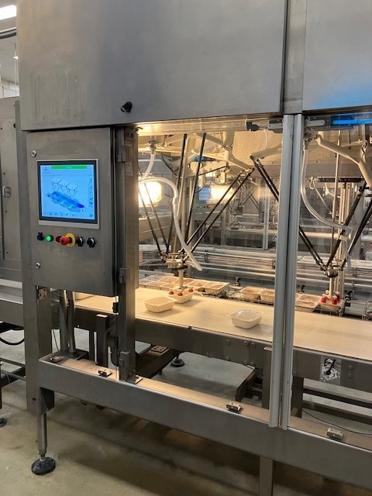
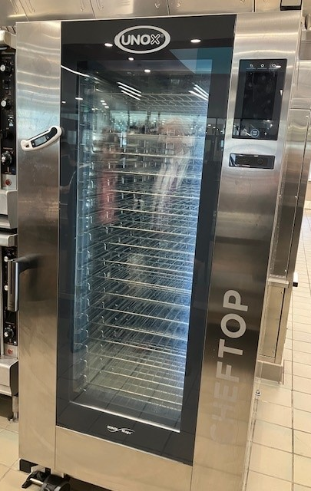
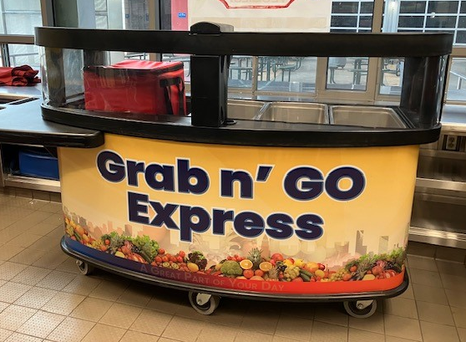
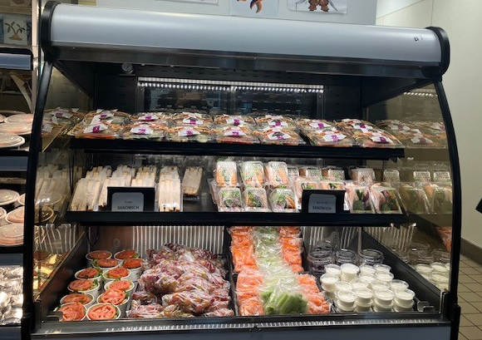
Funding Spotlight:
Kitchen Infrastructure and Training
Los Angeles USD

Slide 32
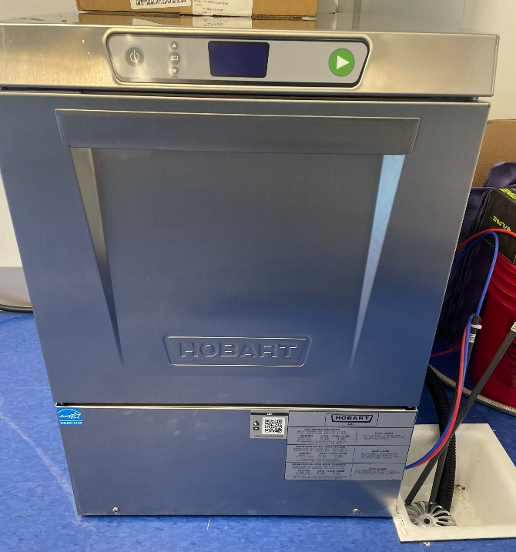
Funding Spotlight: Commercial Dishwasher Grant (CDG)
Girls Athletic Leadership Schools of Los Angeles
CDG funding has helped to support the:
Purchase, installation, and upgrades of a new energy efficient commercial dishwasher
Communication of their new Single Use Service Ware Reduction Policy
Separation of food ware items and condiments from meals, reducing overall waste
Ability to wash and reuse all utensils and dishes

Slide 33
Local Food for Schools (LFS)
Additional $500 million nationwide will be available for the LFS
  More information to come from USDA soon
LFS Reminders:
  Current LFS funds must be expended by November 29, 2024
  Verify your final funding amount on the LFS Funding results web page
  Complete all mandatory reports
Questions: LFSGrant@cde.ca.gov

Slide 34

Resources & Other Announcements

Slide 35
Resource Update: Food Buying Guide (FBG) for Child Nutrition Programs
The FBG updates include final rule updates.
Updates include 30 new foods and 17 traditional Indigenous foods.
Assists program operators and others to purchase accurate amounts of foods and their meal pattern contributions.
The FBG is available as a Web Tool, Mobile App and PDF.
Access the FBG on the Team Nutrition website.

Slide 36
Training: USDA Team Nutrition
The Road to Successful Menu Planning for School Meals
This new series will help you get prepared for the new final rule, Child Nutrition Programs Consistent With the 2020–2025 Dietary Guidelines for Americans.
  Offering both webinars and on-demand trainings:
    60-minute webinar: Creating Your Road Map to School Menu Planning Success
    15-minute training: Reducing Added Sugars (available now) and Menu Planning (coming soon)

Slide 37
Training Opportunity: Spring 2025 California Pre-Apprenticeship
Know someone interested in a school foodservice career?
Open to any California resident or current school food employee interested in learning skills in healthy scratch cooking in K-12 schools
Applications open November 2024
Seven Week Paid Program includes:
12 hours a week of on-the-job learning
3 self-paced online courses, 15 hours
2 live virtual learning sessions, 1.5 hours each
Learn more on the Chef Ann Foundation Pre-Apprenticeship website.

Slide 38
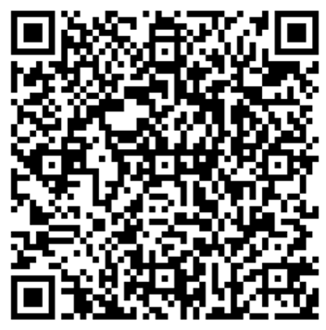
Procurement Training Reminder
Required annual procurement training:
Program directors, management, and staff who work on National School Lunch Program procurement
  USDA has not specified required number of hours or training topics
  Training may count towards professional standards
  Effective date August 23, 2024

Slide 39
California School Nutrition Association (CSNA) Annual Conference
Join us at the CSNA 72nd Annual Conference in Sacramento!
Date: November 13-16, 2024
CSNA Conference registration is available on the CSNA website at https://calsna.org/events/annualConference2024.php.

Slide 40
Tuesday @ 2pm Town Hall Schedule
Held on the fourth Tuesday of the month
Month | Format | Date
November/December | No Town Hall | N/A
January | State Update | 1/28/25

Slide 41
Thank you!
Professional Standards Crediting Information
  Key Area: Administration (3000)
  Training Topic: Program Management (3200)
  Learning Objective: Manage Staff Work Including Scheduling (3210)
  Instructional Hours 1.5 hours
This institution is an equal opportunity provider.

