Slide 1
Taste of CA Challenge
Recipe Standardization in
Small Bites Workshop
California Department of Education (CDE)
2024

Slide 2
Overview
Introduction to the United States Department of Agriculture (USDA) Recipe Template and Recipe Standardization Process
USDA Food Buying Guide (FBG) and Recipe Analysis Workbook (RAW) Overview
Resources

Slide 3
Objectives (1)
Describe a standardized recipe and the benefits of using one.
Recognize the benefits of using locally grown ingredients and scratch cooking to develop recipes students will love.
List the three phases of the USDA Recipe Standardization process.

Slide 4
Objectives (2)
Locate resources that will assist in the Recipe Standardization Process, such as the FBG for Child Nutrition Programs (CNP) and the RAW.

Slide 5
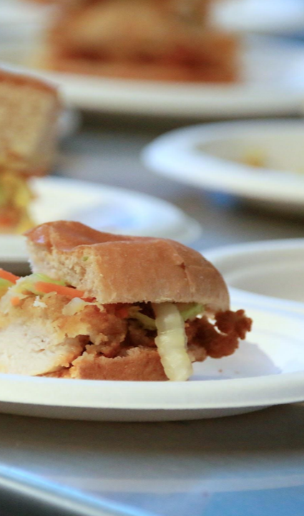
Definition of a Standardized Recipe
The USDA defines a standardized recipe as one that:
  “has been tried, adapted, and retried at least three times and
  has been found to produce the same good results and yield every time
  when the exact procedures are used with the same type of equipment and the same quantity and quality of ingredients.”
  Pictured: Monterey Peninsula Unified School District (USD) Krispy Kimchi Chicken Sandwich

Slide 6
Quantity Recipes
Any recipe that produces 25 servings or more is termed a quantity recipe.
The terms quantity recipes and standardized recipes are not the same.
  Many recipes are written to produce large quantities of food, but the recipe may or may not be standardized.
Quantity recipes are not standardized until they have been prepared at least three times with consistent results.

Slide 7
Components of the USDA Standardized Recipe Template

Slide 8
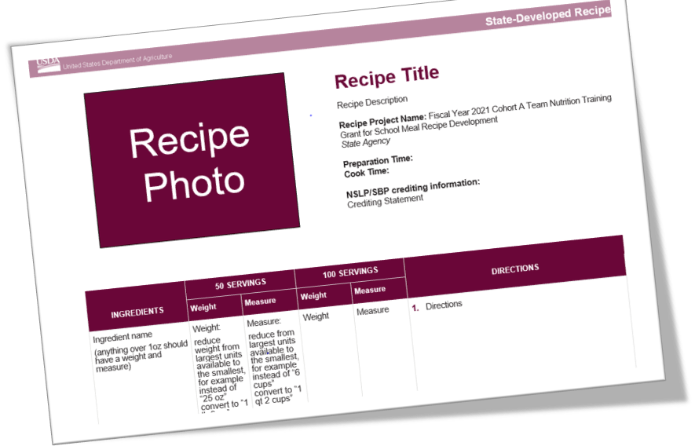
Standardized Recipe Template (1)

Slide 9
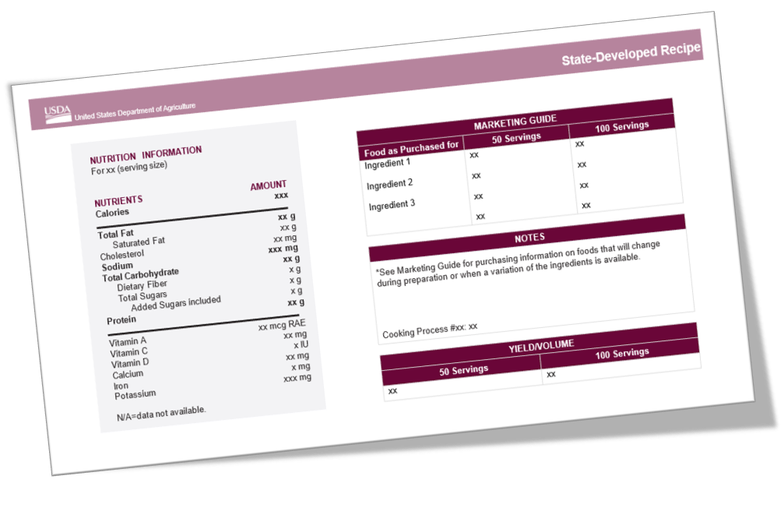
Standardized Recipe Template (2)

Slide 10
Components of a Standardized Recipe (1)
  Recipe Title and Description
  Recipe Category
  Ingredients
  Weight/Volume of each ingredient
  Units of Measure for each ingredient
  Preparation Directions

Slide 11
Components of a Standardized Recipe (2)
  Cooking Time, Temperature, and Preparation Time
  Serving Size
  Yield
  Equipment and Tools Needed
  Crediting Information
  Nutrient Analysis
  Service Style
  Marketing Guide
  Food Safety Guidelines
  Notes Section (optional)

Slide 12
What are Some of the Benefits of Using Standardized Recipes in Your Operation?

Slide 13
Benefits of Standardized Recipes
Consistent food quality
Predictable yield
Customer satisfaction
Consistent nutrient content
Food cost control
Inventory control
Labor cost control
Increased employee confidence
Efficient purchasing procedures

Slide 14
Three Phases of the USDA Recipe Standardization Process

Slide 15
Three-phase Approach
Recipe Verification Phase
Product Evaluation Phase
Quality Adjustment Phase

Slide 16
Phase One: Recipe Verification
Identifying the recipe
Sourcing ingredients
Writing and reviewing the recipe in detail
Preparing the recipe in a small-batch
Verifying yield
Recording changes

Slide 17
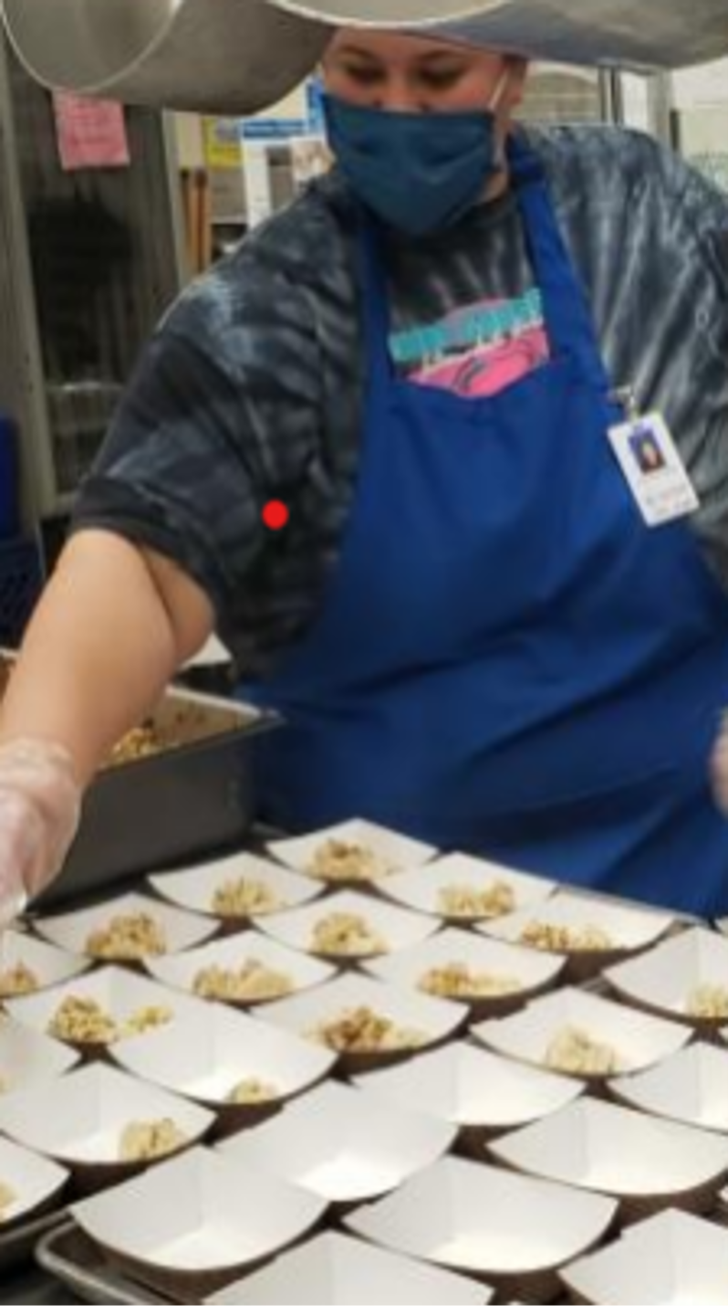
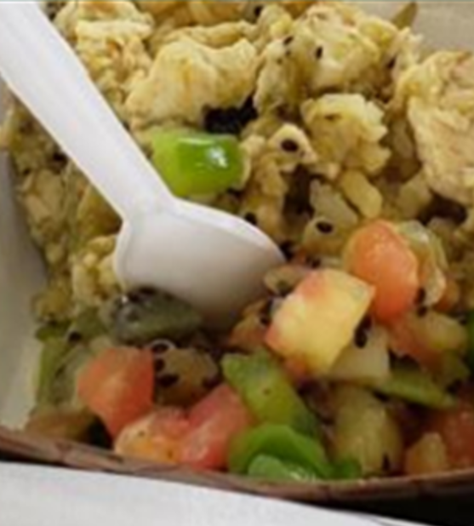
Strategies for Soliciting Recipes from the School Community
    Student surveys
    Student culinary classes
    Partnerships with local farmers
    Celebrate students’ or staff’s cultural or ethnic background
    Feature ingredients grown at school site
    School nutrition staff ideas

Slide 18
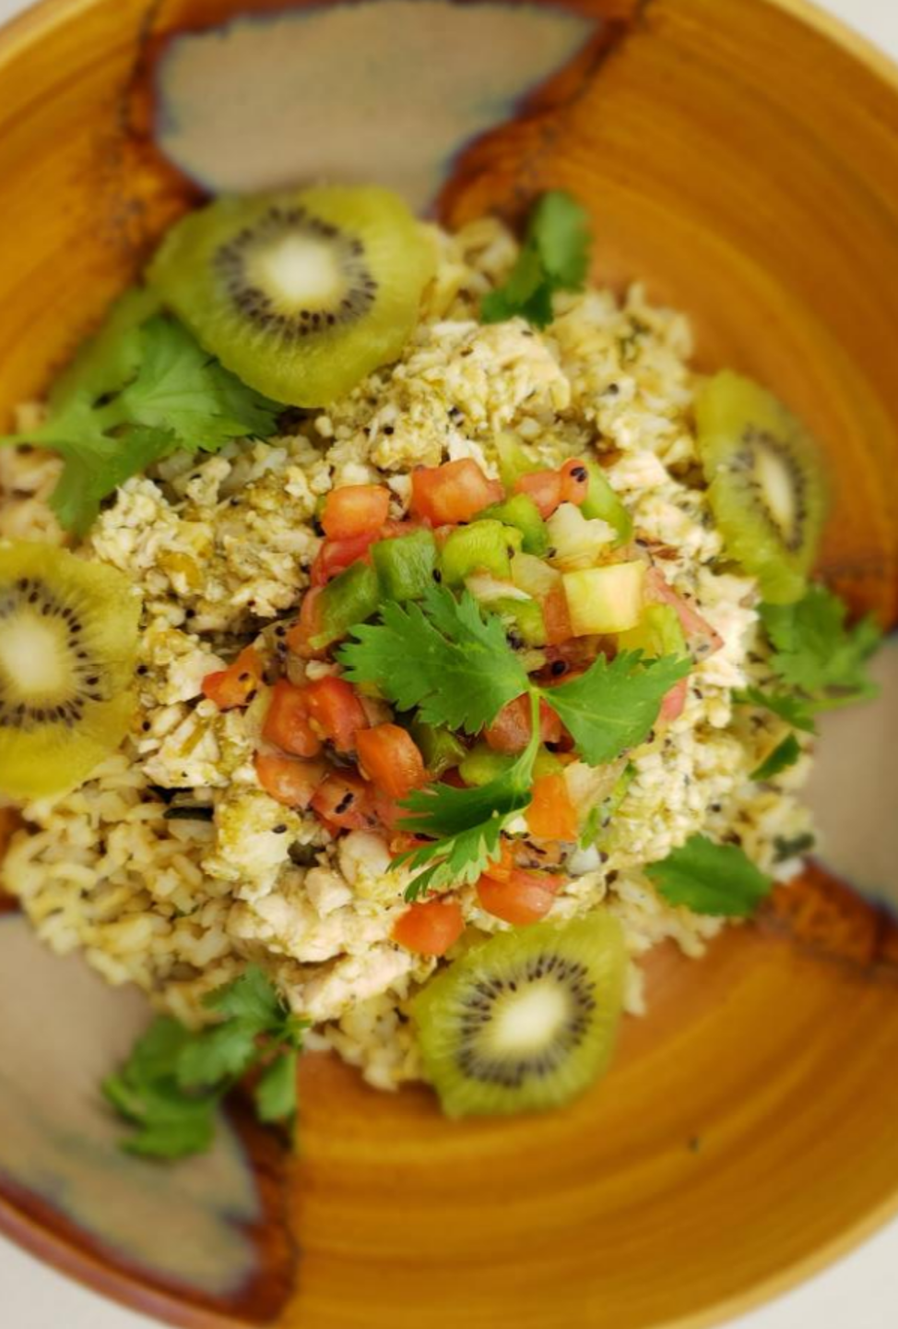
Kickin’ Kiwi Chicken Chili Verde with Kiwi Salsa
Marysville Joint USD
Southwestern comfort food paired with nutrient-rich Kiwi
Student population is 44% Hispanic
Ingredients:
  Kiwi fruit, USDA unseasoned chicken strips, salsa verde (green salsa), tomatoes, jalapeños, green bell pepper

Slide 19
Trivia
Which of the following fruits has the most vitamin C?
  Apples
  Oranges
  Kiwi Fruit
  Strawberries

Slide 20
Trivia-Answer
Which of the following fruits has the most vitamin C?
  c) Kiwi Fruit

Slide 21
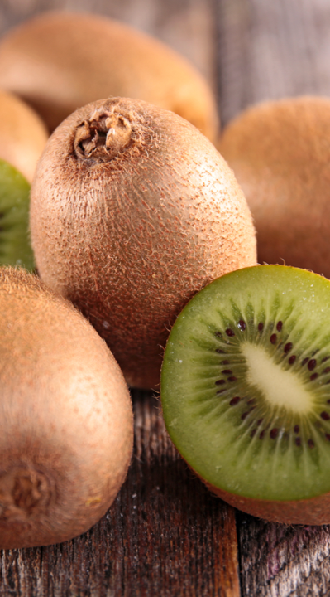
Strategies for Identifying Locally Sourced Food Items
    Through distributors
    From food processors
    Via Department of Defense Fresh Fruit and Vegetable Program (DoD Fresh)
    From individual producers (direct from farmers, ranchers, and fishers)
    From producer cooperatives (co-ops) and food hubs
    From school gardens

Slide 22
Phase One: Recipe Verification (2)
Identifying the recipe
Sourcing ingredients
Writing and reviewing the recipe in detail

Slide 23
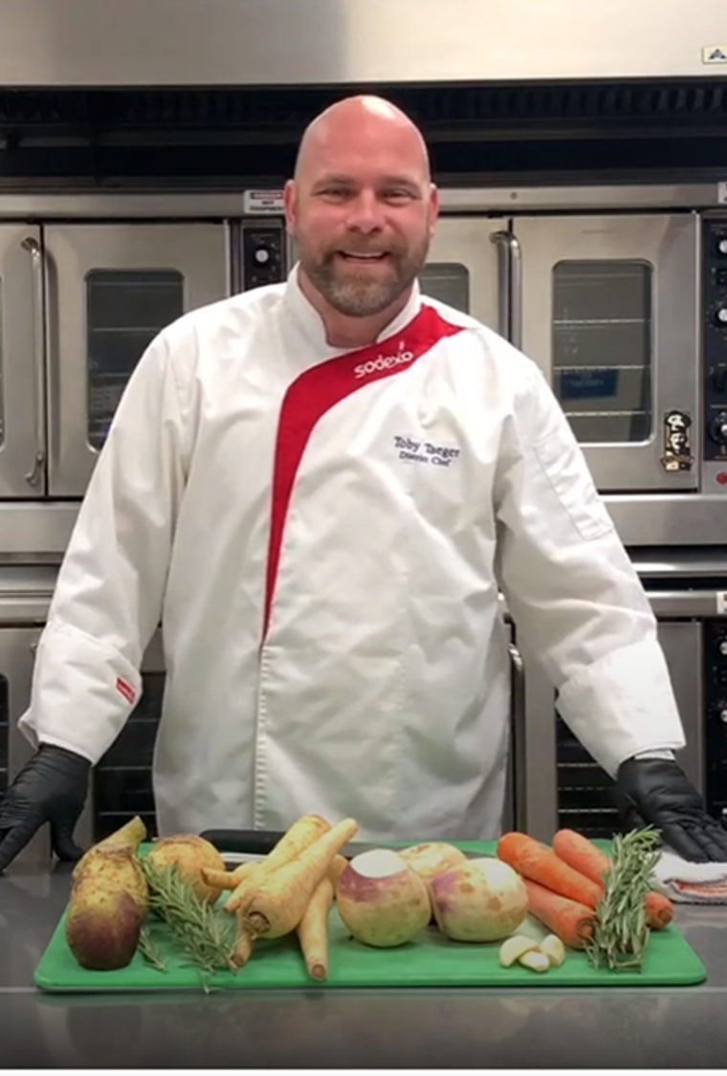
Writing Recipe Directions
Indicate how to combine ingredients.
List, in order, the steps to be followed in preparing the recipe.
Include food safety guidelines.
Use language that is widely understood.

Slide 24
Institute of Child Nutrition (ICN) Recipe Standardization Checklists, Charts, and Tables
Basics at a Glance Poster
Internal Cooking Temperatures Poster
Common measures and conversion tables
Recipe Review Checklist and Decision Guide
Available in the Recipe Standardization Guide for SNPs or on the Food Buying Guide web page.

Slide 25
Phase One: Recipe Verification (3)
Identifying the recipe
Sourcing ingredients
Writing and reviewing the recipe in detail
Preparing it in a small-batch
Verifying its yield
Recording changes

Slide 26
Small Batch Taste Testing and Yield Verification
Produce 25 or 50 servings three times
Involve staff and students to get feedback on feasibility and acceptability
Conduct a nutrient analysis using a USDA approved Nutrient Analysis Software
Verify recipe yield using the FBG RAW

Slide 27
Nutrient Analysis
Determine compliance with school meal regulatory requirements for:
  Calories
  Saturated Fat
  Sodium
  Added Sugars (beginning July 1, 2027)

Slide 28
Phase Two: Product Evaluation
Informal and formal evaluation process
Formal evaluation requires student taste testing and feedback
Use the USDA Quality Score Card or Taste Testing Survey Examples
Determine if the recipe should be rejected, accepted or changed

Slide 29

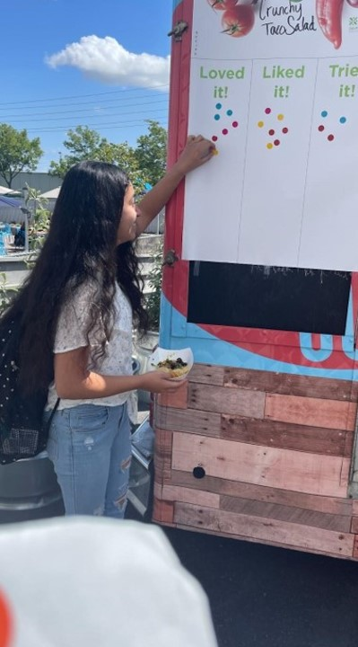
Taste Testing Best Practices
Choose age-appropriate methods and tasting events
Collect feedback using various formats e.g., Google form surveys, QR codes, “Tried it, Liked it, Love it” charts or emojis
Use scores or scales to summarize the results

Slide 30
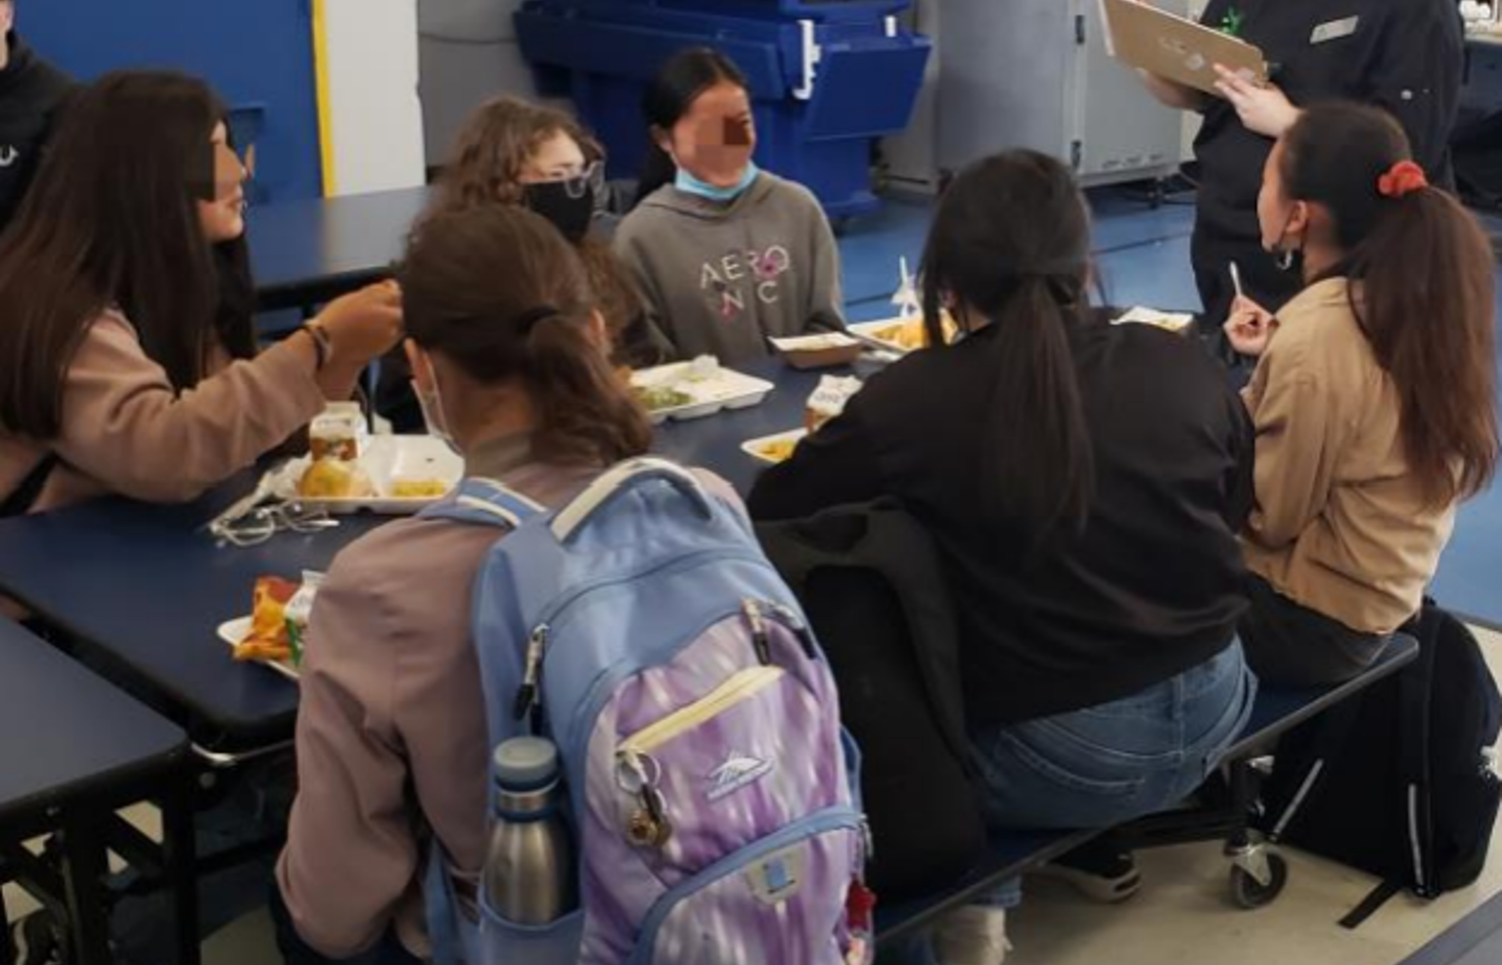
Taste Testing Results
Grades K through 8
96% Acceptability Rating
Survey Questions:
  Do you like the way it looks?
  ...smells? …tastes?
  Overall, what do you think of the item you sampled today?
    Menu Ready! or Still Needs Work

Slide 31
Phase Three: Quantity Adjustment
Adjust the recipe to reflect the number of servings you will use in your program.
Use the factor method to increase or decrease the recipe
Other methods include:
  Direct reading tables method
  Percentage method
  Computerized recipe adjustments

Slide 32
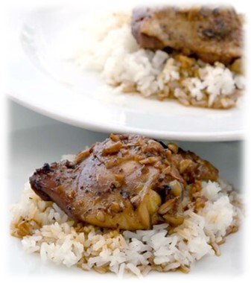
Menu Ready
Complete the recipe standardization process
Menu item
  Age group
  Menu compliance
  Menu mix
Engage students and staff
  Celebration
  Taste testing
  Surveys
Christo Rey San Jose Jesuit
High School Chicken Adobo

Slide 33
Tour of the USDA Food Buying Guide Web-based Tool
Crystal Young
CDE

Slide 34
Introduction to the FBG RAW
What?
The FBG Interactive Web-based Tool includes:
  The FBG Calculator
  Exhibit A Grains Tool
  Downloadable FBG
  RAW
  Product Formulation Statement (PFS) Workbook

Slide 35
Location of the FBG RAW
Where?
USDA FBG web page at https://foodbuyingguide.fns.usda.gov/
Must create a user profile and login to use the RAW
Select RAW or the Tools tab and select Create RAW

Slide 36
Benefits of the FBG RAW
Why?
FBG RAW helps you to:
  Provide consistent food quality ​
  Produce predictable yield ​
  Determine true nutrient content and meal pattern contribution​
  Manage food cost control ​and purchasing
Calculates the information for you!

Slide 37
As Purchased versus Edible Portion
As Purchased (AP)
  The amount of food item as it is purchased before any preparation has been completed
  Example: Carrots, fresh, without tops
Edible Portion (EP)
  The amount of a food item that is ready for use in a recipe after all pre-preparation
  Example: Carrots, trimmed, peeled, and sliced

Slide 38
Estimate the Desired Yield Using the FBG Shopping List
Search and select the Creditable Food Ingredients
Enter the estimated serving size of the ingredient
Enter the desired number of servings
Repeat for each of the creditable ingredients

Slide 39
RAW
Identify your Recipe and Desired Yield
Enter the recipe name
Enter the number of servings (50 or 100)
Enter the planned serving size (considering age group and meal pattern crediting requirements)
Before move you on to the next step select-- Save.

Slide 40
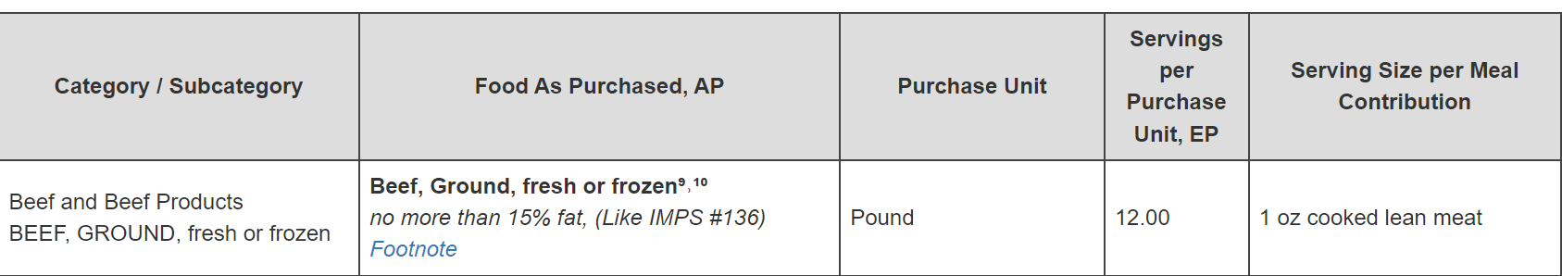
RAW
Identify the Desired Serving and Yield Factor
Search the Creditable Food Ingredients AP
Select the serving that best matches your EP as served
For example, 1 pound of fresh ground beef AP becomes 12 servings of 1 oz of cooked ground beef EP as served.

Slide 41
RAW
Calculate the Quantity to Purchase
Select the Creditable Food Ingredients
Enter the estimated quantity of the EP of the ingredient
Enter the yield factor from the additional information column
  If serving as purchased, enter 0 in the yield factor.
Adjust quantity of each of the ingredients to desired yield and meal contribution

Slide 42
RAW
Using the Yield Factor
Choose the Yield Factor base on how the ingredient is added to the recipe
To find the Edible Portion (serving) amount
  EP equals AP multiplied by the Yield Factor
  Ex. 8 pounds multiplied by .88 equals 7.04 pounds
To find the As Purchased amount
  AP equals EP divided by the Yield Factor
  Ex. 7.04 pounds divided by .88 equals 8 pounds

Slide 43
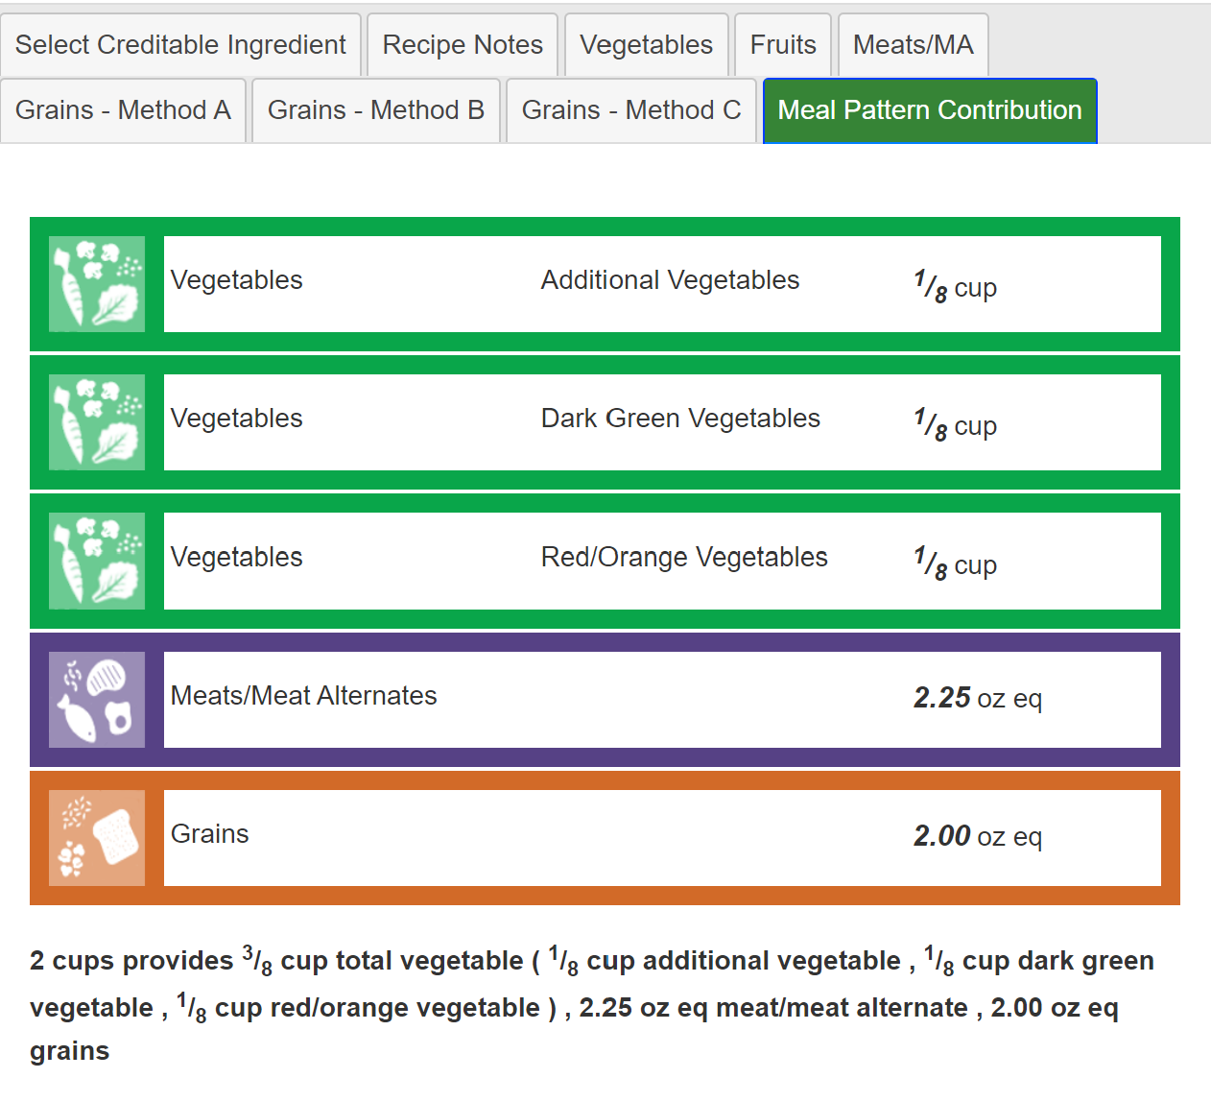
Recipe Analysis Workbook
Calculating the Meal Pattern Contribution
RAW automatically
  Calculates each ingredient based on the yield and total number of servings
  Combines ingredients by components and subgroups

Slide 44
Note about the RAW
The RAW is only as good as the information you put into it.

Slide 45
Resources

Slide 46
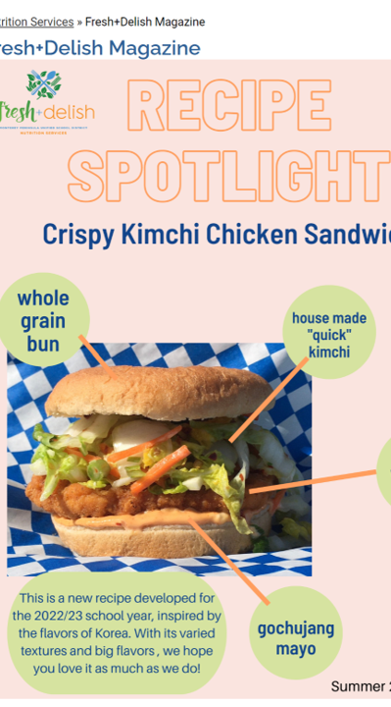
Celebrate & Communicate
Student-approved menu designation
Promotional posters
Nutrition education displays in the cafeteria
Photos
Parent newsletter
Email to the school community
Share with us by email at CARecipes@cde.ca.gov
Photo: Monterey Peninsula USD Fresh Delish Magazine

Slide 47
CDE Web pages
Nutrition What’s New web page at https://cde.ca.gov/568178
Taste of CA Challenge Grant web page at https://cde.ca.gov/567538
CA Culinary Centers Standardized Recipe web page at https://cde.ca.gov/566979

Slide 48
USDA and ICN Resources
Institute for Child Nutrition eLearning website at https://theicn.docebosaas.com/learn
USDA Food Buying Guide web-based tools at https://foodbuyingguide.fns.usda.gov/
USDA Recipe Standardization Guide for SNP Operators at https://theicn.org/cicn/usda-recipe-standardization-guide-for-school-nutrition-programs/

Slide 49
Professional Standard
Crediting Codes and Objectives (1)
Crediting Hours: 1
Key Area Codes
  1–Nutrition
  2–Operations
  4–Communications and Marketing
USDA Professional Standards Codes
  Menu Planning–1100
  Food Production–2100
  Communications and Marketing–4100

Slide 50
Professional Standard
Crediting Codes and Objectives (2)
  1130–Utilize local food sources, especially Farm to School, when possible
  1140–Write standardized recipes, and use FBG
  2110–Understand and effectively prepare food using a standardized recipe.
  2150–Understand CN Labeling, product formulation statements and/or appropriate crediting information for school meal pattern requirements.
  4120–Promote the Child Nutrition Program.

Slide 51
Acknowledgements
Some of this training content was adapted from U.S. Department of Agriculture (USDA), Team Nutrition, and the Culinary Institute of Child Nutrition (ICN) Recipe Standardization Training and resources.
USDA does not endorse any products, services, or organizations.

Slide 52
Contact Information:
CARecipes@cde.ca.gov

Slide 53

Thank you!
This training was created with funding from a 2021 U.S. Department of Agriculture Team Nutrition Grant awarded to the Nutrition Services Division (NSD) of the California Department of Education (CDE).
The CDE is an equal opportunity employer.
This institution is an equal opportunity provider.

