Slide 1
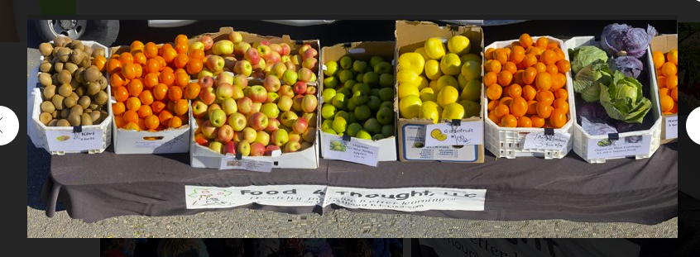
Tuesday @ 2
School Nutrition Town Hall
July 2023
California Department of Education
Nutrition Services Division

Slide 2
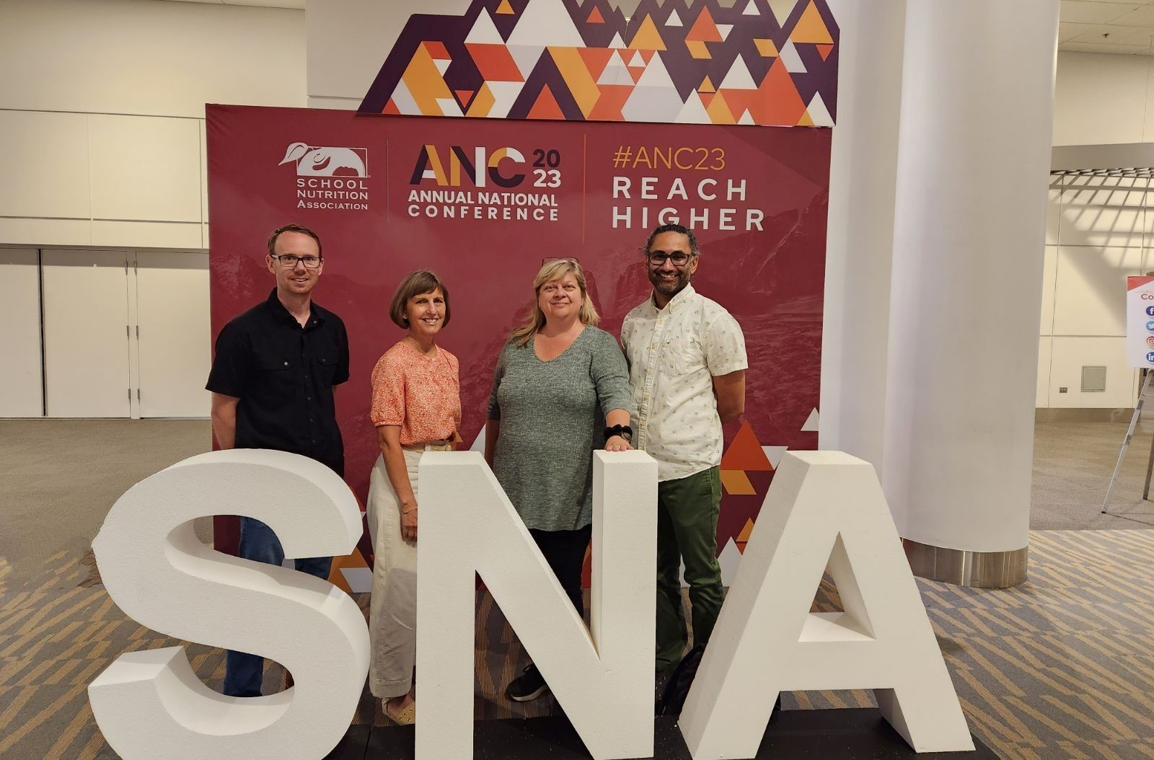
Town Hall At-A-Glance
District Spotlight​
Recognition
State Updates
Funding Updates
Important Dates
Resources & Other Announcements

Slide 3

Turnip the Beet Awards for
Summer 2023
Recognition for outstanding Summer Meal Program Sponsors
Open to Summer Food Service Program and Seamless Summer Option
Nominations due to CDE by
August 30, 2023

Slide 4

Thank You for Participating in
Farm to Summer Celebration Week!
If your agency completed the 3 elements during the week of June 19–23, 2023
  1) Taste
  2) Teach
  3) Share
Then complete the post-survey by 5 p.m. August 31

Slide 5
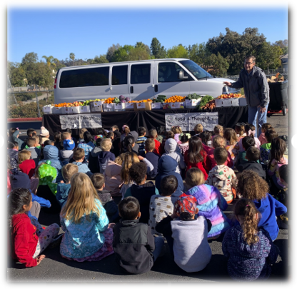
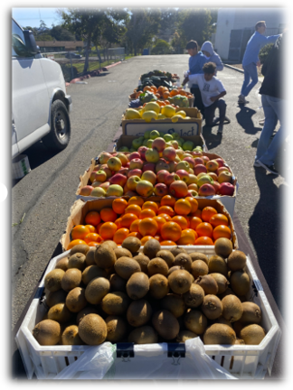
Farmers Market at
Escondido Union School District

Slide 6

Upcoming Celebrations
Dates | Celebrations
The Month of September | Food Literacy Month
The Month of October | Farm to School Month
October 9–13 | National School Lunch Week

Slide 7
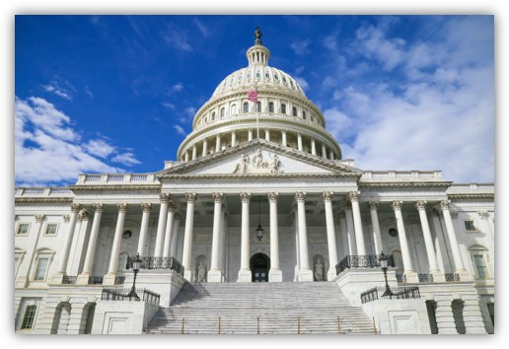
Federal Updates

Slide 8

Healthy Meals Incentives Recognition Awards
Open to School Food Authorities (SFA)
Recognition for improvements to school meal nutrition quality in alignment with 2020-2025 Dietary Guidelines for Americans
Applications accepted through June 30, 2025
Informational webinar: September 21, 2023 12:00-1:00 pm PST

Slide 9
Reminder: National School Lunch Program (NSLP) Sodium Limits Change
Sodium Target and Date | Grades K-5 | Grades 6-8 | Grades 9-12
Target 1A Effective July 1, 2023 | ≤ 1,110 mg | ≤ 1,225 mg | ≤ 1,280 mg
Target 1 Ends June 30, 2023 | ≤ 1,230 mg | ≤ 1,360 mg | ≤ 1,420 mg
Averaged over the course of the week
No change for breakfast; sodium limits remain at Target 1 for School Year (SY) 2023–2024

Slide 10
Annual Release of the Meal
Reimbursement Rates for
SY 2023–2024 (1)
Base federal rates increased by 8.27%
One-time federal increase from SY 2022–23 expired ($0.40 for lunch & $0.15 for breakfast)
California Prop 98 rate increased to $0.9686

Slide 11
Annual Release of the Meal
Reimbursement Rates for
SY 2023–2024 (2)
Meal Type | Total Reimbursement Rate (Fed + Prop 98 + Universal Meals)
Basic Breakfast | $3.2486
Needy Breakfast | $3.6986
Lunch | $5.3186
Snack | $1.17

Slide 12
U.S. Department of Agriculture (USDA)
Foods Entitlement Update
SY 2023-24 Meal Rate: $.3650
  Previous Meal Rate: $.43
Total Lunches Served (TLS)
  Final U.S. Department of Agriculture (USDA) Annual Reconciliation in November 2023
Recommend conducting your own TLS comparison and plan for November update accordingly

Slide 13
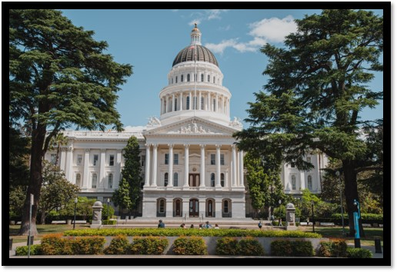
State Updates

Slide 14

State of California Budget
Fiscal Year 2023-24 (1)
California's Universal Meals:
  $154 million funding increase
  Total funding $ 1,647,144,000
8.22% COLA Increase for Categorical Programs

Slide 15
State of California Budget
Fiscal Year 2023-24 (2)
$15 million for energy efficient commercial dishwashers
  Competitive process
  $40,000 per kitchen of a school site within a local educational agency
    Purchase and installation
    Design and associated electrical and plumbing upgrades
    New outlet, counter modification, or appliance relocation
    Venting and heat booster equipment and installation

Slide 16
State of California Budget
Fiscal Year 2023-24 (3)
Freshly Prepared Onsite Meals
“The State Department of Education, in the reasonable exercise of its discretion, may interpret this definition and provide guidance to local educational agencies to support the implementation of this section, consistent with the intent of this section.”
  Anticipate updated guidance by September 1, 2023

Slide 17
Disability Modifications Including Food Allergies
One stop web page with consolidated information including:
  Meal modification requirements
  Compliance
  Training and resources
  Policy
  Frequently asked questions
  Contact information

Slide 18

Breakfast and Snacks for
Nonschoolaged Children
May serve meals through community nutrition meal programs:
  Summer Food Service Program (SFSP)/ Seamless Summer Option (SSO)
  Child and Adult Care Food Program (CACFP)
Providing meals is voluntary

Slide 19
Unpaid Meal Charge Policy and Excess Account Balance Guidance
Management Bulletin (MB) SNP-04-2023
  Addresses local meal charge policies, clarification on collection of delinquent meal payments, and excess student account balances
  Clarifies that SFAs that operate the Universal Meals Program or CEP/Provisions at all sites are not required to establish a meal charge policy.

Slide 20
School Nutrition Program (SNP) Administrative Reviews (AR) in SY 2023–24
Waiver in place to extend the three-year review cycle to five years
ARs will be conducted in person
SFAs scheduled for an SNP AR in 2023-24
  Must complete the Pre-Review Training
  Will be contacted soon regarding entrance dates
  Can reach out to assigned CNC for questions

Slide 21

Food Distribution Program (FDP) Reminders
FDP Contract Packet Annual Update
  Due July 31, 2023
  Missed deadline may result in ineligibility to receive USDA Foods
Check inventory balances at processors in preparation for Annual Inventory Reconciliation (Sweeps)

Slide 22
SY 2023–24 SNP Annual Update
Annual Updates Open for submission
  School Breakfast Program (SBP)
  NSLP
  Afterschool Snack
Must be approved before claims can be submitted
Do not submit Seamless Summer applications for Summer 2024

Slide 23
Back to School Reminders for Successful Universal Meals Implementation
Eligibility Determinations
  Direct certification (DC) must be done three times annually, with the first occasion happening at or near the start of the school year
    Best Practice Alert: Monthly DC
  Required to distribute and collect meal applications if not on Community Eligibility Provision (CEP) a non-base year Provision
    Applications may qualify students for other benefits, including discounted high-speed internet, S-EBT

Slide 24
Important Operational Dates:
Next 30 days
Action | Date
SNP Annual Updates Open | Beginning July 1
FDP Contract Packet due | July 31
All June 2023 Meal Claims due | August 29

Slide 25
Important Operational Dates:
Next 60 days
Action | Date
Complete Mandatory Food Safety Inspection Reports in Child Nutrition Information & Payment System (CNIPS) | August-October

Slide 26
SY 2022–23 Pandemic EBT (P-EBT) (1)
On July 19, 2023, the USDA approved California's P-EBT plan for school age children
  No application is required for students that attended a public school that participates in the NSLP or SBP
    Benefits provided automatically to students that qualify
  Created an application process for students that attend homeschool or private virtual school
  Available to students that attend virtual schools that don't participate in NSLP or SBP

Slide 27
SY 2022–23 P-EBT (2)
Eligibility requirements for public school students
  Free and reduced-price eligible,
  OR
  Attended CEP/Provision school
  Missed
  in-person instruction through enrollment in independent study or had excused absences of five or more days in a month
AND

Slide 28
SY 2022–23 P-EBT (3)
Benefits
  $8.18 for each eligible day from August 1, 2022, to May 11, 2023
  Loaded onto Summer EBT cards or issued a new card
  Mailed to address reported in California Longitudinal Pupil Achievement Data System (CALPADS)
  Benefits issued August through September 2023
  Informational post card to families

Slide 29
Permanent Summer EBT
Congress authorized permanent Summer EBT
  Beginning Summer 2024
  Provides a $40 per month benefit to eligible students
  Pending guidance from USDA and creation of regulations
    Available to students attending NSLP/SBP participating schools
    Must have free or reduced-price eligibility

Slide 30

Funding Updates

Slide 31
Local Food for Schools (LFS)
Part Two Opt-In Deadline Extended
All documentation is due 5:00 p.m. August 21, 2023
Acceptable Documentation:
  A list of all vendors planned for micropurchases
  The product to purchase from each vendor
  The total expected value of the micropurchase
  A purchase schedule

Slide 32
LFS Micropurchases
Alternate Acceptable Documentation for Opt-In:
  On SFA official letterhead
  A list of all vendors planned for micropurchases
  The product to purchase from each vendor
  The total expected value of each micropurchase
  A purchase schedule

Slide 33
Grant Funds Overview (1)
Grant | Timeline
School Breakfast and Summer Meals Program Start Up Grant Award Notifications | Sent June 29
2023–24 Fresh Fruit and Vegetable Program (FFVP) First Allocation Awards Posted | July 21
School Food Best Practices Awards Posted | July 21

Slide 34
Grant Funds Overview (2)
Grant | Timeline
LFS Part Two Opt-in Submission-Extension | August 21 5:00 p.m.
Supply Chain Assistance (SCA) Funds Issued (Rounds Two & Three) | Disbursement in progress
SCA Attestation (Round Four) | September 2023
SCA Funds Issued (Round Four) | December 2023

Slide 35

Resources & Other Announcements

Slide 36
Centers for Disease Control and Prevention (CDC): Extreme Heat Resources
Find various resources on how to beat the heat:
  Stay Cool
  Stay Hydrated
  Stay Informed
For additional heat-related tips check out the CDC web site at https://www.cdc.gov/disasters/extremeheat/index.html

Slide 37
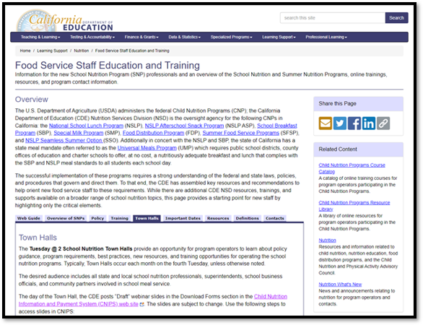
Food Service Staff Education and Training Web Page
Overview of the SNPs
Policy Guidance
Key Trainings
Resources
Important Dates (new)
Townhalls (new)
Contacts

Slide 38
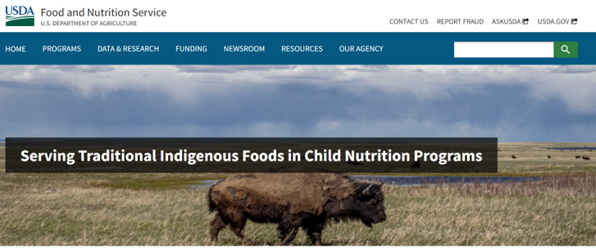
Serving Traditional Indigenous Foods in Child Nutrition Programs New Web Page
Policy Guidance
Recipe Box
Menu Resources
Crediting Tip Sheets

Slide 39
School Nutrition Department Vacancy and Turnover Rate Survey
Goal: Assess California's school food labor challenges
Sponsors: Chef Ann Foundation in partnership with the California School Nutrition Association
Responses will be used to help identify solutions.
Survey is being conducted by the Food Insight Group.
Due: August 25, 2023

Slide 40
Tuesday @ 2pm Town Hall Schedule
Held on the fourth Tuesday of the month
Month | Format | Date
August | State Update and Guest Speaker | 08/22/23
September | State Update | 09/26/23
October | State Update and Guest Speaker | 10/31/23

Slide 41
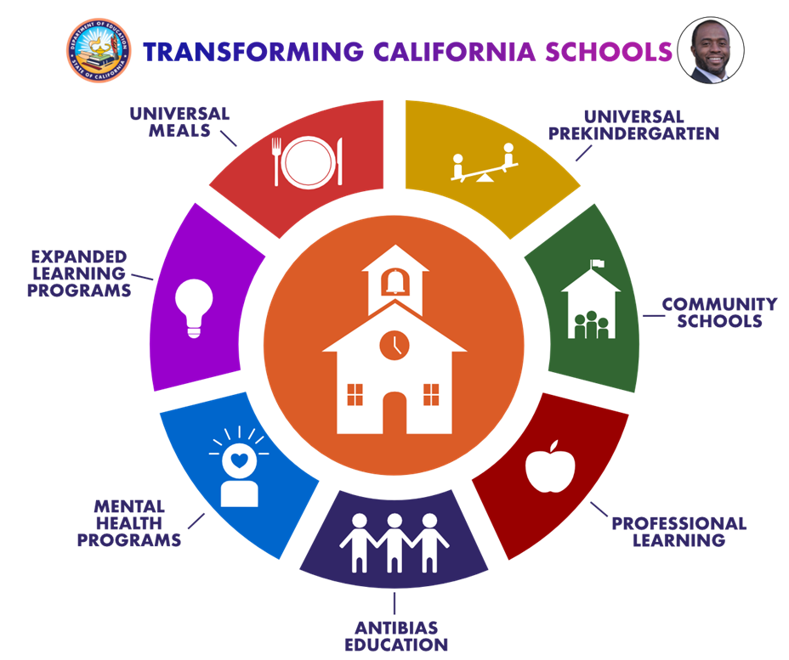
Thank you!
Next Town Hall:
August 22, 2023
This institution is an equal opportunity provider

