Slide 1
School District Boundaries: County Superintendent Roles and Responsibilities* *Advice/opinions offered are not legal opinions nor do they necessarily represent official positions of the California Department of Education. Such advice/opinions are exemplary and are not binding on local educational agencies or other entities. Except for statutes, regulations, and court decisions that may be referenced herein, compliance is not mandatory. (Education Code Section 33308.5)

Slide 2
County Superintendent Responsibilities for District Boundaries
Local
US Census Bureau’s School District Review Program
State Board of Equalization filing

Slide 3
County Superintendent Responsibilities
Education Code Section 2600
“Every county superintendent shall inquire and ascertain whether the boundaries of the school districts … are definitely and plainly described in the records of the board of supervisors and keep … a full and correct transcript of the boundaries.”
What does this mean?

Slide 4
Legal Boundary Descriptions
“… a full and correct transcript of the boundaries.”
This does not say maps are required.
Boundary lines on maps are based on legal descriptions.
Many COEs have determined that this means legal descriptions are required to be maintained.

Slide 5
Maintaining Boundary Descriptions
“Boundaries … are definitely and plainly described in the records of the board of supervisors”
This statement appears to reflect roles and purposes of the board of supervisors in maintaining county records of school districts especially as they relate to assessment issues.

Slide 6
Roles and Responsibilities
What agency is the authoritative source for district boundaries?
EC 2600 and other Education Code sections suggest the authority lies with the county board of supervisors.
However, fiscal independence of county offices of education complicates that assumption.
Fiscal independence changed responsibility for filing boundary changes in most counties.

Slide 7
Fiscally Dependent
Below are the steps for county notification of school district boundary changes to the State Board of Equalization when the county office of education is not fiscally independent from general county government:
County Office of Education notifies the County Board of Supervisors of a school district boundary change.
County Board of Supervisors prepares the official order for the boundary change.
County Board of Supervisors files the order with the State Board of Equalization.
State Board of Equalization records the boundary changes and prepares appropriate tax rate area assignments.
State Board of Equalization notifies County Board of Supervisors (i.e., county assessor) of tax rate area changes.
County Office of Education monitors accuracy of boundary information maintained by County Board of Supervisors.

Slide 8
Fiscally Independent
Below are the steps for county notification of school district boundary changes to the State Board of Equalization when the county office of education is fiscally independent from general county government:
County Office of Education prepares the official order for the boundary change.
County Office of Education files the order with the State Board of Equalization.
State Board of Equalization records the boundary changes and prepares appropriate tax rate area assignments.
State Board of Equalization notifies County Board of Supervisors (i.e., county assessor) of tax rate area changes.
County Office of Education monitors accuracy of boundary information maintained by County Board of Supervisors.

Slide 9
Who’s Responsible?
So, if we look at the process, what agency is the authoritative source for district boundaries?
Argument can be made for shared local authority:
Board of supervisors (elections, assessment) maintain boundaries for specific purposes;
County superintendent of schools has legal obligation to ensure accuracy of boundaries.
State Board of Equalization processes and records all boundary changes.

Slide 10
Resources for Boundary Maps
State Board of Equalization archives.
County elections precinct maps.
County assessor tax rate area maps.
County superintendent of school records and resources.
US Census and CDE Geo Hub.
https://tigerweb.geo.census.gov/tigerweb/ https://data-cdegis.opendata.arcgis.com/

Slide 11
School District Review Program (SDRP)
SDRP PURPOSE
To ensure accuracy of the Small Area Income & Poverty Estimates (SAIPE) data used in calculating the Title I Part A funding for each school district.
“The SDRP enables state officials to review the Census Bureau’s school district information…” (Source: https://www.census.gov/programs-surveys/sdrp.html)

Slide 12
SDRP Schedule
DATA REVIEW SCHEDULE
October to November – CDE mapping coordinator conducts outreach to each county regarding data in their area.
December – Final SAIPE data published, and data used to calculate the Title I Part A allocations.

Slide 13
State Role
State Map Coordinator (at CDE)
Identifies anomalies in District Boundaries and Census Grade Range
Asks counties to review boundaries
Conveys updates/corrections to U.S. Census Bureau

Slide 14
County Office of Education Role
County Offices of Education
Review District Boundaries and Census Grade Range and works with State Map Coordinator to address errors or updates (Note: Census Bureau will not accept school district boundary changes submitted directly to the Census Bureau by local education officials.)

Slide 15
Notification Requirement
Government Code Section 54900
When there is a change in boundaries … of a district … or when … any district … is created … the tax or assessment levying authority of the … district shall file … a statement of the … change … . The … district shall prepare the statement and forward it to the tax or assessment levying authority for filing.
http://www.boe.ca.gov/proptaxes/sprdcont.htm

Slide 16
Board of Equalization Filing
Education Code Section 35765
“…the board of supervisors shall make an order to create, change or terminate school districts … . … the board of supervisors shall cause … the order … to be filed as required by Chapter 8 (commencing with Section 54900) of Part 1 of Division 2, Title 5 of the Government Code.”
Government Code Section 54901
“…The statement shall be in the form required by the Board of Equalization and include … a legal description of … boundaries and a map or plat indicating the boundaries.”

Slide 17
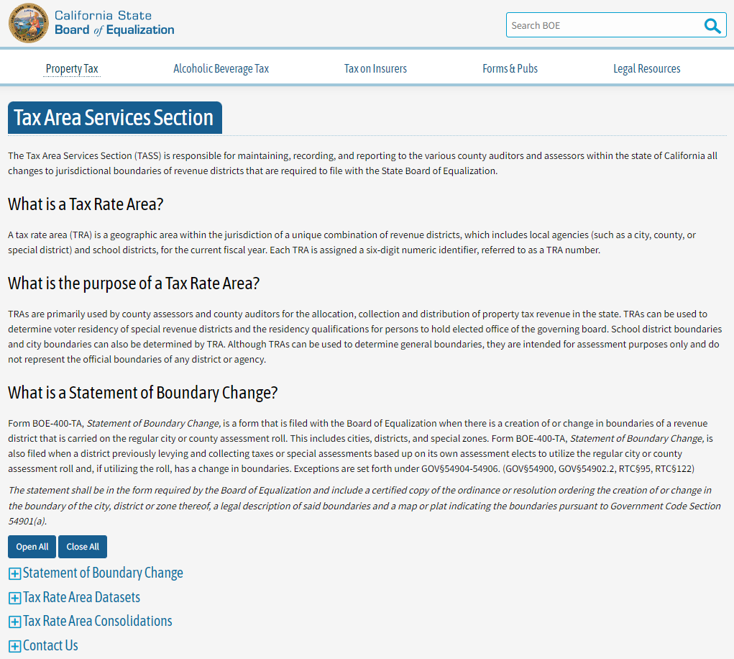
Board of Equalization Filing Website
Tax Area Services Section Resource Page: http://www.boe.ca.gov/proptaxes/sprdcont.htm

Slide 18
Filing Requirements
The State Board of Equalization provides guidelines for the proper submission of geographic descriptions, maps and fees. This document is available at: https://www.boe.ca.gov/proptaxes/pdf/jurboundaryreq.pdf
This document, along with the Statement of Boundary Change (Form BOE-400-TA), sample map, sample geographic description, and other information, also can be accessed through the Tax Area Services Section resource page at http://www.boe.ca.gov/proptaxes/sprdcont.htm
.

Slide 19
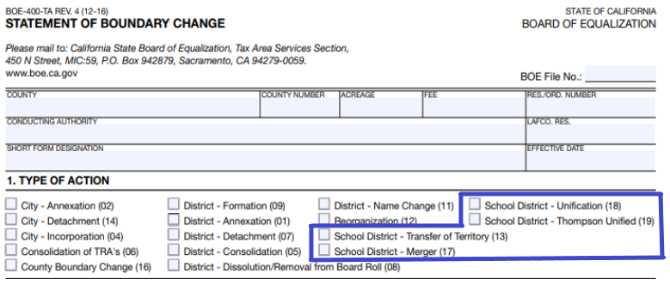
Board of Equalization Form
The Statement of Boundary Change
(Form BOE-400-TA) contains four School District Organization types of action, which are outlined on the form:
(1) Transfer of Territory
(2) Merger
(3) Unification
(4) Thompson Unification
Source:
http://www.boe.ca.gov/proptaxes/pdf/400ta.pdf

Slide 20
CDE Notification
Government Code Section 54903.1
“When a statement … is required to be filed with the State Board of Equalization, the authority required to file the statement and map or plat shall, at the same time, file a copy of the statement and map or plat with the Superintendent of Public Instruction … .”

