Slide 1
California Preschool Data Collection Learning The Customer Service Portal
Applied Data Research and Evaluation Office
California Department of Education

Slide 2
Using the Customer Portal
This section will guide you through the steps to create a new case using the Customer Portal.
Steps covered in this section:
Accessing the customer portal.
Submitting a case in the customer portal.
Reviewing cases in the customer portal.
Commenting on cases in the customer portal.
Case functions at certain states.

Slide 3
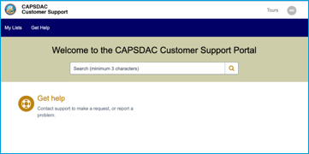
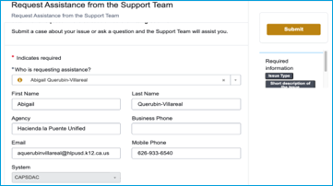
Submitting a Case Through the CAPSDAC Customer Portal
Navigate to the CAPSDAC Customer Service Portal.
Select “Get Help”.
You will arrive on the “Request Assistance from the Support Team” page.

Slide 4
Accessing the Customer Portal and Submitting a Case
If this issue has occurred before, select Yes.
Enter / search for the previous case you opened.
Select “Submit” when finished
NOTE: You can also add attachments by clicking the paper click icon next to “Add Attachments”.

Slide 5
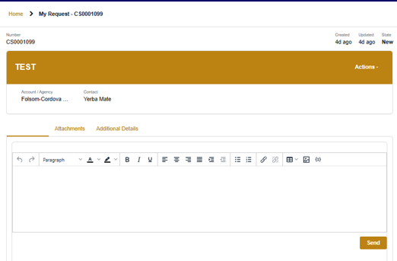
Accessing the Customer Portal and Submitting a Case (2)
“Attachments” shows any attachments you added and allows you to add more.
“Additional Details” shows all that you entered on the form.

Slide 6
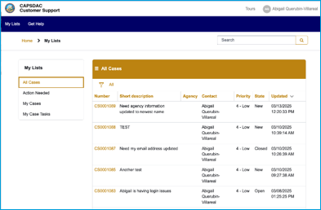
Accessing the Customer Portal and Submitting a Case (3)
Navigate to the CAPSDAC Customer Service Portal.
Select “My Lists” located on the top left navigation bar to view your case lists and status.
A table view of ”All Cases” is visible.

Slide 7
Accessing the Customer Portal and Submitting a Case (4)
A table view of ”All Select a Case in the List of Cases
Review the case details in the Activity log and in Additional Details.
Provide an Update or Ask a Question
Note: A history of additional comments will be displayed here.

Slide 8
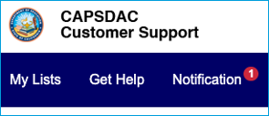
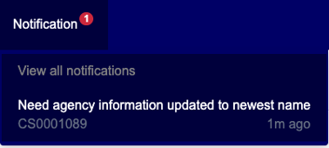
Submitting a Case Through the CAPSDAC Customer Portal
If something on your case needs your urgent attention, the Notifications menu appears. The red circle shows how many cases need to be checked
Clicking Notifications shows the list of cases requiring your attention.
Clicking the case carries you to your case view where you can provide the information.

Slide 9
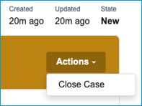
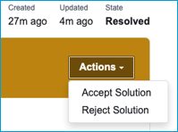
Submitting a Case Through the CAPSDAC Customer Portal (2)
If your case doesn’t say State = Resolved, you can close your case before it’s resolved/solved.
If your case does say State = Resolved, you can accept or reject the solution.
Rejection the solution re-opens your case to re-worked.
Accepting the solution closes your case.
NOTE: A closed case won’t allow you to update it. You will need to open a new case.

Slide 10
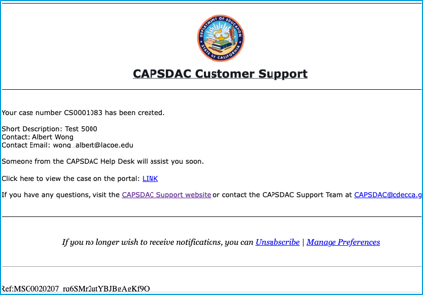
CAPSDAC Customer Support
Every time your case is updated by the CAPSDAC support team, you receive an email notification.
Email notifications can be replied to, and that reply will appear on your case.
This gives you two methods to stay updated and involved: email and the portal.

Slide 11
Thank you!

