Slide 1
Preschool Language Information System (PLIS) Fiscal Year 2023-24 Quarter 1 Reporting
Tuesday, October 10, 2023
10:00 a.m. to 11:30 a.m.

Slide 2
Agenda
PLIS Overview
PLIS: Teacher Designation, Dual Language Learner Status, Language Field Walkthrough
PLIS Demonstration
PLIS to Child Development Management Information System (CDMIS) 801A Data Matching
Question and Answer

Slide 3
Preschool Language Information System (PLIS) Overview
The PLIS is a database system created to collect language characteristics of California State Preschool Program (CSPP) children, teachers, and classrooms, which comprises the PLIS Report
PLIS guidance can be found in Management Bulletin (MB) 23-03
The PLIS Report is submitted on a quarterly reporting schedule, and is required from all CSPP contractors, pursuant to Education Code Section 8241.5
All children who were enrolled for at least one day during the quarter must be reported on the PLIS Report
This includes dual language learner (DLL) and non-DLL, and part-day and full-day children

Slide 4
Quarter 1 Reporting Schedule
Submission Opens | Previous Due Date | New Report Due Date
Sunday, October 1, 2023 | Friday, October 20, 2023 | Tuesday, October 31, 2023
Late Notice | Apportionment Withholding | Report Lock Date
Wednesday, November 1, 2023 | November 15, December 1, December 15, 2023 | Sunday, December 31, 2023

Slide 5
PLIS: Teacher Designation of DLL Status Field (1)
The "Teacher Designation of DLL Status" data field in the PLIS is a field that denotes whether the DLL status was determined if the child is designated as a DLL based on Teacher Designation, through the process detailed in the MB 23-03 Frequently Asked Questions (FAQ) page.
Teacher designation can only occur after observing the child demonstrates they speak, respond to, or understand a language other than English and meeting when meeting to ensure proper designation, the parent or guardian still chooses not to update their answers to the Family Language Instrument; the child’s teacher may designate the child as a DLL through a Teacher Designation. Teacher Designation can only occur after 30 calendar days and after meeting with the parent or guardian.

Slide 6
PLIS: Teacher Designation of DLL Status Field (2)
To ensure this field is being used correctly, below are the accepted entries in this field and what they mean:
Dual Language Learner Status designated from Family Language Instrument and Child is a DLL
Dual Language Learner Status field: Yes
Teacher Designation of DLL Status field: No
Dual Language Learner Status designated from Teacher Designation
Dual Language Learner Status field: Yes
Teacher Designation of DLL Status field: Yes
Dual Language Learner Status designated from Family Language Instrument and Child is NOT a DLL
Dual Language Learner Status field: No
Teacher Designation of DLL Status field: Blank

Slide 7
PLIS: Most-Used Language Field
The Most-Used Language field in the PLIS is a field that corresponds to Question 6 on the Family Language and Interest Interview
Question 6: Which language does your child speak the most overall? This would be inside and outside of the home combined.
This field is only required if the Dual Language Learner Status field is indicated "Yes"
If the Child is NOT a DLL, this field must be English or left blank
If the Child is a DLL, this field can be any of the available languages, including English, but must only be one language

Slide 8
PLIS: Home Language(s) Field
The Home Language(s) field in the PLIS is a field that corresponds to Question 4 on the Family Language and Interest Interview
Question 4: Young children love to talk, read, sing and are able to learn all the languages around them. Which language(s) does your child speak the most at home?
This field is only required if the Dual Language Learner Status field is indicated "Yes"
If the Child is NOT a DLL, this field must be English or left blank
If the Child is a DLL, this field can be any of the available languages, including English; multiple languages can be selected

Slide 9
PLIS: Written Communication Preference Field
The Family Written Communication Preference field in the PLIS is a field that corresponds to Question 7 on the Family Language and Interest Interview
Question 7: In what language would you prefer to receive written communication from us?
This field is only required if the Dual Language Learner Status field is indicated "Yes"
If the Child is NOT a DLL, this field must be English or left blank
If the Child is a DLL, this field can be any of the available languages, including English; only one language can be selected

Slide 10
PLIS: Verbal Communication Preference Field
The Family Verbal Communication Preference field in the PLIS is a field that corresponds to Question 8 on the Family Language and Interest Interview
Question 8: In what language would you prefer us to communicate verbally with you?
This field is only required if the Dual Language Learner Status field is indicated "Yes"
If the Child is NOT a DLL, this field must be English or left blank
If the Child is a DLL, this field can be any of the available languages, including English; only one language can be selected

Slide 11
PLIS: Valid Data Field Combinations (1)
Child is a Dual Language Learner, as indicated by the family on the Family Language Instrument
Dual Language Learner (DLL): Yes
Teacher Designation of DLL Status: No
Most-Used Language: Required; can be any one language, including English
Home Language(s): Required; multiple languages, including English, can be selected
Written Communication Preference: Required; can be any one language, including English
Verbal Communication Preference: Required; can be any one language; including English

Slide 12
PLIS: Valid Data Field Combinations (2)
Child is a Dual Language Learner, as indicated by the teacher
Dual Language Learner (DLL): Yes
Teacher Designation of DLL Status: Yes
Most-Used Language: Required; can be any one language, including English
Home Language(s): Required; multiple languages, including English, can be selected
Written Communication Preference: Required; can be any one language, including English
Verbal Communication Preference: Required; can be any one language; including English

Slide 13
PLIS: Valid Data Field Combinations (3)
Child is not Dual Language Learner, as indicated by the family on the Family Language Instrument, and teacher is in agreement
Dual Language Learner (DLL): No
Teacher Designation of DLL Status: Blank
Most-Used Language: Optional; can be left blank; if a language is reported, it must be blank
Home Language(s): Optional; can be left blank; if a language is reported, it must be blank
Written Communication Preference: Optional; can be left blank; if a language is reported, it must be blank
Verbal Communication Preference: Optional; can be left blank; if a language is reported, it must be blank

Slide 14
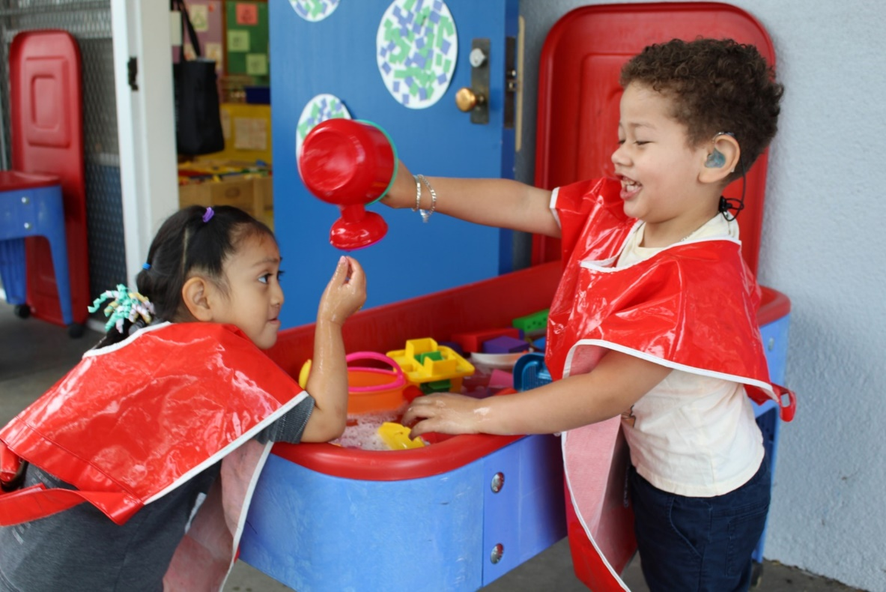
PLIS Demo
PLIS (Live Demonstration):
During this portion of the webinar, a PLIS Support Staff member will share their web browser and showcase the PLIS Website.
Photo Credit: Breed St. Elementary, Deaf & Hard of Hearing Program; Los Angeles, CA

Slide 15
PLIS to 801A Data Matching Common Errors
Users reporting children into both the CDD-801A report and PLIS report need to ensure that the Child’s First Name, Child’s Last Name, Date of Birth, and Family Identification Case Number (FICN) are identical.
These four fields are used for data matching and must be the same.
Field Name | CDD-801A | PLIS
First Name | Steven | Stephen
Last Name | Granados | Grnados
Date of Birth | 02/15/2019 | 02/05/2019
Family Identification Case Number | GRAN123 | GRAN213

Slide 16
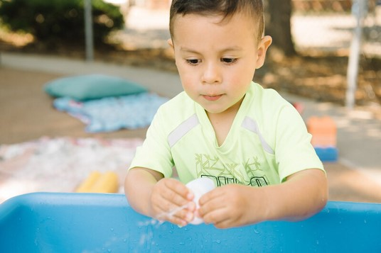
Questions and Answers
Photo Credit: Kidango Decoto Center; Union City, CA

Slide 17
Resources
If you have any data reporting questions or concerns regarding the Preschool Language Information System (PLIS), please do not hesitate to contact the PLIS Support Team at PLIS@cde.ca.gov
PLIS Landing Page
The Preschool Landing page was created to house all related support documents for the PLIS and this DLL guidance.
https://www.cde.ca.gov/sp/cd/ci/plissupportlanding.asp
DLL Support web page
This webpage will provide technical support, guidance, and resources for the identification, reporting, and support of dual language learners in California State Preschool Programs. Our goal is that the webpage will be one location for easy access and reference.
https://www.cde.ca.gov/sp/cd/ci/dllsupport.asp

