Slide 1
Following the Reclassification Rainbow
Multilingual Support Division
California Department of education (CDE)

Slide 2
Reclassification Criteria
The English learner (EL) reclassification criteria set forth in California Education Code (EC) Section 313 remains unchanged and are available on the CDE Reclassification web page at https://www.cde.ca.gov/sp/ml/reclassification.asp:
Criterion 1: Assessment of English Language Proficiency (ELP)
Summative English Language Proficiency Assessments for California (ELPAC)
Summative Alternate ELPAC
Criterion 2: Teacher Evaluation
Criterion 3: Parent Consultation
Criterion 4: Basic Skills Relative to English Proficient Students
Notes:
The four criteria local educational agencies, or LEAs, should continue using to establish reclassification policies and procedures are defined and described in great detail, including considerations and resources specific to each criterion, on the California Department of Education, or CDE, Reclassification web page at https://www.cde.ca.gov/sp/ml/reclassification.asp.

Slide 3
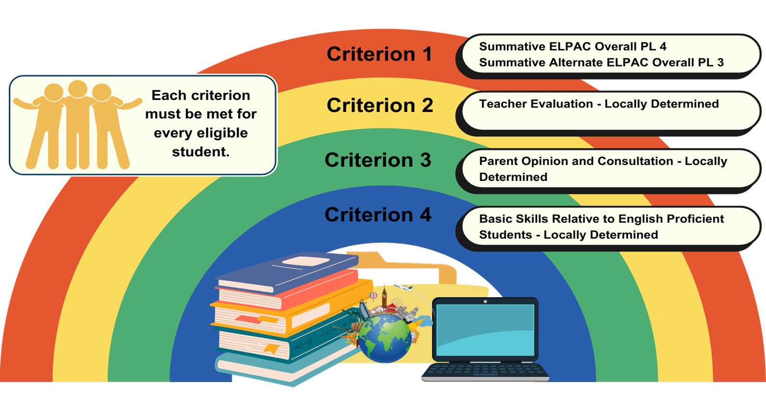
Reclassification Rainbow Each criterion must be met by each student to be eligible
Notes:
This Reclassification Rainbow reminds us that, to determine student eligibility for reclassification, each criterion must be met.

Slide 4
Criterion 1: Assessment of English Language Proficiency with Summative ELPAC
Local educational agencies (LEAs) use ELPAC Overall Performance Level (PL) 4 as the statewide standardized ELP criterion for students assessed with the Summative ELPAC.
All students (assessed with the Summative ELPAC) with a score of Overall PL 4 are eligible for reclassification in conjunction with other required locally-determined reclassification criteria.
Some dually-identified English learners may need specific considerations on this criterion once all necessary and specific supports, based on a student's unique needs and the special education services, have been exhausted.
Notes:
ELPAC Overall Performance Level, or PL, 4 is the statewide standardized English Language Proficiency , or ELP, criterion for students assessed with the Summative ELPAC. All students with an English Language Proficiency Assessments for California, or ELPAC, score of Overall PL 4 are eligible to be considered for reclassification in conjunction with other locally determined reclassification criteria. Some English learners with unique needs, or dually-identified students, may need specific considerations on this criterion once all necessary and specific supports based on the dually identified students’ unique needs have been exhausted.

Slide 5
Criterion 1: Assessment of ELP with Summative Alternate ELPAC
LEAs shall use Alternate ELPAC Overall PL 3 (Fluent English Proficient) as the alternate ELP criterion for students assessed with the Summative Alternate ELPAC.
Identified by local IEP teams, qualifying students with the most significant cognitive disabilities with a Summative Alternate ELPAC Overall PL 3 (Fluent English Proficient) are eligible to be considered for reclassification, in conjunction with the other three locally determined required reclassification criteria.
Notes:
The Summative Alternate ELPAC is the state ELP test for students with significant cognitive disabilities and LEAs may use Summative Alternate ELPAC Level 3 (Fluent English Proficient) as the alternate ELP criterion.
Identified by local IEP teams, qualifying students with the most significant cognitive disabilities with a Summative Alternate ELPAC Overall PL 3 (Fluent English Proficient) are eligible to be considered for reclassification, in conjunction with the other three locally determined required reclassification criteria.

Slide 6
Criterion 2: Teacher Evaluation
Teacher evaluation, including a review of the pupil's curriculum mastery, remains locally determined.
Teacher evaluation is not to be interpreted as teacher opinion and should be based on data as well as the LEA’s locally-established process for soliciting teacher evaluation.
Notes:
LEAs may determine local processes and measures used to meet Criteria 2 through 4. Teacher evaluation, including a review of the pupil's curriculum mastery, remains locally determined.
LEAs can adopt or create a process for collecting teacher feedback that is short and focuses on support and mastery in the current school year.

Slide 7
Criterion 3: Parent Consultation
This criterion remains locally determined.
LEAs can consult with families of all students who are being considered for reclassification in-person, by phone, school platforms, or other available technology to discuss eligibility for reclassification.
Notes:
LEAs may determine local processes and measures used to meet Criteria 2 through 4. Teacher evaluation, including a review of the pupil's curriculum mastery, remains locally determined.
LEAs can adopt or create a process for collecting teacher feedback that is short and focuses on support and mastery in the current school year.

Slide 8
Criterion 4: Basic Skills Relative to English Proficient Students
Comparison of EL performance to performance of native English speakers of the same age in basic skills remains locally determined.
Demonstrates whether the pupil is sufficiently proficient in English to participate effectively in a curriculum designed for pupils of the same age whose native language is English, EC Section 313(f)(4).
The LEA establishes the empirical range of performance in basic skills when setting the criteria for reclassification and considers the overall achievement goals set for all students.
Notes:
Comparison of EL performance to the performance of native English speakers of the same age in basic skills remains locally determined.
For all grade levels, LEAs can use the most recent local assessments or the Smarter Balanced Summative English language arts assessment, and the California Alternate Assessments for ELA.
Guidance can be found on the CDE Reclassification web page at https://www.cde.ca.gov/sp/ml/reclassification.asp.

Slide 9
Laws and Regulations for Criterion 4
EC Section 313(f)(4) calls for a comparison of EL performance in basic skills to an empirically established range of performance in basic skills of English proficient students of the same age.
Title 5 California Code of Regulations (5 CCR) sections 11303 (Reclassification) and 11308 (c)(6) (Advisory Committee) specify that any local reclassification criteria must be reviewed by a school district committee on programs and services for English learner students, such as the District EL Advisory Committee.
Notes:
LEAs should keep in mind the laws and regulations on this slide when developing the LEA’s local criteria for reclassification.

Slide 10
Helpful Related Terms for Criterion 4
Performance in basic skills: The score and/or performance level resulting from a recent administration of an objective assessment of basic skills in English (e.g., Smarter Balanced Assessment Consortium English language arts (ELA) scores, California Alternate Assessments for ELA, district benchmarks, or other assessments identified by the LEA).
Range of performance in basic skills: A range of scores on the assessment of basic skills in English that corresponds to a performance level or a range within a performance level.
Students of the same age: English-proficient students who are enrolled in the same grade as the student who is being considered for reclassification.
Notes:
The definitions of related terms on this slide may be helpful when LEAs establish the empirical range of performance in basic skills while locally setting determinizations for criterion 4.

Slide 11
Questions or Comments?
Please email to: LPLO@cde.ca.gov
Language Policy and Leadership Office
Multilingual Support Division, CDE

