Slide 1
A Site Administrator’s Guide:
Talking to Educators
About the English Language Proficiency Assessments for California (ELPAC)

Slide 2
Intent of This Deck
  This slide deck is intended for use by site administrators to provide information to Educators about the ELPAC. It includes:
    A description of why the ELPAC is given
    Information on who takes the ELPAC
    An overview of test administration for the ELPAC
    Information on how test results are reported
    Available resources for families related to the ELPAC

Slide 3
Recommended Handouts
Fact Sheet
  https://www.cde.ca.gov/ta/tg/ca/assessmentfactsheets.asp
Take an ELPAC Practice Test with Your child
  https://www.cde.ca.gov/ta/tg/ep/
Parent Guide to Understanding
  https://www.cde.ca.gov/ta/tg/ca/parentguidetounderstand.asp

Slide 4
How to Use This Deck (1)
This deck has been created for you to customize and edit as needed:
  Choose the slides you want to use.
      Select the “View” tab, and then select “Normal.”
      In the slide list on left, right-click on the slide you do not want and select “Hide Slide” at the bottom of the menu.
  Add your school’s logo and change colors.
  Change wording for your audience−you know your audience best!
  Talking points are provided in the “Notes” section that can be customized to your audience.

Slide 5
How to Use This Deck (2)
  Change color scheme.
      Select “View” tab, and then “Slide Master.”
        For titles, select slide ─ highlight header text ─ select “Home” tab ─ choose text color ─ return to “View” tab.
        For the body, select slide ─ highlight body text ─ select “Home” tab ─ choose text color ─ return to “View” tab.
        For the green line, select slide ─ highlight line ─ select “Home” tab ─ select “Shape Outline” ─ choose color ─ return to “View” tab.
        When all changes are made ─ select “Slide Master” tab ─ select “Close Master View.”
  The changes should apply to all slides in the deck.

Slide 6
Understanding the English Language Proficiency Assessments for California (ELPAC)
For Educators
[Add School Logo Here if Desired]
[Add School Motto Here if Desired]
Notes:
Today I will be reviewing one of the ways that we measure how well our students here at [insert school name] whose primary language is not English are learning English and what we do with that information.
I’ll also talk to you about important ways that you can work in partnership with your student’s family to ensure their success.
Let’s get started!

Slide 7

Goals For This Session
Provide the purpose of the ELPAC
Explore the ELPAC test administration
Discuss test results
Provide available resources
Provide an overview of the Alternate ELPAC
Notes:
Please take a moment to review the learning goals for today.
We will
Give a description of why the ELPAC is given
Review the test administration for the ELPAC
Review information on how test results are reported
Understand what resources are available for families related to the ELPAC
Provide information regarding the Alternate ELPAC.

Slide 8

What:
The ELPAC measures the understanding and production of English when it is not the student’s primary language.
Notes:
Let’s spend the next few minutes talking about the ELPAC.
The ELPAC is part of the statewide assessment system.
The ELPAC is California’s assessment that is used to determine the English language proficiency of students whose primary language is not English.
The ELPAC is aligned with the 2012 California English Language Development Standards.
The information from this test is used to decide how much, and what type, of support we need to provide for EL students to help them succeed in school.
The ELPAC tests students in four different areas, called domains. Listening, Speaking, Reading, and Writing in English.
Let’s talk briefly about what your student might be asked to do in each domain.
For listening students might be asked to listen to a story and then answer some questions.
For speaking, students might be asked to talk about a scene they are shown with pictures.
For reading, students might be asked to read a short story and then answer a multiple-choice question.
For writing, students might be asked to describe a picture they are shown.

Slide 9

Two Assessments
Notes:
The ELPAC consists of two separate assessments – the ELPAC Initial Assessment and the ELPAC Summative Assessment.
Let’s talk more specifically about each of these assessments.

Slide 10

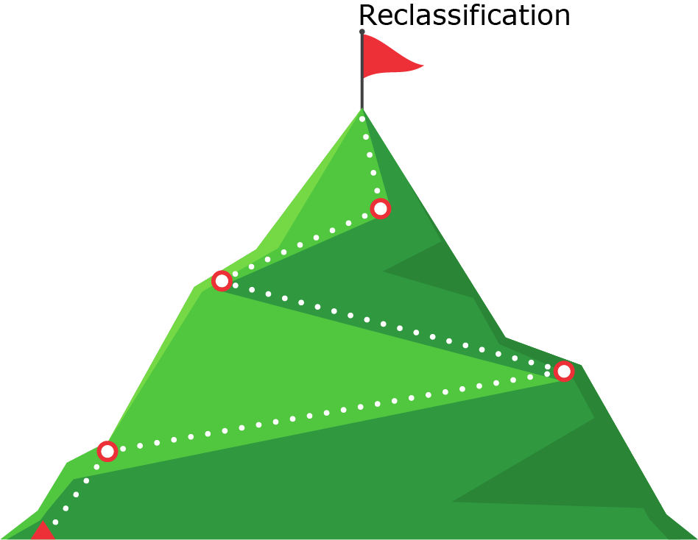
Why:
Initial ELPAC
Summative ELPAC
Notes:
Let’s start with the “why”.
The Initial ELPAC is used to identify students as being either an English learner (EL) or an IFEP, which stands for initially fluent English proficient.
The Summative ELPAC is given annually to all EL students to measure how well they are progressing with English development proficiency in each of the four domains.
Identifying students and monitoring their progress annually is important so these students can receive the supports they need to do well in school and have access to the full curriculum.

Slide 11


Who:
Initial ELPAC
Summative ELPAC
Notes:
The Initial Assessment is given only once during a student’s time in the California public school system to students if their home language survey indicates a language other than English. The Initial ELPAC is given within 30 days of when the student is enrolled at the school.
It’s important to understand that students may not have to take this part of the ELPAC.
LEAs should check CALPADS, the student information system, or students' cumulative files to determine whether or not the student has already been assessed with the Initial ELPAC or Summative ELPAC.
The Summative ELPAC is given only to students who have previously been identified as an English learner student based upon the Initial Assessment results, (either the CELDT Initial or the Initial ELPAC), until students are reclassified as English proficient.
The results are used as one of four criteria to determine if the student is ready to be reclassified as fluent English proficient, to help inform proper educational placement, and to report progress.

Slide 12
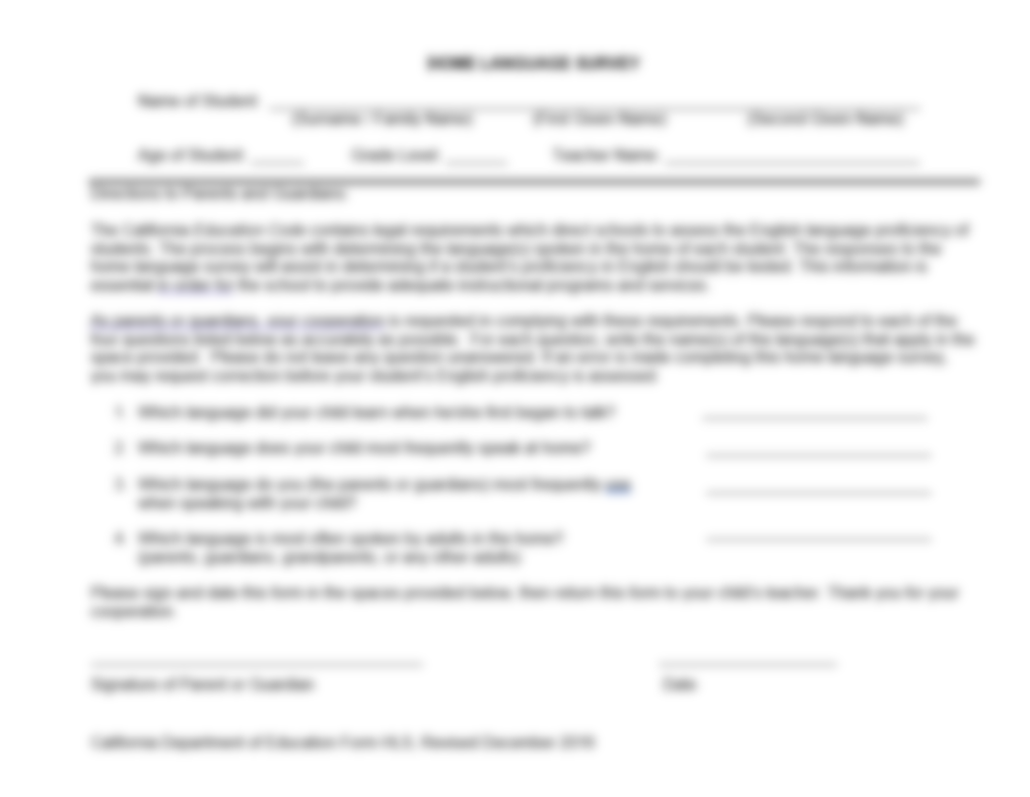
Home Language Survey
English Learner Forms - Compliance Monitoring (CA Dept of Education)
Notes:
[to remove blur, double click on the image, click the Artistic effects button, select remove effects]
As discussed in the precious slide, the home language survey is what indicates if a student needs to be administered the Initial ELPAC assessment.
If a language other than English is indicated, it becomes a basis administration of the Initial ELPAC.
This survey is given only once when a student enrolls in a CA public school for the very first time and is given by the school or LEA.

Slide 13

How:
Initial:
K, 1, 2, 3–5, 6–8, 9–12
Summative:
K, 1, 2, 3–5, 6–8, 9–10, 11–12
Notes:
The Initial ELPAC is given in kindergarten and grades 1, 2, 3–5, 6–8, and 9–12. This will be a computer-based assessment beginning on August 20, 2020.
The Summative ELPAC is given in kindergarten and grades 1, 2, 3–5, 6–8, 9–10, and 11–12. This is also primarily a computer-based assessment.
In kindergarten through grade 2, all domains are administered individually. However, K-2 writing can be given in a small group up to 10 students. In grades 3–12, the test is administered in groups, exclusive of speaking, which is assessed one-on-one.

Slide 14
When:
Initial ELPAC
July 1 – June 30
Optional Summative ELPAC
August 20 – October 30
Summative ELPAC
Feb 1 – May 31
Notes:
The Initial ELPAC is administered anytime throughout the year when a student, whose primary language is not English, enrolls in a U.S. school for the first time.
The Summative ELPAC is given each spring between February 1 and May 31.
(Tentative) Due to regulation changes stemmed from COVID-19, the CDE is planning an administration of an optional Summative ELPAC in fall 2020 for reclassification purposes.

Slide 15
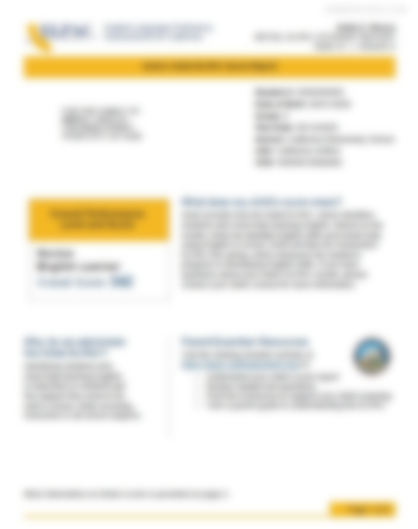
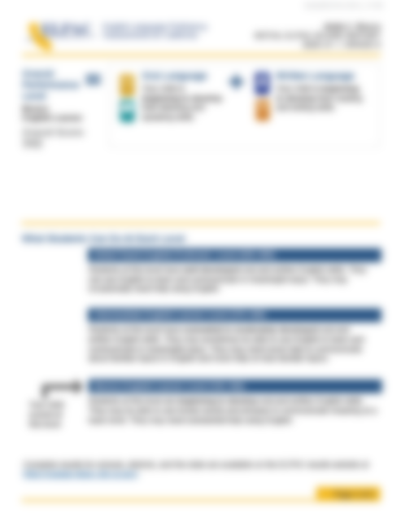
Initial ELPAC Student Score Report (SSR)
Initial
  Overall Score / Level (1–3)
  Oral Score / Level (1–3)
  Written Score / Level (1–3)
Notes:
[to remove blur, double click on the image, click the Artistic effects button, select remove effects]
Students who take the Initial ELPAC will also receive a student score report.
Because the ELPAC Initial is a shorter assessment, slightly less information is provided due to the validity and reliability of scores based on few assessment items.
For the ELPAC Initial, students will receive information about their overall score in one of three levels (compared to four levels for the Summative Assessment).
Students will also receive scores and performance levels for oral and written language at three levels.

Slide 16
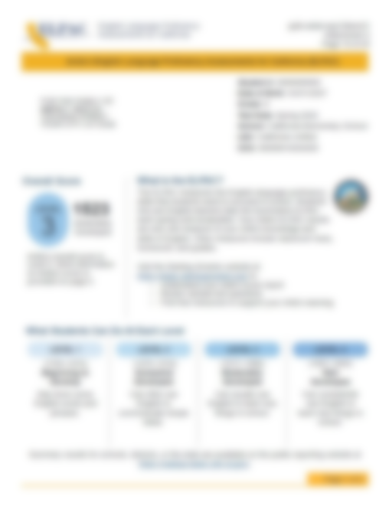
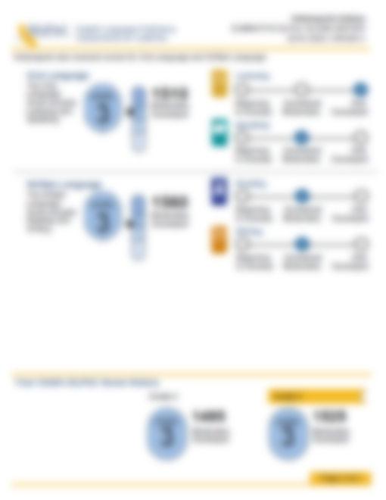
Summative ELPAC Student Score Report (SSR)
Summative
  Overall Score / Level (1–4)
  Oral Score / Level (1–4)
  Written Score / Level (1–4)
  Domain Level (1–3)
Notes:
[to remove blur, double click on the image, click the Artistic effects button, select remove effects]
Schools will receive Summative ELPAC student score reports between March and August. LEAs receive a file electronically and they can either make the SSRs available to parents electronically, print them, or order SSRs from the contractor. ETS no longer prints them and sends them to LEAs.
Student score reports will be sent 6-8 weeks after the tests are received by the testing vendor.
Each Student Score Report will provide parents specific information about how their child performed on the Summative ELPAC.
Students will receive scores and performance levels for oral and written language at four levels compared to three for the ELPAC Initial.
Summative ELPAC Score reports will show:
Overall Score and Level, which is the total number of points received by the student on this test.
Oral Language Composite and Written Language Composite score and level.
Oral Language Composite is comprised of speaking and listening
Written Language Composite is comprised of reading and writing
This gives you information on where student strengths and challenges are in the English language and where they might need additional support.
And finally you will see a Beginning, Somewhat/Moderately, or Well Developed assigned to each domain: listening, speaking, reading, and writing.

Slide 17

Alternate ELPAC - What:
The Alternate ELPAC measures the student’s English language proficiency through their expressive (speaking/writing) and receptive (reading/listening) communication.
Notes:
The Alternate ELPAC is designed for students with the most significant cognitive disabilities. Students are eligible only if an alternate assessment is indicated in their active individualized education program (IEP) by the IEP team.
There’s a both an Initial Alternate and a Summative Alternate ELPAC available to this population of students.

Slide 18
Alternate ELPAC - Why:
Initial Alternate ELPAC
Summative Alternate ELPAC
Notes:
The purpose of the Alternate ELPAC is twofold: the Initial Alternate ELPAC will provide information to determine a student’s initial classification as an English learner (EL) or as Initial Fluent English proficient (IFEP).
The Summative Alternate ELPAC will provide information on EL student’s annual progress toward ELP and support decisions for students who are eligible to be Reclassified Fluent English proficient (RFEP) or to continue receiving services if the reclassification criteria was not met.
The alternate ELPAC helps determine a student's ELP despite their significant cognitive disability and ensures a student's disability doesn't get in the way of demonstrating their language proficiency.
Some of the benefits of this assessment include allowing your child to demonstrate their level of English proficiency while taking into consideration the student’s cognitive disabilities, helping the school provide services and assistance targeted to the student’s individual needs, and providing you, the educator, with an annual report of your child’s progress in English proficiency.

Slide 19
Alternate ELPAC - Who:
Initial ELPAC
Summative ELPAC
Notes:
Students are eligible to take the Initial Alternate ELPAC if their IEP specifically states that they should take the Alternate ELP assessment AND their Home Language Survey indicates a language other than English.
The Initial Alternate ELPAC will be administered to all eligible students in kindergarten through twelve, ages three through twenty-one, whose primary language is a language other than English.
If the student is then classified as EL using the regular Initial ELPAC, and later determined eligible for an alternate ELP assessment, and it is listed in the student’s IEP, the student will be administered the Summative Alternate ELPAC.
LEAs are required to administer the Summative Alternate ELPAC annually to students identified as ELs until they are RFEP.

Slide 20
Alternate ELPAC - How:
Notes:
This is a computer-based assessment administered one-on-one by a Test Examiner who is familiar with the student and their needs.
The student will interact with a trained test examiner who will collect and record responses in the test delivery system.
The Alternate ELPAC is untimed; test items will be administered to the student over the course of one or more testing sessions, as needed, for the student to complete the English proficiency assessment.

Slide 21

Alternate ELPAC – When (1)
Notes:
The Alternate ELPAC Field Test will be conducted January 12 through February 16, 2021.
This is a Census operational field test which means it is not optional.
Every student with significant cognitive disabilities with an indicated need to take alternate assessments on their IEP will be administered the Alternate ELPAC operational Field Test.
IEP teams and school need to start planning for this (holding IEP meetings, talking to parents, etc.) This is the first time there is a statewide Alternate ELPAC assessment available and will take place of all local alternate assessments for English language proficiency.

Slide 22
Alternate ELPAC – When (2)
Initial ELPAC
July 1 – June 30
Summative ELPAC
Feb 1 – May 31
Notes:
The window for the Alternate ELPAC is the same as the regular ELPAC.
The Initial window spans from July 1 – June 30.
The Summative window spans from February 1 – May 31.

Slide 23

Reclassification
https://www.cde.ca.gov/sp/el/rd/
Notes:
As we briefly mentioned earlier, reclassification is the process whereby a student is reclassified from an English learner to RFEP.
There are criteria that must be met to determine if a student has sufficient English proficiency to be reclassified as a fluent English speaker.
For more information about reclassification, please go to the CDE Reclassification web page.

Slide 24

Resources for Teachers
Available Resources Website
https://www.elpac.org/resources/available-resources-elpac/
Notes:
So now that you have a better understanding of the ELPAC assessment, we would like to provide some resources that can help support students through their English Learner development.
A helpful resource can be found on the Available Resource webpage on the CDE website.
There is an Available Resource page for each assessment.
Here you can find links to multiple resources associated with the administration of the ELPAC.
They are updated annually and are a great starting point if you want to learn more about the assessments.

Slide 25
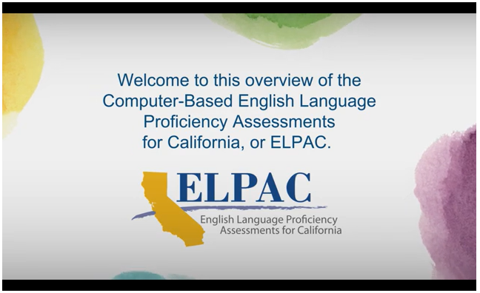
For Parents and Teachers
ELPAC Overview Video in English and Spanish
https://www.elpac.org/resources/videos/
Notes:
The computer-based ELPAC Overview Video is another valuable resource.
This video provides information about the ELPAC including, why the ELPAC is important, the domains included in the assessment, accessibility, and other significant aspects to the administration of the ELPAC assessment.

Slide 26
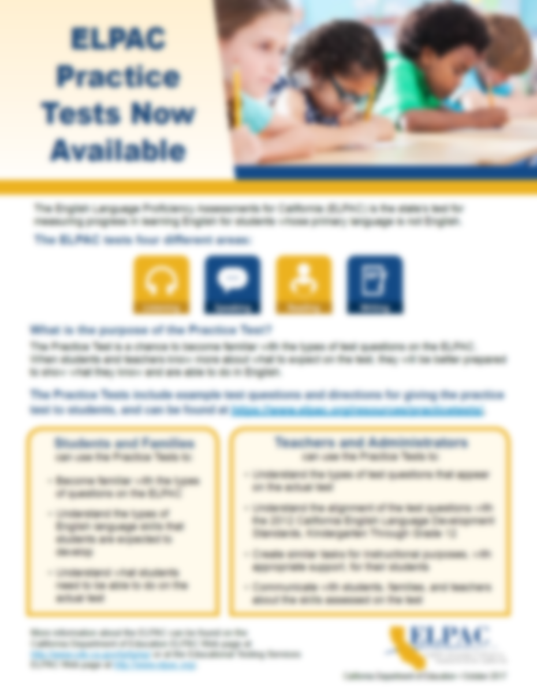

For Parents and Teachers
Practice Test Flyers
Notes:
If you want to know even more, as I’m sure you do, here is another helpful resource for you: Training Test Flyers.
As you can see both of these flyers are for the ELPAC but the one on the left is geared towards educators and the one on the right towards parents.
The practice tests are free and available to anybody who wants to use them, no special login required.
Practice tests allow students to become familiar with the items on the ELPAC and what is asked of the student.

Slide 27
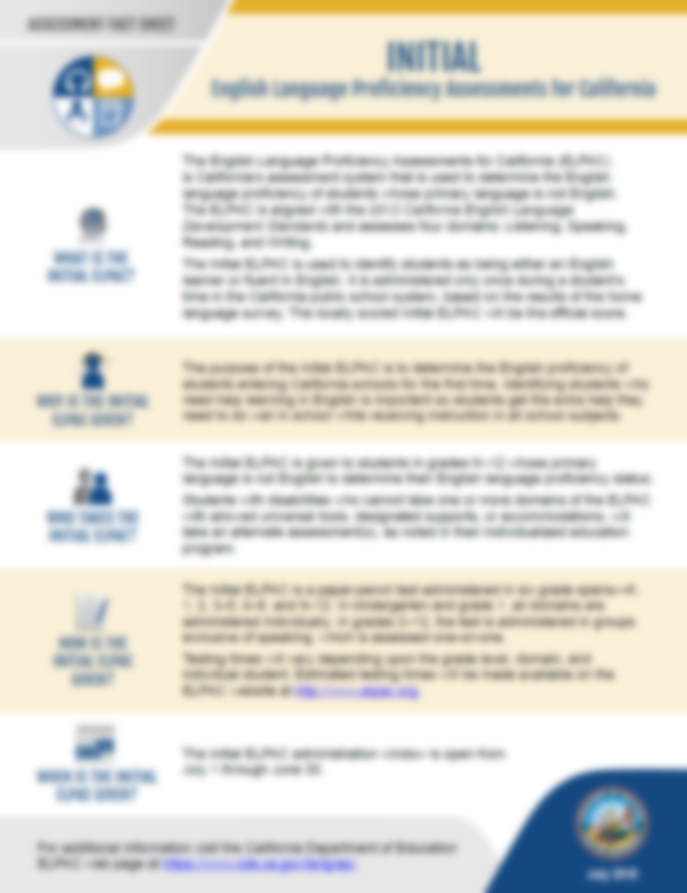
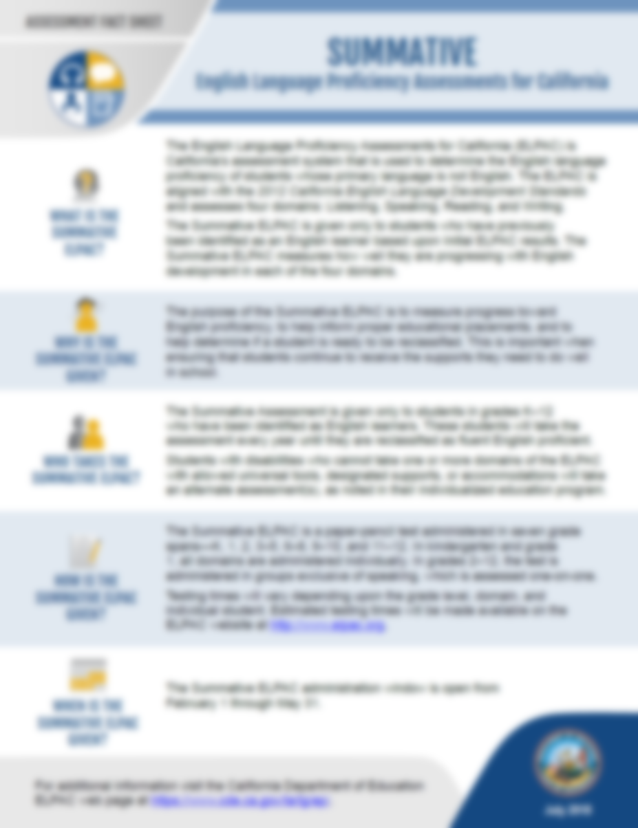
Information for Parents
Assessment Fact Sheets
Notes:
[to remove blur, double click on the image, click the Artistic effects button, select remove effects]
Let’s talk for a moment about the handouts you picked up at the beginning of this session.
You will find them helpful in learning more about the ELPAC and communicating the pertinent information with families of your students.
The first one I wanted to mention is a series of documents called Assessment Fact Sheets. What you see here are two assessment fact sheets:
One for the Initial ELPAC
And one for the Summative ELPAC
You may use these to learn general information about the what?, why?, who?, how?, and when? of the different parts of the ELPAC.
These documents are updated annually so they represent the most current information available and contain links to CDE web pages where you can find more information about each assessment.

Slide 28
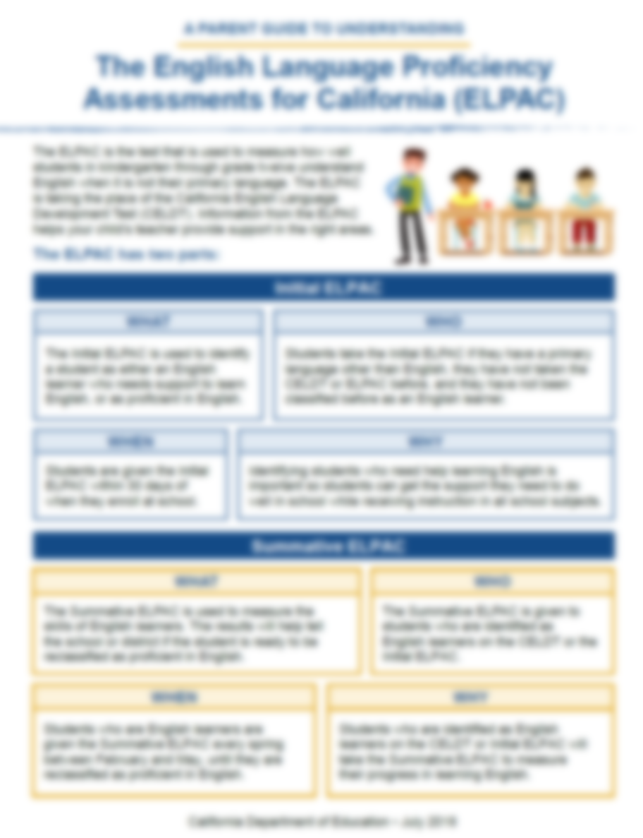

Information for Parents
Parent Guides to Understanding
Notes:
[to remove blur, double click on the image, click the Artistic effects button, select remove effects]
Next you have the Parent Guides to Understanding.
This also covers the basics of who?, what?, when?, why?, and how? of the ELPAC
It provides information in a more parent-friendly language and are available on the CDE website in the top seven languages spoken in California.
These handouts would be great to provide to parents at the parent/teacher conference or even at the back-to-school night.

Slide 29

Family Engagement
Notes:
We would also like to call out the things parents would like to know about their child’s progress in school. When you talk to parents about their student’s ELPAC scores or classroom progress, you can focus on:
Where their child is doing well?
Where their child might need some extra support?
Who will provide that extra support?
How can they and other family members help at home?

Slide 30

Starting Smarter
https://ca.startingsmarter.org/
https://elpac.startingsmarter.org/
Notes:
Once these conversations occur, it may be helpful to provide parents with these great resources for the CAASPP and ELPAC.
Both websites are available in both English and Spanish and include a wealth of resources to help parents understand their child’s student assessment scores and what steps they can take to help their child progress in their learning.

Slide 31
Questions?
Notes:
We have reached the end of this presentation.
Are there any questions I can answer?
Thank you!

Slide 32
Posted by the California Department of Education | June 2020

