Slide 1
Item 1: Related to California’s State and Federal Accountability System: Review of the 2024 California School Dashboard and the 2025 Accountability Work Plan
California Practitioners Advisory Group
December 13, 2024

Slide 2
Topics
2024 California School Dashboard (Dashboard) Overview
Review of the 2025 Accountability Workplan
Next Steps for the State Board of Education (SBE)
Public Comment

Slide 3
2024 California School Dashboard Overview

Slide 4
Student Groups Reported in the Dashboard
Race/Ethnicity Student Groups | Program Student Groups
African American | Foster Youth
American Indian | Homeless
Asian | Socioeconomically Disadvantaged
Filipino | Students with Disabilities
Hispanic | English Learners
Two or More Races | Long-Term English Learners-NEW
Pacific Islander | n/a
White | n/a

Slide 5

Long-Term English Learner in Accountability
Definition: “A pupil who has not attained English language proficiency within 7 years of initial classification as an English learner”
Accountability Cumulative Enrollment Student Count: 300,802
Included in Local Control Funding Formula Accountability Determinations

Slide 6

2024 Dashboard: New Indicator
Science Indicator appears for informational purposes on the 2024 Dashboard
Based on data from the California Science Test (CAST) and
California Alternate Assessment for Science (CAA Science)

Slide 7

Science Indicator Methodology and Grades Included
Similar methodology as the Academic Indicators for English Language Arts/Mathematics but uses different scales
Status and Change: Distance From Standard
Grades tested:
  Students in grade 5th and 8th grade students
  Once in high school students (tested in either 10th, 11th, or 12th grade)

Slide 8

No Performance Levels
Science Indicator is not used for school or district accountability determinations in 2024
Performance levels for this indicator will be considered by the SBE in 2025

Slide 9
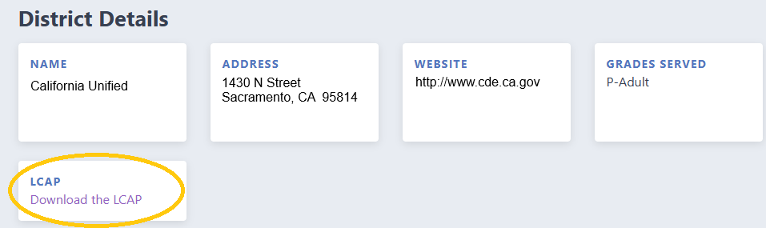
Local Control and Accountability Plan Download
The LCAP is now accessible on the Dashboard home page for every local educational agency

Slide 10
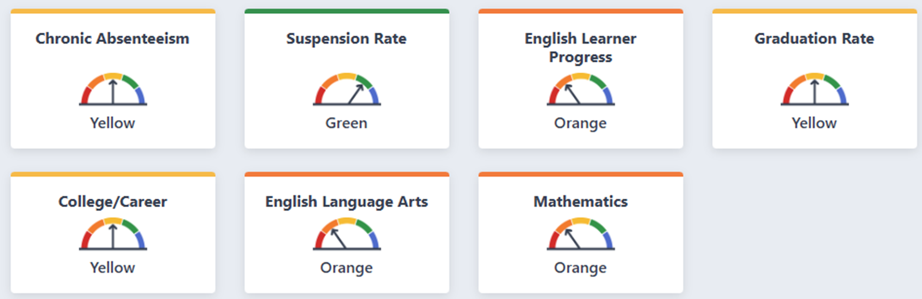
2024 Dashboard State Summary

Slide 11
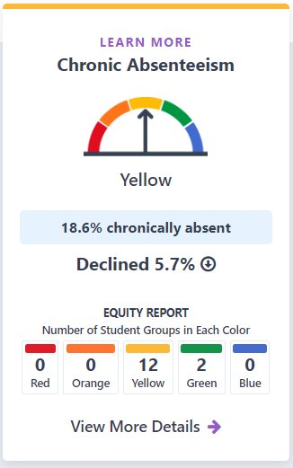
Chronic Absenteeism Indicator Statewide Results
Represents LEAs and schools that serve kindergarten through grade eight students whose students were absent 10 percent or more of the school year.
For most state indicators, the desired outcome is to have a high percentage of performance in the current year. This indicator has a reverse goal of having the lowest percentage of students chronically absent in the current year.

Slide 12
Chronic Absenteeism Additional Information
Type | Total | Red | Orange | Yellow | Green | Blue
Schools | 7,731 | 547 (7.1%) | 866 (11.2%) | 4,996 (64.6%) | 1,041 (13.5%) | 281 (3.6%)
Districts | 837 | 46 (5.5%) | 98 (11.7%) | 559 (66.8%) | 118 (14.1%) | 16 (1.9%)

Slide 13
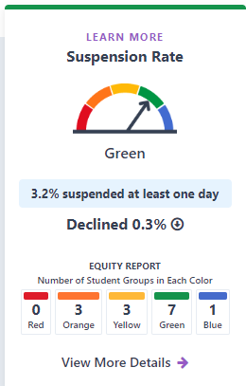
Suspension Rate Indicator Statewide Results
This indicator represents the percentage of students who were suspended for an aggregate total of one full day anytime during the school year.
For most of the other state indicators, the desired outcome is to have a high percentage in the current year and an increase in percentage from the prior year. However, for this indicator, the desired outcome is reversed, and the goal is to achieve a low suspension rate.

Slide 14
Suspension Rate Additional Information
Type | Total | Red | Orange | Yellow | Green | Blue
Schools | 9,671 | 674 (7.0%) | 2,018 (20.9%) | 1,580 (16.3%) | 2,396 (24.8%) | 3,003 (31.1%)
Districts | 943 | 73 (7.7%) | 218 (23.1%) | 206 (21.9%) | 302 (32%) | 144 (15.3%)

Slide 15
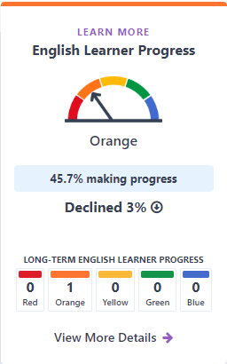
English Learner Progress Indicator Statewide Results
This indicator represents the percentage of English learner (EL) students who are progressing towards English language proficiency. In 2024, this indicator added Long-Term English Learners, which is subset of the EL student group.
It measures progress toward English language proficiency by comparing English Learner students’ results from the current Summative English Language Proficiency Assessments for California (ELPAC) and Summative Alternate ELPAC to the prior year Summative ELPAC and Summative Alternate ELPAC results.

Slide 16
English Learner Progress Indicator Additional Information
Type | Total | Red | Orange | Yellow | Green | Blue
Schools | 6,415 | 1,624 (25.3%) | 1,877 (29.3%) | 916 (14.3%) | 1,267 (19.8%) | 731 (11.4%)
Districts | 666 | 105 (15.8%) | 286 (42.9%) | 104 (15.6%) | 129 (19.4%) | 42 (6.3%)

Slide 17
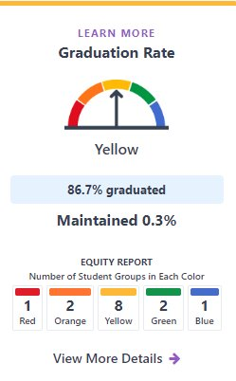
Graduation Rate Indicator Statewide Results
Represents the percentage of students who received a high school diploma within four or five years of entering ninth grade or complete their graduation requirements at an alternative school.

Slide 18
Graduation Rate Indicator Additional Information
Type | Total | Red | Orange | Yellow | Green | Blue
Schools | 1,942 | 258 (13.3%) | 208 (10.7%) | 314 (16.2%) | 468 (24.1%) | 694 (35.7%)
Districts | 407 | 19 (4.7%) | 37 (9.1%) | 63 (15.5%) | 182 (44.7%) | 106 (26%)

Slide 19
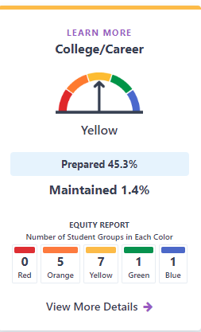
College/Career Indicator Statewide Results
This indicator represents the percentage of high school graduates who are prepared by their school/LEA for college or a career.
The indicator was designed to encourage high schools to provide all students with a rigorous broad course of study that prepares them for postsecondary success. For the 2024 Dashboard, the CCI returns to having full colors on the Dashboard.

Slide 20
College/Career Indicator Additional Information
Type | Total | Red | Orange | Yellow | Green | Blue
Schools | 1,930 | 351 (18.2%) | 443 (23%) | 360 (18.7%) | 513 (26.6%) | 263 (13.6%)
Districts | 405 | 22 (5.4%) | 91 (22.5%) | 106 (26.2%) | 149 (36.8%) | 37 (9.1%)

Slide 21
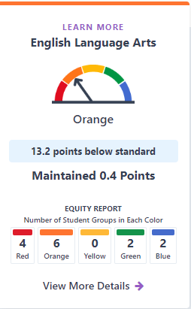
English Language Arts Indicator Statewide Results
This indicator applies to districts and schools that serve students in grades three through eight and grade eleven and is based on Student performance on the Smarter Balanced Summative Assessments and the California Alternate Assessments.
Each Academic Indicator is calculated using two components:
Distance from Standard (DFS): The average distance (in points) away from Level 3/Standard Met, and
Participation rate

Slide 22
English Language Arts Indicator Additional Information
Type | Total | Red | Orange | Yellow | Green | Blue
Schools | 8,914 | 951 (10.7%) | 2,852 (32.0%) | 2,237 (25.1%) | 2,017 (22.6%) | 857 (9.6%)
Districts | 884 | 64 (7.2%) | 362 (41.0%) | 211 (23.9%) | 184 (20.8%) | 63 (7.1%)

Slide 23
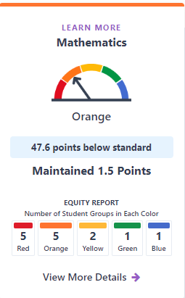
Mathematics Indicator Statewide Results
This indicator applies to districts and schools that serve students in grades three through eight and grade eleven and is based on Student performance on the Smarter Balanced Summative Assessments and the California Alternate Assessments.
Each Academic Indicator is calculated using two components:
Distance from Standard (DFS): The average distance (in points) away from Level 3/Standard Met, and
Participation rate

Slide 24
Mathematics Indicator Additional Information
Type | Total | Red | Orange | Yellow | Green | Blue
Schools | 8,916 | 956 (10.7%) | 2,878 (32.3%) | 2,581 (29.0%) | 1,709 (19.2%) | 792 (8.9%)
Districts | 884 | 81 (9.2%) | 349 (39.5%) | 261 (29.5%) | 133 (15.1%) | 60 (6.8%)

Slide 25
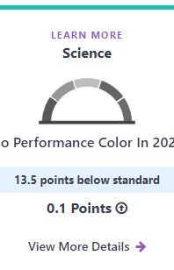
Science Indicator Statewide Results
This indicator is for informational purposes and reports how well students are meeting grade-level standards on the Science assessment. This measure is based on student performance on either the California Science Test (CAST) or the California Alternate Assessment for Science, which is taken annually by students in grades 5, 8 and once during high school.

Slide 26
Local Control Funding Formula Eligibility Determinations

Slide 27
Levels of Support
Level of Support | Description of Support
Level 1- Universal Support for All | Resources and assistance that is made available to all local educational agencies
Level 2 – Targeted Support/Supplemental (Differentiated Assistance) | Local educational agencies that meet certain eligibility criteria for additional support
Level 3 – Intensive Intervention (Direct Technical Assistance) | The California Collaborative on Education Excellence (CCEE) provides more intensive support for eligible LEAs
State Level Intervention | The SSPI may, with the approval of the State Board of Education, intervene where the CCEE determines that the LEA meets specified criteria

Slide 28
Differentiated Assistance Criteria
Districts and county offices of education (COEs) are eligible for differentiated assistance based on the following entry criteria:
    Student group performance in two or more LCFF state priority areas, or
    Performance on local indicators in two or more priority areas, or
    A combination of student group performance in one state priority area and local indicator performance in one different priority area.
The eligibility criteria for charters is identical to districts/COEs eligibility criteria, except for charter schools are required to meet the criteria in two or more years.

Slide 29
Multi-Year County Office of Education/District Differentiated Assistance Eligibility
Category | 2019 | 2022 | 2023 | 2024
Districts/COEs | 333 | 617 | 466 | 436

Slide 30
2024 County Office of Education/District
Differentiated Assistance Eligibility
Category | 2024
Districts/COEs no longer eligible | 153
Newly eligible Districts/COEs | 123

Slide 31
Districts/COEs LCFF
Differentiated Assistance Results
In 2024, 153 or 15.4 percent of the COEs/Districts eligible for differentiated assistance in 2023 made significant improvements and are no longer eligible for differentiated assistance.
In 2024, 436 districts and COEs are eligible for differentiated assistance under LCFF.
The three student groups in greatest need of support are:
  Long-Term English Learners
  Students with Disabilities
  Homeless

Slide 32
Multi-Year Charter School
Differentiated Assistance Eligibility
Category | 2023 | 2024
Charter Schools | 203 | 173

Slide 33
2024 Charter Schools
Differentiated Assistance Eligibility
Category | 2024
Charter Schools no longer eligible | 94
Newly eligible Charter Schools | 67

Slide 34
Charter School LCFF
Differentiated Assistance Results
In 2024, 173 or 13.6 percent of charter schools are eligible to receive differentiated assistance.
In 2024, 94 or 7.4 percent of the charter schools eligible for differentiated assistance in 2023 made significant improvements and are no longer eligible for differentiated assistance.
The three student groups in greatest need of support are:
  Students with Disabilities
  Socioeconomically Disadvantaged
  English Learners

Slide 35
Every Student Succeeds Act (ESSA)
Schools Eligible for Assistance

Slide 36
ESSA School Eligibility
A verbal update will be provided on the status on this release at the CPAG meeting.

Slide 37

Dashboard Toolkit
The Accountability Toolkit is organized as a one-stop-spot for all your Dashboard communications needs and links.

Slide 38
Long-Term English Learner
Web Resource
New web page to support data reporting for Long-term English Learners.
Includes overview of definitions, start and end dates for determining how long a student is an EL, and relevant additional resources.

Slide 39
2025 Accountability Workplan

Slide 40
2025 California School Dashboard
The California Department of Education (CDE) is committed to continuous improvement within the accountability system and Dashboard.
CDE's annual workplan reviews the state and local indicators and performance standards and addresses suggested revisions or updates in the workplan each January and approves all action by the July meeting of that year.

Slide 41
Update to Dashboard Schedule
SB 114 (Chapter 48, Statutes of 2023) moves up the publication date of the 2025 Dashboard to November 15, 2025.

Slide 42
Review of 2025 Accountability Workplan
Incorporation of the Science indicator into the Dashboard
Incorporation of the Student-Level Growth Model for Grades 4 through 8 in ELA and Mathematics into the Dashboard
Review of currently adopted College/Career Indicator components
Review of Participation Rate for Academic Indicators and Science
Review of DASS Application/Renewal Criteria
Differentiated Assistance Eligibility based on CALPADS data submissions
Review of Priority 1: Teacher Assignment Data
ESSA State Plan

Slide 43
Incorporation of the Science Indicator into the Dashboard

Slide 44
Science Workplan and Dashboard Principles
Principle 5: Values high performance and growth equally.
Principle 8: Reflects technical quality through measures that are valid and reliable.
Principle 11: Is subject to continuous revision and improvement.

Slide 45
Background on Science (1 of 3)
2018
  First operational California Science Test was administered to student in grades five, eight, and once in high school.
2020
  At the March SBE meeting, CDE discussed the timeline for potential incorporation of the Science test results into the Dashboard.

Slide 46
Background on Science (2 of 3)
March 2022 SBE Meeting
  CDE provided an update on the feasibility of when the science results could be incorporated into the Dashboard considering the revised blueprints.
September 2022 SBE Meeting
  SBE approved the insertion of a link on the Dashboard Additional Reports to the California Science Test results on the CAASPP website.

Slide 47
Background on Science (3 of 3)
December 2022 and 2023
  2022 Dashboard Additional Reports links to the California Science Test (CAST) results on the CAASPP website.
July 2024 SBE Meeting
  SBE approves a metric to measure Science on the Dashboard, inclusion of a participation rate, and a high school methodology
November 2024
  Science Indicator published on the 2024 Dashboard with status and change for informational purposes only

Slide 48
SBE Decision Points for Science Workplan
To move forward with this process, the SBE will need to take action on the following five remaining decision points:
Approval of Status Cut Points
Approval of Change Cut Points
Approval of a Color Scheme for the Five-by-Five Color Grid
Inclusion of the Indicator within the State Accountability System through Differentiated Assistance Criteria (DA)
Inclusion of the Indicator within the Federal Accountability System through Every Student Succeeds Act (ESSA) Eligibility Identification

Slide 49
Decision Points 2-4:
Creation of a Color on the Dashboard
CDE will evaluate the results and share the distribution of results for the Science Assessment metric from the 2021–22, 2022–23 and 2023–24 assessments.
SBE will establish cut points for status and change and choose a color scheme for the five-by-five color grid.

Slide 50
Decision Points 5 and 6:
Support Eligibility Determinations
The final decision points for the SBE would be to evaluate whether results on the metric would be added to the criteria to identify LEAs under the LCFF eligibility criteria and/or schools ESSA criteria.

Slide 51
2025 Science Assessment Workplan: Science Indicator with a Color
Phase II: Decision Points 2, 3, and 4
Approval of Status Cut Points, Change Cut Points, and Color Scheme for the Five-by-Five Color Grid
  CDE Work Timeframe: January 2025
  State Board of Education Meeting: March 2025
Posting of Science Indicator with a full color on the 2025 Dashboard

Slide 52
2025 Science Assessment Workplan:
State and Federal Eligibility
Phase II: Decision Points 5 and 6
Decision on the inclusion of the Indicator within the state accountability system through Differentiated Assistance Criteria and Federal Accountability System through ESSA Eligibility Identification
  CDE Work Timeframe: January – May 2025
  California Practitioners Advisory Group: June 2025
  State Board of Education Meeting: July 2025
(If Approved) Inclusion of Science in LCFF Determinations based on 2025 Dashboard
(If Approved) Submit ESSA State Plan Revisions for Inclusion of Science in ESSA Determinations to U.S. Department of Education effective with the 2026 Dashboard

Slide 53
Incorporation of the
Student-Level Growth Model for Grades 4 through 8 in English Language Arts and Mathematics into the Dashboard

Slide 54
Student Level Growth Workplan and Dashboard Principles
This work aligns with the following Dashboard Principles:
  Principle 2: Reports opportunity and performance gaps among student groups through the Equity Report that is available for each state indicator.
  Principle 4: Values each indicator equally.
  Principle 5: Values high performance and growth equally.
  Principle 8: Reflects technical quality through measures that are valid and reliable.
  Principle 11: Is subject to continuous revision and improvement.

Slide 55
Background on Student Level Growth Data
The SBE adopted a growth calculation and model in May 2021.
In December 2024, the CDE will release the initial set of English Language Arts (ELA) and mathematics growth data using three years of assessment data from 2021–22, 2022–23 and 2023–24.
The release of these results will allow the SBE to begin conversations about how growth data will be incorporated into the Dashboard and support determinations for the State and Federal Accountability systems.

Slide 56
Growth Workplan: Early 2025
Early 2025: CDE will release the initial set of student level growth data using the three years of the California Assessment of Student Performance and Progress (CAASPP) summative assessment scores from the 2021–22, 2022–23, and 2023–24 school years.

Slide 57
Growth Release on the Dashboard
The release will include:
  A graphic display of the results on the “Details” page of the Dashboard
    Explanations of the growth scores will be presented on each page and customized to each score and each school/district

Slide 58
2025 Growth Workplan
June 2025 CPAG Meeting
July 2025 SBE Meeting:
  SBE will decide if/how growth will be included in Accountability determinations
  SBE will approve performance standards for student growth
Late 2025/Early 2026:
  Growth data released based on CAASPP Summative Assessments for 2022–23, 2023–24 and 2024-25 school years.

Slide 59
Review of Currently Adopted College/Career Indicator components

Slide 60
College/Career Workplan and Dashboard Principles
The work on this state indicator aligns with the following Dashboard Principles:
  Principle 2: Reports opportunity and performance gaps among student groups through the Equity Report that is available for each state indicator.
  Principle 3: Reports each indicator separately.
  Principle 4: Values each indicator equally.
  Principle 8: Reflects technical quality through measures that are valid and reliable.
  Principle 11: Is subject to continuous revision and improvement.

Slide 61

What is the College/Career Indicator?
Measures how well districts and schools are preparing its graduates for college/career.

Slide 62
Development of the CCI
The CCI was developed to emphasize that a high school diploma represents the completion of a broad and rigorous course of study that prepares students for success after high school.
It was originally adopted by the State Board of Education (SBE) in July 2016 and performance levels (colors) were reported for the first time on the 2018 Dashboard.
It is based on students in each four-year graduation cohort and uses specific criteria that are reliant on assessments and course completion data to determine if students are “Prepared,” “Approaching Prepared,” or “Not Prepared” for college and/or career.

Slide 63
CCI Dashboard Workplan
Review currently adopted CCI Components:
  College Credit Courses
  Assessments
  State and Federal Jobs Program: ROC/P Programs
Update the SBE on the data collection for the Seal of Civic Engagement

Slide 64
College Credit Courses
Current requirements for courses:
  Correct college credit course code (Academic College Credit Course or CTE Course)
  Receive a C- or better
Evaluate additional components for course data:
  UC/CSU Transferability
  Minimum number of units
  A-G Subject Area

Slide 65
Assessments in CCI
Review the inclusion of Assessments in the CCI
  CAASPP Assessments
    Scores by students are included in both the Academic Indicators as well as the CCI
  Advanced Placement/International Baccalaureate Scores

Slide 66
State and Federal Jobs Programs: ROC/P
Adopted in 2020 as part of career measures for Dashboard Alternative Status Schools
Review removal of this measure from CCI as duplicative of other state and federal jobs programs
  CALPADS collection on this data was incomplete in 2021
  CALPADS no longer collects any data about these programs

Slide 67
Update on Data Collection for the
Seal of Civic Engagement
CDE created an ad-hoc data collection to the 2023–24 End-of-Year (EOY) process for LEAs to submit student-level information for those who have earned the Seal of Civic Engagement.
CDE will analyze the data and learn more about the students who are earning the seal for future consideration by the SBE.

Slide 68
Review of Participation Rate for Academic Indicators and Science

Slide 69
Participation Rate Rules
The Dashboard incorporates a participation rate penalty into the status for all schools/districts/student groups that fall below 95 percent
  Business rules were established in 2018 to include a grace period at the start and end of the assessment windows for participation
In response to feedback from the field, the CDE will evaluate the reliability and validity of the grace periods using recent assessment and Dashboard information and provide an update to the SBE

Slide 70
Review of DASS Application/ Renewal Criteria

Slide 71
Background on Dashboard Alternative School Status
California Education Code (EC) Section 52052(g) requires the Superintendent of Public Instruction, with approval of the SBE, to develop an alternative accountability system for schools that serve a large percentage of high-risk students.
The EC also identifies specific types of schools as alternative (e.g., juvenile court, county community day, etc.) that would automatically be eligible to participate in alternative school accountability.

Slide 72
Alternative Schools Not Included in Education Code
In 2003, the SBE adopted the first definition of alternative schools eligible for inclusion in the alternative school system.
This definition includes alternative schools of choice and charter schools in which 70 percent of the school’s total enrollment is composed of the following high-risk groups:
  Expelled
  Suspended
  Wards of the court
  Pregnant and/or parenting
  Recovered dropouts
  Habitually truant or habitually insubordinate and disorderly
  Retained more than once in kindergarten through grade eight

Slide 73
2017 Additional Criteria for Identification of Alternative Schools
In July 2017, the SBE adopted the following additional criteria for DASS schools:
  Define recovered dropouts based on EC Section 52052.3(b) as students who: (1) are designated as dropouts pursuant to the exit and withdraw codes in the California Longitudinal Pupil Achievement Data System (CALPADS), or (2) left school and were not enrolled in a school for a period of 180 days.
  Students who are credit deficient (i.e., one semester or more behind in the credits required to graduate on-time)
  Students with a gap in enrollment
  Students with high level transiency
  Foster Youth
  Homeless Youth
  Emotionally disturbed students

Slide 74
Alternative Schools Application Process
The SBE-adopted DASS criteria required that the alternative school application process should include a process to verify over time that schools continue to serve a large percentage (i.e., 70 percent) of high-risk students, as defined in the SBE eligibility criteria.
The SBE also adopted a requirement that DASS schools (not explicitly defined as alternative in EC) be required to re-certify every three years for alternative school status.

Slide 75
Differentiated Assistance Eligibility Based on CALPADS Data Submissions

Slide 76


CALPADS Differentiated Assistance

Slide 77
CALPADS Differentiated Assistance (DA)
Background
Requirements
Implementation
Universal Supports

Slide 78

California School Dashboard Deadlines
By 2026, the California School Dashboard shall be released by October 15th concurrent with the annual release of statewide California Assessment of Student Performance and Progress (CAASPP)

Slide 79
Requirement—Senate Bill 114 (2023)
Education Code Section (EC) 52071 created new DA eligibility criteria for School Districts and County Office of Education (COEs)
Any district or COE that “fails to submit data according to the processes and timelines” in (EC 60900(f))
  (EC 60900(f)) states that “local educational agencies shall submit data according to the processes and timelines established by the department.”
For DA, “the county superintendent of schools shall provide technical assistance focused on the school district’s data management processes” and existing DA requirements

Slide 80
CALPADS DA Exceptions
Charter Schools are not included in the CALPADS DA eligibility assistance criteria
Charter Authorizer and COEs can still support charter schools in efforts to certify accurate data on time

Slide 81
Considerations for CALPADS DA Implementation
Criteria for Eligibility
When to notify DA eligible LEAs
What is needed for COEs to monitor this assistance
Developing awareness of supports for all LEAs from CSIS

Slide 82
Three-Year Phased in CALPADS DA Process
Moving from a focus on certification to a focus on certifying timely and accurate data
2023-24 Certified Data
PLUS
2024-25 Submission Deadlines Universal Supports Toolkit
PLUS
2025-26 Accurate Data

Slide 83
Support Toolkit Considerations for DA Phase 2
Address reasons for CALPADS DA eligibility
Existing data management practices
  Self evaluation
  Proctored evaluation
Root cause analysis
Data management needs assessment
LCAP integration – or other ways to stay accountable

Slide 84
Data Quality Considerations for DA Phase 3
Eligibility for data quality DA Identification
Timeline for eligibility
Threshold for eligibility

Slide 85


Example DA Eligibility

Slide 86
DA Phase 2 Eligibility Timeline Example
(District Submits Fall 1 Data After Close of Amendment Window)
January 2025 FALL 1 Close
District Submits Fall 1 Data
District notified of DA Eligibility
District/COE Creates and Implements Plan addressing Data Management, Data Governance, and Root Cause for DA eligibility using DA Toolkit
December DA Eligibility List Published

Slide 87
Next Steps
Collaborate with partners
Add CALPADS DA as an eligibility type in existing DA file
Develop CDE and CSIS webpages and resources
  Universal Supports Toolkit
  CALPADS DA Data Quality eligibility parameters
    Timeline and Threshold
    Creating Data Quality List

Slide 88
CSIS Update on DA Resources
Universal Supports Toolkit
Data Management
  Data Culture
Tools
Training

Slide 89
Poll – Where are you on your data management journey now?
Beginner - I just learned about data management today.
Intermediate - We started but I don’t know where we are.
Advanced - We have exhaustive Data Governance plans and documentation that describes everything we do.
Expert - Do you want to add anything?

Slide 90
Resource: Data Management Assessment
CDMA Scenarios:
Baseline Practices
Analyze Departments
Target Specific Areas
Continual Improvement

Slide 91
CSIS Data Management Assessment (CDMA)
Categories
Data Governance
Data Culture & Literacy
Compliance & Reporting
Data Use & Analysis
Data Privacy & Security
Data Quality
Continuous Improvement & Feedback
Student Success & Outcomes
Information Systems & Data Integration
Data Team Staffing & Professional Learning

Slide 92
CSIS Data Management Maturity Model (CDM3)
Actionable Insights: Assisting informed decision making and prioritizing
Maturity Levels: Understanding your current data management capabilities
Guidance and Criteria: Establish a clear roadmap for progress and improvement
Artifacts and Activities: Implementing effective projects and initiatives
Progress Tracking: baseline and continuous improvement benchmarks.

Slide 93
Fostering Data Culture through Governance
People
Processes
Data systems

Slide 94
What Do We Mean by Data Culture?
To be data-driven and to comply with regulations
Vision & Strategy:
People
  Beliefs
  Values
Process
  Norms
Technology
  Resources
  Space
Data governance
Data culture

Slide 95
People
Special Education Coordinator
Business Advisory Services
School Sites Registrars Counselors Principals
English Learner Coordinators
Community Outreach Coordinator
Curriculum Instruction Director
Behavioral Assistant Superintendent Student Services
Risk/Compliance Coordinator
Maintenance Operations Director
Testing Assessment Coordinator
Classroom Teachers
Student Services Director
Payroll Technicians
Technology Director/CTO
HR/Credentials Analysts
Student Services Director and Superintendent

Slide 96
Processes
Strategic Planning
Special Education Compliance
HR Hiring On/Offboarding
Student Enrollment
Transportation Scheduling
Parent community Engagement
Performance Monitoring
Facilities Management,
Compliance Reporting
Assessment Testing
Maintenance Work Order
Budget Planning Development
Assessment Testing
Attendance Tracking
Benefits Management
Asset Inventory Management
Professional Development.

Slide 97
Processes (continue)
Human Resources Information System (HRIS)
Enterprise Resource Planning (Finance) (ERP)
Parent / Community Engagement Systems
Transportation Management Systems
Facilities Management & Security Systems
Student Information System (SIS)
Special Education Data System (SEDS)
Testing / Assessment Systems
Data Warehousing & Local Dashboards
Enterprise Document Management Platform

Slide 98
Review of Priority 1: Teacher Assignment Data

Slide 99
Priority 1–Teacher Data Workplan and Dashboard Principles
This work aligns with the following Dashboard Principles:
  Principle 8: Reflects technical quality through measures that are valid and reliable.
  Principal 9: Leverages the expertise and perspectives of a broad set of educational partners and community members.
  Principle 10: Promotes coherence between data reporting and support/improvement programs.
  Principal 11: Is subject to continuous revision and improvement.

Slide 100

Priority 1—Teacher Data Background
In 2023, the SBE adopted displaying information from the 2021–22 Teacher Assignment Monitoring Outcomes (TAMO) reports within Local Measure Priority 1
The SBE also updated the self-reflection tool for Priority 1 consistent with the addition of statewide data related to the assignment of teachers

Slide 101
Priority 1–Teacher Data Workplan
In 2024, the CDE continues to provide technical and policy support to LEAs for these reports and similar reports on the School Accountability Report Card (SARC)
The CDE is preparing for the release of these related reports on DataQuest in early 2025:
  Certificated Staff Counts by Race/Ethnicity (2019–20 through 2023–24)
  Certificated Staff Experience Summary (2019–20 through 2023–24)
  Certificated Staff Education Summary (2019–20 through 2023–24)
  Student/Certificated Staff Ratios (2019–20 through 2023–24)
Following the release of these new reports, the CDE will support the field to effectively use these reports

Slide 102
Every Student Succeeds Act State Plan

Slide 103
ESSA State Plan Considerations
In 2025, the SBE will provide direction on whether to amend the ESSA State Plan to include the following items to the U.S. Department of Education to be effective with the 2026 Dashboard
  Science Indicator
  Long-term English Learners
  Growth data

Slide 104
Next Steps for the State Board of Education

Slide 105
January SBE Meeting
SBE will provide feedback and adopt the 2025 Accountability Workplan

Slide 106
Public Comment

Slide 107
Public Comment Call-in Number
Phone number: 717-908-1926
Participant Access Code: #1166083
Notes: Turn down the volume of your computer or live webcast to avoid background echoes.
When it is your turn, an operator will announce, “Please say your name and affiliation and begin public comment. Your time begins now.”

