Slide 1
Title II, Part A Supporting Effective Instruction Monitoring
SEI 11: Parents’ Right to Know Teacher Qualifications
Part One: Parents' Right to Request
Notes:
Good afternoon, thank you for taking the time to view this Title II Part A Supporting Effective Instruction (SEI) presentation of SEI 11: Parents’ Right to Know Teacher Qualifications, Part One-Parents' Right to Request. My name is ___________, one of the Title II, Part A reviewers.

Slide 2
Agenda
Parents' Right to Request Teacher Qualifications legal requirement
Parents’ Right to Know template
Frequently asked questions
Slide notes are present throughout this presentation.
Notes:
Agenda
Parents' Right to Request Teacher Qualifications legal requirement
Parents’ Right to Know template
Frequently asked questions
Best practices

Slide 3
Title II Purpose
Increasing student achievement consistent with the challenging state academic standards.
Improving the quality and effectiveness of teachers, principals, and other school leaders.
Increasing the number of teachers, principals, and other school leaders who are effective in improving student academic achievement in schools.
Providing low-income and minority students greater access to effective teachers, principals, and other school leaders.
20 United States Code (U.S.C.) Section 6601
Notes:
The purpose of Title II, Part A is to:
Increasing student achievement consistent with the challenging state academic standards
Improving the quality and effectiveness of teachers, principals, and other school leaders
Increasing the number of teachers, principals, and other school leaders who are effective in improving student academic achievement in schools
Providing low-income and minority students greater access to effective teachers, principals, and other school leaders
20 United States Code (U.S.C.) Section 6601

Slide 4
Parents’ Right to Know Teacher Qualifications
Supporting Effective Instruction (SEI) 11: Parents’ Right to Know Teacher Qualifications has two components relating to Title I sites that Title II monitors during a Federal Program Monitoring (FPM).
Parents' Right to Request
The Four-Week Letter
Notes:
Local educational agencies (LEAs) are required to submit evidence of two parental notifications about teacher qualifications for the families of students attending Title I school sites for SEI 11.
Parents’ Right to Request
The Four-Week Letter
This presentation will focus on the Parents’ Right to Request. Part two of SEI 11 will review the Four-Week Letter.

Slide 5
Parents' Right to Request Teacher Qualifications
At the beginning of each year, an LEA that receives Title I funds shall notify the parents of each student attending any school receiving Title I funds that the parents may request, and the agency will provide the parents on request (and in a timely manner), information regarding the professional qualifications of the student's classroom teachers.
20 U.S.C. Section 6312[e][1][A]
Notes:
At the beginning of each year, a LEA that receives Title I funds shall notify the parents of each student attending any school receiving Title I funds that the parents may request and the agency will provide the parents on request (and in a timely manner), information regarding the professional qualifications of the student's classroom teachers. 20 U.S.C. Section 6312[e][1][A]

Slide 6
Parents' Right to Request Teacher Qualifications Template (1)
Your child is attending a school receiving Title I federal funds through the Elementary and Secondary Education Act (ESEA). At the beginning of each school year, LEAs receiving Title I funds are required to notify parents whose student(s) attend a Title I school that they may request, and the agency will provide the parents on request (and in a timely manner), information regarding the professional qualifications of the student’s classroom teachers, including at a minimum:
Notes:
Your child is attending a school receiving Title I federal funds through the Elementary and Secondary Education Act (ESEA). At the beginning of each school year, local educational agencies receiving Title I funds are required to notify parents whose student(s) attend a Title I school that they may request, and the agency will provide the parents on request (and in a timely manner), information regarding the professional qualifications of the student’s classroom teachers, including at a minimum:

Slide 7
Parents' Right to Request Teacher Qualifications Template (2)
Whether the student’s teacher:
Has met State qualification and licensing criteria for the grade levels and subject areas in which the teacher provides instruction;
Is teaching under emergency or other provisional status through which State qualification or licensing criteria have been waived; and
Is teaching in the field of discipline of the certification of the teacher.
Whether the child is provided services by paraprofessionals and, if so, their qualifications.
Notes:
Whether the student’s teacher:
Has met State qualification and licensing criteria for the grade levels and subject areas in which the teacher provides instruction;
Is teaching under emergency or other provisional status through which State qualification or licensing criteria have been waived; and
Is teaching in the field of discipline of the certification of the teacher.
Whether the child is provided services by paraprofessionals and, if so, their qualifications.

Slide 8
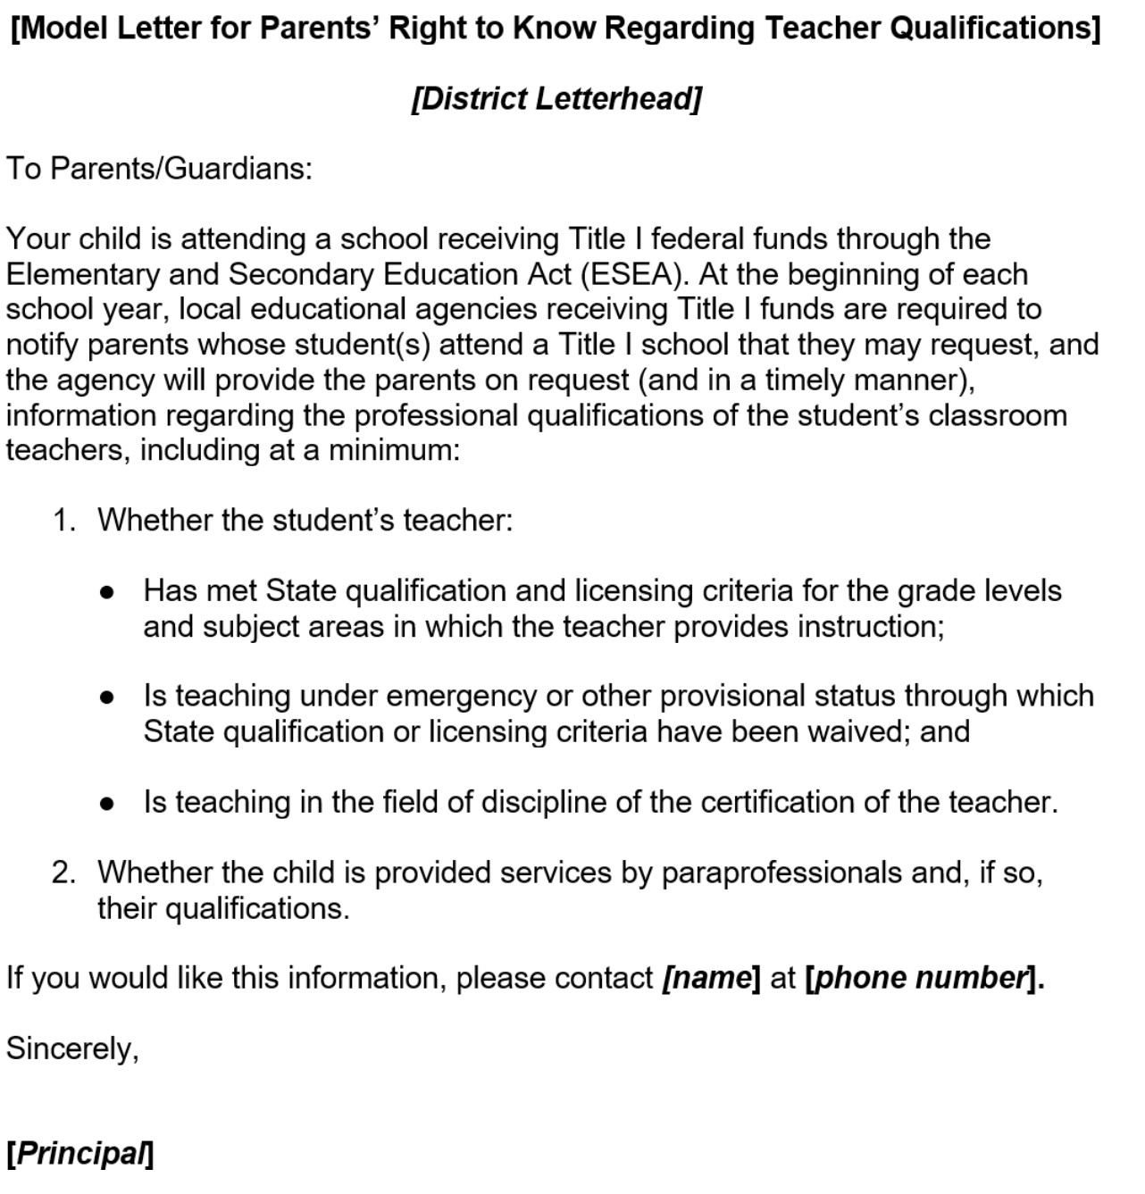
Parents’ Right to Know Letter Template
Notes:
Here is the sample template for the Parents’ right-to-know notice. The template can be found on the CDEs web page located at https://www.cde.ca.gov/ls/pf/c12/documents/modltparsrtktqeng.doc. Translated versions can be found on CDEs web page located here: http://inet2.cde.ca.gov/cmd/translatedparentaldoc.aspx?docid=3789-3814,3825-3827,3839,3841,3842,3857,3859,3876,3879,3881-3886

Slide 9
Parents' Right to Request Evidence
Evidence: Parents’ Right to Request Information on Teacher Qualifications
Item Description: Submit evidence of the notification and a description of how the LEA distributes the information to all families of students at Title I sites. Evidence may include student/family handbook (indicate page number), letters to families, electronic communication reports, etc.
Notes:
LEAs must submit to the California Department of Education (CDE) Monitoring Tool (CMT) evidence of the notification and a description of how the LEA distributes the information to all families of students at Title I sites. Evidence may include:
student/family handbook (indicate page number)
letters to families
electronic communication reports
The evidence must demonstrate how the information is distributed annually. If necessary, explain the process in a CMT comment.

Slide 10
Parents' Right to Request Information on Teacher Qualifications – Questions (1)
Question: If families have questions, who should they contact?
Answer: The LEA may determine who families should contact. Each LEA should create a process that works best for the individual district. Some districts have families contact an employee at the district office and others prefer the families to contact a staff or administrator at the school site.
Notes:
Question: Who should families contact about the notice?
Answer: The LEA may determine who the families should contact. Each LEA should create a process that works best. Some districts have families contact an employee at the district office and others prefer the families to contact a staff or administrator at the school site.

Slide 11
Parents' Right to Request Information on Teacher Qualifications – Questions (2)
Question: May I alter the wording of the notice?
Answer: Maybe. The wording in the sample notice meets federal guidelines, however, additions may be made.
Any changes to the notice can be reviewed by the CDE for feedback. Send to TitleII@cde.ca.gov.
Notes:
Question: May I alter the wording of the notice?
Answer: Maybe. The wording in the sample notice meets federal guidelines, however, additions can be made.
Any changes to the notice can be reviewed by our office for feedback. Please send to TitleII@cde.ca.gov.

Slide 12
Parents' Right to Request Information on Teacher Qualifications – Questions (3)
Question: Can we put the information into our family handbook?
Answer: Yes. Please make sure that all families receive a copy of the handbook.
Notes:
Question: Can we put the information into our family handbook?
Answer: Yes. Please make sure that all families receive a copy of the handbook.

Slide 13
Parents' Right to Request Information on Teacher Qualifications – Questions (4)
Question: Can we post the information on our website?
Answer: Yes. However, please make sure that families are notified. Posting to a web page is a best practice but may not ensure that all families are notified.
Notes:
Question: Can we post the information on our website?
Answer: Yes. However, please make sure that families are notified. Posting to a web page is a best practice but may not ensure that all families are notified.

Slide 14
Contact and Resources
Title II web page: https://www.cde.ca.gov/ci/pl/title2parta.asp
Title II Email: TitleII@cde.ca.gov
If you are not already on our listserv, please take a moment and send a blank email to join-Title-II@mlist.cde.ca.gov
Thank You!

