Slide 1
Welcome! We will start soon.

Slide 2
Title II, Part A Supporting Effective Instruction
Federal Program monitoring
August 2024

Slide 3
Welcome and Housekeeping
Feel free to ask questions in the chat during the presentation. We will also have time at the end of the presentation for questions.​
Please join our listserv by sending a blank email to join-Title-II@mlist.cde.ca.gov.
Slides will be posted in the California Department of Education (CDE) Monitoring Toolbox (CMT).

Slide 4
Check In
Knowing who is in the room helps to ensure our presentation is tailored to your needs. Using the Poll feature, please share with us your experience with Federal Program Monitoring (FPM).
How many FPMs you have participated in?
This is my first​
1
2–4
5+

Slide 5
Webpage Resources
Title II Webpage
Short PowerPoint for each Supporting Effective Instruction (SEI) item that includes requirements for each item, examples of evidence when applicable, and best practices.
Resources for each item organized by SEI instrument number
https://www.cde.ca.gov/ci/pl/title2parta.asp

Slide 6
Federal Program Monitoring Box

Slide 7
California Department of Education Monitoring Tool (1)
Documents only need to be uploaded once, even if they are for other items.
Best Practices:
Include the year in the document title.
Include the Instrument and item number in the document title.
Provide a detailed description.

Slide 8
California Department of Education Monitoring Tool (2)
Image text: Appendix 1

Slide 9
Instrument Details
Here the Instrument details the legal requirements.
Each item has a list of evidence requests with specific item instructions and a brief description of what is required.

Slide 10
Frequency of Findings 2021–24
Top 3 SEI Findings
Use of Funds
Four-Week Letter
Educator Equity
*Use of funds includes supplement, not supplant.
Image text: Appendix 2

Slide 11
Title II Purpose
Increasing student achievement consistent with the challenging state academic standards.
Improving the quality and effectiveness of teachers, principals, and other school leaders.
Increasing the number of teachers, principals, and other school leaders who are effective in improving student academic achievement in schools.
Providing to effective teachers, principals, and other school leaders. low-income and minority students greater access
20 United States Code (U.S.C.) Section 6601

Slide 12
Supporting Effective Instruction 01: Consultation and Staff Development (1)
In developing the application for Title II, Part A funds, the local educational agency (LEA) shall meaningfully consult with teachers, principals, other school leaders, paraprofessionals (including organizations representing such individuals), specialized instructional support personnel, charter school leaders (in an LEA that has charter schools), parents, community partners, and other organizations or partners with relevant and demonstrated expertise in programs and activities designed to meet the purpose of Title II, Part A.
20 U.S.C. sections 6601 and 6612(b)(3)(A)

Slide 13
Supporting Effective Instruction 01: Consultation and Staff Development (2)
The LEA shall seek advice from the individuals and organizations as described above regarding how best to improve the LEA’s activities to meet the purpose of Title II, Part A, as described above.
20 U.S.C. Section 6612(b)(3)(B)
The LEA will use data and ongoing consultation with the educational partners described above to continually update and improve activities supported by Title II, Part A.
20 U.S.C. Section 6612(b)(2)(D)

Slide 14
Supporting Effective Instruction 01: Consultation and Staff Development (3)
LEA Level Planning Documents
Description: The current approved Local Control and Accountability Plan (LCAP) and LCAP Federal Addendum.
Item Instructions: Submit the LCAP, the LCAP Federal Addendum, and planning documents that include Title II goals and strategies.

Slide 15
Supporting Effective Instruction 01: Consultation and Staff Development (4)
Educational Partner Feedback
Description: Evidence that all staff and relevant educational partners collaborated regarding how best to improve the LEA activities.
Item Instructions: Submit evidence of the LEA’s collaboration with educational partners and use of data to update and improve Title II activities. Evidence may include agendas, meeting notes, lists of participants present, presentations, documents shared during meetings, surveys (including survey and results), data, and feedback forms.

Slide 16
Educational Partner Evidence
Survey
Administrators, teachers, and paraprofessionals
All sites districtwide
Survey and data uploaded
Leadership Meeting
Agenda indicating members present
Review survey data
Review student academic data
Professional Development (PD) Plan
Based on the survey, data, and leadership meeting
Plan created
Short- and long-term goals

Slide 17
List of Educational Partners (1)
Educational Partners Required for Consultation | Best Practices/Suggestions
Teachers | Elementary school, middle school, high school, alternative, charter, teacher leaders, and special education.
Principals and Assistant Principals | Elementary school, middle school, high school, alternative, and charter.
Paraprofessionals | Elementary school, middle school, high school, regular and special education
Families | Elementary school, middle school, high school, alternative, educational rights holders (foster youth), caregivers

Slide 18
List of Educational Partners (2)
Educational Partners Required for Consultation | Best Practices/Suggestions
Community Partners | Business partners, community-based organizations, civic organizations, law enforcement, including probation offers.
Charter School Leaders | Principals and executive directors.
Other educational leaders | Private school leaders, executive directors, cabinet members, board of education members

Slide 19
List of Educational Partners (3)
Educational Partners Required for Consultation | Best Practices/Suggestions
Specialized Instructional Support Personnel | Teachers on assignment, instructional coaches, media specialists, instructional technology, counselors, resource officers, restorative justice coordinators, pathway/career technical education coaches
Other relevant organizations or partners | Teacher union, principal and assistant principal unions, before and after school programs, professional educational organizations, institutions of higher education

Slide 20
Consultation Question (1)
Question: Does the educational partner engagement for our LCAP meet the consultation requirement for Title II?
Answer: Maybe. 20 U.S.C. Section 6612(b)(3)(A) requires the LEA to consult with educational partners in developing the application for Title II. Consultation with educational partners shall seek educational partner advice regarding how best to improve the LEAs activities to meet the purpose of Title II.

Slide 21
Consultation
Title II, Part A investments should align with the LEA’s overall strategies to support effective instruction to improve student academic outcomes. Consultation is a critical part of ensuring that Title II, Part A funds are used effectively and decisions about resource allocation are fully informed.

Slide 22
Data and Ongoing Consultation
Educational Partners
Educators
Student Data
Demographics
School Data
Resources
Safety
Educator Data
Students
Families
Community
Achievement and Growth
Graduation Rates
Climate
Equity
Effectiveness
Retention Rates
Job Satisfaction
Teacher Assignment

Slide 23
Supporting Effective Instruction 02: Comprehensive Support and Targeted Support Prioritization (1)
The LEA shall prioritize funds to schools served by the agency that are implementing Comprehensive Support and Improvement (CSI) activities and TSI activities and have the highest percentage of children counted under Title I, Part A.
20 U.S.C. Section 6612(b)(2)(C)

Slide 24
Supporting Effective Instruction 02: Comprehensive Support and Targeted Support Prioritization (2)
LEA Level Planning Documents
Description: The current approved LCAP and LCAP Federal Addendum.
Item Instructions: Submit the LCAP, LCAP Federal Addendum, and other plans, which may include the CSI plan(s) and the School Plan for Student Achievement.

Slide 25
Local Control and Accountability Plan Federal Addendum – Title II (1)
Prioritizing Funding
Provide a description of how the LEA will prioritize funds to schools served by the agency that are implementing CSI activities and targeted support and improvement (TSI) activities and have the highest percentage of children counted under Section 1124.

Slide 26
Local Control and Accountability Plan Federal Addendum - Title II (2)
What information does the LEA need to provide to meet the Title II Prioritizing Funding provision requirements of the LCAP Federal Addendum?
Describe the LEA’s process for determining Title II, Part A funding among the schools it serves.
Describe how the LEA determines funding that prioritizes CSI and TSI schools and schools serving the highest percentage of children counted under Section 1124(c).
Describe how CSI and TSI schools and schools that have the highest percentage of children counted under Section 1124(c) that the LEA serves receive priority in Title II funding decisions compared to other schools the LEA serves.

Slide 27
Supporting Effective Instruction 02: Comprehensive Support and Targeted Support Prioritization (3)
PD Planning Documents
Description: Provide documentation of PD planning.
Item Instructions: Submit districtwide PD calendars. Submit evidence of short- and long-term PD planning and goals. Evidence may include calendars, agendas, meeting notes, lists of participants present, presentations, documents shared during meetings, surveys (including survey and results), data, and feedback forms.

Slide 28
Supporting Effective Instruction 03: Review and Revise Local Control and Accountability Plan Federal Addendum
An LEA shall submit an application to the state educational agency at such time, in such manner, and containing such information as the state educational agency may reasonably require.
20 U.S.C. Section 6612(b)(1)
The LEA plan shall remain in effect for the duration of the LEAs participation in the Title II, Part A program, and said plan shall be periodically reviewed, and revised when necessary.
20 U.S.C. sections 6312(a)(4), 6312(a)(5), and 6612(b)(1)

Slide 29
Review and Revise Local Control and Accountability Plan Federal Addendum Evidence
Item | Item Description and Instructions
LEA Level Planning Documents | The current approved LCAP and LCAP Federal Addendum
LEA Planning Implementation and Monitoring Documents | Evidence the LEA implements, monitors, and revises the LCAP Federal Addendum, Title II plan, and Title II budget. Evidence may include agendas, meeting notes, lists of participants, presentations, documents shared during meetings, surveys (including survey and results), data, and feedback forms.

Slide 30
Supporting Effective Instruction 04: Identify and Address Disparities (1)
The LEA shall identify and address any disparities that result in low-income students and minority students being taught at higher rates than other students by ineffective, inexperienced, or out-of-field teachers.
20 U.S.C. Section 6312(b)(2)

Slide 31
Supporting Effective Instruction 04: Identify and Address Disparities (2)
Educator Equity Data
Description: The current Educator Equity Data includes data on comparable sites by grade span. Data should include the number and percentage of ineffective, inexperienced, and out-of-field teachers, as well as the number and percentage of low-income and minority students at all sites.
Item Instructions: Upload Educator Equity Data. The CDE has templates you may use. https://www.cde.ca.gov/ci/pl/documents/edequitydata.xlsx

Slide 32
Supporting Effective Instruction 04: Identify and Address Disparities (3)
Educator Equity Data Tables can be found on the CDE Step 2: Equity Data Collection and Analysis Tools web page at https://www.cde.ca.gov/ci/pl/documents/edequitydata.xlsx

Slide 33
Educator Equity Data Question (1)
Question: What is the definition of a disparity? At what point do we need to create an Educator Equity Plan?
Answer: The Every Student Succeeds Act does not define when a disparity exists. However, the CDE is working to support LEAs in this process. When looking at the data, answer the question – are low-income or minority students taught at a higher rate by ineffective, inexperienced, or out-of-field teachers?

Slide 34
Example of Disparity
Definition
The difference between the rate at which low-income or minority students are taught by effective, in-field, and experienced teachers, compared to their higher-income, non-minority counterparts.
Example
Twelve percent of teachers in an LEA’s highest-poverty school are inexperienced compared to two percent of teachers in the lowest-poverty schools. This LEA has an educator equity gap of ten percentage points.

Slide 35
Supporting Effective Instruction 04: Identify and Address Disparities (4)
LEA Level Planning Documents
Description: The current approved LCAP and LCAP Federal Addendum.
Item Instructions: Describe how the LEA reviews and revises the LCAP Federal Addendum—Title I, Part A Educator Equity provision. Provide evidence of the LEA's process for identifying and addressing disparities that result in low- income and minority students being taught at higher rates than other students by ineffective, inexperienced, or out- of-field teachers. Describe the actions the LEA will take to address any disparities discovered during the equity data analysis process.

Slide 36
Educator Equity Data Question (2)
Key Questions:
Are schools with a higher percentage of low-income students taught at a higher rate by ineffective, out-of-field, or inexperienced teachers?
Are schools with a higher percentage of minority students taught at a higher rate by ineffective, out-of-field, or inexperienced teachers?

Slide 37
Supporting Effective Instruction 05: Alignment, Academic Standards, and Professional Development Coordination (1)
Title II activities shall be aligned to challenging state academic standards.
20 U.S.C. Section 6612(b)(2)(A)
The LEA shall coordinate activities with other related strategies, programs, and activities being conducted in the community.
20 U.S.C. Section 6612(b)(3)(C)
The LEA will coordinate PD activities intended to support effective instruction with PD activities provided through other federal, state, and local programs.
20 U.S.C. Section 6612(b)(2)(F)

Slide 38
Supporting Effective Instruction 05: Alignment, Academic Standards, and Professional Development Coordination (2)
Evidence Requests
PD Planning Documents
Description: Provide documentation of PD planning.
Item Instructions: Submit evidence of coordination with other related strategies, programs, and activities. Evidence may include agendas, meeting notes, lists of participants, presentations, documents shared during meetings, surveys (including survey and results), data, and feedback forms.

Slide 39
Supporting Effective Instruction 05: Alignment, Academic Standards, and Professional Development Coordination (3)
PD Records
Description: Documentation of completed PD relevant to the program which may include, but is not limited to, agendas, calendars, certificates, sign-in sheets, minutes, and training materials.
Item Instructions: Submit evidence of at least three completed PD activities for teachers, paraprofessionals, and administrators that are aligned to the state academic standards. Evidence may include agendas, meeting notes, lists of participants, presentations, etc.

Slide 40
Supporting Effective Instruction 05: Professional Development Planning Documents Example
PD planning evidence example submitted in the CMT.
Submitted as one document that demonstrates coordination with other strategies, programs, and activities.
Aligns to state academic standards.

Slide 41
Supporting Effective Instruction 05: Professional Development Planning Example
Science Three-year Plan
Curriculum and Instruction Master Calendar
Professional Learning implementation plan with indicators and training provided for each goal
Curriculum and Instruction meeting notes to create a Science Kick-off PD along with the agenda and handouts from the PD. Feedback from PD participants and the meeting notes from Curriculum and Instruction debriefing the PD to determine the next steps

Slide 42
Supporting Effective Instruction 05: Professional Development Records Example (1)
Cover Page
Balanced Literacy PD
Agenda
Sign in
Presentation Slides
Handouts
Exit Ticket for participants
Data from Exit Tickets
This LEA created a cover page indicating the set of documents uploaded in this one upload.
Upload was about 20 pages.
One of three sets for professional develop records provided.
Every LEA is unique and this may not reflect your process.

Slide 43
Supporting Effective Instruction 05: Professional Development Records Example (2)
PD record evidence example submitted in the CMT.
Multiple PD sessions submitted as one document that demonstrates alignment with state academic standards.

Slide 44
Supporting Effective Instruction 06: Use of Funds Supporting Effective Instruction 07: Supplement, Not Supplant
An LEA that receives a subgrant under Title II, Part A shall use the funds made available through the subgrant to develop, implement, and evaluate comprehensive programs and activities: (1) in accordance with the purpose of Title II; and (2) that address the learning needs of all students, including children with disabilities, English learners, and gifted and talented students.
20 U.S.C. Section 6613(a)(b)
Funds made available under Title II, Part A shall be used to supplement, and not supplant, state and local funds that would otherwise be used for activities authorized under Title II, Part A.
20 U.S.C. Section 6691

Slide 45
Use of Funds Evidence (1)
Item | Item Description and Instructions
Budget | Submit the current year’s budget for the Title II program, including object codes that align with the LEA goals and key improvement strategies.
General Ledger | Detailed Title II (resource 4035) general ledger for the current and prior school year. The ledger must include the vendor, date, and expenditure amount.

Slide 46
General Ledger Example
Image text: Appendix 3

Slide 47
Use of Funds Evidence (2)
Item | Item Description
Invoices | Backup documentation should include invoices, purchase orders, and contracts. If the expenditure is for a PD, provide documentation detailing who attended, including staff name and position, the content of the PD, and any other relevant documentation to substantiate the costs to the program.

Slide 48
Invoices: Expenditure Sample Backup Documentation Example (1)
US Bank statement
Purchase Order
Receipt from hotel
Conference Agenda and proof of attendance
Conference request

Slide 49
Invoices: Expenditure Sample Backup Documentation Example (2)
Detailed Purchase Order
Board Agenda Item for approval
Detailed Consultant Contract
Invoices showing dates of service
Backup documents showing services provided

Slide 50
Submitting Backup Documentation in the California Department of Education Monitoring Toolbox

Slide 51
California Department of Education Monitoring Toolbox Expenditure Sample Request Directions
You may upload items individually or as a group. You do not need to wait until you have all the backup documentation for all items before you upload.
When uploading evidence into the CMT, refer to the CDE reference number.
Provide as much backup information as possible such as contracts, invoices, board approval, presentations, agendas, sign-in documents page and line description from LCAP (if applicable), and attendees (if applicable). Please explain how each expenditure aligns with Title II’s purpose.
After review, CDE may ask additional questions.

Slide 52
Reviewer Expenditure Sample in the California Department of Education Monitoring Toolbox

Slide 53
Use of Funds Evidence (3)
Item | Item Description
Position Control Report | Report from current and prior years indicating staff who are partially or fully funded from Title II. Include staff name, position, and the percentage their position is charged to the program.
Duty Statement | An individual employee's duty statement describing responsibilities and activities (cost objectives), as agreed to by employer and employee.
Time and Effort Records | Documentation to support salaries and benefits charged to Title II

Slide 54
Position Control Report Example

Slide 55
Supporting Effective Instruction 07: Supplement, Not Supplant
To determine whether a fiscal expenditure supplements and does not supplant, school districts must run the following tests:
Test I: Are the services that the district wants to fund with Elementary and Secondary Education Act (ESEA) funds required under state or local law? If they are, it may be supplanting.
Test II: Were state or local funds used in the past to pay for these services? If they were, it may be supplanting.
Test III: Are the same services being provided in other schools paid for with state or local funds? If they are, it may be supplanting.

Slide 56
Private School Consultation
LEAs shall, after timely and meaningful consultation, provide educational services to eligible children and their teachers on an equitable basis. Educational services or other benefits, including materials and equipment, provided under this section, shall be secular, neutral, and nonideological.
20 U.S.C. sections 7881(a)(2) and 7881(b)(B)

Slide 57
Supporting Effective Instruction 08 Evidence
Item​ | Item Description​
Intent to Participate | Dated communication to private schools regarding eligibility for Title I, Title II, or Title III services
Consultation with Private Schools | Documents that show how the LEA consulted with private schools regarding participation in federal programs
Private School Affirmation | A written document signed and dated by private school officials that the required consultation has occurred

Slide 58
Supporting Effective Instruction 09: Certification and Licensure
All teachers and paraprofessionals meet applicable state certification and licensure requirements, including any requirements for certification obtained through alternative routes to certification.
20 U.S.C. sections 6601, 6311(g)(2)(J), 6312(c)(6), 6611(c)(4)(B)(i), 6611(c)(4)(B)(iv), 6611(d)(2)(B), and 6613(b)(3)(B); California Education Code sections 41401, 44001, and 48000(g)

Slide 59
Staff Credentials Evidence
Item Description: Provide a sortable spreadsheet of all certificated staff displaying credentials and full staff name, including full middle name.
Item Instructions: Include each teacher’s name, credential(s), subject matter authorization(s), waiver(s), permit(s), authorization(s), school site, and current assignment(s). For current assignment, list all classes the teacher teaches. Include information for all teachers throughout the LEA.

Slide 60
Example list of Staff Credentials (1)
Last Name | First Name | Site | Position | Assignment | Credential | Subject
Lapp | Josh | Hill High School | Teacher Grades Nine to Twelve (9–12) | Chemistry | Single Subject/ English Language Art 1 (ELA1) | Chemistry
Lapp | Josh | Hill High School | Teacher 9–12 | CLAD
Tige | Peggy | Hill High School | Teacher 9–12 | English 10 | Single Subject/ELA1 | English

Slide 61
Example list of Staff Credentials (2)
Last Name | First Name | Site | Position | Assignment | Credential | Subject
Heart | Beth | Bell Elementary School | Teacher -Elementary | Grade Four | Multiple Subject/ ELA1 | General Subject
Allen | Chad | Map Middle School | Teacher-Middle | Grade Seven English/Social Studies | Multiple Subject
Allen | Chad | Map Middle School | Teacher-Middle | Grade Seven English/Social Studies | SDAIE-SB 1969

Slide 62
Supporting Effective Instruction 09: Certification and Licensure (1)
LEA shall ensure that all paraprofessionals working in Title I, Part A funded schools meet applicable state certification and licensure requirements:
Completion of at least two years of study at an institution of higher education, or
Possession of an associate’s degree or higher, or
Knowledge of, and ability to assist in, instructing reading, writing, and mathematics demonstrated through a local or state assessment, that is appropriate to the responsibilities to be assigned to the paraprofessional.

Slide 63
Supporting Effective Instruction 09: Certification and Licensure (2)
Paraprofessional Staff Authorizations
Description: Provide a sortable spreadsheet of paraprofessionals, including full names and qualifications.
Item Instructions: Submit a sortable spreadsheet for each instructional paraprofessional districtwide which includes full name, school site, current assignment(s), and how each paraprofessional meets the qualification: 1) Completion of at least two years of study at an institute of higher education or 2) Possession of an associate’s degree or higher or 3) Passing a local assessment. Include the information for all paraprofessionals districtwide.

Slide 64
Example of Paraprofessional List
Image text: Appendix 4

Slide 65
Supporting Effective Instruction 10: Professional Growth and Improvement Evidence
Item | Item Description and Instructions
LEA Level Planning Documents | The current approved LCAP and LCAP Federal Addendum.
PD Records | Submit evidence of at least three completed PD activities for teachers, paraprofessionals, and administrators aligned to the state academic standards.
Educational Partner Feedback | Evidence that all staff and relevant educational partners collaborated regarding how best to improve the LEA activities

Slide 66
Supporting Effective Instruction 11: Parents’ Right to Know Teacher Qualifications (1)
At the beginning of each year an LEA that receives Title I funds shall notify the parents of each student attending any school receiving Title I funds that the parents may request, and the agency will provide the parents on request (and in a timely manner), information regarding the professional qualifications of the student's classroom teachers, including at a minimum, the following:
20 U.S.C. Section 6312(e)(1)(A)

Slide 67
Parents' Right to Request Teacher Qualifications Template (1)
Your child is attending a school receiving Title I federal funds through the ESEA. At the beginning of each school year, LEAs receiving Title I funds are required to notify parents whose student(s) attend a Title I school that they may request, and the agency will provide the parents on request (and in a timely manner), information regarding the professional qualifications of the student’s classroom teachers, including at a minimum:

Slide 68
Parents' Right to Request Teacher Qualifications Template (2)
Whether the student’s teacher:
Has met State qualification and licensing criteria for the grade levels and subject areas in which the teacher provides instruction;
Is teaching under emergency or other provisional status through which State qualification or licensing criteria have been waived; and
Is teaching in the field of discipline of the certification of the teacher.
Whether the child is provided services by paraprofessionals and, if so, their qualifications.

Slide 69
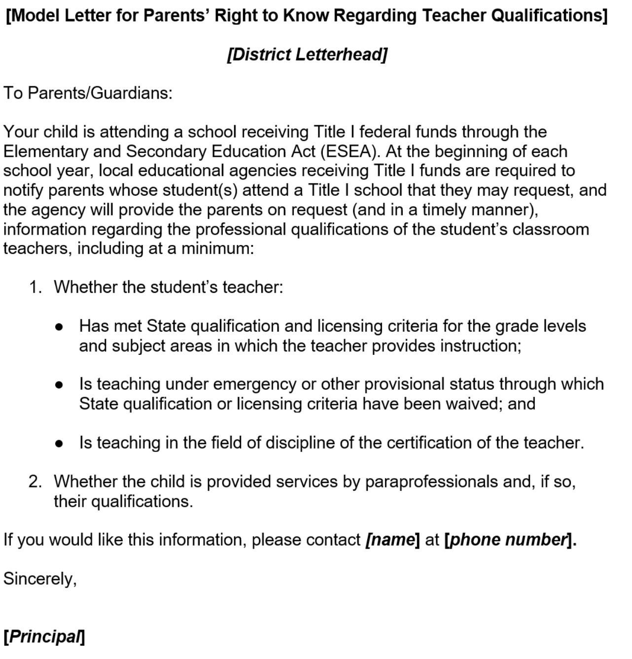
Parents’ Right to Know Letter Template
Image text: Appendix 5

Slide 70
Supporting Effective Instruction 11: Parents’ Right to Know Teacher Qualifications (2)
Evidence Requests
Parents' Right to Request Information on Teacher Qualifications
Description: Notification to parents regarding their right to request information on teacher qualifications.
Item Instructions: Submit evidence of the notification and a description of how the LEA distributes the information to all families of students at Title I sites. Evidence may include student/family handbook (indicate page number), letters to families, electronic communication reports, etc.

Slide 71
Four-Week Letter
A school that receives Title I funds shall provide to each individual parent of a child who is a student in such school, with respect to such student—
Timely notice that the student has been assigned, or has been taught for four or more consecutive weeks by, a teacher who does not meet applicable state certification or licensure requirements at the grade level and subject area in which the teacher has been assigned.
20 U.S.C. Section 6312(e)(1)(B)(ii)

Slide 72
Four-Week Letter Evidence (1)
Item | Item Description
Four-Week Notice | Submit evidence of the four-week letter template. Submit the credential monitoring process for the four-week letter, including the waiver(s), permit(s), and authorization(s) that determine the need for a four-week letter. Submit evidence that the four-week letter was distributed to families, if necessary.

Slide 73
Supporting Effective Instruction 11: Parents’ Right to Know Teacher Qualifications – Four-Week Letter
Timely notice that the student has been assigned, or has been taught for four or more consecutive weeks by, a teacher who does not meet applicable state certification or licensure requirements at the grade level and subject area in which the teacher has been assigned.
20 U.S.C. Section 6312(e)(1)(B)(ii)

Slide 74
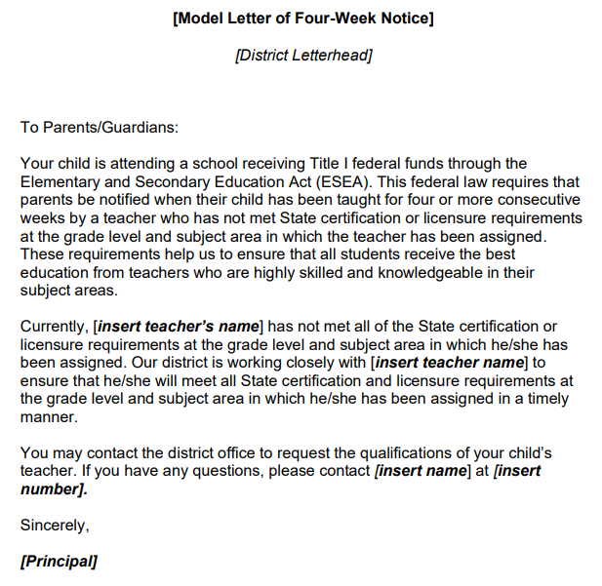
Four-Week Letter Template
Image text: Appendix 7

Slide 75
Four-Week Letter Evidence (2)
Evidence Requests:
Submit evidence of the four-week letter template.
Submit the credential monitoring process for the four-week letter, including the waiver(s), permit(s), and authorization(s) that determine the need for a four-week letter.
Submit evidence that the four-week letter was distributed to families, if necessary. Redact student names or other identifiable student information.

Slide 76
Four-Week Letter Best Practices
An effective LEA plan clearly outlines the process to monitor teacher credentials and assignments and is shared with relevant departments and sites. The plan should include:
Identification of who or what position(s) is/are responsible for each component of the plan;
A list of the teacher equity definitions under ESSA and how they determine the need for the four-week letter;
How the letter is distributed to families; and
The timeline for plan implementation.

Slide 77
Determination Chart Four-Week Letter (1)
Term | Definition
Ineffective Teacher | An individual whose assignment is legally authorized by an emergency permit that does not require possession of a full teaching license. Under this definition, teachers with the following limited emergency permits would be considered ineffective: Provisional Internship Permits Short-Term Staff Permits Variable Term Waivers Substitute permits or Teaching Permits for Statutory Leave holders serving as the teacher of record

Slide 78
Determination Chart Four-Week Letter (2)
Term | Definition
Out-of-field teacher | A credentialed teacher who has not yet demonstrated subject matter competence in the subject area(s) or for the student population to which he or she is assigned. Under this definition, the following limited permits will be considered out of the field: General Education Limited Assignment Permit Special Education Limited Assignment Permit Short-Term Waivers Emergency EL or Bilingual Authorization Permits Local Assignment Options (except for California Code of Regulations, Title 5, Section 80005(b))

Slide 79
Four-Week Letter Plan Example (1)
Task | Notes | Timeframe | Position Responsible
Update 4-Week Letter | Review CDE web page for changes and incorporate into letter | Before the first day of school year | Executive Assistant to Assistant Superintendent of Human Resources (HR)
Run report of teachers who are not fully credentialed | Use determination chart to identify teachers | Six weeks after school year begins | Credential Analyst

Slide 80
Four-Week Letter Plan Example (2)
Task | Notes | Timeframe | Position Responsible
Communicate with sites about letters | Provide site principals with a list of teachers who trigger the letters. Send talking points to principals to share with teachers Share the above info with union | Six weeks after the school year begins | Executive Assistant to Assistant Superintendent of HR

Slide 81
Four-Week Letter Plan Example (3)
Task | Notes | Timeframe | Position Responsible
Send letters electronically | Run reports of emails that bounce back and send to sites. Sites to confirm email address or mail hard copy to family. | Six weeks after the school year begins | Credential Analyst and communications dept
Repeat process 2nd semester | Repeat process. | Six weeks into 2nd semester | Credential Analyst and Executive Director of HR

Slide 82
Helpful Hints
The SEI Instrument is your guide.
Time and organization—It is never too early to start gathering and submitting evidence.
Use the FPM process as an opportunity to strengthen collaboration across LEA departments (instructional services, human resources, fiscal).
Contact the Title II office with questions and for support.

Slide 83
Reviewer Contact Information (1)
Jill Johnson | JJohnson@cde.ca.gov | 310-748-5794
Adelanto Elementary | Los Angeles Unified | Vacaville Unified
Bear Valley Unified | Mountain View Elementary | Vallejo City Unified
Colton Joint Unified | Newport-Mesa Unified | West Covina Unified
Covina Valley Unified | Oxnard Union High
El Monte Union High | Palm Spring Unified
Garden Grove Unified | San Diego Unified

Slide 84
Reviewer Contact Information (2)
Terri Battenburg | TBattenburg@cde.ca.gov | 916-322-5836
Atwater Elementary | Mojave Unified | San Leandro Unified
East Side Union High | Oakland Unified | San Lorenzo Unified
Fullerton Joint Union High | Pajaro Valley Unified | Twin Rivers Unified
Lake Elsinore Unified | Porterville Unified | Vineland Elementary
Union Elementary | Sacramento City Unified | Yuba City Unified

Slide 85
Reviewer Contact Information (3)
Janet Abdelsayed | JAbdelsayed@cde.ca.gov | 916-445-7332
Baldwin Park Unified | Hemet Unified | Whittier Union High
Corona-Norco Unified | Los Banos Unified | Wilsona Elementary
Eureka City Schools | Moorpark Unified
Folsom-Cordova Unified | Santa Ana Unified
Gilroy Unified | Santa Rosa High

Slide 86
Contact and Resources
Title II web page: https://www.cde.ca.gov/pd/ti/
Title II Email: TitleII@cde.ca.gov
If you are not already on our listserv, please take a moment and send a blank email to join-Title-II@mlist.cde.ca.gov
Thank You!

Slide 87
Appendix 1
A document uploaded into the California Department of Education Monitoring Tool. Three arrows point to important aspects of the tool:
An arrow points to the Evidence Request. The text reads:
LEALvlPlngDocs
Items: SEI 01, SEI 02, SEI 03, SEI 04, SEI 10, SEI 11
An arrow points to the Document Title: Current Federal Addendum to the LCAP
An arrow points to a second Document Title: 2021 LCAP
Image slide: California Department of Education Monitoring Tool (2)

Slide 88
Appendix 2
Bar chart showing the top three Supporting Effective Instruction findings from the years 2021–22, 2022–23, and 2023–24.
Use of Funds has the largest percentage of findings with the 21–22 school year school year at 20 percent; the 22–23 school year is at 40 percent and the 23–24 school year is at 29 percent. The second most frequent percentage of findings is the 4-week letter: the 21–22 school year was 23 percent of findings; the 22–23 school year was 22 percent; and the 23–24 school year was 29 percent. And our third most common finding is Educator Equity. The 21–22 and 22–23 school year there were 29 percent of findings from Educator equity, and in 23–24 there were 15 percent of findings.
Image slide: Frequency of Findings 2021–24

Slide 89
Appendix 3
A screenshot of general ledger. A general ledger is the system of record for an organization’s financial transactions. Transaction data in a general ledger is organized by type: assets, liabilities, owner’s equity, revenues, and expenses. A general ledger, sometimes abbreviated as GL, is also known as a general journal.
Image slide: General Ledger Example

Slide 90
Appendix 4
A screenshot of an example paraprofessional list. The list provided by the local educational agency to the California Department of Education needs to include the first and last name of the paraprofessional, their position, the location they are assigned to, and how they meet the state certification. The state certification requires paraprofessionals to have a high school diploma or equivalent and either have 48 semester college units or a degree such as an Associate, Bachelor, or Masters.
Image slide: Example of Paraprofessional List

Slide 91
Appendix 5
The Parents Right to Know Letter is required by the Elementary and Secondary Education Act. The language states:
“Your child is attending a school receiving Title I federal funds through the Elementary and Secondary Education Act (ESEA). At the beginning of each school year, local educational agencies receiving Title I funds are required to notify parents whose student(s) attend a Title I school that they may request, and the agency will provide the parents on request (and in a timely manner), information regarding the professional qualifications of the student’s classroom teachers, including at a minimum (continued on next slide)

Slide 92
Appendix 6
Whether the student’s teacher:
Has met State qualification and licensing criteria for the grade levels and subject areas in which the teacher provides instruction;
Is teaching under emergency or other provisional status through which State qualification or licensing criteria have been waived; and
Is teaching in the field of discipline of the certification of the teacher.
Whether the child is provided services by paraprofessionals and, if so, their qualifications.”
Image slide: Parents’ Right to Know Letter Template

Slide 93
Appendix 7
Template of the Four-Week Notice that states:
“Your child is attending a school receiving Title I federal funds through the Elementary and Secondary Education Act (ESEA). This federal law requires that parents be notified when their child has been taught for four or more consecutive weeks by a teacher who has not met State certification or licensure requirements at the grade level and subject area in which the teacher has been assigned. These requirements help us to ensure that all students receive the best education from teachers who are highly skilled and knowledgeable in their subject areas. (continued on next slide)

Slide 94
Appendix 8
Currently, [insert teacher’s name] has not met all of the State certification or licensure requirements at the grade level and subject area in which he/she has been assigned. Our district is working closely with [insert teacher name] to ensure that he/she will meet all State certification and licensure requirements at the grade level and subject area in which he/she has been assigned in a timely manner. You may contact the district office to request the qualifications of your child’s teacher. In you have any questions, please contact [insert name] at [insert number]. Sincerely, [Principal]
Image slide: Four-Week Letter Template

