Slide 1
Child Development Management Information System (CDMIS)
Contractor Training Webinar October 4th, 2023

Slide 2
What is CDMIS? (1)
The CDMIS is a database system that the Early Education Division (EED) at the California Department of Education (CDE) uses to collect information about families, children, and providers.
This data collection system was built for agencies to submit the CDD-801A Monthly Child Care Population Report (CDD-801A), CDD-801B Monthly Sample Report (CDD-801B), and Subsidized Provider Report (SPR) to meet federal and state requirements.

Slide 3
Overview
What is CDMIS?
System Access
CDD-801A Report
CDD-801B Report
Subsidized Provider Report
Updating Agency Information
Frequently Asked Questions (FAQs)
Questions and Answers

Slide 4
What is CDMIS? (2)
The CDMIS also permits agencies to update their administrative information. For example, super users may request program director and executive director changes, report no service periods, enter site and license information, and add/edit CDMIS users. ​
These updates, additions, or deletions are a critical component for the EED’s Agency Information Certification, which is a key part of the Continued Funding Application (CFA).

Slide 5
How the Data Is Used (1)
EED Strategic Plan:
Excellent Service
Ensure program integrity and responsiveness to children, families, and communities through highly accountable public investments
Use data to inform program improvement and refine processes, tools, reports, and training and technical assistance
Data collected is used by the EED to
Identify needs, plan, and support continuous improvement
Evaluate programs and conduct research studies

Slide 6
How the Data Is Used (2)
Respond to data requests from numerous sources including the following:
Department of Finance
Department of Social Services
The Legislature
The Legislative Analyst Office
Local Planning Councils
California Children and Families Commission (aka: First 5 California)
The National Institute for Early Education Research (NIEER)
The American Institute of Research

Slide 7
How the Data Is Used (3)
The California Budget Project
Advocacy Groups
R & R Network
California Alternative Payment Program Association (CAPPA)
Academic research institutions
Newspapers
and, lastly, many of the agencies attending this meeting will request data about themselves or their county

Slide 8
System Access Overview
There are two types of user access levels in the CDMIS: Super Users and Regular Users.
An agency's super user is usually the program director. He or she is responsible for completing the CDD-801A and CDD-801B or designating individuals in the agency to complete these reports. An agency may have as many super users and users as deemed necessary; however, an agency must always have at least one active super user.

Slide 9
System Access: Super Users (1)
Super users can do the following:
See all usernames and passwords
Update information for all users
Request new user accounts & deactivate existing users
Update Agency Information (Site, FCCH, etc.)
Report “No Services” for programs not operating during specific months

Slide 10
System Access: Super Users (2)
Super users can do the following:
Create and edit sub-agencies (if sub-agencies are used for the CDD-801A)
Assign regular users to sub-agencies (if sub-agencies are used for the CDD-801A)
Complete and submit the CDD-801A for the entire agency (regardless of if the agency reports by sub-agency for the CDD-801A or not)
Complete and submit the CDD-801B for the entire agency

Slide 11
System Access: Regular Users
Regular Users can do the following:
Change his or her own user information only
Complete and submit the CDD-801A for only one sub-agency (if sub-agencies are used for the CDD-801A)
Complete and submit the CDD-801A for the entire agency (if sub-agencies are not used for the CDD-801A)
Complete and submit the CDD-801B for the entire agency

Slide 12
CDD-801A Overview
CDD-801A Report: Monthly data collection report in which agencies provide specific information about all families receiving childcare and development services provided by funding from a contract with the CDE, Early Education Division (EED) and/or CDSS, Child Care and Development Division (CCDD).
CDD-801A Due Date: 20th of the month following the end of the report period
For example, the report for October 2023 is due by November 20, 2023

Slide 13
How to Submit CDD-801A Reports
Agencies may submit the CDD-801A report using one of the following two methods:
Web Input/Edit, or
Electronic File Upload
Agencies may switch between and/or use a combination of the reporting methods to fulfill the CDD-801A reporting requirement.

Slide 14
Web Input/Edit/Copy Forward
This method of submitting CDD-801A reports consists of manually adding families’ information into the CDMIS website and copying families’ information from one month to the next.
Once copied forward, families’ information can be added, deleted, or modified to reflect the actual services provided during that report month.

Slide 15
Electronic File Upload
This method of submitting CDD-801A reports consists of agencies generating and uploading a specially formatted text file to the CDMIS website.
This text file contains all family, child, and provider information for a particular report month.
Submission Status Processing Time
CDMIS will inform if the upload was successful once upload is complete
The information from the upload (families and child count) will not be available until the next day

Slide 16
CDD-801A Management Reports (1)
CDD-801A Electronic File Status Report
For agencies who submit electronic files
• Use to see if your file passed or, if the file failed, to see errors that caused the file to fail.
CDD-801A Submission Report
• Use to see all families included in report for a specific report month.

Slide 17
CDD-801A Management Reports (2)
CDD-801A Submission Export
Use to check the information that was submitted in the report and export a month of data to Excel.
CDD-801A Program Code Report
To get a count of children by program for a specific month (or to use as proof the report was submitted)

Slide 18
Managing Sub-Agencies
Sub-agencies are optional and can be created to break the families into more manageable groups.
The agency determines how they want the sub-agencies broken down (by site, classroom, etc)
The agency can create as many sub-agencies as needed
Users can be assigned to sub-agencies and Super Users have access to all sub-agencies.

Slide 19
Reporting No Services
"No Services" must be indicated for each month that no services were provided for a given contract
When marking “No Services” make sure the Fiscal Year (FY) is correct:
July 1 is the beginning of a new FY.
You must change the FY in the dropdown list to the upcoming FY before you save the no services information for a future FY.

Slide 20
CDD-801A Data Quality
To ensure data is accurate and complete, the agency should implement data quality checking once submissions for the month are complete. Users can check data for common errors, such as:
Duplicate families (same family, different family identification/case numbers).
Inconsistent child counts from month to month.
Invalid Head of Household or Provider Zip Codes (+4 portion of zip code contains all zeros).
Excessive number of children reported for same provider [based on Provider Federal Employment Identification Number (FEIN)] when services are provided in licensed homes or license-exempt settings.

Slide 21
CDD-801A Report (Demo)
CDD-801A Report (Live Demonstration):
During this portion of the webinar, a CDMIS staff member will share their web browser to showcase how to complete the CDD-801A Report.
Photo Credit: Ford and Shannon Transitional Kindergarten; Richmond, CA

Slide 22
CDD-801B Overview
CDD-801B: Monthly data collection report limited to approximately 250 families randomly sampled from the CDD-801A statewide submissions for a given month
In this data collection, agencies provide more thorough descriptions of the families selected as a part of the sample
Because the sample for this data collection is small, most agencies will not be required to complete a CDD-801B report, monthly

Slide 23
CDD-801B Selection
Agency executive directors and program directors are notified via email if one or more families have been selected for the CDD-801B. The email notification includes the following:
Sample month
Number of families sampled
Date information is due (approximately 14 calendar days after the date the email is sent)
Agency staff who have CDMIS access may check to see if one or more families have been selected for the CDD-801B sample by utilizing the "CDD-801B Input/Edit" function.

Slide 24
CDD-801B Reporting Instructions (1)
From the CDMIS Main Menu select the function "CDD-801B Input/Edit"
Select the sample month and year indicated in the email from the CDMIS Office
Click on the Head of Household name to open the "Edit Family" screen
Enter all information requested for the family
Update incorrect information listed in the CDD-801B and the corresponding CDD-801A

Slide 25
CDD-801B Reporting Instructions (2)
5. Click the "Save" button
Resolve all error messages, if displayed
Click the "Save" button
Repeat the above steps as necessary until no error messages appear
6. Click the "Return to View Families" button
If "Yes" appears under the "Completed" column next to the family name, the CDD-801B report for this family is complete

Slide 26
CDD-801B Excluding Families (1)
To exclude a child that did not receive subsidized services during the indicated sample month, select a reason for exclusion
Navigate to the area above the family/child information
Select a reason for the exclusion from the dropdown menu
Click the "Exclude" button

Slide 27
CDD-801B Excluding Families (2)
The web page will automatically reload
The child and provider type of childcare information will be indicated as "Excluded from Reporting"
An "Un-exclude" button will appear above the family/child information section
Delete the family/child from the CDD-801A report for the selected month

Slide 28
CDD-801B Report (Demo)
CDD-801B Report (Live Demonstration):
During this portion of the webinar, a CDMIS staff member will share their web browser to showcase how to navigate to the CDD-801B Report
Photo Credit: Breed St. Elementary, Deaf & Hard of Hearing Program; Los Angeles, CA

Slide 29
Report Month Locking
• Reports are open for review and revision for approximately sixty (60) days after the due date
• Reports are locked after the sixty (60) days; no further changes to data can be made
• Previously-submitted data may be viewed and exported using the “CDD-801A/B Management Reports” function on the CDMIS Main Menu

Slide 30
Subsidized Provider Report (SPR)
Subsidized Provider Report (SPR): Monthly data collection report in which agencies provide specific business and/or personal information about all providers receiving state funds for early learning and care provided in a home-based setting.
The SPR is required for agencies who administer their contracts with license-exempt and family childcare home providers as defined by law.

Slide 31
Home-Based Type of Care
Contractors who report the following types of care in the monthly CDD-801A Report are required to submit the SPR:
02 Licensed family childcare home
03 Licensed large family childcare home
05 License-exempt in child’s home by a relative
06 License-exempt in child’s home by a nonrelative
07 License-exempt outside the child’s home by a relative
08 License-exempt outside the child’s home by a nonrelative

Slide 32
How to Submit the SPR
Electronic File Upload only
Agencies must follow the following file format:
Files must be a tab-delimited text ASCII file
Files must not be compressed (i.e., zipped)
Files must contain 27 columns
Files must contain at least one record
Submission status is provided instantaneously.

Slide 33
SPR Due Date
20th of the month following the end of the report period similar to the 801A
March 2023 report period is due by April 20, 2023
Providers on the report are providers that were paid during that report period
Combined Contract Code:
Survey was sent out requesting feedback
Results will be reviewed to determine if action can be taken
Watch for Bulletins outlining future changes with SPR
https://www.cdss.ca.gov/Portals/9/Additional-Resources/Letters-and-Notices/CCBs/2023/CCB_23-12.pdf?ver=2023-05-01-130523-073

Slide 34
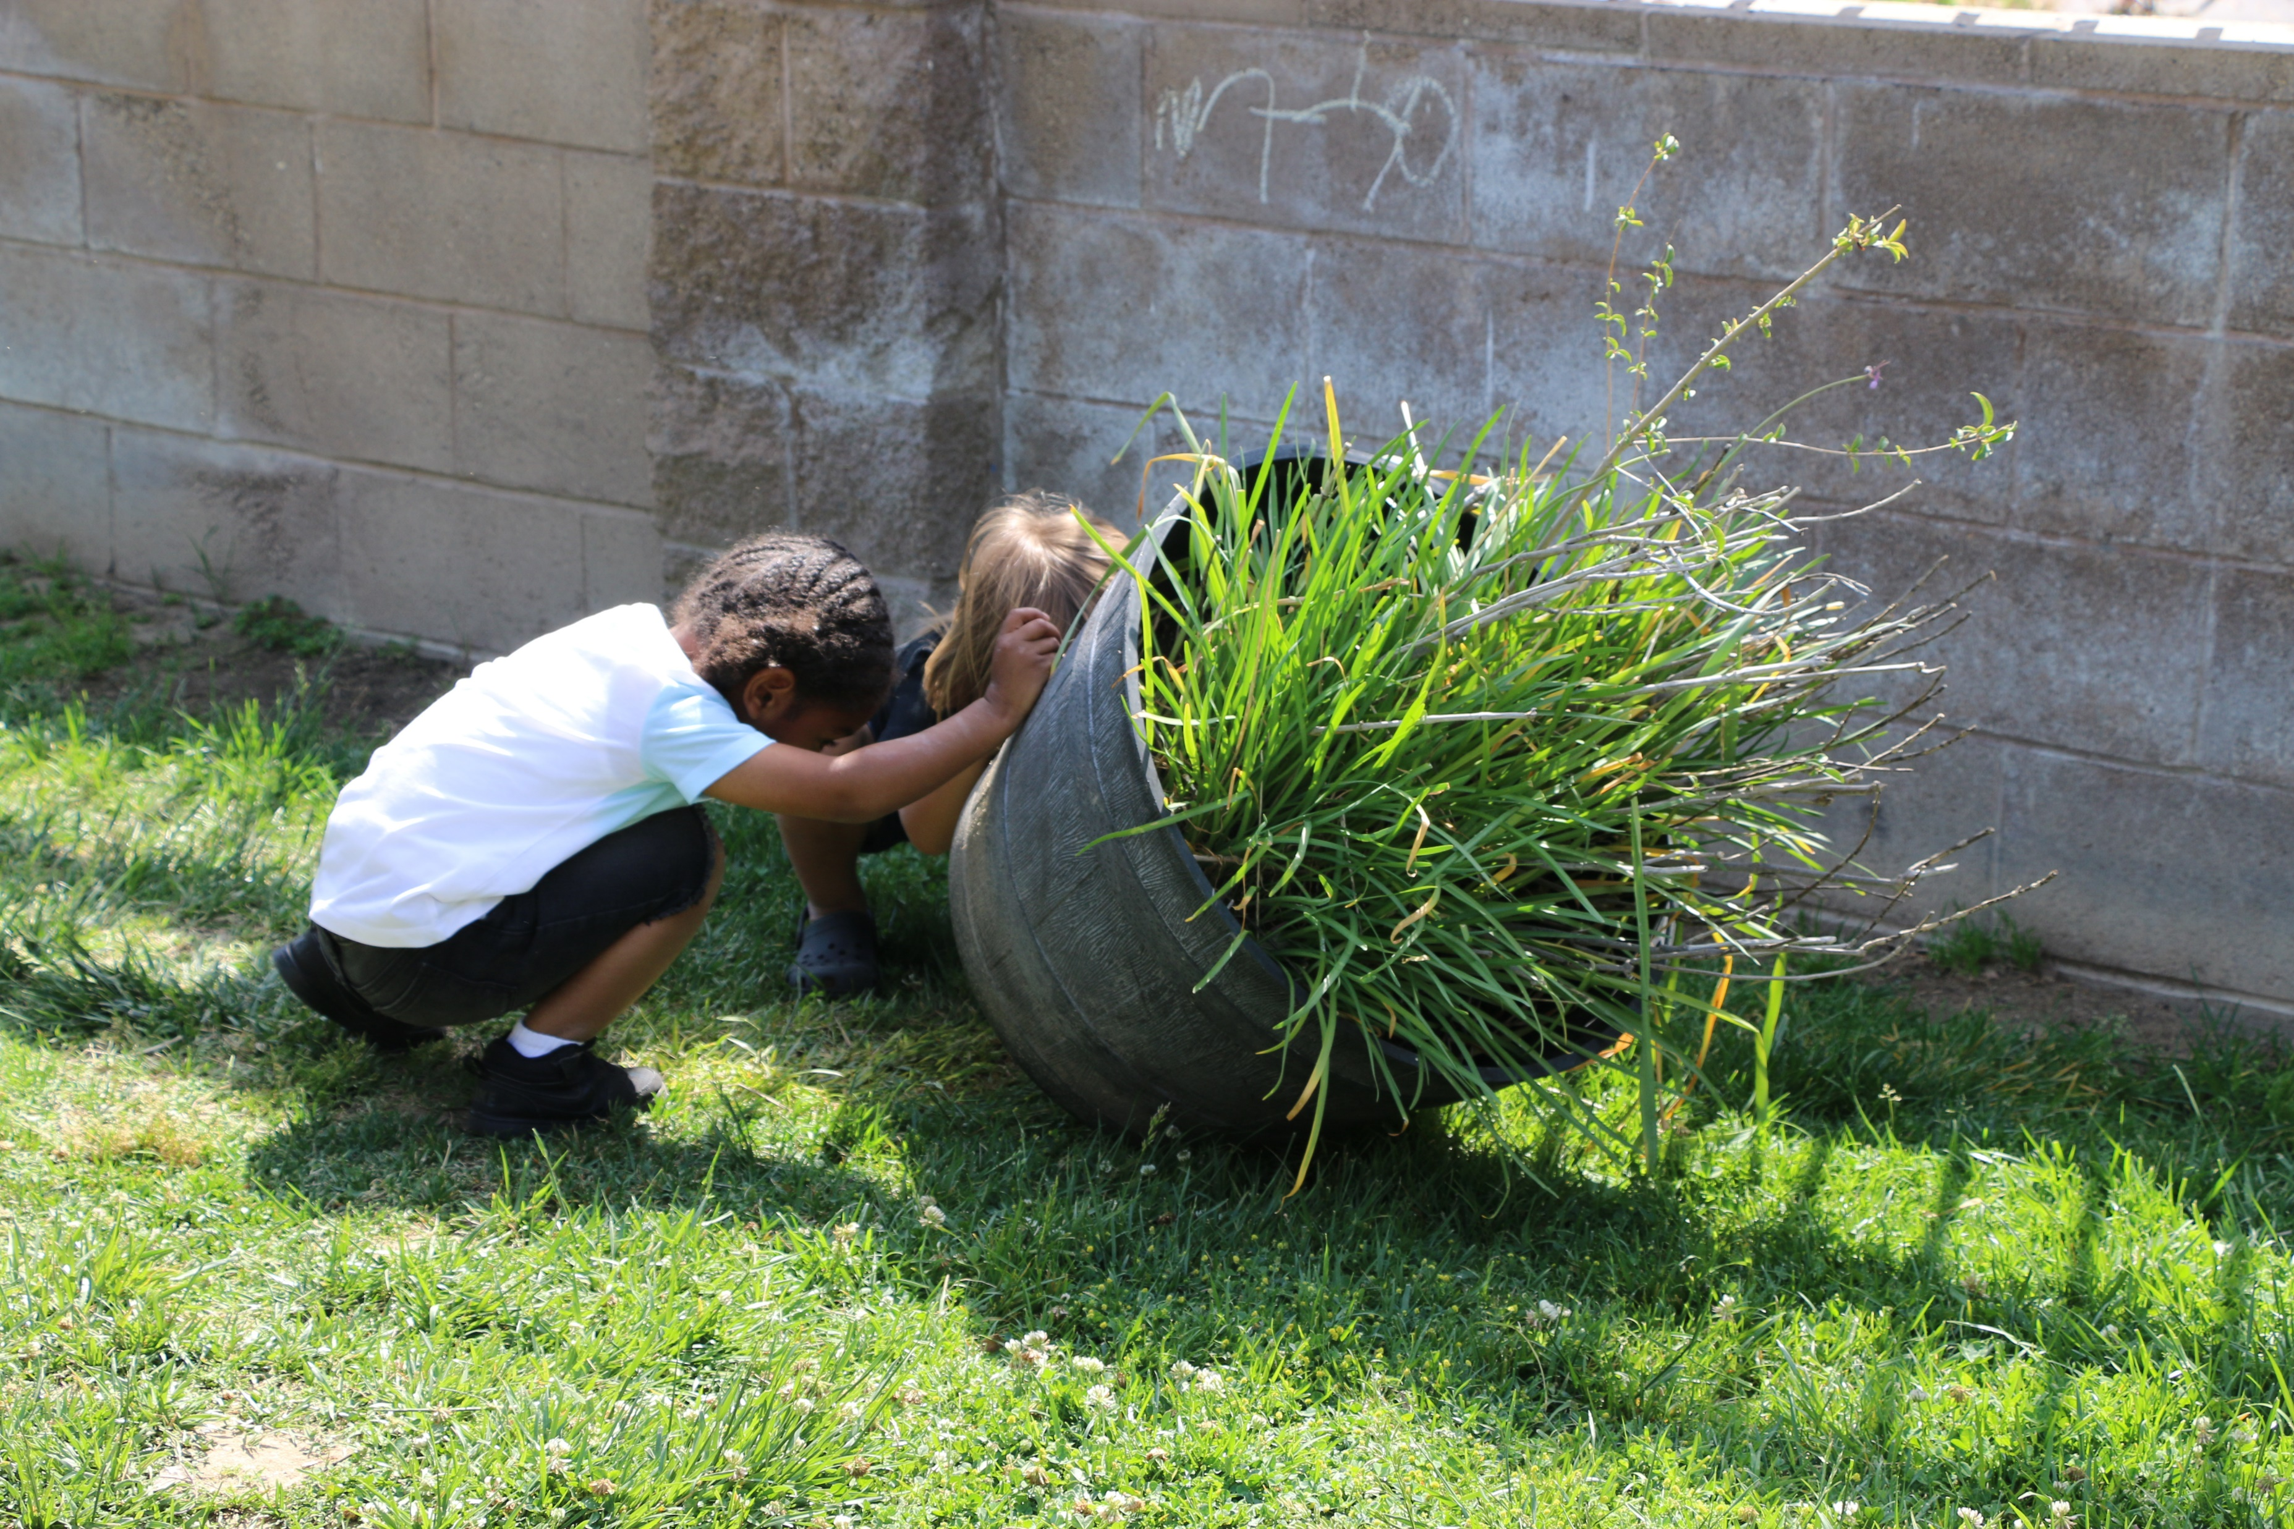
Subsidized Provider Report (Demo)
Subsidized Provider Report (Live Demonstration):
During this portion of the webinar, a CDMIS staff member will share their web browser to showcase the steps needed to reactivate an account.
Photo Credit: LaVera Williams Early Learning Center; Fresno, CA

Slide 35
Updating Agency Information
Why is it so important to make sure your agency information is up to date?
Community responsibility towards data accuracy
Keeps our Policy Offices informed for data-driven decisions
Provides quality information for current and future research ventures
Inaccurate information could lead to:
Possible delays in state and federal funding
Misinformation and miscommunication

Slide 36
How to Update Agency Information on CDMIS (1)
Through the 'Update Agency Information' function in CDMIS
Edit Executive Director/Program Director information
Add/Edit Family Child Care Home (FCCH) Information/Sites or Offices
Upload Files
Updating Agency Information Process
Agencies will add/edit information through the CDMIS and communicate with their consultant for approvals
Your assigned consultant can be found at the top of every page under the 'Update Agency Information' function

Slide 37
How to Update Agency Information on CDMIS (2)
To keep contact information and site information current, update the following as or before changes occur:
Key Personnel Changes
Contract FCCH Changes
Site or Office Changes (Contract/License information)

Slide 38
Updating Personnel Information on CDMIS (1)
The 'Edit Executive Director Information' option allows users to view current information and edit certain fields
Edit Executive Director Information when
New Executive Officer/Superintendent is hired
Executive Director contact information changes (phone, FAX, address, email, etc.)

Slide 39
Updating Personnel Information on CDMIS (2)
The 'Edit Program Director Information' option allows users to view current information and edit certain fields
Users can view their agency's contracts, program directors, and the program directors responsible for those contracts
Edit Program Director Information when
New Program Director is hired (add new program director or assign an existing program director to a contract)
Program Director contact information changes (phone, FAX, address, email)

Slide 40
Updating Personnel Information on CDMIS (3)
Changes will show 'Pending' status until approved by your consultant
Changes showing 'Pending' can still be edited or cancelled until approved by consultant
Annual review of these pages required as part of the Continued Funding Application (CFA) process.

Slide 41
Updating FCCH Information on CDMIS (1)
The 'Add/Edit FCCH Information' option allows users to view current information and edit certain fields
View current FCCH information for your agency's contracts
Add/Updating FCCH information per contract
Add FCCH information per contract
Edit FCCH information per contract
Delete FCCHs no longer in operation

Slide 42
Updating FCCH Information on CDMIS (2)
Add/Edit FCCH Information Fields
Contract (only selected once when adding a new FCCH)
Number of Homes
Children served per age group

Slide 43
Updating FCCH Information on CDMIS (3)
Add/Updating FCCH information per contract
Changes will show 'Pending' status until approved by your consultant
Changes showing 'Pending' status can still be edited/cancelled until approved
Annual review of this page required as part of the Continued Funding Application (CFA) process

Slide 44
Updating Site/Office Information on CDMIS (1)
Add/Edit Site or Office Information
View existing Site/Office information for your agency
Add new site or update existing site information

Slide 45
Updating Site/Office Information on CDMIS (2)
Site/Office Information Elements
Site/Office name
Address
Facility Type
Site Supervisor Contact Information
Contract Type
Children served by contract type
Licensing information (number, age served, hours of operation, capacity)

Slide 46
Updating Site/Office Information on CDMIS (3)
Add/Edit Site or Office Information
Changes will show 'Incomplete' status until approved by your consultant
Changes showing 'Incomplete' status can still be edited/cancelled until approved
Annual review of this page required as part of the Continued Funding Application (CFA) process

Slide 47
Updating Agency Information: Uploading Files
Upload Feature
Users are able to upload corresponding files, of specified formats, to the CDMIS under the Update Agency Information function.
Acceptable formats for file uploads are:
Microsoft Word file - .doc or .docx
Microsoft Excel file - .xls or .xlsx
JPEG image - .jpeg or .jpg
PNG image - .png
Text file - .txt
PDF file - .pdf
ZIP file - .zip
Must be under 20MB

Slide 48
Updating Agency Information Annually (1)
The Continued Funding Application (CFA) is completed on an annual basis for contractors that intend to continue services into the next contract year. Failure to complete a CFA constitutes notification of a contractor's intent to discontinue services into the next fiscal year.

Slide 49
Updating Agency Information Annually (2)
Agencies applying for continued funding for the California State Preschool Program (CSPP) or other California Department of Social Services (CDSS) funded programs must complete and submit the CFA Certification form to certify their information is accurate and up to date.
CFA Certification forms can be submitted electronically or physically by mailing in a hard copy (electronic submissions are preferred).
CFA Certification forms can be found at the bottom of the 'Update Agency Information' page.

Slide 50
Updating Agency Information Annually (3)
Before submitting the CFA form, please double-check that all information displayed on the 'Update Agency Information' page is correct and as up to date as possible. Submission of the CFA form with outdated data could result in delays in funding, misinformation, and miscommunication.

Slide 51
Updating Agency Information (Demo)
Updating Agency Information (Live Demonstration):
During this portion of the webinar, a CDMIS staff member will share their web browser to showcase the steps needed to update their agency information. (Site Data, FCCH Data, etc.)
Photo Credit: Tree of Life International Charter School; Anderson, CA

Slide 52
Frequently Asked Questions (1)
How can I become a CDMIS user?
Answer: CDMIS executive and program directors should have a CDMIS account created on their behalf once they are assigned to their position. New accounts can be created by existing CDMIS super users.
Who do I contact if I forgot my login credentials for CDMIS?
Answer: CDMIS super users can provide login credentials to all users. The user can also use the "Forgot Password" or "Forgot Username" functions on CDMIS.

Slide 53
Frequently Asked Questions (2)
Why can't I see the families I uploaded to 801A?
Answer: Although CDMIS notified you that the file upload passed, the file still needs to be written to the database. Families and children uploaded will be available to view the next day.
What should I do if I am notified that I did not complete a report for a month I did not provide services?
Answer: Check that "No Services" was indicated for the correct FY, contract and report period in CDMIS.
How can I verify that the CDD-801A report has been completed for a certain report period?
Answer: View the Program Code Report under the CDD-801A Management Report drop down menu to ensure the number of children and families is accurate.

Slide 54
Frequently Asked Questions (3)
What information should I provide when contacting CDMIS for support?
Answer: Please provide agency information with vendor number, and specific CDMIS or report related concern.
CDMIS Support can be reached at CDMIS@cde.ca.gov and/or CDMIS@dss.ca.gov
If you prefer to receive support via a phone call, please provide the phone number with times and dates you will be available.
CDMIS Support can also conduct Teams Meetings for support allowing the agency and CDMIS to share screens to troubleshoot concerns. If this is needed, provide detail of the concern you would like covered, and best times and dates to schedule.
What if I have a question specific to my contracts, program or child eligibility?
Answer: CDMIS Support can support with functions in CDMIS and reporting concerns. The agency would need to contact the designated Fiscal Consultant or Program Quality Consultant for specific program or contract related questions.

Slide 55
CDMIS Resources and Contact Information
CDMIS technical assistance inbox:
CDMIS@cde.ca.gov and CDMIS@dss.ca.gov
CDMIS Resources Webpage:
https://www.cde.ca.gov/sp/cd/ci/main.asp
CDMIS Live Site:
https://www4.cde.ca.gov/cdmis
SPR Resources Webpage:
https://www.cde.ca.gov/sp/cd/ci/spreport.asp

Slide 56
Questions and Answers
Photo Credit: Kidango Decoto Center; Union City, CA

Slide 57
Thank you!

