Slide 1
Fiscal Year 2023–24
Continued Funding Application for
California State Preschool Program and Prekindergarten and Family Literacy Support Contractors
Presented by the Early Education Division ​​
Date: November 29, 2022
Time: 4:00 p.m. to 5 p.m.

Slide 2

Welcome and Introductions

Slide 3
Agenda
Management Bulletin (MB) 22-06
Statutory Background
Autorenewal
Application Updates: New for Fiscal Year (FY) 2023–24
2023–24 Continued Funding Application (CFA) Submission
Instructions
Electronic CFA Walkthrough
Contact Information
Questions
Closing

Slide 4
Management Bulletin 22-06: Continued Funding Application Fiscal Year 2023–24
MB 22-06 Purpose
FY 2023–24 CFA Submission Due Date
The complete FY 2023–24 CFA Electronic Application and forms are available on the CFA web page at https://www.cde.ca.gov/sp/cd/ci/cfaforms2324.asp
Each contractor is to review this information as soon as possible to ensure appropriate time and resources are reserved to complete and submit the FY 2023–24 CFA in a timely manner

Slide 5
Statutory Background
The CDE administers the California State Preschool Program (CSPP) and Prekindergarten and Family Literacy Support (CPKS) Program.
California Code of Regulations, Title 5, CFA requirements.
  Responding to the CFA request in accordance with the instructions and timelines.
  Failure to respond to the CFA request.

Slide 6
Autorenewal
Any CSPP and CPKS contractors who apply for and are approved for continued funding will not need to sign a contract to provide services for 2023–2024.
CSPP and CPKS contracts approved for continued funding will be automatically renewed in accordance with all applicable federal and state laws, as well as all CSPP and CPKS Contract Terms and Conditions that will be incorporated into the subsequent contract, as applicable.

Slide 7
Application Updates: New for Fiscal Year 2023–24
Electronic CFA–Snap Survey
Updated Program Calendar
Section II, Part 2
Family Literacy Support Contractors
Subcontractor information
Self-Certification for License Exempt Public Agencies

Slide 8
Instructions Overview
Contractors must review the instructions prior to completing the CFA. The CFA may be submitted electronically, by email, or by hard copy mailed in.
Download and complete required attachments from the CFA website. Please save a copy for your agency’s records.
Complete the CFA, including the required attachments. If submitting a physical copy of the application, print all pages single-sided only.

Slide 9
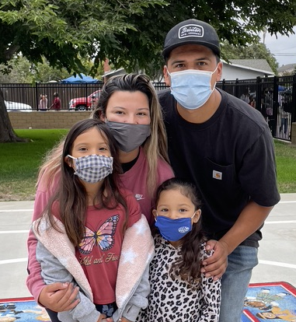
Instructions: Submission of the 2023–24 CFA
Due Date: December 23, 2022, by 5 p.m.
Methods of submission
  Electronically by Application
  Electronically Printed, Scanned, and Emailed CFA
    CFA@cde.ca.gov
  Hard Copy by Mail
Photo Credit: University Preparation School at CSU Channel Islands

Slide 10
Instructions (1)
Section I: Contractor Information
Section II: Contract Types
  The contract types are as follows: (1) CSPP (2) CPKS. Please also indicate if the CSPP contractor operates a Family Childcare Home Education Network.
  The program types are as follows: (1) Full-Day/Full-Year, (2) Part-Day/Part-Year, (3) Full-Day/Part-Year, and (4) Part-Day/Full-Year.
Section III: Contractor’s Officers and Board of Directors

Slide 11
Instructions (2)
Section IV: Program Narrative
  Indicate if the contractor does or does not have programmatic or minimum days of operation (MDO) changes for FY 2023–24.
  For programmatic or MDO changes, complete and submit the program narrative change form and ensure the FY 2023–24 Program Calendar aligns with the MDO.
  All contractors must submit the FY 2023–24 Program Calendar for each CSPP type operated.

Slide 12
Instructions (3)
Section V: Personnel Certifications
  The State of California requires any contractor receiving early education and care funding, disbursed by the CDE, to employ fully qualified personnel as stipulated in the California Education Code; and the California Code of Regulations, Title 5; and the Contract Terms and Conditions.
Section VI: Subcontract Certification
Section VII: Contractor Certification

Slide 13
Instructions (4)
Section VIII: Certification of Information in the Child Development Management Information System (CDMIS)
  CSPP contractors are required to review and update all information in the CDMIS and certify under penalty of perjury that the information in CDMIS is complete and accurate as of the date of the certification.
  The information in the CDMIS becomes part of the agency’s contract.
  Incomplete or inaccurate information in the CDMIS can result in an audit finding at the state level and a finding of noncompliance for your agency.

Slide 14
Instructions (5)
Section IX: Required Attachments
  All attachments must be completed and attached to the application, as applicable to the CSPP contractor.
Section X: CFA Checklist
  The items bolded or with an asterisk require a signature. Check all of the boxes for documents submitted, and if submitting the completed CFA by mail, assemble the application in page number order as indicated.

Slide 15
Electronic CFA Walkthrough
The electronic CFA can be accessed from the CFA webpage.
We will now perform a walkthrough of the electronic CFA to demonstrate how to complete each section.

Slide 16
Updated Program Calendar
The program calendar has been updated to an excel document.

Slide 17
Contact Information
Submit questions regarding the application process to the CFA team by email at CFA@cde.ca.gov.
Submit programmatic questions regarding the CFA to your assigned Early Education Division, Program Quality Implementation Office regional consultant.
Submit fiscal related questions regarding the CFA to your assigned Early Education Nutrition Fiscal Services apportionment analyst.

Slide 18
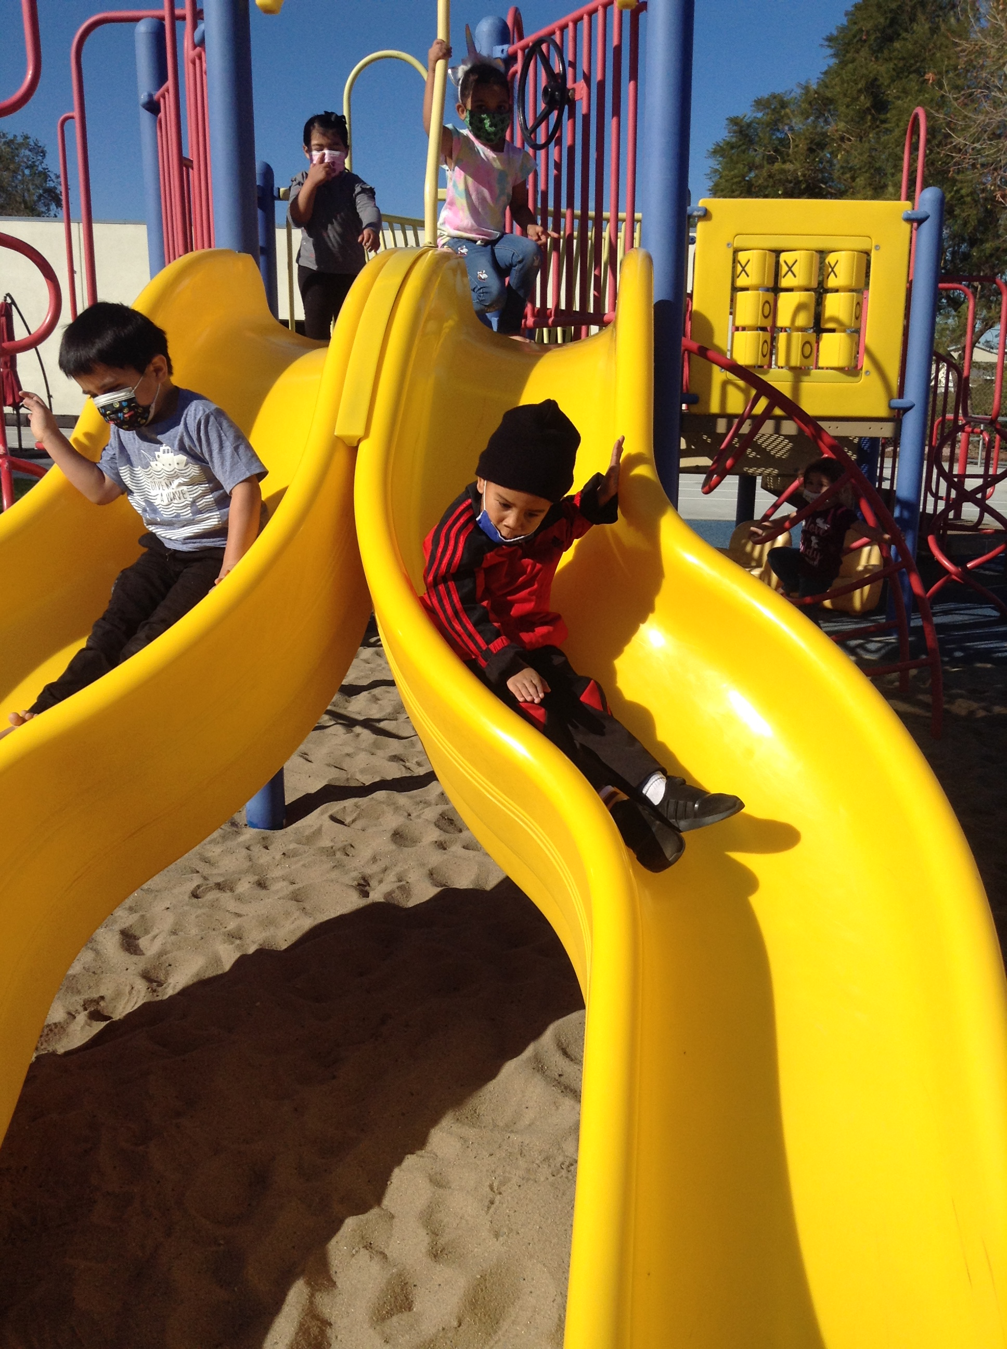
Questions
Photo Credit: University Preparation School at CSU Channel Islands

Slide 19
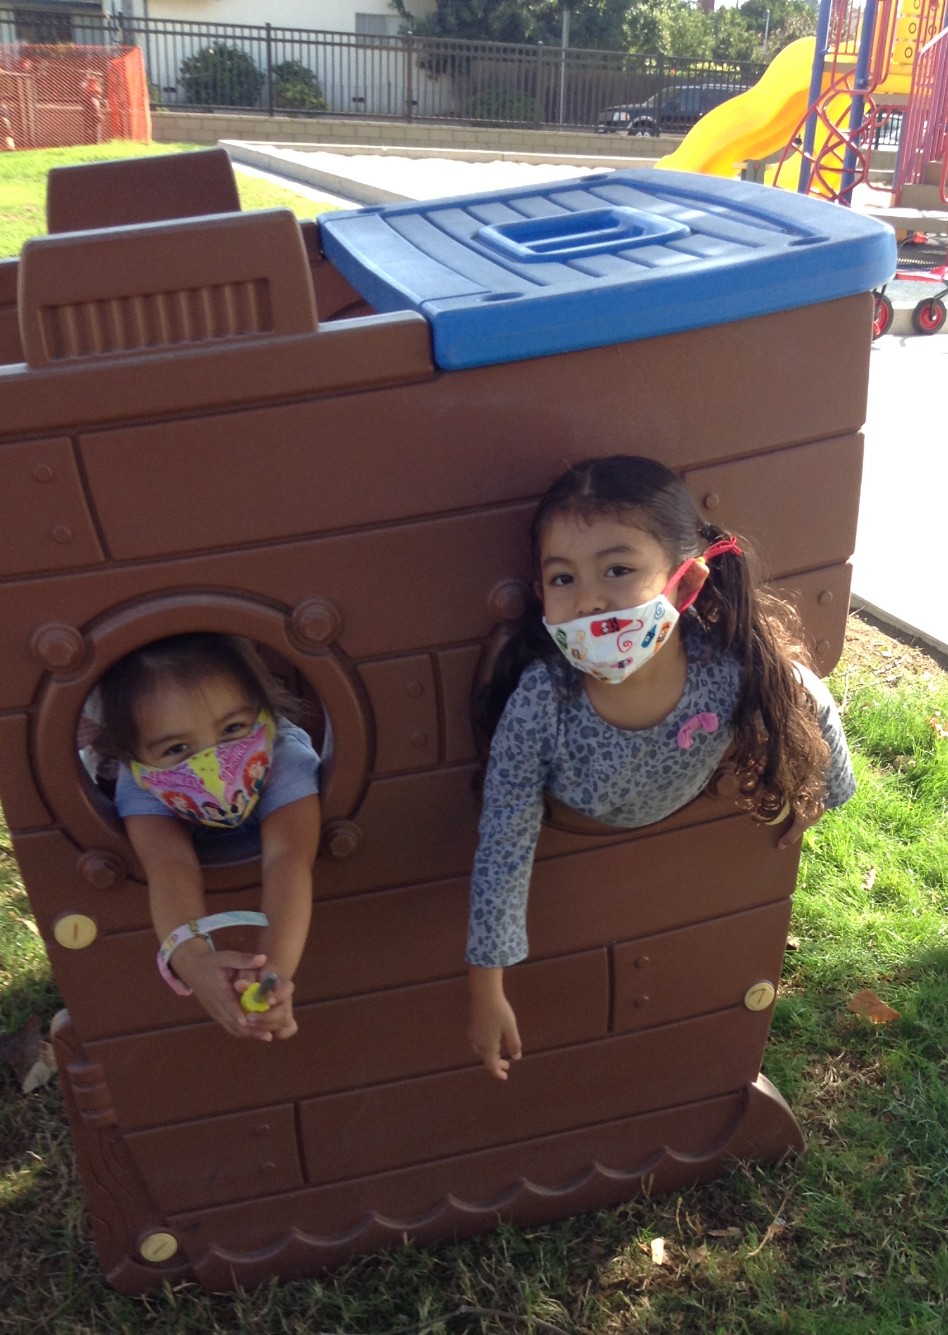
Closing
Photo Credit: University Preparation School at CSU Channel Islands

