Slide 1
Fiscal Year 2025–26 Continued Funding Application for California State Preschool Program and Prekindergarten and Family Literacy Support Contractors Presented by the Early Education Division ​​ Date: September 27, 2024 Time: 10:30 a.m. to 12:30 p.m.

Slide 2
Welcome and Introductions

Slide 3
Agenda
Management Bulletin (MB) 24-09
Statutory Background
Autorenewal
Continued Funding Application (CFA) Updates for Fiscal Year (FY) 2025–26
CFA Submission
CFA Instructions and Walkthrough
Contact Information
Questions
Closing

Slide 4
Management Bulletin 24-09: Continued Funding Application Fiscal Year 2025–26
MB 24-09 Purpose
Due Date: November 1, 2024
The FY 2025–26 Continued Funding Application (CFA) and all required forms are available on the CFA web page at https://www.cde.ca.gov/sp/cd/ci/cfa2526.asp
Each contractor is to review this information as soon as possible to ensure appropriate time and resources are reserved to complete and submit the FY 2025–26 CFA in a timely manner

Slide 5
Statutory Background
The California Department of Education (CDE) administers the California State Preschool Program (CSPP) and Prekindergarten and Family Literacy Support (CPKS) Program.
California Code of Regulations, Title 5, CFA requirements.
Responding to the CFA request in accordance with the instructions and timelines.
Failure to respond to the CFA request.

Slide 6
Autorenewal
CSPP and CPKS contractors who apply for and are approved for continued funding will not need to sign and return a contract to provide services for FY 2025–26.
CSPP and CPKS contracts approved for continued funding will be automatically renewed in accordance with all applicable federal and state laws, as well as all CSPP and CPKS Contract Terms and Conditions that will be incorporated into the subsequent contract, as applicable.

Slide 7
Application Updates for Fiscal Year 2025–26
Download the application document. It is provided as a Portable Document Format (PDF).
Submit by email to CFA@cde.ca.gov
New question: Any sites on Tribal reservations (Section 2)
Only one signature required in the CFA (Section 6)

Slide 8
Submission of the 2025–26 CFA (1)
Due Date: November 1, 2024, by 5:00 p.m.
Download the CFA and all required attachments from the CFA web page.
Complete each document and save it on your computer.
Obtain signature by Authorized Representative.

Slide 9
Submission of the 2025–26 CFA (2)
Option 1: Email completed documents to CFA@cde.ca.gov.
Documents may be signed electronically or signed by hand, scanned, and emailed.
All email submissions must include the required certification statement noted in the CFA Instructions.
Option 2: Submit hard copy by mail to:
California Department of Education
Early Education Division
Attention: Continued Funding Application 2025–26
1430 N Street, Suite 3410
Sacramento, CA 95814-5901

Slide 10
Instructions Overview
Contractors operating a CSPP, or both a CSPP and CPKS Program, must review the CFA Instructions prior to completing the CFA for FY 2025–26.
Refer to the CFA Instructions and Frequently Asked Questions (FAQs) posted on the CFA web page.
Photo Credit: University Preparation School at CSU Channel Islands

Slide 11
Section I: Contractor Information

Slide 12
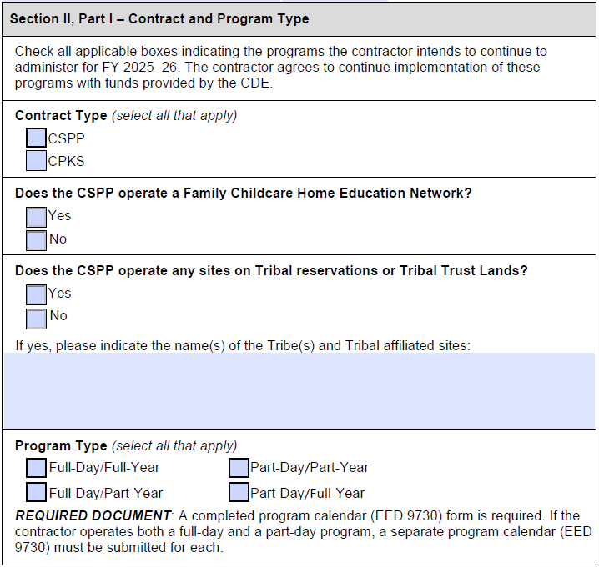
Section II: Part I – Contract and Program Type

Slide 13
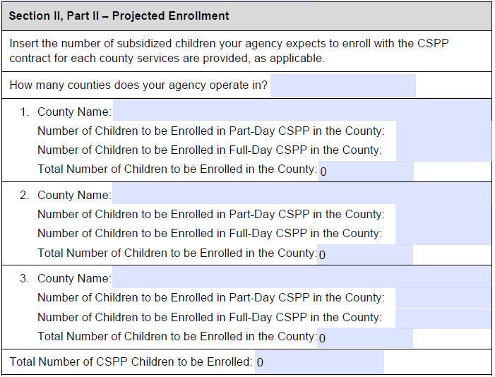
Section II: Part II – Projected Enrollment

Slide 14
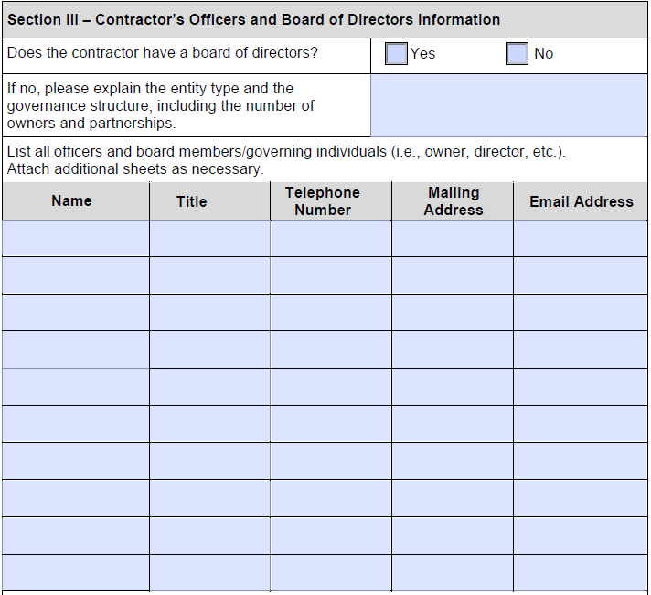
Section III: Contractor’s Officers and Board of Directors

Slide 15
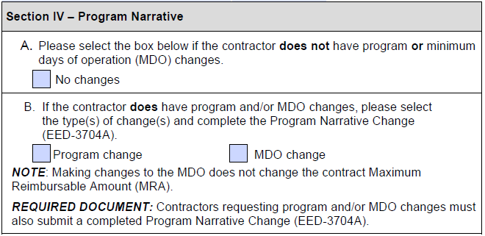
Section IV: Program Narrative

Slide 16
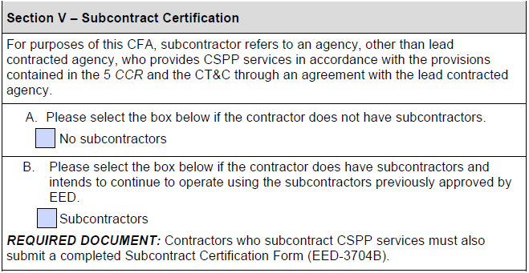
Section V: Subcontract Certification

Slide 17
Section VI: Contractor Certification Instructions
Contains required Personnel Certifications, Certification of Information in CDMIS, and Contractor Certifications.
The State of California requires any contractor receiving early education and care funding, disbursed by the CDE, to employ fully qualified personnel as stipulated in the California Education Code; and the California Code of Regulations, Title 5; and the Contract Terms and Conditions.
Must be signed by the agency’s Authorized Representative.

Slide 18
Section VI: Contractor Certification Instructions (continued)
CSPP contractors are required to review and update all information in the CDMIS and certify under penalty of perjury that the information in CDMIS is complete and accurate as of the date of the certification.
The information in the CDMIS becomes part of the agency’s contract.
Incomplete or inaccurate information in the CDMIS can result in an audit finding at the state level and a finding of noncompliance for your agency.
CDMIS technical support: CDMIS@cde.ca.gov

Slide 19
Section VII: CFA Checklist Instructions
All required attachments must be completed and included with your CFA submission.
Indicate agency type.
Check each box to confirm each section is complete and each required attachment is included.
Use the checklist of required attachments for your agency type.

Slide 20
Required Attachments (1)
All contractors must provide these documents:
CFA
CSPP Program Calendar(s) (EED 9730)
California Civil Rights Laws Certification (CO-005)
Contractor Certification Clauses (CCC)
Federal Certification (CO.8)
CDMIS Agency Information Certification

Slide 21
Required Attachments (2)
Program Calendar (EED 9730)
Check each date the program will provide services to certified children.
If a contractor operates both a full-day and a part-day program, a separate Program Calendar must be provided for each.
Total days of operation must align with the contractor’s approved MDO unless an MDO change is being requested.

Slide 22
Required Attachments (3)
LEAs must include verification of LEA name and address
California School Directory or California Community College Chancellor’s web page, as applicable

Slide 23
Required Attachments (4)
Public Agencies must include a Board Resolution, Board Meeting Minutes, or Board Policy authorizing execution of the 2025–26 CFA and identifying the individual(s) authorized to sign.
See template resolution

Slide 24
Required Attachments (5)
Non-Public agencies (including non-profit community-based organizations) must include:
State of California Payee Data Record (STD. 204)
STD. 205 only if payment address differs from mailing address
Secretary of State certification or search results to verify legal business name and address.

Slide 25
Required Attachments (6)
Non-Public Agencies:
A resolution is not required from a non-public agency if all CFA documents are signed by the agency’s Executive Director, Owner, or President.
If an individual with a different title than above signs, provide Board Resolution, Board Minutes, or letter on company letterhead indicating the signee’s authority to sign contractual agreements.

Slide 26
Required Attachments (7)
Contractors with Program or MDO changes include the Program Narrative Change Form (EED 3704A).
Contractors using subcontractors include the Subcontract Certification Form (EED 3704B).
LEAs applying to be exempt from licensure pursuant to Health & Safety Code Section 1596.792(o) include the Application for License Exemption.

Slide 27
CFA Timeline
September 3, 2024: MB 24-09 released
September 27, 2024: CFA Webinar
November 1, 2024: CFA Due
November 1, 2024 – February 28, 2025: Review and Processing of CFAs by EED
March 2025: Completed CFAs received by Contracts Office
Contracts and funding terms and conditions shall be issued to contractors no later than June 1, 2025

Slide 28
Contact Information
Submit questions regarding the application and submission process to the CFA team by email at CFA@cde.ca.gov.
Submit programmatic questions to your assigned PQI office consultant.
Submit fiscal-related questions to your assigned Early Education Nutrition Fiscal Services apportionment analyst.

Slide 29
Questions
Photo Credit: University Preparation School at CSU Channel Islands

Slide 30
Closing
Photo Credit: University Preparation School at CSU Channel Islands

