Slide 1
Preschool Language Information System (PLIS) Technical Assistance Webinar
Early Education Division (EED)
Date: December 14, 2022
Time: 9:30 - 11:00am

Slide 2
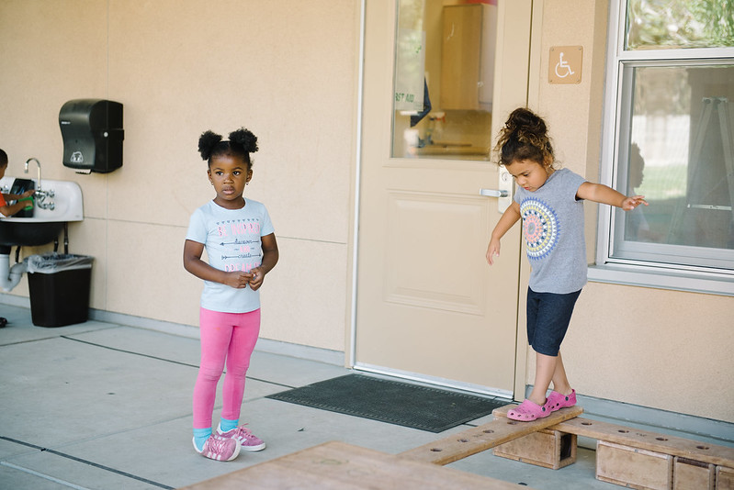
Preschool Dual Language Learners (DLL) Management Bulletin (MB) 22-04(a)
Photo Credit: Lighthouse for Children CDC, Fresno CA

Slide 3
Revisions in MB 22-04(a)
Updates on how to determine if a child is a dual language learner
The Family Language Instrument is to now be completed no later than upon enrollment beginning January 1, 2023.
Data collection details released:
Attachment C and Attachment D
Preschool Language Information System (PLIS) portal link included
Optional reporting period from December 1 through December 31, 2022

Slide 4
Preschool Dual Language Learners MB
Directive
Contractors must determine dual language learner status for every child enrolled in CSPP by one of two approaches:
Conduct the Family Language Instrument to determine dual language learner status, or
Obtain information on the child’s designation as an English learner in TK or K. (This approach is only possible if the child is dually enrolled in CSPP and TK or K for expanded learning and care.)

Slide 5
Preschool Dual Language Learners MB Tools
Family Language Instrument
The Family Language Instrument will be utilized to help identify the language or languages a child is exposed to at home and in their community; which languages the child understands; and which languages the child can speak.
Family Language and Interest Interview
This Interview between families and program staff will be used to build relationships, identify and support the strengths and interests of the child, the language background of the child; and the needs of parents, guardians, or family members to support the language and development of the child.

Slide 6
Resources to Share with Families
Ways to develop your child’s multilingualism (Spanish):
https://www.multilinguallearningtoolkit.org/wp-content/uploads/2021/08/Support-Billingualism-Spanish-1.pdf(PDF)
Keeping Your Home Language (available in 16 languages):
https://cmascanada.ca/2018/05/15/keeping-your-home-language/%20
Benefits of Multilingualism:
https://ncela.ed.gov/files/announcements/20200805-NCELAInfographic-508.pdf(PDF)
The Importance of Home Language Series (available in English, Spanish, Arabic, Chinese, and other languages):
https://eclkc.ohs.acf.hhs.gov/culture-language/article/importance-home-language-series

Slide 7
Preschool Dual Language Learners MB
Data Collection
Data Collection Components
Child home language, language the child uses most, and family/guardian preferred language to receive verbal and written communication
Race or ethnicity
Language characteristics of program including but not limited to, whether the program uses the home language for instruction, such as DLL, or other program that supports the development of home languages.
The language composition of the program staff.
Proposed Data System
PLIS
Contractors will enter in their user credentials (the same credentials used for the Child Development Management Information System [CDMIS]/801A Data).
Contractors have the option to enter the data directly into PLIS or upload a file.

Slide 8
Preschool Language Information System (PLIS)

Slide 9
Preschool Language Information System (PLIS)
The PLIS has been created to collect the PLIS Report, which will contain all of the required data collection components outlined in MB 22-04(a).
The PLIS Report will be due quarterly (due every three months for three months' data) during a 20-day submission period.
The PLIS is accessible on a site outside of the Child Development Management Information System (CDMIS), but credentials for PLIS and CDMIS are synchronized.

Slide 10
PLIS Data Reporting Instructions
Manual Input
Click "Add Child"
Report is separated into three fields: Child, Family, Classroom and Facility
Once all information is input, click "Add Child Record"
Electronic File Input
Click "Upload Child Records"
If a previous quarter has already been reported on, there's an option to download the previous report as a tab-delimited file to reupload
After uploading, if there are errors, all errors will pop up on the screen
Upon successful upload, a message will populate, and all information will be available in manual input

Slide 11
PLIS Reporting Schedule
The reporting schedule for Fiscal Year 22–23 will be as follows:
Report Quarter | Reporting Period | First Day Reports May Be Submitted | Report Due Date
Quarter 2 (Optional) | December 1 – December 31, 2022 | January 1, 2023 | January 20, 2023
Quarter 3 | January 1, 2023 – March 30, 2023 | April 1, 2023 | April 20, 2023
Quarter 4 | April 1, 2023 – June 30, 2023 | July 1, 2023 | July 20, 2023

Slide 12
Data Crosswalk PLIS – 801A Child Data
PLIS Report Data Field # | PLIS Data Field Name | CDD-801A Data Field Name | 801A Data Field #
1 | Last Name | Child's Last Name | 15/O
2 | First Name | Child's First Name | 16/P
3 | MI (Middle Initial) | Child's Middle Initial | 17/Q
4 | Child Identification and Case Number (CICN) | n/a | n/a

Slide 13
Child Identification Case Number (CICN) PLIS Data Field
Unique identifier for a specific child enrolled within your agency
Can be different from the Family Identification Case Number, and must be different if the family has more than two children enrolled
If you do not have a CICN assigned, the PLIS will auto-generate this number as a combination of the following fields:
Family Identification Case Number (FICN)-Date of Birth-First Name-Middle Initial
Field allows for a maximum of 100 characters (numbers, letters, special characters)

Slide 14
Data Crosswalk PLIS – 801A Child Data (2)
PLIS Report Data Field # | PLIS Data Field Name | CDD-801A Data Field Name | 801A Data Field #
5 | Date of Birth | Child's Date of Birth | 25/Z
6 | Date of Enrollment | Child's Start Date | 29/AC
7 | Date of Instrument | n/a | n/a
8 | Hispanic | Child's Ethnicity | 18/R

Slide 15
Date of Instrument PLIS Data Field
The Date of Instrument data field is the date the Family Language Instrument was completed for this child
If a child is dually enrolled in Transitional Kindergarten (TK) or Kindergarten (K) and the California State Preschool Program (CSPP), and has been designated as an English Learner based on their English Language Proficiency Assessments for California (ELPAC) score, the Date of Instrument field can be left blank
All other children are required to have a date response in this field
Must be input in date format: MM/DD/YYYY

Slide 16
Data Crosswalk PLIS – 801A Child Data (3)
PLIS Report Data Field # | PLIS Data Field Name | CDD-801A Data Field Name | 801A Data Field #
9 | Race(s) | Child's Race | 19-23/S-W
10 | Home Language(s) | n/a Interview Question 4 | n/a
11 | Most-Used Language | Child's Primary Language Interview Question 6 | 27/AA
12 | Dual Language Learner | n/a | n/a

Slide 17
Home Language(s) PLIS Data Field
The response to this field is found in the Family Language Interest Interview as Question 4.
Multiple languages can be selected and reported within this field.
Language codes can be found on Attachment C, and must be two characters (ex. English = 00)

Slide 18
Dual Language Learner PLIS Data Field
This field asks whether a child is a dual (or multi) language learner
The response to this field should be Yes if a child is identified as a dual language learner
If not, the response to this field should be No
On an electronic file, please enter either Y or N in this field

Slide 19
Data Crosswalk PLIS – 801A Family Data
PLIS Report Data Field # | PLIS Data Field Name | CDD-801A Data Field Name | 801A Data Field #
13 | Family Identification Case Number (FICN) | Family Identification Case Number (FICN) | 3/C
14 | Head-of-Household Full Name | Head-of-Household Last Name and First Name Fields | 4-5/D-E
15 | Written Communication Preference | n/a Interview Question 7 | n/a
16 | Verbal Communication Preference | n/a Interview Question 8 | n/a

Slide 20
Written and Verbal Communication Preference PLIS Data Field
The Family's preferred language for written communication and verbal communication
The written communication preference response can be found in the Family Interest Interview Question 7
The verbal communication preference response can be found in the Family Interest Interview Question 8
Language codes can be found on Attachment C, and must be two characters (ex. English = 00)

Slide 21
Data Crosswalk PLIS – 801A Class Data
PLIS Report Data Field # | PLIS Data Field Name | CDD-801A Data Field Name | 801A Data Field #
17 | Language(s) Used – Lead Teacher | n/a | n/a
18 | Language(s) Proficient – Lead Teacher | n/a | n/a
19 | Language(s) used – Other Program Staff | n/a | n/a
20 | Language(s) Proficient – Other Program Staff | n/a | n/a

Slide 22
Languages of Lead Teacher PLIS Data Fields
Language(s) Used – Lead Teacher
The languages the lead teacher in the child's classroom uses
This field allows for multiple responses to be selected
Language(s) Proficient– Lead Teacher
The languages which the lead teacher in the child's classroom are proficient in
This field allows for multiple responses to be selected
Language codes can be found on Attachment C, and must be two characters (ex. English = 00)

Slide 23
Languages of Program Staff PLIS Data Fields
Language(s) Used – Other Program Staff
The languages other program staff in the child's classroom uses
This field allows for multiple responses to be selected
Language(s) Proficient– Other Program Staff
The languages which other program staff in the child's classroom are proficient in
This field allows for multiple responses to be selected
Language codes can be found on Attachment C, and must be two characters (ex. English = 00)

Slide 24
Data Crosswalk PLIS – 801A Class Data (2)
PLIS Report Data Field # | PLIS Data Field Name | CDD-801A Data Field Name | 801A Data Field #
21 | Language Program Type | n/a | n/a
22 | Facility Name | n/a | n/a
23 | Facility License Number | n/a | n/a
24 | LEA Provider CDS Code | n/a | n/a

Slide 25
Language Program Type (1) PLIS Data Fields
This field indicates which program type the classroom participates in. Users will choose the relevant program or the "None" option if no language program is offered.
Dual Language Immersion Programs (2)
50/50 Program: Where English and the other target language are used equally throughout the day
Other Language Allotment (Majority Non-English): Where a proportion of more than half the content is taught in a language other than English

Slide 26
Language Program Type (2) PLIS Data Fields
Other Language Allotment (Majority English): Where a proportion of more than half of content is taught in English
Other Language Program: Other language program or home language development program not listed above
Home Language Support: English-only instruction with home-language support
Only one response is allowed
Corresponding codes for these reporting options in an electronic file can be found in Attachment C

Slide 27
Facility Name PLIS Data Fields
This field indicates the name of the facility at which the child is enrolled in and receiving subsidized child care services
The Facility Name is equivalent to Site Name from the CDMIS
Please report the Facility Name exactly how it is listed in CDMIS
Allows for a maximum of 100 characters

Slide 28
Facility License Number PLIS Data Fields
Indicates the eight to nine digit code of the Day Care Center or Family Child Care Home License and Facility number that the child attends
Can be found in the "Provider and Site Name" box under Section IV: Data on Children on Form 9600
If not applicable, the following Local Education Agency (LEA) Provider County-District-School (CDS) code field must be completed
Only eight or nine numbers will be accepted in this field

Slide 29
LEA Provider CDS Code PLIS Data Fields
Indicates the 14-digit County-District-School (CDS) code of the local education agency (LEA) that provides services at this facility
If not applicable, the before Facility and License Number field must be completed
The system does not allow for both fields to be blank
Only 14 numbers will be accepted in this field

Slide 30
Demo of the PLIS
Walkthrough of the PLIS site

Slide 31
Management Bulletin and PLIS Q&A
Questions can also be directed to: PLIS@cde.ca.gov

Slide 32
PLIS Resources
PLIS Site Link:
https://www3.cde.ca.gov/plis
Management Bulletin 22-04(a):
https://www.cde.ca.gov/sp/cd/ci/mb2204a.asp
PLIS Email Support Inbox:
PLIS@cde.ca.gov

Slide 33
Thank you

