Slide 1
2021–22 Every Student Succeeds Act Comprehensive Support and Improvement County Office of Education Plan Approval Application for Funding Webinar
February 10, 2022

Slide 2
Acronyms (1)
CDE—California Department of Education
COE—County Office of Education
CSI—Comprehensive Support and Improvement
ESSA—Every Student Succeeds Act
FY—Fiscal Year
GMART—Grant Management and Reporting Tool
Grad Rate—Graduation Rate

Slide 3
Acronyms (2)
LCAP—Local Control and Accountability Plan
LEA—local educational agency
PCA—Program Cost Account
SBE—State Board of Education
SEA—state educational agency
SPSA—School Plan for Student Achievement

Slide 4
Housekeeping
Please use the Zoom Q & A feature to post any questions you may have.
A PDF of today’s presentation is located on the CDE’s CSI web page at:
https://www.cde.ca.gov/sp/sw/t1/csiwebinars.asp

Slide 5
FY 2021 CSI Funds for COEs Webinar Series
This presentation is one of two presentations that is being provided to COEs receiving CSI funds.
The FY 2021 Budget Act updated expectations on the uses of CSI funds for COEs.
Today’s presentation will address requirements related to the COE role and responsibilities for LEA CSI plan approval.

Slide 6
Today’s Overview: Part One
Subgrant Information
  Purpose and Statutory Authority
  Eligibility Requirements
  Allowable and Disallowable Costs
  Reporting Requirements
  Apportionments
  Timeline

Slide 7
Today’s Overview: Part Two
Technical Assistance
  New COE Web Pages
  Conflict of Interest Guidance
  Guidelines for the Review and Approval Process of CSI Plans
  Frequently Asked Questions (FAQs)

Slide 8
Today’s Overview: Part Three
Completing and Submitting Application
  Process
  Sections
  Status

Slide 9
Part One:
Subgrant Information

Slide 10
Purpose
The Budget Act of 2021 appropriates $5,000,000 of ESSA, Section 1003 funds to COEs for the purposes of review and approval of 2022–23 CSI plans through the CSI prompts in the 2022–23 LEA LCAP.

Slide 11
FY 2021 CSI Funds for COEs: Statutory Authority (1)
Senate Bill 170: https://leginfo.legislature.ca.gov/faces/billNavClient.xhtml?bill_id=202120220SB170.
Section 6100-134-0890
  Splits the $10,000,000 previously allotted to COEs in prior years’ Budget Bills into two separate provisions:
    Keeps $5,000,000 in Schedule 1 for the purposes of providing CSI plan development and implementation support for LEAs.

Slide 12
FY 2021 CSI Funds for COEs: Statutory Authority (2)
  Senate Bill 170: https://leginfo.legislature.ca.gov/faces/billNavClient.xhtml?bill_id=202120220SB170.
  Section 6100-134-0890
  Shifts $5,000,000 to a new provision in Schedule 2 (Provision 11) for the purposes of CSI plan approval through review and approval of CSI prompts in the LEA LCAP.
  The next section will cover how to apply for funding authorized under this Provision.

Slide 13
2021 Budget Act: Provision 11 of Schedule 2
Here the COE is working on behalf of the SBE to meet the ESSA SEA requirement to approve LEA CSI plans.
The prior expectation to review and approve CSI prompts in the LEA LCAP is shifted from the old Provision 7 of Schedule 1 to the new Provision 11 of Schedule 2.

Slide 14
Which COEs are eligible to Apply for FY 2021 Funding?
Eligible COEs that have an LEA or LEAs in their county that serve schools eligible for CSI based on the 2021–22 ESSA Assistance Status Data Files are eligible for funding.

Slide 15
2021–22 ESSA Assistance Status Data Files (1)
California received a federal waiver and was not required to report performance levels (or colors) on the 2021 California State Dashboard. Because these data are not available, determination of exit from the CSI–Lowest Performing Schools category is not possible. Therefore, schools designated as such in 2019–20, remained in place through 2021–22 and are reflected in the 2021–22 Data Files.

Slide 16
2021–22 ESSA Assistance Status Data Files (2)
However, LEAs were required to report graduation rate data which California used to determine if those schools designated as CSI–Low Grad Rate in 2019–20 were eligible to exit.
Schools with a three-year school-wide (i.e., 2018–19, 2019–20, and 2020–21 school years) average graduation rate at or above 68 percent exited the CSI–Low Grad Rate category on the 2021–22 Data Files.

Slide 17
2021–22 ESSA Assistance Status Data Files (3)
Please visit the CDE ESSA Assistance Status Data Files web page to view the 2021–22 Data Files and the corresponding record layouts.
For more information about school eligibility for CSI, please visit the ESSA Assistance Status Data Files web page at https://www.cde.ca.gov/sp/sw/t1/essaassistdatafiles.asp

Slide 18
Allowable Activities and Costs
Funds authorized under this subgrant shall be spent on the review and approval of 2022–23 LEA CSI plans through the CSI prompts in the 2022–23 LEA LCAP.
The COE will only be reimbursed for actual work performed.
The COE CSI Program Information web page is located at https://www.cde.ca.gov/sp/sw/t1/csicoeproginformation21.asp.

Slide 19
Disallowable Activities and Costs
The use of federal funds must be consistent with the Office of Management and Budget’s (OMB) Uniform Administrative Requirements, Cost Principles, and Audit Requirements for Federal Awards.
For federal guidance on Supplement not Supplant for school improvement, see question 29a, pages 21 to 22 at https://www2.ed.gov/policy/elsec/leg/essa/snsfinalguidance06192019.pdf

Slide 20
Subgrant Reporting Requirements (1a)
Report Name | Reporting Data | Performance Period | Reporting Due Date
Report 1 | Budget Revisions (BR) Expenditures (E) | March 14, 2022, to June 30, 2022 | July 15, 2022 (BR) July 31, 2022 (E)
Report 2 | Budget Revisions (BR) Expenditures (E) | July 1, 2022, to September 30, 2022 | October 15, 2022 (BR) October 31, 2022 (E)
Report 3 | Budget Revisions (BR) Expenditures (E) | October 1, 2022, to January 31, 2023 | February 15, 2023 (BR) February 28, 2023 (E)

Slide 21
Subgrant Reporting Requirements (1b)
Report Name | Reporting Data | Performance Period | Reporting Due Date
Report 4 | Budget Revisions (BR) Expenditures (E) | February 1, 2023, to June 30, 2023 | July 15, 2023 (BR) July 31, 2023 (E)
Final Report | Budget Revisions (BR) Expenditures (E) | July 1, 2023, to September 30, 2023 | October 15, 2023 (BR) October 31, 2023 (E)

Slide 22
Subgrant Reporting Requirements (2)
COE expenditures must be submitted with each report.
Zeroes must be submitted if there are no expenditures.
When expenditure amounts claimed for object codes are in excess of 10 percent of the last approved budget, a project budget revision request must be submitted. Budget revision requests require CDE approval and are due 15 business days prior to the expenditure reporting due date.

Slide 23
Subgrant Reporting Requirements (3)
Budget revision requests must be submitted using the GMART located at https://www3.cde.ca.gov/gmart/gmartlogon.aspx
The PCA number is 15565.
The Final Report must be completed in the GMART prior to closeout.

Slide 24
Application and Funding Results Timeline (1)
Activity | Due Date
Funding Profile Posted to the CDE Web Page | December 2021
The 2021–22 ESSA Assistance Status Spreadsheet available (indicate CSI high schools that exited CSI low-graduation status) | Early 2022
2021–22 ESSA CSI COE Plan Approval Application for Funding Release Date | February 7, 2022
2021–22 ESSA CSI COE Plan Approval Application for Funding Webinar | February 10, 2022, at 10 a.m.

Slide 25
Application and Funding Results Timeline (2)
Activity | Due Date
2021–22 ESSA CSI COE Plan Approval Application for Funding Due to the CDE | February 28, 2022, by 4 p.m.
2021–22 ESSA CSI COE Plan Approval Application for Funding review by CDE Staff | March 2022
Funding Results and Schedule of Apportionments Posted to the CDE Web Page | April/May 2022

Slide 26
Part Two:
Technical Assistance

Slide 27
New Web Pages for FY 2021 CSI Funds and Ongoing
COE CSI Program Information https://www.cde.ca.gov/sp/sw/t1/csicoeproginformation21.asp
Four Sections:
    COE CSI Home
    Program Requirements (includes Guidelines for the Review and Approval Process of CSI Prompts)
    Guidance on Conflict of Interest
    FAQs

Slide 28
Impact of Dual Roles for COEs (1)
Because the $10,000,000 in funds is now split into two $5,000,000 amounts to be used for different purposes, there is a potential conflict of interest for COEs expending the FY 2021 funds.
  COEs are expected to assist the LEA with CSI plan development and implementation and serve on behalf of the SBE to approve CSI Plans.
  This subgrant is for supporting LEAs in reviewing and approving the 2022–23 CSI plans through the CSI prompts in the 2022–23 LEA LCAP.

Slide 29
Impact of Dual Roles for COEs (2)
With these two provisions, it is possible for a COE to receive funding to support LEAs with their CSI plans, and also to receive funding in order to review and approve CSI plans.
CDE provides recommendations to COEs in order to avoid conflicts in the event that COEs are allocated funds for both CSI plan development and implementation support AND the review and approval of CSI plans.

Slide 30
Guidelines for Preventing Conflicts of Interest (1)
A complete guide on how to avoid a conflict of interest with CSI funds for COEs is located on the new COE CSI web page at https://www.cde.ca.gov/sp/sw/t1/csicoeproginformation21.asp
COEs are encouraged to review the posted guidance with their legal departments and make any changes, where and if needed.
The next two slides will address a few key highlights of the posted guidelines for preventing a conflict of interest.

Slide 31
Guidelines for Preventing Conflicts of Interest (2)
To prevent a conflict between these responsibilities and to retain the integrity of the duties involved in each Provision, COEs should consider implementing an internal firewall separating the individuals involved with the planning elements of the CSI plans from the individuals involved with the review and approval process of CSI plans and prohibiting discussion of specific districts and plans.

Slide 32
Internal Firewall Procedures
    Include:
    Providing notice.
    Written acknowledgement.
    Individuals work in separate places and do not share information.
    Records are maintained.
    Complete details are on the CSI COE web page located at https://www.cde.ca.gov/sp/sw/t1/csicoeproginformation21.asp.

Slide 33
Guidelines for the
Review and Approval Process of CSI Plans

Slide 34
Guidelines for the Review and Approval Process of CSI Plans (1)
The 2022–23 CDE CSI prompts are as follows:
Identify the schools within the LEA that are eligible for CSI.
Describe how the LEA is supporting its eligible schools to develop their CSI plans.
Describe how the LEA will monitor and evaluate the implementation and effectiveness of the CSI plan to support student and school improvement.

Slide 35
Guidelines for the Review and Approval Process of CSI Plans (2)
Under ESSA Section 1111(d)(1)(B), LEAs must develop CSI plans in collaboration with its educational partners for each school eligible for CSI.
Educational partners include principals and other school leaders, teachers, and parents.
Approved CSI plans should include a description of the LEA’s process for developing the CSI plan, including which educational partners were involved and how their feedback was incorporated into the CSI plans.

Slide 36
Guidelines for the Review and Approval Process of CSI Plans (3)
In reviewing CSI plans, COEs should:
See the extent that educational partners were involved and considered in the development of the CSI plans.
See how CSI plans were informed by the indicators.
See that evidence-based interventions were selected and align to the reasons why the school is eligible for CSI.
See how the LEA identified resource inequities.

Slide 37
Guidelines for the Review and Approval Process of CSI Plans (4)
  COEs may consider incorporating some of these practices:
    Facilitate planning targeted to the needs of low-performing schools across the district or region.
    Support districts to assess the capacity of school staff.
    Share examples of strategies.
    Provide clear expectations and adequate resources.
    Provide guidance, flexibility, and space.

Slide 38
Guidelines for the Review and Approval Process of CSI Plans (5)
Under ESSA Section 1111(d)(1)(B)(iii), CSI plans must be based on a school-level needs assessment.
    CSI plans should describe the LEA's needs assessment, including the type(s) of data and information examined and how the data informed development of the CSI plan.
    Reviewing COEs should ensure that CSI plans correlate to needs identified in the needs assessment and any relevant data.

Slide 39
FAQs

Slide 40
What does it mean for a COE to approve CSI plans?
The COE approves LEA CSI plans through the review and approval process of the CSI prompts in the LEA LCAP.

Slide 41
Must a COE approve CSI plans for Charter Schools?
Yes. Charter schools eligible for CSI will complete the CSI prompts in the Plan Summary section of the LCAP. The charter school will submit only the Plan Summary section of the LCAP to the County Superintendent of Schools of the county in which the charter school is located for review and approval.

Slide 42
What is the COE required to do after it approves the CSI plans?
In fall 2022, the COE will submit to the CDE a list of LEAs with approved CSI plans. The CDE will present this list of LEAs to the SBE for final approval.
It is the expectation that the COE ensures that all LEAs with schools eligible for CSI within its county, including charter schools, complete and submit to the COE the CSI prompts for review and approval.
The COE should contact the CDE as soon as possible should its list of LEAs be incomplete.

Slide 43
Which CSI Plans do the FY 2021 funds support?
FY 2021 CSI funds support development and implementation activities for the 2022–23 CSI plans. In most LEAs, CSI plan development activities begin as early as winter 2021/spring 2022. It is the expectation that CSI plan implementation should begin by the first day of the 2022–23 school year.
The COE will use its FY 2021 CSI funds under this application to approve the 2022–23 CSI plans through review and approval of CSI prompts in the LEA LCAP.

Slide 44
How is the conflict of interest concern different from the dual roles the COE plays regarding the LCAP?
The concern for a potential conflict of interest is a federal concern and relates to the dual roles of COEs for CSI. The purpose of this guidance is only related to CSI implementation and is not intended for state accountability purposes.

Slide 45
When will the FY 2021 CSI funds for COEs become available?
  First apportionments are expected to be distributed in spring 2022.

Slide 46
What if the COE declines funding?
Regardless of whether or not the COE elects to accept funding authorized under this application, the COE is expected to approve CSI plans for all LEAs, including charter schools, in its county with schools eligible for CSI. This requirement is carried out through COE review and approval of CSI prompts in the LEA LCAP.

Slide 47
Questions?

Slide 48
Part Three:
Application

Slide 49
Completing and Submitting the 2021‒22 Application

Slide 50
The GMART (1)
The application and all COE subgrant reporting will be managed in the GMART.
The GMART is a web-based system that allows COEs to submit, view, print, and modify the application for funding. It is located at https://www3.cde.ca.gov/gmart/gmartlogon.aspx.
A reference-only PDF of the application is posted to the Funding tab of the CSI web page located at
https://www.cde.ca.gov/sp/sw/t1/documents/csicoepaaffref21.docx

Slide 51
The GMART (2)
Usernames and passwords:
  Are the same as in prior years
  Were emailed to county superintendents
  Are case-sensitive
For more information, visit the GMART instructions web page located at https://www.cde.ca.gov/sp/sw/t1/gmartinstructions.asp.

Slide 52
Logging on to the GMART (1)
On the GMART landing page, the COE will enter their unique username and password.
The COE will be prompted to select a link labeled “2021–22 Comprehensive Support and Improvement County Office of Education Plan Approval Application for Funding.”
The COE will be directed to the Application Overview.
The Application Overview page will show tabs for all sections of the application.

Slide 53
Selecting the Subgrant Application
GMART
Select Grant
Logoff
Please select the link below to begin or continue with your application:
2021–22 ESSA CSI COE Plan Approval Application for Funding

Slide 54
Application Sections
The 2021–22 application includes four sections:
Section 1: General Assurances, Certifications, Terms, and Conditions
Section 2: COE Applicant Information
Section 3: Proposed Project Budget
Section 4: Signatures

Slide 55
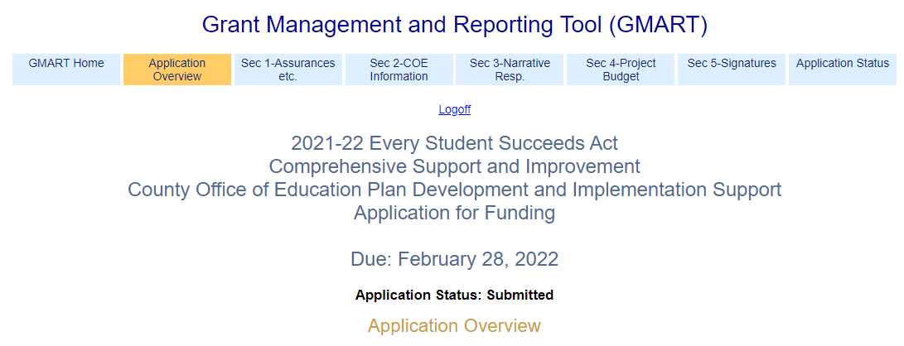
Application Overview (1)
Reference the Appendix 1 for alternative text version.
Notes:
Note: Each section of this application must be completed before advancing to subsequent sections Add to script

Slide 56
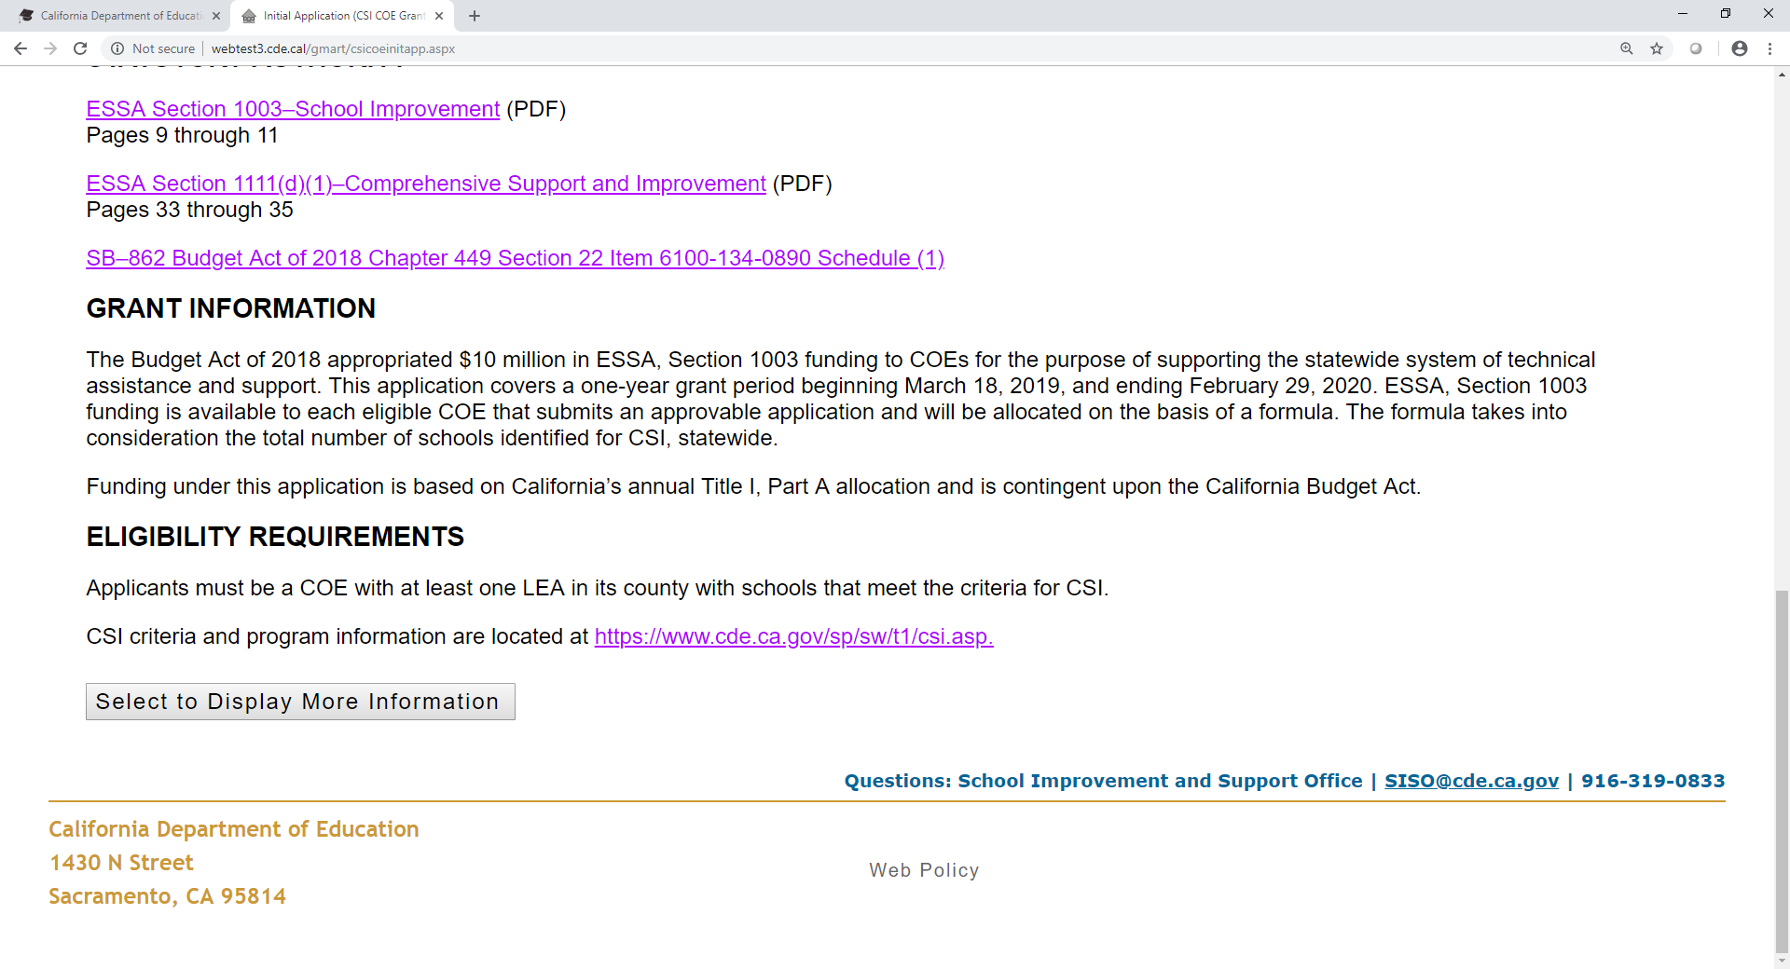
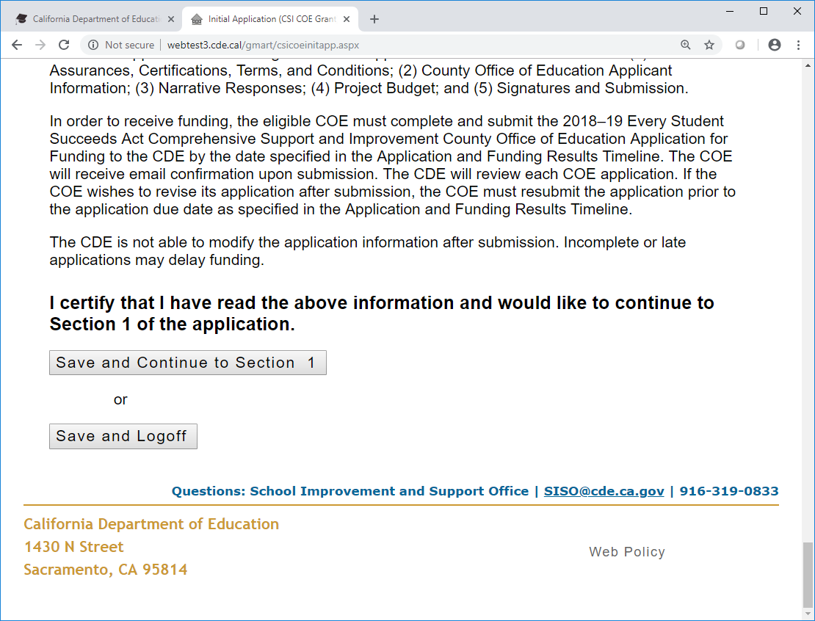
Application Overview (2)
Reference the Appendix 2 for alternative text version.

Slide 57
Application Section 1 (1)
General Assurances, Certifications, and Terms, and Conditions
Assurances, certifications, terms, and conditions are requirements of applicants and sub-grantees as a condition of receiving funds.
General Assurances and Certifications are available on the CDE Funding Forms web page located at https://www.cde.ca.gov/fg/fo/fm/ff.asp.

Slide 58
Application Section 1 (2)
Terms and Conditions:
The 2021–22 ESSA CSI COE Plan Approval Application for Funding must be electronically signed by the authorized designee of the COE and submitted to the CDE using the web-based application.
All funds must be encumbered, expended, and legally obligated within the dates designated and must not exceed the maximum amount indicated in the Apportionment Letter. No extensions or carryover of this subgrant will be allowed.

Slide 59
Application Section 1 (3)
Terms and Conditions continued
The COE agrees that FY 2021 ESSA, Section 1003 funds allotted under this application shall be used only for costs associated with 2022–23 CSI plan approval through the review and approval of the CSI prompts in the 2022–23 LEA LCAP.

Slide 60
Application Section 1 (4)
The COE will submit a list of LEAs with approved CSI prompts, including the dates of approval, to the CDE at such time, in such form, and including such information as the CDE may require.

Slide 61
Application Section 1 (5)
Terms and Conditions continued
The COE will not increase its allotment under this application with ESSA, Section 1003 funds received by the COE for the purposes of supporting 2022–23 CSI plan development and implementation activities for LEAs.

Slide 62
Application Section 1 (6)
Terms and Conditions continued
Regardless of whether or not the COE elects to accept funding authorized under this application, the COE agrees to review and approve 2022–23 CSI plans through the CSI prompts in the 2022–23 LEA LCAP for those LEAs in its county with schools eligible for CSI.

Slide 63
Application Section 1 (7)
I have read the General Assurances, Certifications, and Terms and Conditions and would like to proceed to Section 2 of the application.

Slide 64
Application Section 2 (1)
COE Applicant Information
  Applicant information can be verified on the California School Directory web page located at https://www.cde.ca.gov/schooldirectory/
  The Preliminary FY 2021 Allocation Amount for the COE can be verified on the CDE CSI COE Fiscal Information web page located at https://www.cde.ca.gov/sp/sw/t1/csicoefiscalinfo.asp#planapproval.

Slide 65
Application Section 2 (2)
COE Applicant Information continued
  COEs can verify their Data Universal Numbering System number through the Online Public Update for Schools web page located at https://www3.cde.ca.gov/opuscds/default.aspx

Slide 66
Application Section 2 (3)
If the information is inaccurate, do not submit the application.
Use the “Save and Logoff” button and contact the School Improvement and Support Office for assistance.
Phone: 916-319-0833
  Email: ESSACOE@cde.ca.gov

Slide 67
Application Section 2 (4)
Edit Contact Information
The COE provides name and contact information for:
  Primary Grant Coordinator
  Secondary Grant Coordinator
  Fiscal Coordinator

Slide 68
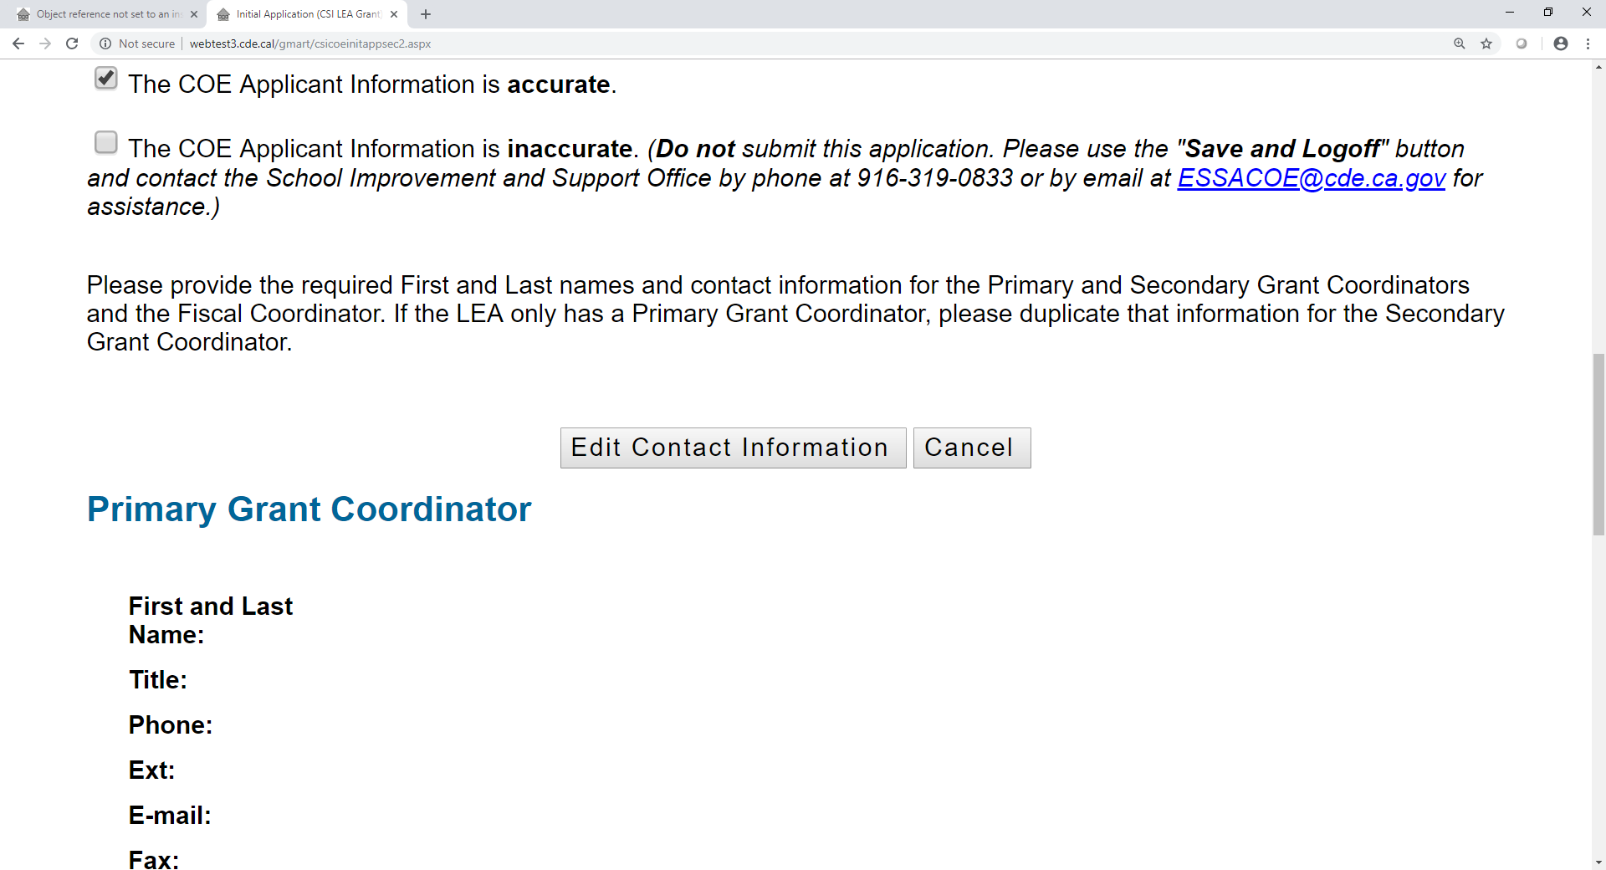
Application Section 2 (5)
Reference the Appendix 3 for alternative text version.

Slide 69
Application Section 2 (6)
SAVE AND CONTINUE TO SECTION 3
Or
SAVE AND LOGOFF

Slide 70
Application Section 3 (1)
Provide an expenditure description for all proposed expenditures within the major Object Codes.
Descriptions should directly align to the allowable use of funds described in this application and include how the costs are necessary and reasonable to execute the subgrant requirements.
The Total Budget Amount must match the Preliminary FY 2021 Allocation Amount.

Slide 71
Application Section 3 (2)
SAVE AND CONTINUE TO SECTION 4
Or
SAVE AND LOGOFF

Slide 72
Application Section 4 (1)
The County Office Superintendent or authorized designee will be prompted to check the following:
ASSURANCES/CERTIFICATIONS/TERMS/CONDITIONS:
As the duly authorized representative of the applicant, I have read all assurances, certifications, terms, and conditions associated with the 2021–22 ESSA CSI COE Plan Approval Application for Funding and I agree to comply with all requirements as a condition of funding.

Slide 73
Application Section 4 (2)
The County Office Superintendent or authorized designee will be prompted to check the following:
ASSURANCES/CERTIFICATIONS/TERMS/CONDITIONS:
I certify that all applicable state and federal rules and regulations will be observed and that to the best of my knowledge, the information contained in this application is correct and complete.

Slide 74
Application Section 4 (3)
SUBMIT APPLICATION
Or
SAVE AND LOGOFF

Slide 75
Application Status
Application Status: Submitted
The COE should adhere to its record retention policies and print this application for record keeping.
Print Submitted Application
Application Submission and Review History:
Application Version | Application Status | Date and Time | Name | Notes
1 | Submitted | 2/22/22 10:23:31 | Abcdefg | ***

Slide 76
Time for Questions

Slide 77
Feedback Please
  In our efforts to continuously improve, we would appreciate you completing a survey that will be emailed to you shortly from the ESSACOE@cde.ca.gov mailbox.
  The survey will be available until February 17, 2022.
  We will consider your input as we develop future webinars.

Slide 78
Contacts
School Improvement and Support Office
ESSACOE@cde.ca.gov
916.319.0833

Slide 79
Appendix 1 for Slide 55
This is a screen print of the Application Overview section of the subgrant application on the GMART web page. It contains the following information:
Navigation tabs at the top of the page for each section of the grant application: GMART Home; Application Overview; Section 1‒Assurances; Section 2‒COE Information; Section 3‒Project Budget; Section 4‒Signatures; Application Status; and CDE Contact Information.

Slide 80
Appendix 2 for Slide 56
This is a screen print of the Application Overview showing the button “ Select to Display More information” at the top, and the statement: I certify that I have read the above information and would like to continue to Section 1 of the application.
There are boxes that display: Save and Continue to Section 1
Or
Save and Logoff

Slide 81
Appendix 3 for Slide 68
This is a screen print of the check boxes in Section 2 of the subgrant application on the GMART web page. It contains the following information:
  Button to select to edit contact information
  Button to select to cancel
  Sub-heading titled “Primary Grant Coordinator” with the following fields to complete:
  First and Last Name, Title, Phone, Extension, Email, and Fax

