Slide 1
California Preschool Data Collection Contractor Training Webinar
Applied Data Research and Evaluation Office
California Department of Education
Date: April 8, 2025
Time: 10 a.m. – 11:30 a.m.

Slide 2
Agenda
California Preschool Data Collection (CAPSDAC) Technical Assistance Support: CAPSDAC Customer Service Portal Launch & Training
CAPSDAC Customer Service Portal Timeline
Draft CAPSDAC Second Iteration Data File Domains and Fields
Statutory Age Calculator
Resources and Contact Information
Upcoming Monthly Webinars
Questions and Answers

Slide 3
CAPSDAC Customer Service Portal Launch & Training
Official CAPSDAC Customer Service Portal Launch Date: April 8, 2025
What is CAPSDAC Customer Service Portal : A web portal for California Preschool Data Collection (CAPSDAC) where users can request technical assistance, ask questions, and track issues related to CAPSDAC.
How to use CAPSDAC Customer Service Portal:
Live Demo: Mr. Ty Steels, Business Consultant/Deliver Lead, AHEAD

Slide 4
Live Demonstration of the new CAPSDAC Customer Service Portal

Slide 5
CAPSDAC Customer Service Portal Timeline (1)
Stage 1 – Testing & Feedback (March 2025)
Internal User Acceptance Testing (UAT) with volunteers.
Stage 2 – CAPSDAC Customer Service Portal Soft Launch (April 8, 2025)
CAPSDAC Customer Support Portal is now live for CAPSDAC-related support requests.
Early feedback during this phase will help guide future improvements.
the CAPSDAC Customer Support Portal.

Slide 6
CAPSDAC Customer Service Portal Timeline (2)
Stage 3 – Post-Launch Support (April 8–Ongoing)
Continued training, improvements, and monitoring based on user feedback.
Special thanks to our UAT Volunteers-We will be collecting feedback from you and all early users through April 21st.
Stage 4 – Customer Service Requests via CAPSDAC Inbox will no longer be monitored (May 31, 2025)
All technical assistance requests will directed to the CAPSDAC Customer Support Portal.

Slide 7
Draft CAPSDAC Second Iteration Data File Domains and Fields: Overview (1)
Aligned to California Longitudinal Pupil Achievement Data System (CALPADS)
Around 14 files with the following drafted domains: Family, Child, Language, Enrollment, Attendance, Staff, Classroom, Education Program, and Incident
Each file links to other files through certain repeated data fields, such as identifiers (IDs). Those linked fields are not listed in each domain in the next slides, they are only listed once within the main file type (e.g. California State Preschool Program (CSPP) Identification (ID) in Child File Domain).

Slide 8
Draft CAPSDAC Second Iteration Data File Domains and Fields: Overview (2)
In CAPSDAC some domains may be split into different files to link to different data fields (e.g. staff domain may become three files such as staff, staff assignment, and staff classroom to link staff to assignments and to classrooms; classroom may become two files such as classroom and classroom enrollment to link child to assigned classroom).

Slide 9
Draft CAPSDAC Second Iteration Data File Domains and Fields: Family
FAMID: Family ID CAPSDAC generated
FamilyIDCaseNumber: Family ID locally generated
HeadofHousehold(HoH)1/2FirstName
HoH1/2MiddleInitial
HoH1/2FirstLastName
Email
ResidentialAddress1/2
ResidentialAddressZip
ResidentialAddressState
MailingAddress1/2
MailingAddressCity
MailingAddressZip
MailingAddressState
HoHWrittenCommPreference
HoHVerbalCommPreference
FamilyIncome
HoH1/2Reason for Needing Service1 (up to 9)
CALWorksRecipient
FamilySize

Slide 10
Draft CAPSDAC Second Iteration Data File Domains and Fields: Child
CSPPID: CAPSDAC generated child ID
ChildIDCaseNumber: Locally generated child ID
ChildFirstName
ChildMiddleName
ChildLastName1
ChildLastName2
ChildNameSuffix
ChildDateOfBirth(DOB)
ChildGender
Child Ethnicity Missing Indicator
ChildRace1 (up to 5) Code
ChildRaceMissingIndicator
ChildCityofBirth
ChildCountryofBirth
ChildStateofBirth

Slide 11
Draft CAPSDAC Second Iteration Data File Domains and Fields: Language
InstrumentDate
InstrumentOptOut
InstrumentLanguagesHeard1 (up to 8)
InstrumentLanguagesUnderstood1 (up to 8)
InstrumentLanguagesSpoken1 (up to 8)
DLLInstrumentDesignated
DLLTeacherDesignated
DLLTeacherDesignatedDate
InterviewHomeLanguage1 (up to 8)
InterviewMost-UsedLanguage

Slide 12
Draft CAPSDAC Second Iteration Data File Domains and Fields: Enrollment
Reporting Active Local Educational Agencies:(LEA) code in County, District, School (CDS)
PreschoolCode: Active preschool code in CDS
PreschoolCDSCode: County and district of preschool site
InstrumentLanguagesUnderstood1 (up to 8)
ContractType: Direct or subcontract
ProgramYear
EnrollmentStartDate
EnrollmentEndDate
EnrollmentEndReason
ProgramType: Full day or part day
ProgramDuration: Full year or part year
TimeBase: Part-time, full-time, or full-time plus
EligibilityStatus: Reason for eligibility

Slide 13
Draft CAPSDAC Second Iteration Data File Domains and Fields: Attendance
Month
DaysExpected
DaysAttended
DaysAbsentExcused
DaysAbsentUnexcused
DaysAbsentSuspension
DaysAttendedSuspension

Slide 14
Draft CAPSDAC Second Iteration Data File Domains and Fields: Staff (1)
Month
StaffLegalFirstName
StaffLegalMiddleName
StaffLegalLastName1
StaffLegalLastName2
State Educator Identification (SEID)
DaysAttended
Permit/CredentialNumber
Permit/CredentialIssuedDate
Permit/CredentialExpirationDate
Waiver
WaiverIssuedDate
DaysAbsentUnexcused
WaiverExpirationDate
StaffDOB
StaffGender
StaffEthnicity
StaffEthnicityMissingIndicator
StaffRace1Code (up to 5)
StaffRaceMissingIndicator
StaffHighestDegreeCode
StaffEthnicity
StaffLocalID
StaffLanguage1 (up to 8)

Slide 15
Draft CAPSDAC Second Iteration Data File Domains and Fields: Staff (2)
Month
StaffCurrentEmploymentStartDate
StaffCurrentEmploymentEndDate
StaffOverallEmploymentStartDate
ClassroomStaffRole1 (up to 2)
ClassroomStaffRole1(up to 2)RolePercentofTime
Non-ClassroomRole1 (up to 3)
Non-ClassroomRole1 (up to 3)PercentofTime

Slide 16
Draft CAPSDAC Second Iteration Data File Domains and Fields: Classroom
ClassroomName: Locally generated
ProgramCode
ProgramTypesOffered: Full day, part day
ProgramDurationsOffered: Full year, part year
ContractTypesOffered: Direct, subcontract
SettingTypesOffered: Center, Family Childcare Home
MHCSOffered: Mental health consultation services
LanguageProgramType

Slide 17
Draft CAPSDAC Second Iteration Data File Domains and Fields: Education Program
ProgramStartDate
ProgramCode
ProgramEndDate
HomelessDwellingTypeCode
UnacompaniedYouthIndicator
EducationServiceCode
EducationServiceAcademicYear
MigrantEducationStudentID

Slide 18
Draft CAPSDAC Second Iteration Data File Domains and Fields: Incident
IncidentID: Locally generated unique ID for incident that may result in suspension and/or expulsion
Incident Date
IncidentResultCode: Action taken (e.g. suspension, expulsion, parent consultation, written plan, etc.)
Incident Result Date
Incident Result Suspension Duration
Incident Result Mod Code: Modification made to incident result (e.g. shortened suspension)

Slide 19
Pre-K Statutory Age Calculator (1)
The California Department of Education (CDE) is excited to announce the launch of the Pre-Kindergarten Statutory Age Eligibility Calculator, available starting today, April 8th, 2025.
This tool will function similarly to the Family Fee Calculator and will assist users in determining a child’s age eligibility for:
California State Preschool Program (CSPP)
Transitional Kindergarten (TK)
This web application will allow for users to select the Fiscal Year, Report Period, and Child’s Date of Birth. Once this information has been inputted, the system will provide immediate confirmation of whether the child meets age eligibility for CSPP or TK.

Slide 20
Pre-K Statutory Age Calculator (2)
Next Steps & Communication
We are sharing the calculator with you now so you can begin using it right away and provide any early feedback as you explore the tool. In the coming weeks, we will be publishing our communications about the calculator in both our:
CAPSDAC Update Series
CDMIS Update Series
A targeted email announcement will also go out to:
Program Directors, Executive Directors, Software Vendors, and all system users of CAPSDAC, CDMIS, and PLIS.

Slide 21
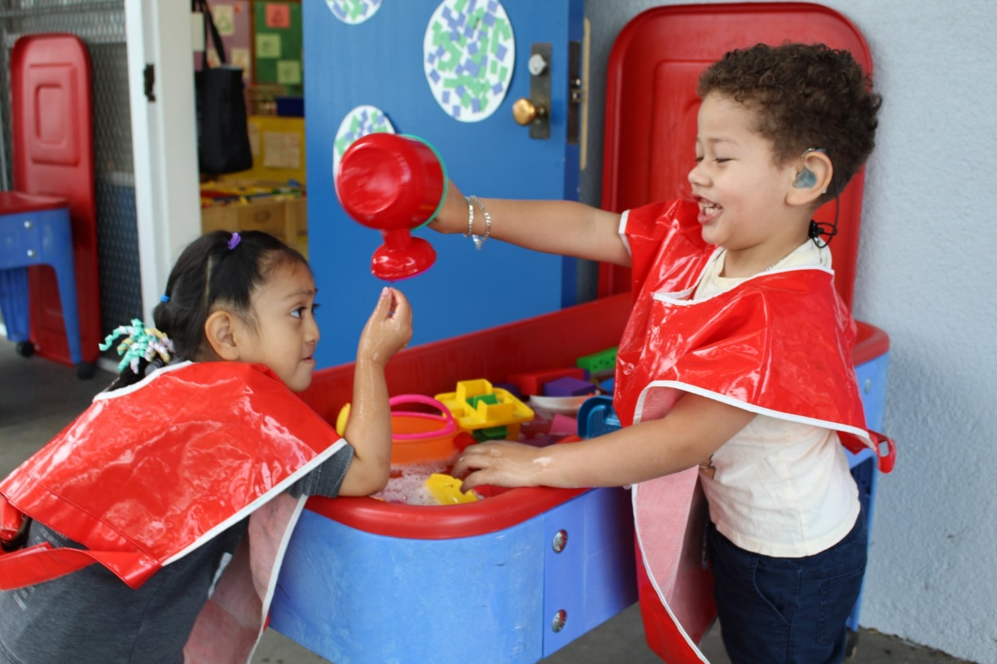
Pre-K Statutory Age Calculator (3)
Live Demonstration:
During this portion of the webinar, a staff member will share their web browser to showcase the Pre-K Statutory Age Calculator.
Photo Credit: Breed St. Elementary, Deaf & Hard of Hearing Program

Slide 22
CAPSDAC: Resources & Contact Information
Resources
CAPSDAC Online Portal: https://www.capsdac.org/
CAPSAC Support Page: https://www.cde.ca.gov/sp/cd/ci/capsdacsupportlanding.asp
Statutory Age Calculator: https://www2.cde.ca.gov/ageeligcalc/ageeligibilitycalc.aspx
Contact Information
CAPSDAC Support Team: CAPSDAC@cde.ca.gov

Slide 23
CAPSDAC Resources
CDE CAPSDAC Support webpage: https://www.cde.ca.gov/sp/cd/ci/capsdacsupportlanding.asp
CAPSDAC Update #5: Transition to CAPSDAC Customer Support Portal for CAPSDAC Support Requests: https://www.cde.ca.gov/sp/cd/ci/capsdacupdates.asp
CAPSDAC Customer Support Training PowerPoint Slide Deck and Training Video have been posted on the CDE CAPSDAC Customer Support Resource Page:
https://www.cde.ca.gov/sp/cd/ci/servicenow.asp
Individual or small group training will be provided by the CDE CAPSDAC Support Team upon requests

Slide 24
Upcoming Office Hours and Webinars
Webinars:
May 13, 2025, 10 a.m. to 11:30 a.m.
Also found at https://www.cde.ca.gov/sp/cd/ci/capsdacwebinars.asp

Slide 25

Questions and Answers
Photo Credit: Kidango Decoto Center; Union City, CA

Slide 26
Thank you!

